Slide 1
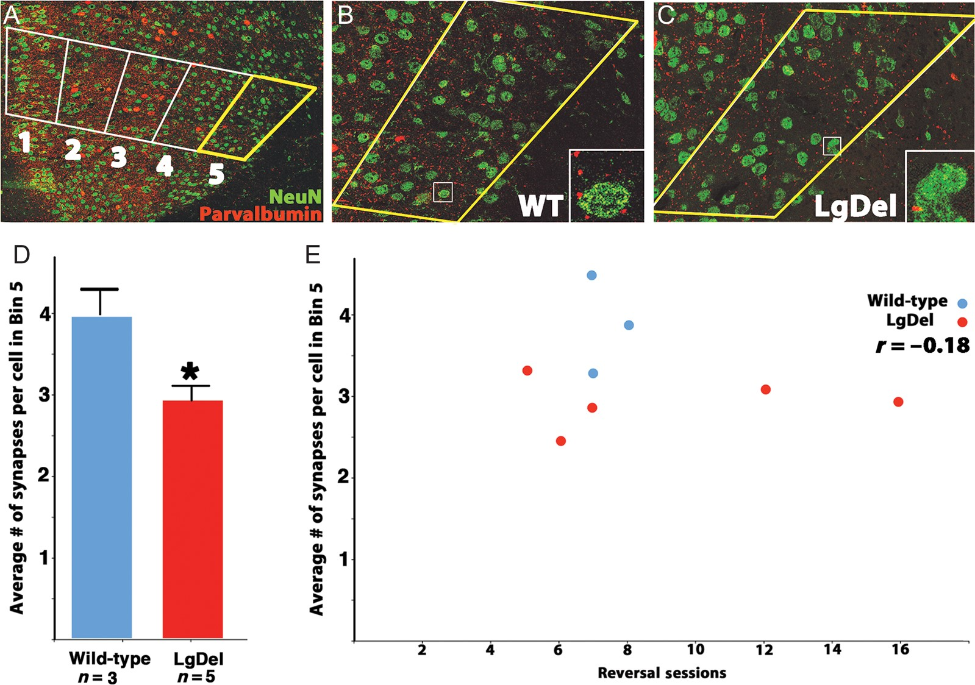
Figure 3. The distribution of perisomatic inhibitory synaptic endings is altered in the LgDel mAFC. (A) ...
Notes:
Figure 3. The distribution of perisomatic inhibitory synaptic endings is altered in the LgDel mAFC. (A) Low-magnification image of parvalbumin-labeled interneurons and NeuN-labeled neurons in the mAFC. A counting box traversed the mAFC, as described above, and average numbers of perisomatic parvalbumin terminals per cell per bin were determined. (B) Images of perisomatic parvalbumin-labeled synapses in bin 5 of WT and (C) LgDel animals. Insets show individual parvalbumin-labeled puncta (red), and their relationship to NeuN-labeled cell bodies (green). (D) The average number of parvalbumin-labeled perisomatic terminals in bin 5 (layer 6) is significantly reduced in LgDel versus WT animals, *P < 0.05. (E) There was no significant correlation between the number of these terminals in bin 5, where group differences are found, and reversal sessions.
Unless provided in the caption above, the following copyright applies to the content of this slide: © The Author 2013. Published by Oxford University Press. All rights reserved. For Permissions, please e-mail: journals.permissions@oup.com

Slide 2
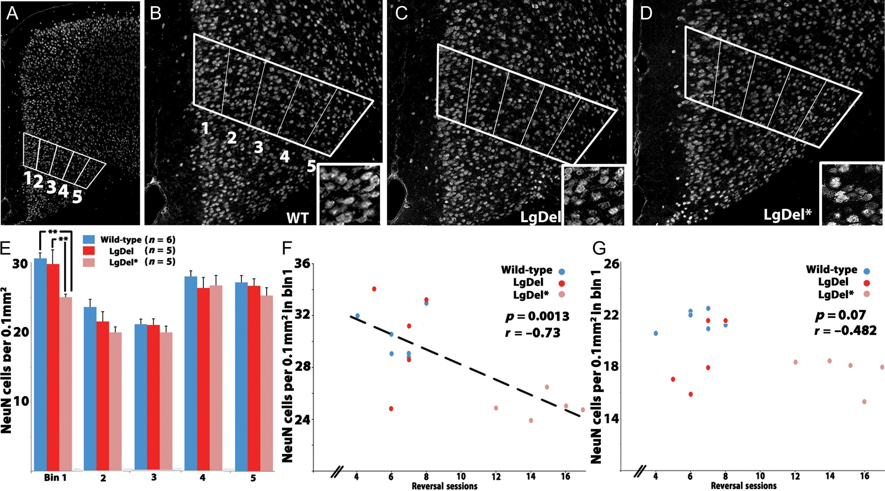
Figure 4. Projection neuron density in mAFC layer 2/3 predicts reversal learning performance in the LgDel mouse. (A) ...
Notes:
Figure 4. Projection neuron density in mAFC layer 2/3 predicts reversal learning performance in the LgDel mouse. (A) NeuN-labeled neurons in the mAFC. The counting box was placed over the mAFC as described above. (B) WT, (C) LgDel, and (D) LgDel* animals. Insets show representative differences in cell frequency in bin 1 (layer 2/3) for each group. (E) Poorly performing LgDel animals displayed reduced superficial layer neuronal density (bin 1) relative to normally performing LgDel (**P < 0.01) and WT animals (**P < 0.01). (F) A significant negative correlation between superficial layer (bin 1) neuronal density and reversal learning was seen within the entire behaviorally tested cohort (WT and LgDel combined) and within the LgDel group alone. (G) A correlation between superficial layer (bin 1) neuronal density and reversal sessions in lAFC was not seen within the entire behaviorally tested cohort (WT and LgDel combined) or within the LgDel group alone.
Unless provided in the caption above, the following copyright applies to the content of this slide: © The Author 2013. Published by Oxford University Press. All rights reserved. For Permissions, please e-mail: journals.permissions@oup.com

Slide 3
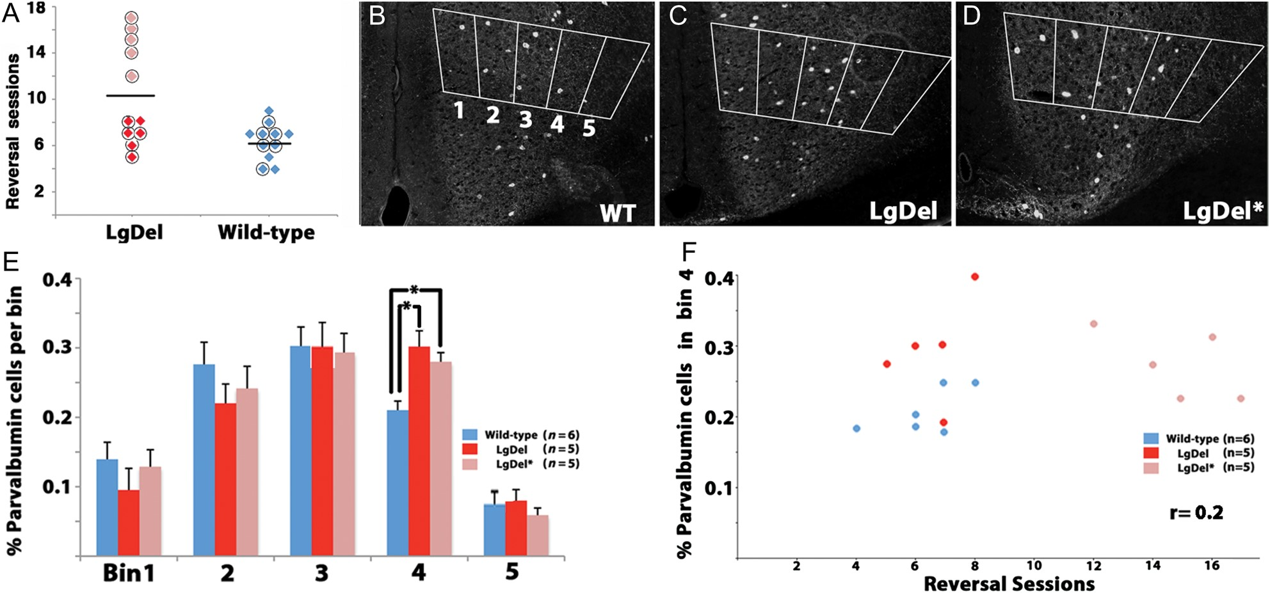
Figure 2. Relationship between variable behavior and mAFC interneuron distribution in the LgDel mouse. (A) Circled data ...
Notes:
Figure 2. Relationship between variable behavior and mAFC interneuron distribution in the LgDel mouse. (A) Circled data points on the reversal learning sessions performance graph represent behaviorally tested animals that were analyzed histologically (10/11 behaviorally tested LgDel, 6/11 behaviorally tested WT). LgDel animals were split into better performing (darker red points, LgDel) and poor performing (lighter red points, LgDel*) groups for further analysis. (B) Images of parvalbumin interneuron distribution in the mAFC of WT, (C) LgDel, and (D) LgDel* animals. A counting box comprised of 5 bins traversed the mAFC (see Fig. 1 and Materials and Methods). (E) The number of parvalbumin-labeled interneurons is significantly increased in bin4 (layer 5) in LgDel and LgDel * animals, *P < 0.05. (F) There was no significant correlation between the number of parvalbumin-labeled cells in bin 4 and reversal learning sessions.
Unless provided in the caption above, the following copyright applies to the content of this slide: © The Author 2013. Published by Oxford University Press. All rights reserved. For Permissions, please e-mail: journals.permissions@oup.com

Slide 4
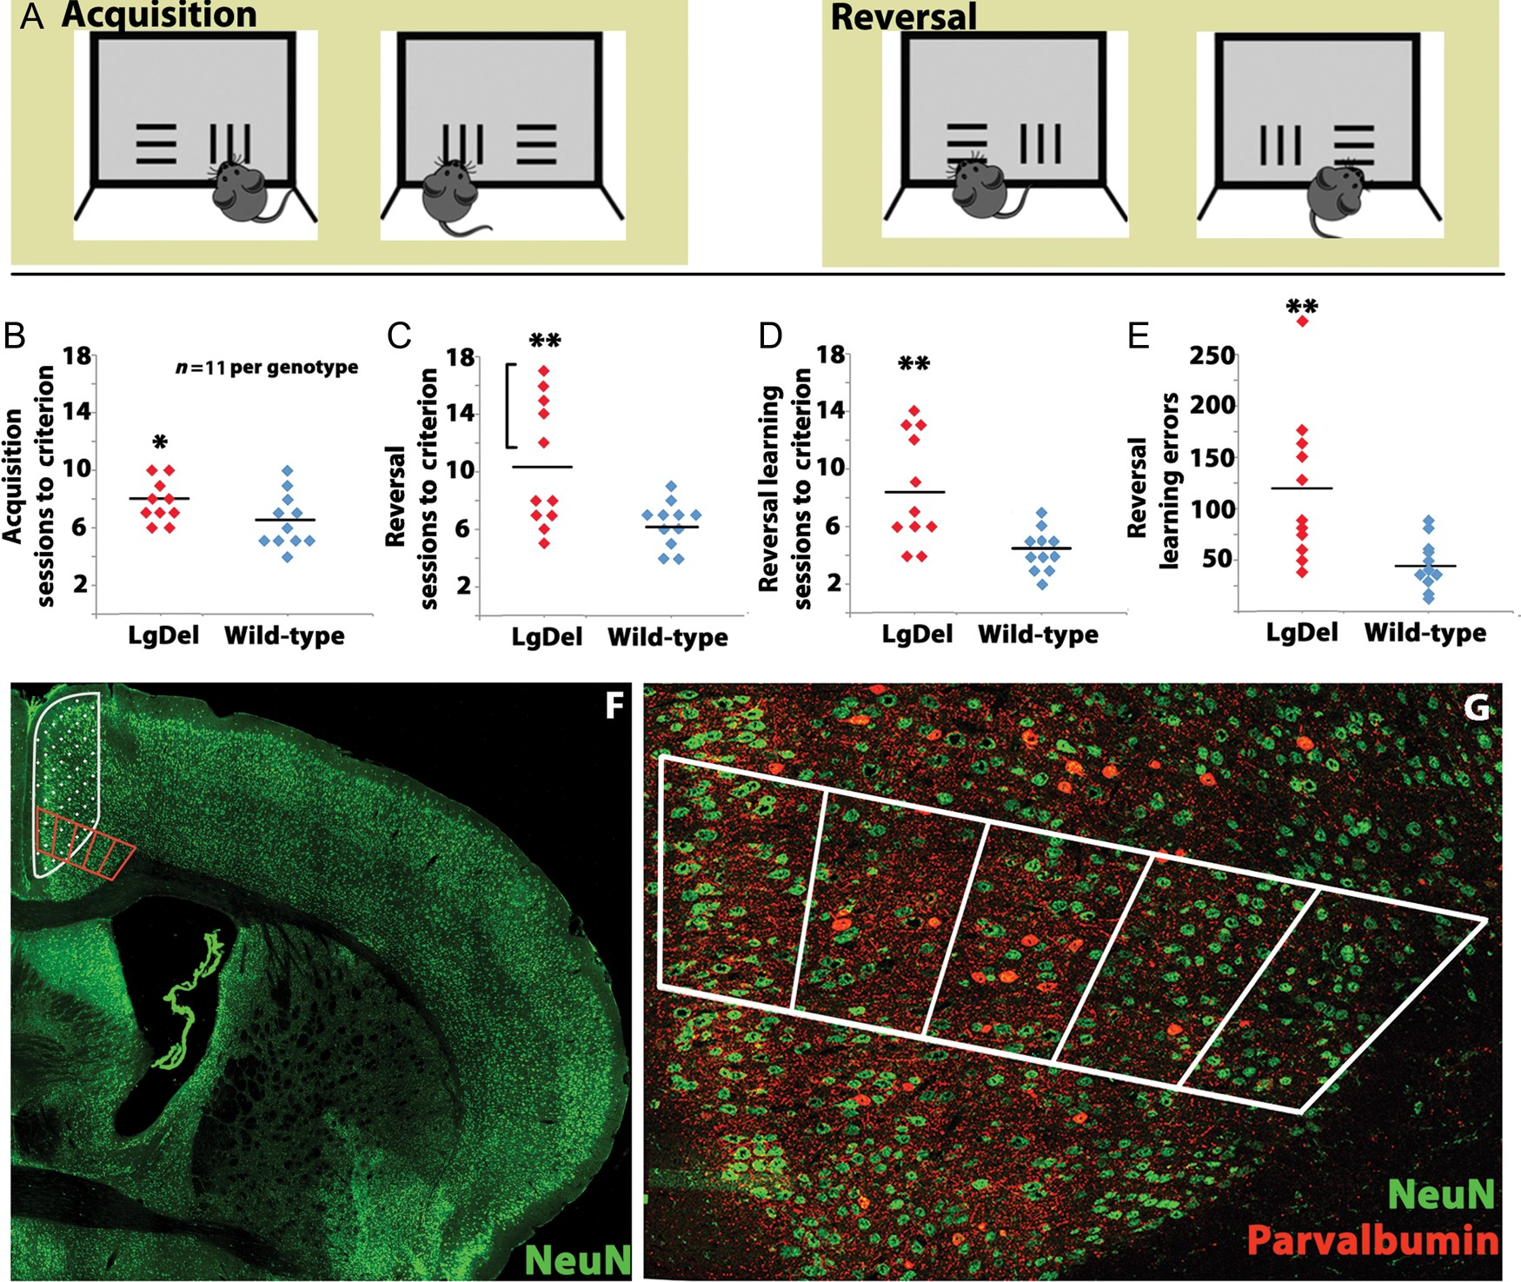
Figure 1. Behavioral assessment and cortical localization of cognitive functions in LgDel and WT mice. (A) The ...
Notes:
Figure 1. Behavioral assessment and cortical localization of cognitive functions in LgDel and WT mice. (A) The touchscreen visual discrimination/reversal task assesses murine executive functions. At left: The mouse initially learns to discriminate which touch-sensitive pattern—vertical versus horizontal lines—presented on the LCD screen is associated with food reward, irrespective of screen position. At right: During reversal learning, the pattern associated with food reward is switched. (B) During the initial acquisition phase of the behavioral task, LgDel animals take modestly longer to learn the rule associated with food reward, *P < 0.05 (C) LgDel animals require more reversal sessions to learn that the pattern associated with food reward has been reversed, **P < 0.01. (D) The number of learning sessions required by LgDel animals during the reversal phase was significantly increased, **P < 0.01. (E) The number of learning errors made by LgDel animals during the reversal phase was also greater, **P < 0.01. (F) The medial anterior frontal cortex (mAFC) from behaviorally tested animals was assessed histologically (red counting box). This region overlaps with the lesioned regions (hatched area, based upon Brigman and Rothblat 2008) shown to be important for reversal learning. (G) Parvalbumin-labeled GABAergic interneuron distribution, perisomatic parvalbumin-labeled puncta (presumed to be synaptic endings, not visible in this low power image), and NeuN cell frequency (including presumed projection neurons in layer 2/3) were assessed within the counting box.
Unless provided in the caption above, the following copyright applies to the content of this slide: © The Author 2013. Published by Oxford University Press. All rights reserved. For Permissions, please e-mail: journals.permissions@oup.com

