Slide 1
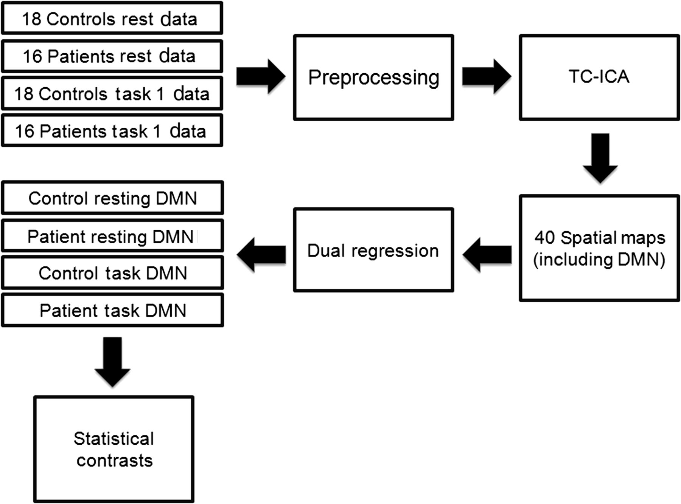
Figure 1. An overview of analysis pipeline for the study, producing maps of DMN co-activation for both patients and ...
Notes:
Figure 1. An overview of analysis pipeline for the study, producing maps of DMN co-activation for both patients and controls during resting and task states. TC-ICA; temporal concatenation group ICA.
Unless provided in the caption above, the following copyright applies to the content of this slide: © The Author 2012. Published by Oxford University Press. All rights reserved. For Permissions, please e-mail: journals.permissions@oup.com

Slide 2
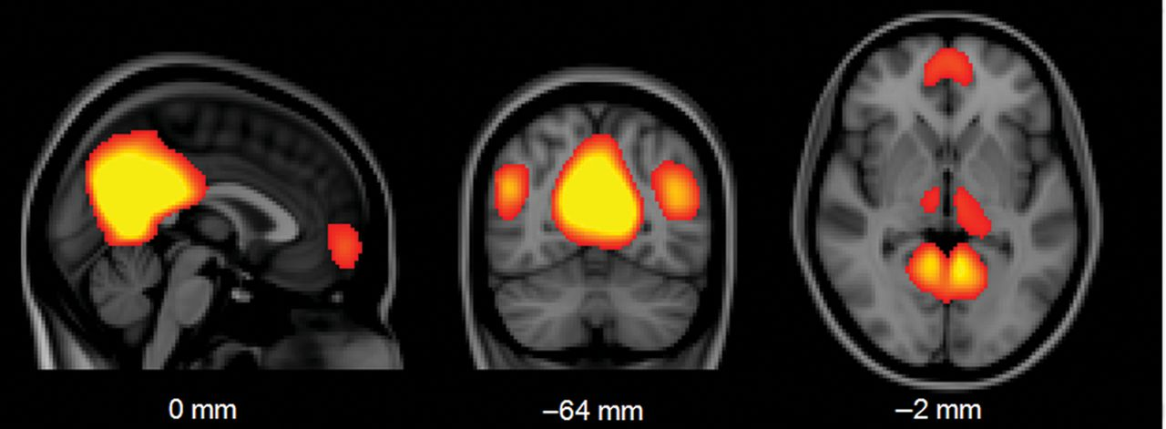
Figure 2. The DMN component identified from temporal concatenation ICA.
Notes:
Figure 2. The DMN component identified from temporal concatenation ICA.
Unless provided in the caption above, the following copyright applies to the content of this slide: © The Author 2012. Published by Oxford University Press. All rights reserved. For Permissions, please e-mail: journals.permissions@oup.com

Slide 3
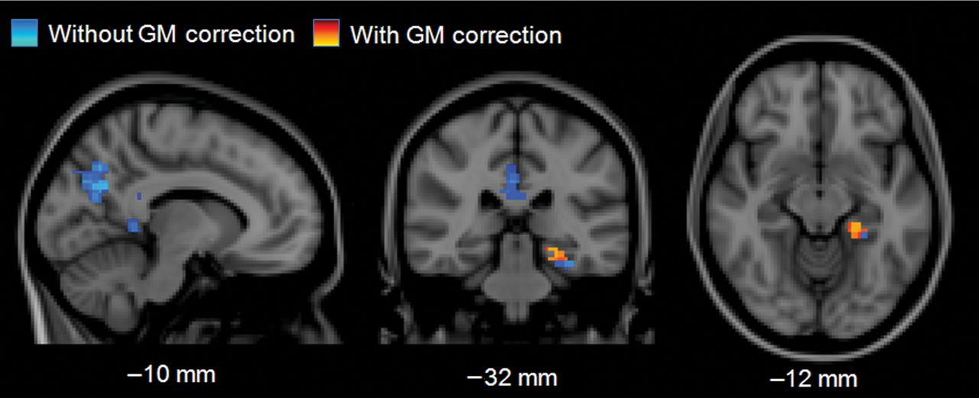
Figure 3. Patients show reduced DMN co-activation compared with controls during rest (P < 0.05, FWE-corrected).
Notes:
Figure 3. Patients show reduced DMN co-activation compared with controls during rest (P < 0.05, FWE-corrected).
Unless provided in the caption above, the following copyright applies to the content of this slide: © The Author 2012. Published by Oxford University Press. All rights reserved. For Permissions, please e-mail: journals.permissions@oup.com

Slide 4
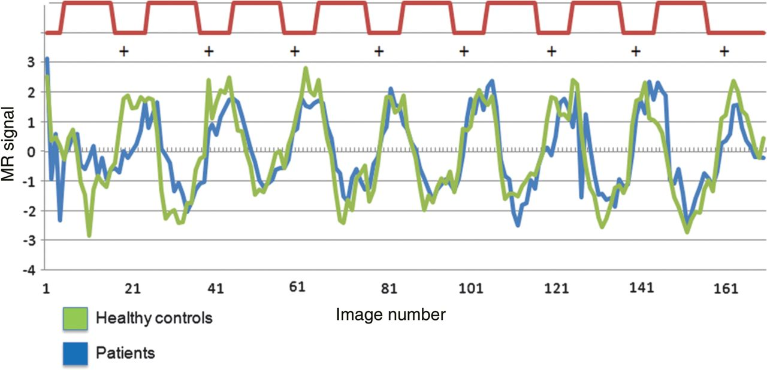
Figure 4. The time course of DMN signal during task run 1 for patients and controls. A time course of the fixation and ...
Notes:
Figure 4. The time course of DMN signal during task run 1 for patients and controls. A time course of the fixation and task blocks are shown in red. In both groups, DMN signal is greatest during fixation blocks.
Unless provided in the caption above, the following copyright applies to the content of this slide: © The Author 2012. Published by Oxford University Press. All rights reserved. For Permissions, please e-mail: journals.permissions@oup.com

Slide 5
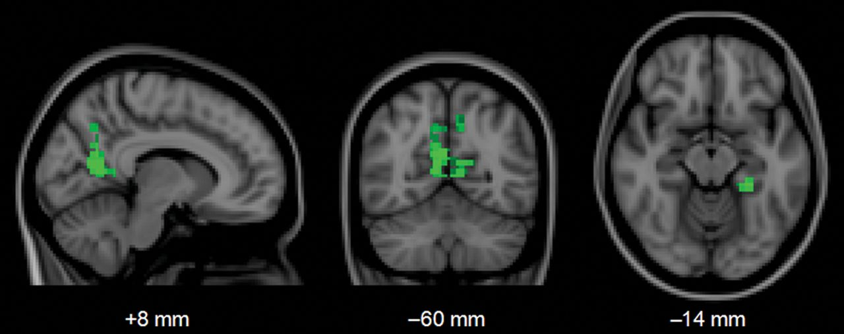
Figure 5. Areas in green show greater DMN co-activation during rest than during task in healthy controls (P < 0.05, ...
Notes:
Figure 5. Areas in green show greater DMN co-activation during rest than during task in healthy controls (P < 0.05, FWE-corrected).
Unless provided in the caption above, the following copyright applies to the content of this slide: © The Author 2012. Published by Oxford University Press. All rights reserved. For Permissions, please e-mail: journals.permissions@oup.com

Slide 6
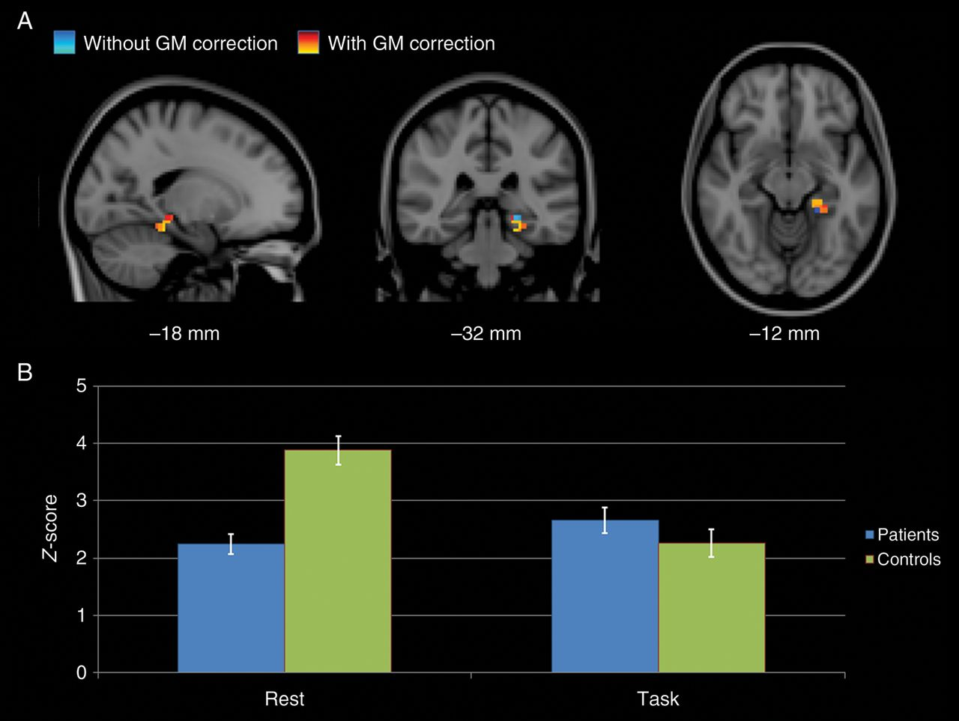
Figure 6. Interaction effect. (A) A cluster in the left PHG and hippocampus shows a greater increase in DMN ...
Notes:
Figure 6. Interaction effect. (A) A cluster in the left PHG and hippocampus shows a greater increase in DMN co-activation at rest among controls than among patients (P < 0.005, uncorrected). (B) The average co-activation Z-score within this MTL cluster (GM-corrected) for patient and control groups, during rest and task states. Error bars show standard error of the mean.
Unless provided in the caption above, the following copyright applies to the content of this slide: © The Author 2012. Published by Oxford University Press. All rights reserved. For Permissions, please e-mail: journals.permissions@oup.com

Slide 7
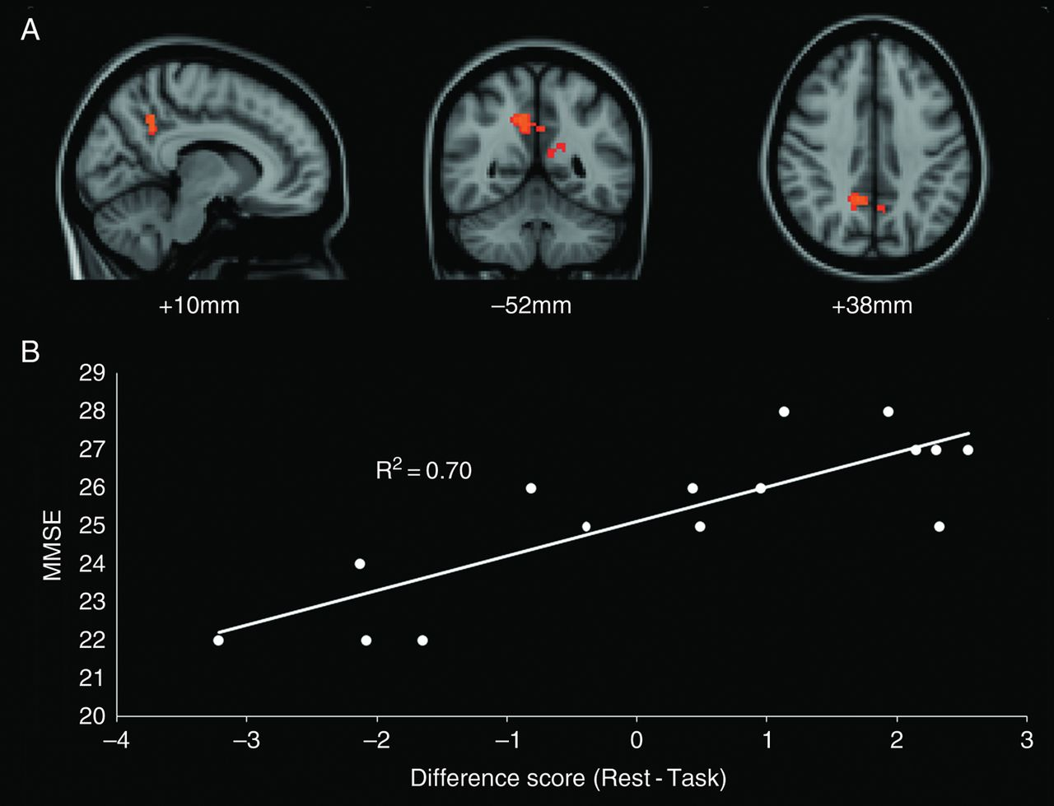
Figure 7. Voxel-wise regression of DMN modulation and MMSE score in patient group. (A) Orange cluster identifies ...
Notes:
Figure 7. Voxel-wise regression of DMN modulation and MMSE score in patient group. (A) Orange cluster identifies precuneus and posterior cingulate regions showing a significant relationship after GM correction (P < 0.05, FWE-corrected). These clusters subsume those found without GM correction. (B) Mean difference scores for these clusters demonstrate the relationship between greater positive difference score and higher MMSE in the 16 patients.
Unless provided in the caption above, the following copyright applies to the content of this slide: © The Author 2012. Published by Oxford University Press. All rights reserved. For Permissions, please e-mail: journals.permissions@oup.com

