Slide 1
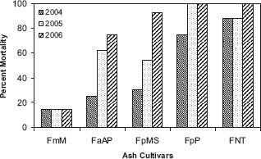
Fig. 1. Percent mortality from 2004 to 2006 for ash taxa that were not treated with imidacloprid. See Table 1 for ...
Notes:
Fig. 1. Percent mortality from 2004 to 2006 for ash taxa that were not treated with imidacloprid. See Table 1 for list of cultivar abbreviations.
Unless provided in the caption above, the following copyright applies to the content of this slide: © 2008 Entomological Society of AmericaThis is an Open Access article distributed under the terms of the Creative Commons Attribution Non-Commercial License (http://creativecommons.org/licenses/by-nc/3.0/), which permits non-commercial reuse, distribution, and reproduction in any medium, provided the original work is properly cited. For commercial re-use, please contact journals.permissions@oup.com

Slide 2
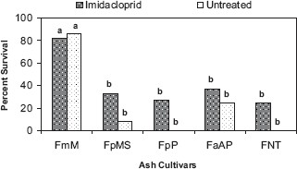
Fig. 2. Percent survival of ash taxa, with and without being treated with imidacloprid, after 3 yr of attack from ...
Notes:
Fig. 2. Percent survival of ash taxa, with and without being treated with imidacloprid, after 3 yr of attack from emerald ash borer. Bars with different letters are significantly different (χ2, P ≤ 0.05). See Table 1 for list of cultivar abbreviations.
Unless provided in the caption above, the following copyright applies to the content of this slide: © 2008 Entomological Society of AmericaThis is an Open Access article distributed under the terms of the Creative Commons Attribution Non-Commercial License (http://creativecommons.org/licenses/by-nc/3.0/), which permits non-commercial reuse, distribution, and reproduction in any medium, provided the original work is properly cited. For commercial re-use, please contact journals.permissions@oup.com

Slide 3
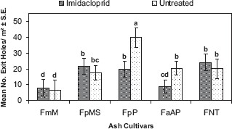
Fig. 3. Mean density of emerald ash borer exit holes (±SE) for each ash taxon, with and without being treated with ...
Notes:
Fig. 3. Mean density of emerald ash borer exit holes (±SE) for each ash taxon, with and without being treated with imidacloprid. Data were pooled from 2004 and 2005 and square root (x) transformed for statistical comparison. Means with different letters are significantly different (LSD for unbalanced data, P ≤ 0.05). See Table 1 for list of cultivar abbreviations.
Unless provided in the caption above, the following copyright applies to the content of this slide: © 2008 Entomological Society of AmericaThis is an Open Access article distributed under the terms of the Creative Commons Attribution Non-Commercial License (http://creativecommons.org/licenses/by-nc/3.0/), which permits non-commercial reuse, distribution, and reproduction in any medium, provided the original work is properly cited. For commercial re-use, please contact journals.permissions@oup.com

