Slide 1
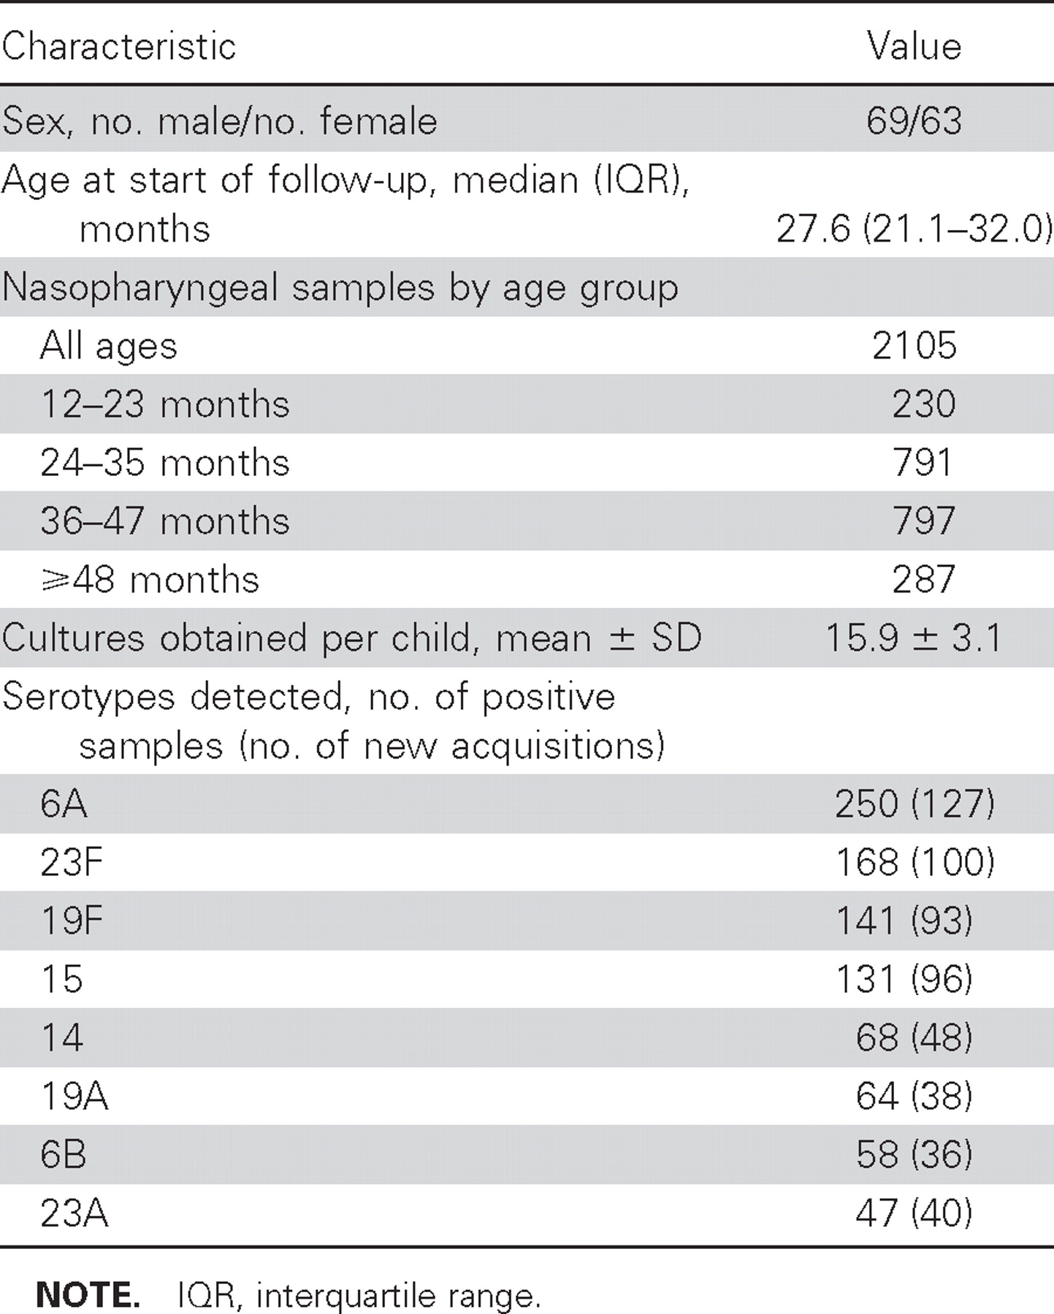
Table 1. Demographic characteristics of the 132 subjects in the study population.
Notes:
Table 1. Demographic characteristics of the 132 subjects in the study population.
Unless provided in the caption above, the following copyright applies to the content of this slide: © 2008 by the Infectious Diseases Society of America

Slide 2
Table 2. Effect of prior colonization on new acquisition of the same serotype (univariate analysis).
Notes:
Table 2. Effect of prior colonization on new acquisition of the same serotype (univariate analysis).
Unless provided in the caption above, the following copyright applies to the content of this slide: © 2008 by the Infectious Diseases Society of America

Slide 3
Table 3. Effect of prior colonization with a particular serotype on new acquisition of the same or different ...
Notes:
Table 3. Effect of prior colonization with a particular serotype on new acquisition of the same or different serotype.
Unless provided in the caption above, the following copyright applies to the content of this slide: © 2008 by the Infectious Diseases Society of America

Slide 4
Table 4. Effect of serotype prevalence in a day care center on new acquisition of serotype.
Notes:
Table 4. Effect of serotype prevalence in a day care center on new acquisition of serotype.
Unless provided in the caption above, the following copyright applies to the content of this slide: © 2008 by the Infectious Diseases Society of America

Slide 5
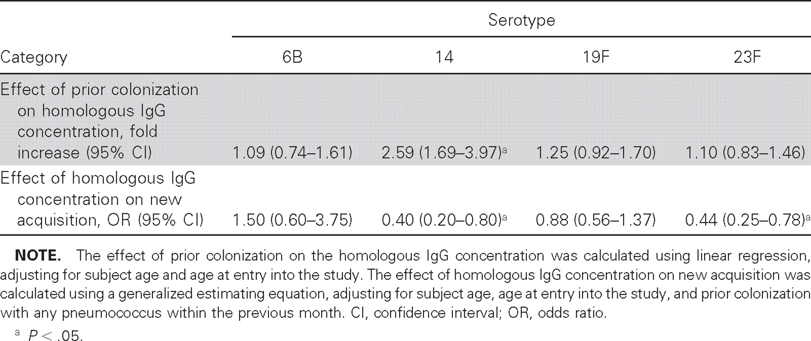
Table 5. Relationship between antibody and serotype-specific protection.
Notes:
Table 5. Relationship between antibody and serotype-specific protection.
Unless provided in the caption above, the following copyright applies to the content of this slide: © 2008 by the Infectious Diseases Society of America

