Slide 1
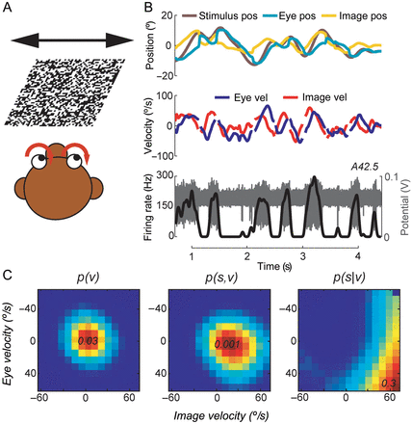
Figure 1. White noise motion paradigm. (A) The visual large-field stimulus moved rapidly and randomly along the axis of ...
Notes:
Figure 1. White noise motion paradigm. (A) The visual large-field stimulus moved rapidly and randomly along the axis of each neuron's preferred direction. The monkey's task was to follow this stimulus as well as possible, performing optokinetic eye movements (OKR). (B) The top plot shows example traces of stimulus (brown) and eye (cyan) position. Retinal image position (yellow) is the difference between stimulus and eye position. The velocity traces of eye (blue) and retinal image (red) are shown in the middle plot. Saccades were removed from both traces. The bottom plot shows a corresponding extracellular recording (gray) and extracted firing rate (black) from an example MSTd neuron. (C) Determination of the probabilistic tuning function demonstrated for the example neuron shown in (B): p(v) denotes the probability mass function of the occurrence of a specific combination of image velocity and eye velocity for the whole dataset. p(s,v) denotes the joint probability mass function of coincident spike and variable occurrence. Dividing p(s,v) by p(v) yields the conditional probability p(s|v) of observing a spike given any combination of image velocity and eye velocity. Colors from blue to red indicate probability values dependent on image velocity (horizontal axis) and eye velocity (vertical axis). Peak values are denoted in each colormap. By multiplication with the sampling rate of 1 kHz, p(s|v) translates directly into an expectation value of the spiking rate.
Unless provided in the caption above, the following copyright applies to the content of this slide: © The Author 2014. Published by Oxford University Press. All rights reserved. For Permissions, please e-mail: journals.permissions@oup.com

Slide 2
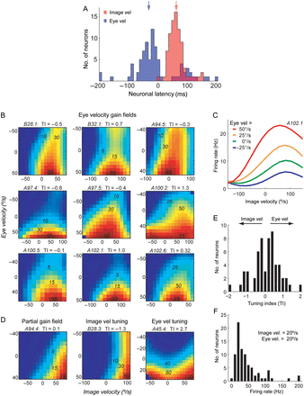
Figure 2. Neural latency and tuning functions for image and eye velocity. (A) For each neuron 2 latency values were ...
Notes:
Figure 2. Neural latency and tuning functions for image and eye velocity. (A) For each neuron 2 latency values were estimated: (1) relative to image velocity (red) and (2) relative to eye velocity (blue). Our estimation procedure maximized the mutual information between neural activity and both signals (see Experimental Procedures). Neural activity lagged ∼60 ms behind the image velocity signal. In contrast, most neurons fired before the eye velocity signal, as indicated by negative latency values. Vertical arrows indicate the mean values for both distributions. (B) 2D tuning curves of 9 example neurons exhibiting gain-field-like behavior. Colors from blue to red indicate the mean firing rate (Hz) dependent on image velocity (horizontal axis) and eye velocity (vertical axis). Corresponding frequencies for red, yellow, and light blue are denoted in each colormap, dark blue indicates values close to zero or bins that have been omitted from analysis due to low amount of data. ‘TI’ denotes the tuning index (see below). (C) Image velocity tuning curves of neuron A102.1 for different eye velocity values. Each curve represents a slice through the 2D tuning function in (B). Values between centers of the bins were linearly interpolated. (D) Other types of tuning functions: (1) partial gain-field structure, probably resulting from a limited stimulus range; (2) ‘vertical’ tuning, showing almost pure selectivity for image velocity; (3) ‘horizontal’ tuning, exhibiting primarily modulation by eye velocity. (E) Tuning indices of the analyzed population. The TI-value indicates the slope of the tuning function. Negative values indicate predominant ‘vertical’ tuning, corresponding to higher selectivity for image velocity. Positive values indicate ‘horizontal’, eye velocity-related tuning. (F) Distribution of mean firing rates for image and eye velocity values of 20°/s.
Unless provided in the caption above, the following copyright applies to the content of this slide: © The Author 2014. Published by Oxford University Press. All rights reserved. For Permissions, please e-mail: journals.permissions@oup.com

Slide 3
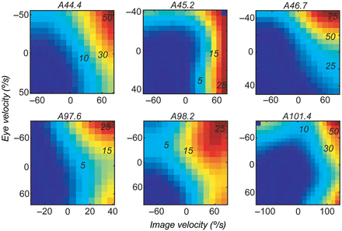
Figure 3. Neurons with opposite visual and eye movement-related selectivity. Tuning functions of 6 units in which ...
Notes:
Figure 3. Neurons with opposite visual and eye movement-related selectivity. Tuning functions of 6 units in which spiking activity increased with image velocity in preferred and eye velocity in anti-preferred direction. In all these neurons, neural latency relative to eye velocity had positive values.
Unless provided in the caption above, the following copyright applies to the content of this slide: © The Author 2014. Published by Oxford University Press. All rights reserved. For Permissions, please e-mail: journals.permissions@oup.com

Slide 4
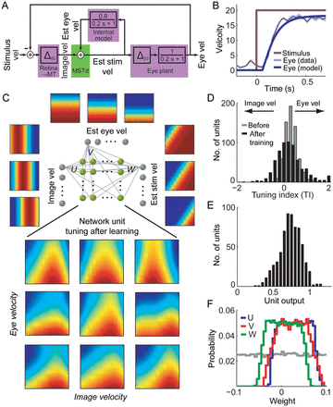
Figure 4. Modeling the visuomotor coordinate transformation. (A) Basic system-level model of the OKR. Image velocity is ...
Notes:
Figure 4. Modeling the visuomotor coordinate transformation. (A) Basic system-level model of the OKR. Image velocity is the difference between stimulus and eye velocity. A delay of 60 ms accounts for the latency of the image velocity signal due to retinal and neural processing along the visual system. The eye plant is modeled by a low-pass filter with a time constant of 200 ms and an additional delay of 20 ms. Image velocity is transformed to an estimated stimulus velocity signal by adding the estimated eye velocity signal, provided by an internal model of the eye plant. We assume that this coordinate transformation is implemented in area MSTd. (B) The step function response of the model (blue) for a sudden increase in stimulus velocity to 20°/s (brown). The light blue trace shows example eye velocity data from Ono et al. (2010). (C) Neural network model of the coordinate transformation. The network consists of 2 input layers, one intermediate network unit layer, and an output layer. The ‘image velocity’ input layer has 31 units. Each unit is Gaussian tuned with differing preferred image velocity. The ‘estimated eye velocity’ input layer has 21 units. Each unit has a sigmoid tuning with differing inflection velocity. The ‘estimated stimulus velocity’ output layer consists of 41 sigmoid-tuned units. Each of the 651 intermediate units is connected with each input and output unit. During the back-propagation learning process the weights of these connections are modified. Below the model, the tuning functions for image and eye velocity of 9 example network units after learning are shown. (D) Distribution of tuning indices of all intermediate unit tuning functions before (gray) and after (black) learning. The vertical arrow indicates the mean of the distribution after learning. (E) Output values of the trained network units for image and eye velocity values of 20°/s. (F) Distribution of weight values before (gray) and after learning for image velocity input (U, blue), eye velocity input (V, red), and output weights (W, green).
Unless provided in the caption above, the following copyright applies to the content of this slide: © The Author 2014. Published by Oxford University Press. All rights reserved. For Permissions, please e-mail: journals.permissions@oup.com

