Slide 1
Fig. 1 The experimental set-up. The stump was hidden under a table and synchronous brushstrokes were applied to the ...
Notes:
Fig. 1 The experimental set-up. The stump was hidden under a table and synchronous brushstrokes were applied to the stump and the index finger of a rubber hand placed in full view in front of the participant (A). After experiencing the illusion, the participant was asked to demonstrate where he or she had felt the touches by making a horizontal pointing movement along a ruler with eyes closed (B). We also stabbed the rubber hand with a needle whilst simultaneously measuring the associated changes in the participant's skin conductance as an objective measure of any fear and anticipated pain. (See the Methods section for details.)
Unless provided in the caption above, the following copyright applies to the content of this slide: © 2008 The Author(s)This is an Open Access article distributed under the terms of the Creative Commons Attribution Non-Commercial License (http://creativecommons.org/licenses/by-nc/2.0/uk/) which permits unrestricted non-commercial use, distribution, and reproduction in any medium, provided the original work is properly cited.

Slide 2
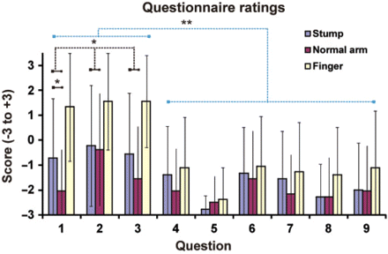
Fig. 2 The results of the questionnaire. The responses to Questions 1–3 reflect the experiences of the illusion: ...
Notes:
Fig. 2 The results of the questionnaire. The responses to Questions 1–3 reflect the experiences of the illusion: Q1—‘I felt the touch of the brush on the prosthetic hand’; ‘Q2—It seemed as if the brush caused the sensation touch that I experienced’; Q3—It felt as if the prosthetic hand was my hand’. The responses to Questions 4–9 served as controls for suggestibility and task compliance (see Methods section). The scores for the illusion questions (Q1–Q3) were significantly greater (P < 0.01) than those for the control conditions after the period of synchronous stimulation on the stump and the prosthetic hand (blue). Further, on average, the scores on the three illusion-related questions were greater in the stump condition than in the control condition when contralateral intact arm was stimulated (P < 0.05). Finally, it can be noted that the illusion ratings when stroking the participants’ stumps were lower than when testing the classical rubber hand illusion by stroking their intact contralateral hand (yellow). For details, see the Results section.
Unless provided in the caption above, the following copyright applies to the content of this slide: © 2008 The Author(s)This is an Open Access article distributed under the terms of the Creative Commons Attribution Non-Commercial License (http://creativecommons.org/licenses/by-nc/2.0/uk/) which permits unrestricted non-commercial use, distribution, and reproduction in any medium, provided the original work is properly cited.

Slide 3
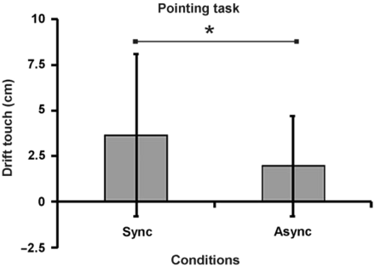
Fig. 3 Behavioural evidence that people perceived a change in the location of the sensation of touch from the stump ...
Notes:
Fig. 3 Behavioural evidence that people perceived a change in the location of the sensation of touch from the stump (and phantom in the cases of referred sensations) towards the rubber hand. When asked to indicate where they had sensed the touches of the paintbrush, by pointing with the intact hand with their eyes closed, the participant indicated greater drift in the perceived location of the touch towards the rubber hand after the illusion condition with synchronous stimulation (Sync) than after the asynchronous control condition (Async; P < 0.05).
Unless provided in the caption above, the following copyright applies to the content of this slide: © 2008 The Author(s)This is an Open Access article distributed under the terms of the Creative Commons Attribution Non-Commercial License (http://creativecommons.org/licenses/by-nc/2.0/uk/) which permits unrestricted non-commercial use, distribution, and reproduction in any medium, provided the original work is properly cited.

Slide 4
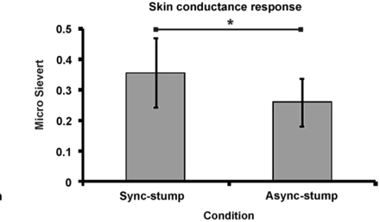
Fig. 4 Objective physiological evidence that the participants experienced an increase in the ownership of the ...
Notes:
Fig. 4 Objective physiological evidence that the participants experienced an increase in the ownership of the prosthetic hand when we brushed the stump and the prosthetic hand synchronously. Greater psychologically induced sweating, as measured with the skin conductance response (in micro Sievert), was observed when the prosthetic hand was stabbed with a needle in the illusion condition (sync-stump) than in the asynchronous control condition (async-stump; P < 0.05).
Unless provided in the caption above, the following copyright applies to the content of this slide: © 2008 The Author(s)This is an Open Access article distributed under the terms of the Creative Commons Attribution Non-Commercial License (http://creativecommons.org/licenses/by-nc/2.0/uk/) which permits unrestricted non-commercial use, distribution, and reproduction in any medium, provided the original work is properly cited.

Slide 5
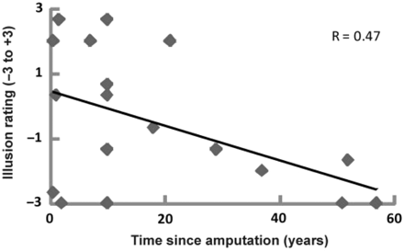
Fig. 5 Significant relationship between the time since amputation and the strength of the illusion as indicated by ...
Notes:
Fig. 5 Significant relationship between the time since amputation and the strength of the illusion as indicated by the illusion-items in the questionnaire (Pearson's correlation = −0.474, N = 18, P = 0.047, two-tailed P < 0.05). See the Results section for details.
Unless provided in the caption above, the following copyright applies to the content of this slide: © 2008 The Author(s)This is an Open Access article distributed under the terms of the Creative Commons Attribution Non-Commercial License (http://creativecommons.org/licenses/by-nc/2.0/uk/) which permits unrestricted non-commercial use, distribution, and reproduction in any medium, provided the original work is properly cited.

