Slide 1
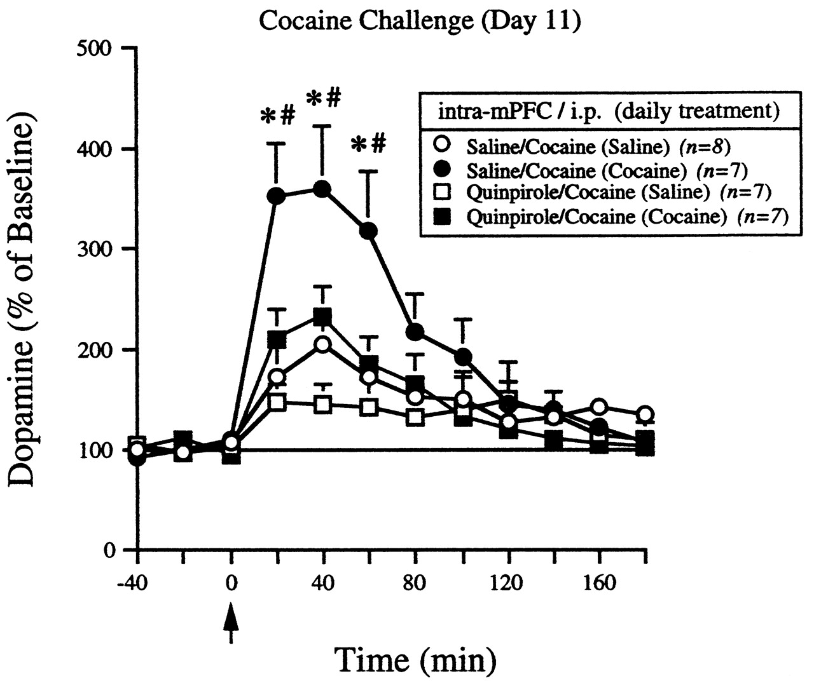
Figure 7. The effects of intra-mPFC quinpirole (5 nmol/side) injection on the expression of neurochemical sensitization ...
Notes:
Figure 7. The effects of intra-mPFC quinpirole (5 nmol/side) injection on the expression of neurochemical sensitization to cocaine (15 mg/kg i.p.). The measurements of DA in the NAc were made following the cocaine challenge and the neurochemical data are expressed as mean percent of baseline ± SEM. The basal DA concentrations did not statistically differ and the values are reported in the Results section. The arrow represents the time that injections were administered. Significant differences between groups were determined by repeated-measures ANOVA and multiple comparisons were made according to methods described elsewhere (Milliken and Johnson, 1984). The F-scores were as follows. Treatment effect, F(3,25) = 1.280 and P = 0.303; time effect, F(11,275) = 18.196 and P < 0.01; interaction effect, F(33,275) = 3.720 and P < 0.01.
Unless provided in the caption above, the following copyright applies to the content of this slide: © Oxford University Press

Slide 2
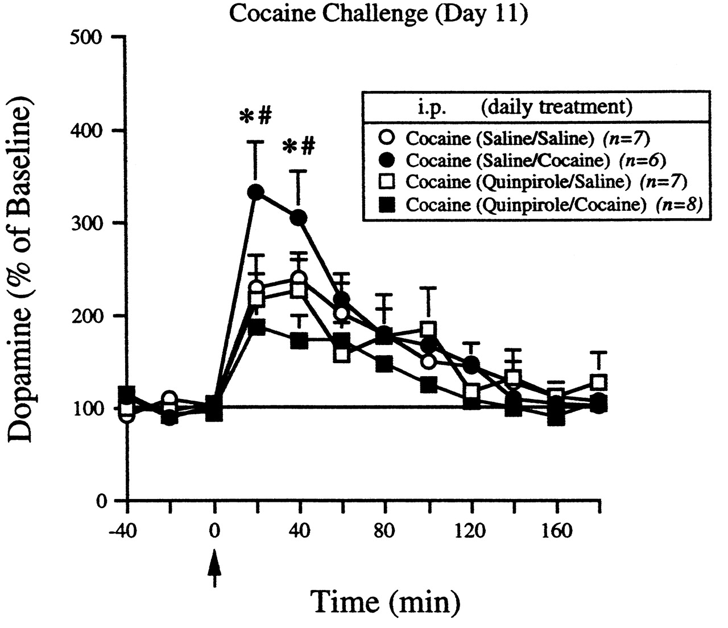
Figure 6. Effects of intra-mPFC quinpirole (5 nmol/side) microinjection on the initiation of neurochemical ...
Notes:
Figure 6. Effects of intra-mPFC quinpirole (5 nmol/side) microinjection on the initiation of neurochemical sensitization as defined by cocaine-induced (15 mg/kg i.p.) DA concentrations in the NAc. The measurements of DA were made following the cocaine challenge and are expressed as mean percent of baseline ± SEM. The raw basal DA concentrations did not statistically differ between treatment groups (see the Results section for values). The arrow represents the time that injections were administered. Significant differences between groups were determined by repeated-measures ANOVA and multiple comparisons were made according to methods described elsewhere (Milliken and Johnson, 1984). The F-scores were as follows. Treatment effect, F(3,24) = 1.750 and P = 0.184; time effect, F(11,264) = 7.903 and P < 0.01; interaction effect, F(33,264) = 1.617 and P = 0.022.
Unless provided in the caption above, the following copyright applies to the content of this slide: © Oxford University Press

Slide 3
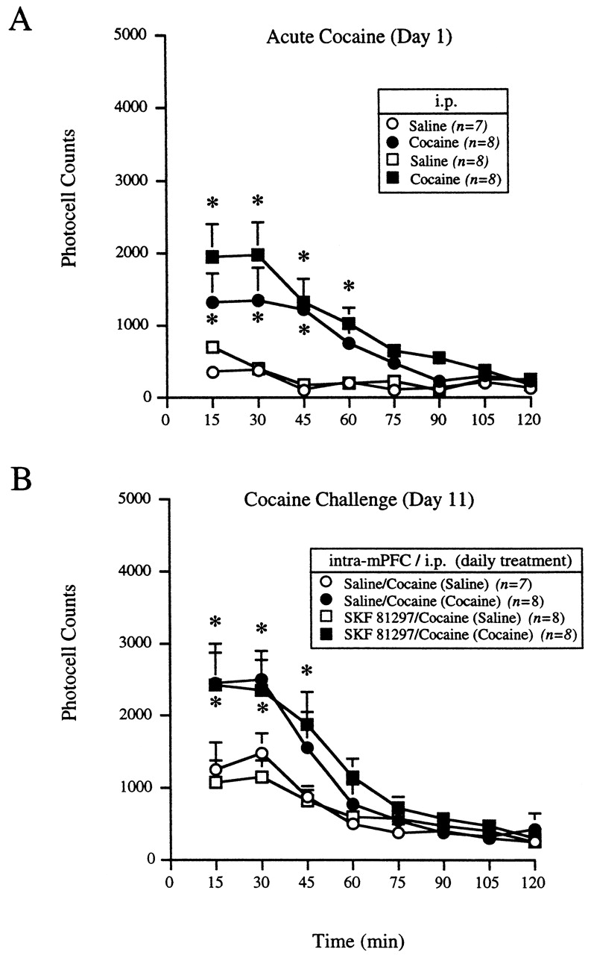
Figure 5. Effect of intra-mPFC SKF 81297 (3 nmol/side) administration on the expression of behavioral sensitization to ...
Notes:
Figure 5. Effect of intra-mPFC SKF 81297 (3 nmol/side) administration on the expression of behavioral sensitization to cocaine (15 mg/kg i.p.). The data are expressed as mean photocell counts ± SEM for the (A) first and (B) last day of exposure to cocaine. (B) The treatments in parentheses are the daily consecutive injections that were administered the week prior to the cocaine challenge. The significance of the differences between treatment groups was determined by repeated-measures ANOVA followed by post hoc analysis using a modified least significant differences test (Milliken and Johnson, 1984). The F-scores were as follows. (A) Treatment effect: F(3,27) = 6.266 and P < 0.01; time effect, F(7,189) = 19.860 and P < 0.01; interaction effect, F(21,189) = 3.858 and P < 0.01. (B) Treatment effect, F(3,27)=2.556 and P = 0.076; time effect, F(7,189) = 32.290 and P < 0.01; interaction effect, F(21,189) = 1.877 and P = 0.015. (A) *P < 0.05 compared to saline. (B) *P < 0.05 compared to saline/cocaine (saline).
Unless provided in the caption above, the following copyright applies to the content of this slide: © Oxford University Press

Slide 4
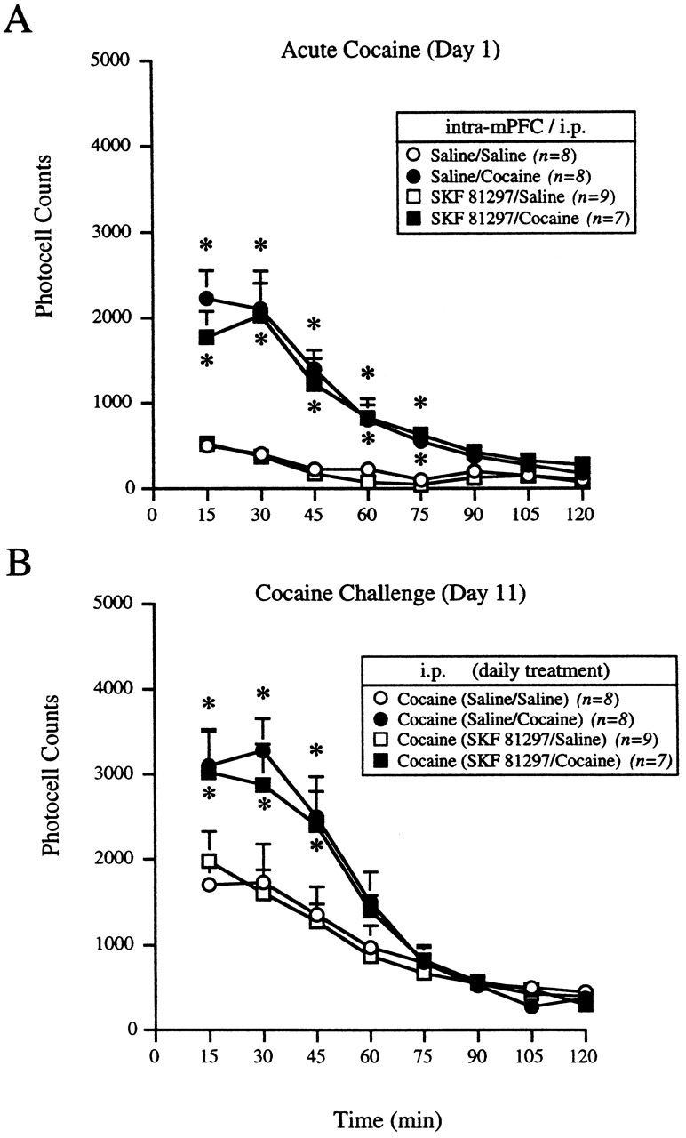
Figure 4. The effects of intra-mPFC SKF 81297 (3 nmol/side) administration on the initiation of behavioral ...
Notes:
Figure 4. The effects of intra-mPFC SKF 81297 (3 nmol/side) administration on the initiation of behavioral sensitization to cocaine (15 mg/kg i.p.). The data are expressed as mean photocell counts ± SEM for the (A) first and (B) last day of exposure to cocaine. (B) The treatments in parentheses are the daily consecutive injections that were administered the week prior to the cocaine challenge. The significance of the differences between treatment groups was determined by repeated-measures ANOVA followed by post hoc analysis using a modified least significant differences test (Milliken and Johnson, 1984). The F-scores were as follows. (A) Treatment effect: F(3,28) = 16.564 and P < 0.01; time effect, F(7,196) = 50.119 and P < 0.01; interaction effect, F(21,196) = 8.522 and P < 0.01. (B) Treatment effect: F(3,28) = 2.561 and P = 0.075; time effect, F(7,196) = 82.172 and P < 0.01; interaction effect, F(21,196) = 3.946 and P < 0.01. (A) *P < 0.05 compared to saline/saline. (B) *P < 0.05 compared to cocaine (saline/saline).
Unless provided in the caption above, the following copyright applies to the content of this slide: © Oxford University Press

Slide 5
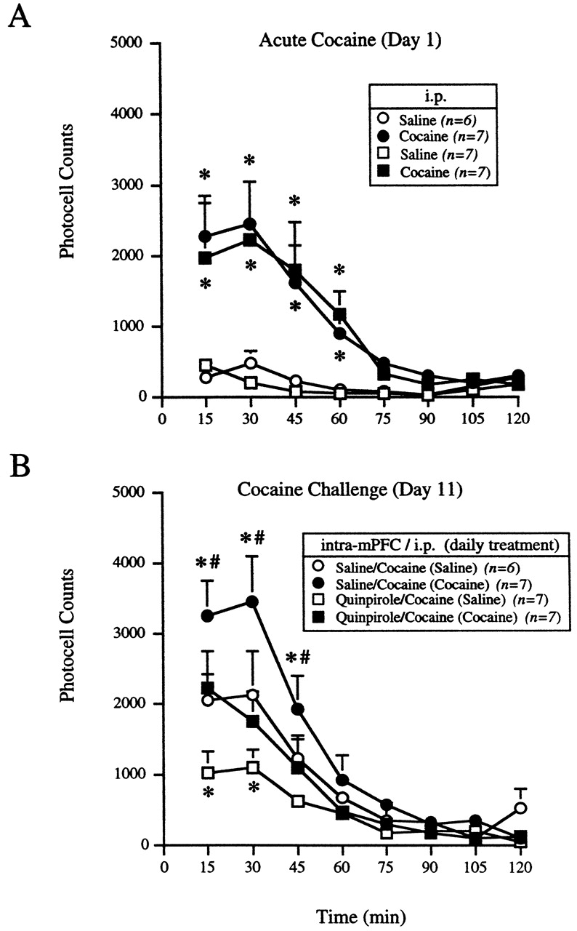
Figure 3. Effect of intra-mPFC quinpirole (5 nmol/side) administration on the expression of behavioral sensitization to ...
Notes:
Figure 3. Effect of intra-mPFC quinpirole (5 nmol/side) administration on the expression of behavioral sensitization to cocaine (15 mg/kg i.p.). The data are expressed as mean photocell counts ± SEM for the (A) first and (B) last day of exposure to cocaine. (B) The treatments in parentheses are the daily consecutive injections that were administered the week prior to the cocaine challenge. The significance of the differences between treatment groups was determined by repeated-measures ANOVA followed by post hoc analysis using a modified least significant differences test (Milliken and Johnson, 1984). The F-scores were as follows. (A) Treatment effect: F(3,23) = 5.545 and P < 0.01; time effect, F(7,161) = 16.017 and P < 0.01; interaction effect, F(21,161) = 3.743 and P < 0.01. (B) Treatment effect: F(3,23)=4.730 and P = 0.010; time effect, F(7,161) = 45.784 and P < 0.01; interaction effect, F(21,161) = 2.824 and P < 0.01. (A) *P < 0.05 compared to saline. (B) *P < 0.05 compared to saline/cocaine (saline) and #P < 0.05 compared to quinpirole/cocaine (cocaine).
Unless provided in the caption above, the following copyright applies to the content of this slide: © Oxford University Press

Slide 6
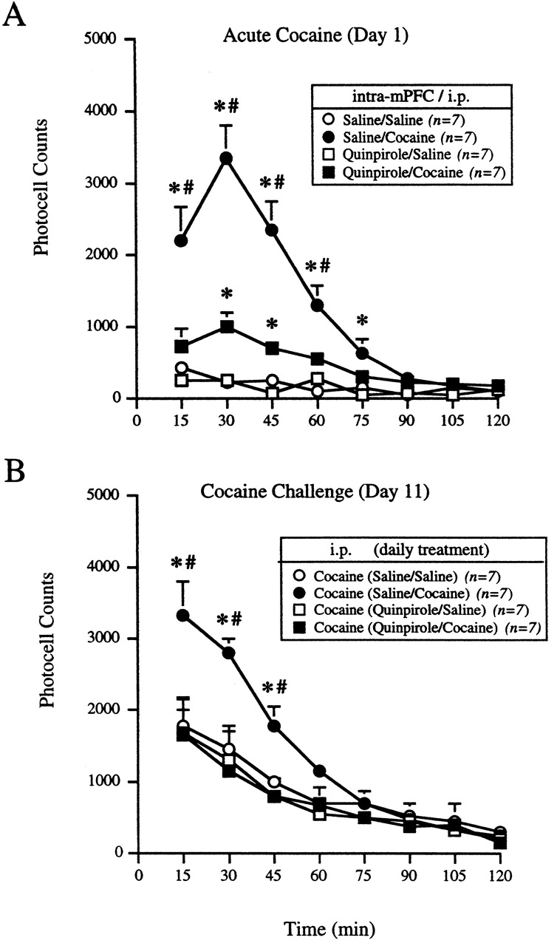
Figure 2. The effects of intra-mPFC quinpirole (5 nmol/side) administration on the initiation of behavioral ...
Notes:
Figure 2. The effects of intra-mPFC quinpirole (5 nmol/side) administration on the initiation of behavioral sensitization to cocaine (15 mg/kg i.p.). The data are expressed as mean photocell counts ± SEM for the (A) first and (B) last day of exposure to cocaine. (B) The treatments in parentheses are the daily consecutive injections that were administered the week prior to the cocaine challenge. The significance of the differences between treatment groups was determined by repeated-measures ANOVA followed by post hoc analysis using a modified least significant differences test (Milliken and Johnson, 1984). The F-scores were as follows. (A) Treatment effect, F(3,24) = 32.578 and P < 0.01; time effect, F(7,168) = 29.164 and P < 0.01; interaction effect, F(21,168) = 12.758 and P < 0.01. (B) Treatment effect, F(3,24) = 3.304 and P = 0.037; time effect, F(7,168) = 60.318 and P < 0.01; interaction effect, F(21,168) = 4.057 and P < 0.01. (A) *P < 0.05 compared to saline/saline and #P < 0.05 compared to quinpirole/cocaine. (B) *P < 0.05 compared to cocaine (saline/saline) and #P < 0.05 compared to cocaine (quinpirole/cocaine).
Unless provided in the caption above, the following copyright applies to the content of this slide: © Oxford University Press

Slide 7
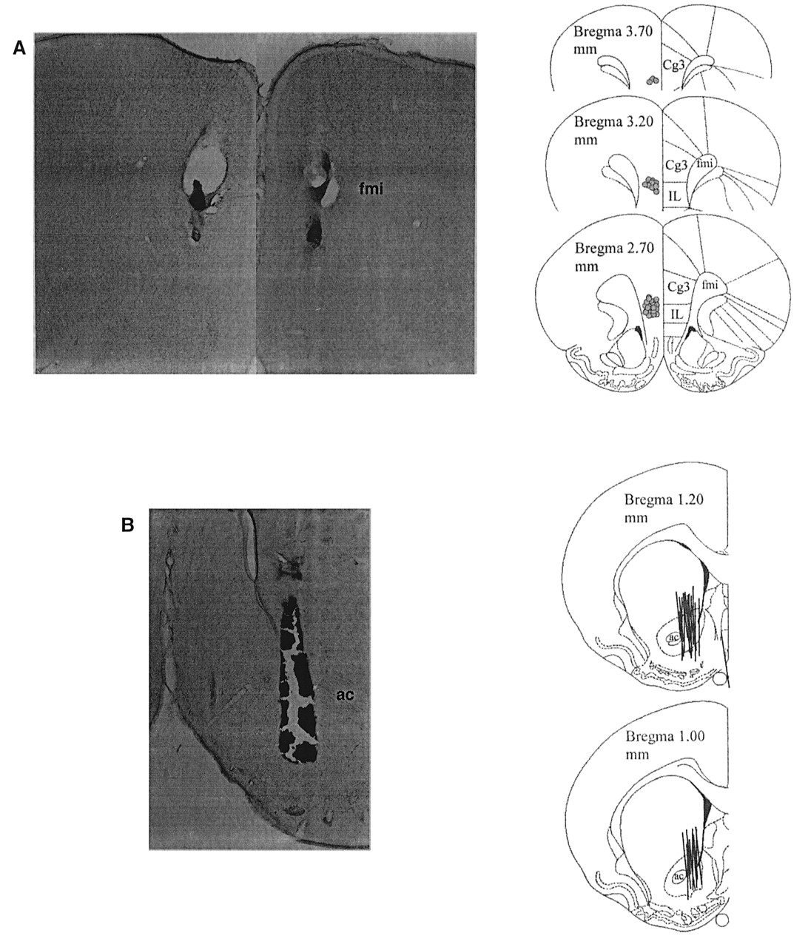
Figure 1. Determination of (A) injector cannula and (B) microdialysis probe placement in the mPFC and NAc respectively. ...
Notes:
Figure 1. Determination of (A) injector cannula and (B) microdialysis probe placement in the mPFC and NAc respectively. Representative photomicrographs of cresyl violet-stained coronal sections are shown on the left side of each panel. The right side of each panel shows line drawings of the injector and probe placements for all animals included in the study. The drawings were adapted from the CD-ROM version of The Rat Brain in Stereotaxic Coordinates (Paxinos and Watson, 1997).
Unless provided in the caption above, the following copyright applies to the content of this slide: © Oxford University Press

