Slide 1
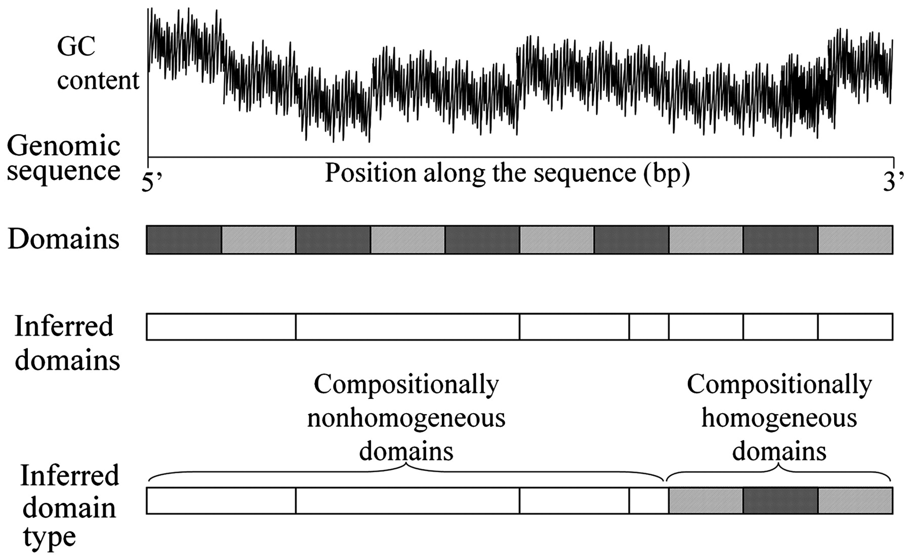
Figure 1. Example of a hypothetical genomic sequence composed of 10 compositionally homogeneous domains used to ...
Notes:
Figure 1. Example of a hypothetical genomic sequence composed of 10 compositionally homogeneous domains used to demonstrate two aspects of sequence analysis: partitioning and testing for homogeneity. Note that the partitioning yielded seven domains, out of which three were found to be homogeneous and the rest were nonhomogeneous.
Unless provided in the caption above, the following copyright applies to the content of this slide: © The Author(s) 2010. Published by Oxford University Press.This is an Open Access article distributed under the terms of the Creative Commons Attribution Non-Commercial License (http://creativecommons.org/licenses/by-nc/2.5), which permits unrestricted non-commercial use, distribution, and reproduction in any medium, provided the original work is properly cited.

Slide 2
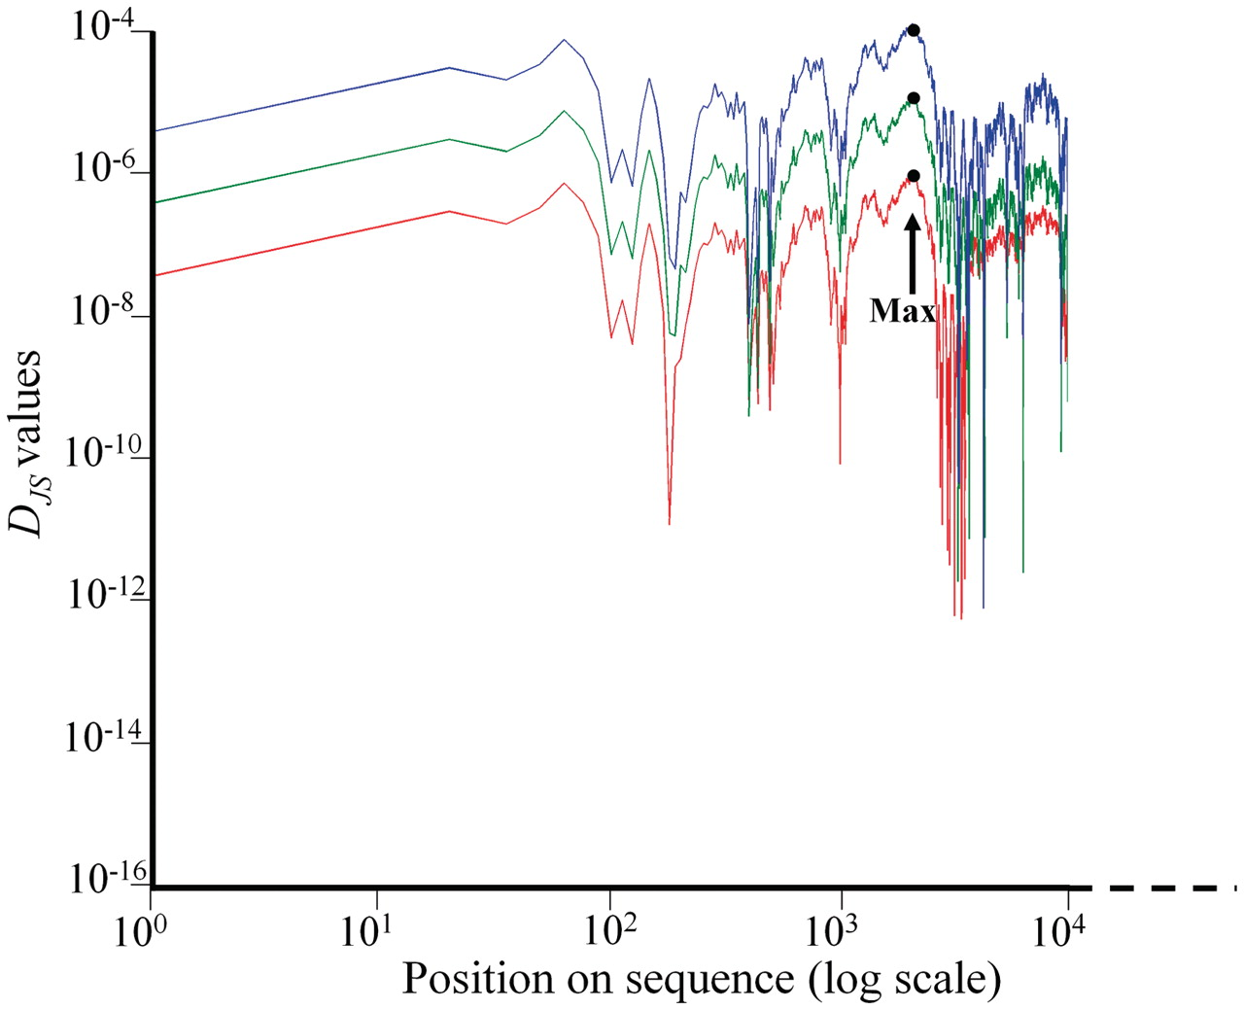
Figure 2. A demonstration of the relationship between D_{JS} entropy statistic, sequence length and ...
Notes:
Figure 2. A demonstration of the relationship between DJS entropy statistic, sequence length and variability ( σGC ), using 1-Mb simulated sequence (red) with σGC of 1% and two initial subsequences of sizes: 100 kb (green) and 10 kb (blue). Segmentation is carried out by obtaining the DJS statistic values for all possible bipartition for each of the three sequences and partitioning them at the point of maximal DJS ( ). The DJS values are plotted for each position in a different color for each sequence. The entropy measures are marked for each plot by a large dot. The plot illustrates the difference in DJS values obtained for sequences with similar initial content but different lengths. A fixed threshold of 5.8 × 10 −5 will not partition the shortest sequence although it has the same initial content as the other sequences.
Unless provided in the caption above, the following copyright applies to the content of this slide: © The Author(s) 2010. Published by Oxford University Press.This is an Open Access article distributed under the terms of the Creative Commons Attribution Non-Commercial License (http://creativecommons.org/licenses/by-nc/2.5), which permits unrestricted non-commercial use, distribution, and reproduction in any medium, provided the original work is properly cited.

Slide 3
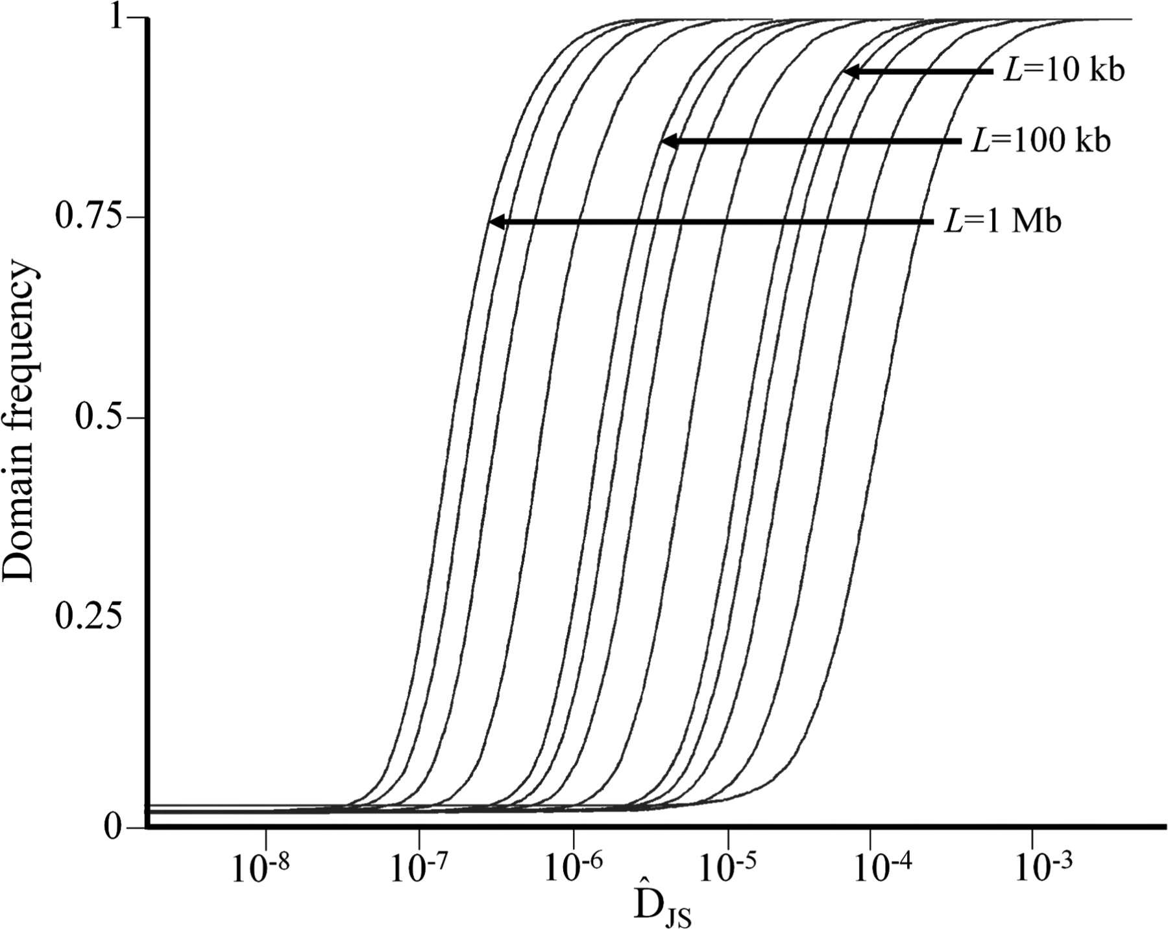
Figure 3. Cumulative distributions calculated for 10 000 sequences of σ_{GC} = 1% and different lengths L . ...
Notes:
Figure 3. Cumulative distributions calculated for 10 000 sequences of σGC = 1% and different lengths L . The thresholds ( Dt ) are obtained from the top 0.01% percentile of each cumulative distribution and are marked for three sequence lengths.
Unless provided in the caption above, the following copyright applies to the content of this slide: © The Author(s) 2010. Published by Oxford University Press.This is an Open Access article distributed under the terms of the Creative Commons Attribution Non-Commercial License (http://creativecommons.org/licenses/by-nc/2.5), which permits unrestricted non-commercial use, distribution, and reproduction in any medium, provided the original work is properly cited.

Slide 4
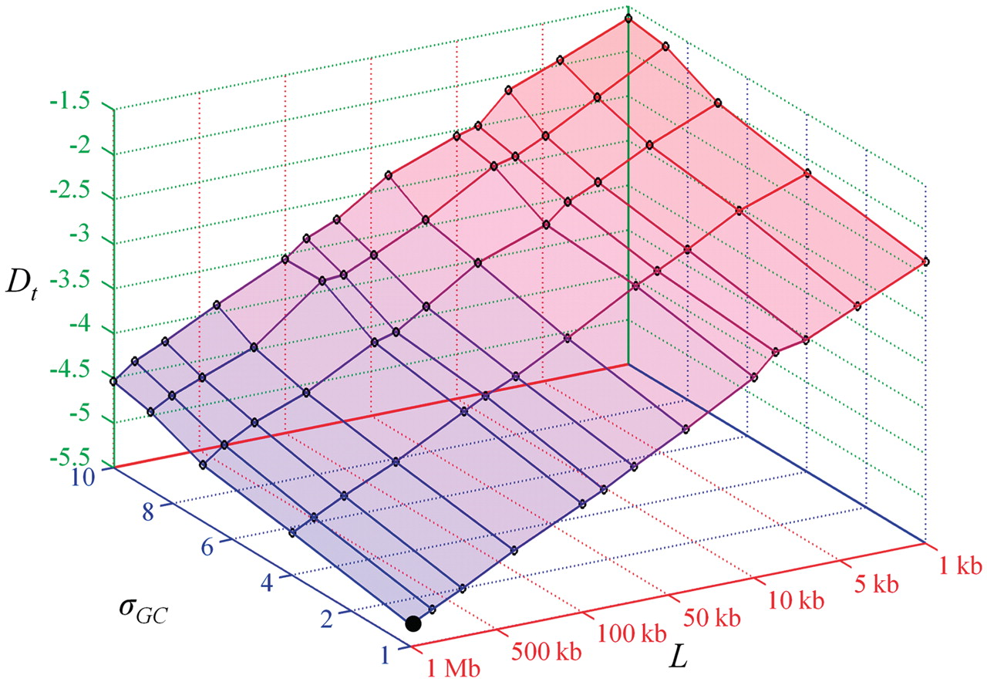
Figure 4. The threshold D_{t} values obtained from simulated sequences with various lengths and GC standard ...
Notes:
Figure 4. The threshold Dt values obtained from simulated sequences with various lengths and GC standard deviations are plotted against each sequence length L and variability σGC on a log–log scale. The threshold chosen by Cohen et al . ( 10 ) is marked by a large dot.
Unless provided in the caption above, the following copyright applies to the content of this slide: © The Author(s) 2010. Published by Oxford University Press.This is an Open Access article distributed under the terms of the Creative Commons Attribution Non-Commercial License (http://creativecommons.org/licenses/by-nc/2.5), which permits unrestricted non-commercial use, distribution, and reproduction in any medium, provided the original work is properly cited.

Slide 5
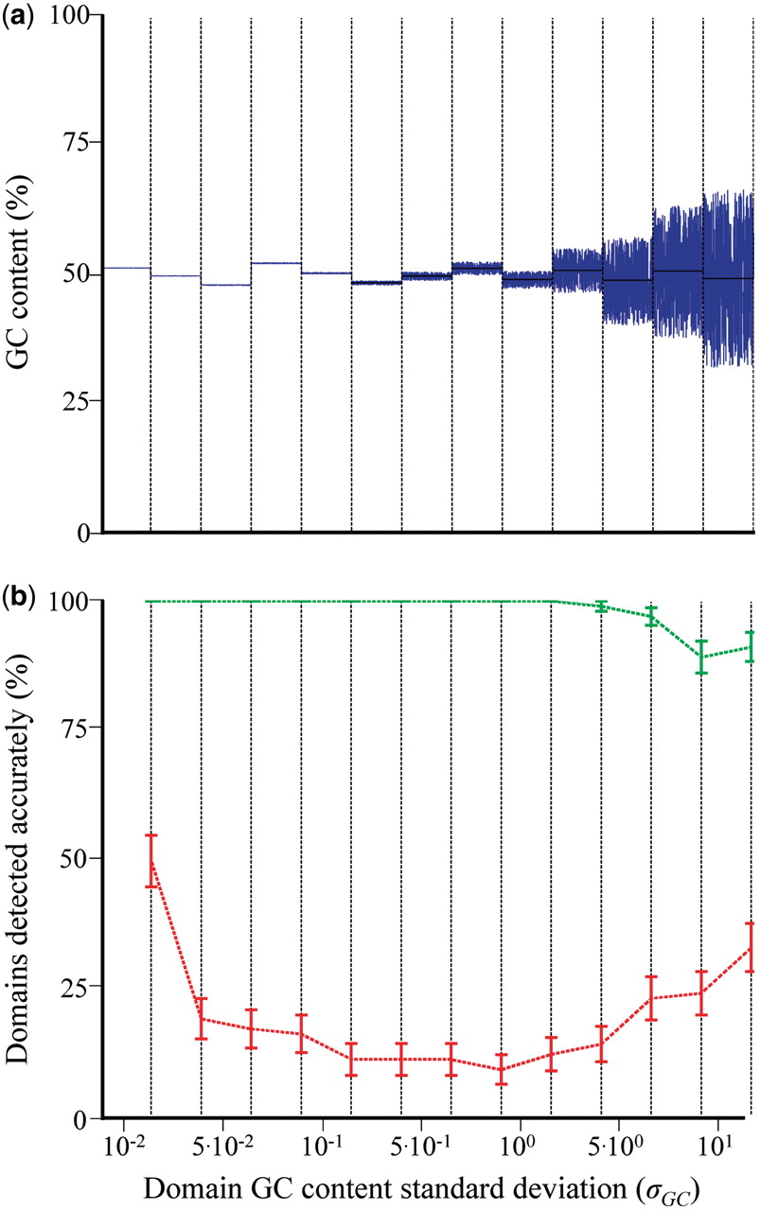
Figure 5. ( a ) An illustration of the GC content spatial distribution along a 130-kb simulated sequence that contains ...
Notes:
Figure 5. ( a ) An illustration of the GC content spatial distribution along a 130-kb simulated sequence that contains 13 equally sized domains (dotted bars). Domain mean GC content is marked by black lines. ( b ) The mean sensitivities (with error bars) of IsoPlotter (green) and D JS (red) are shown for every domain (dotted bars).
Unless provided in the caption above, the following copyright applies to the content of this slide: © The Author(s) 2010. Published by Oxford University Press.This is an Open Access article distributed under the terms of the Creative Commons Attribution Non-Commercial License (http://creativecommons.org/licenses/by-nc/2.5), which permits unrestricted non-commercial use, distribution, and reproduction in any medium, provided the original work is properly cited.

Slide 6
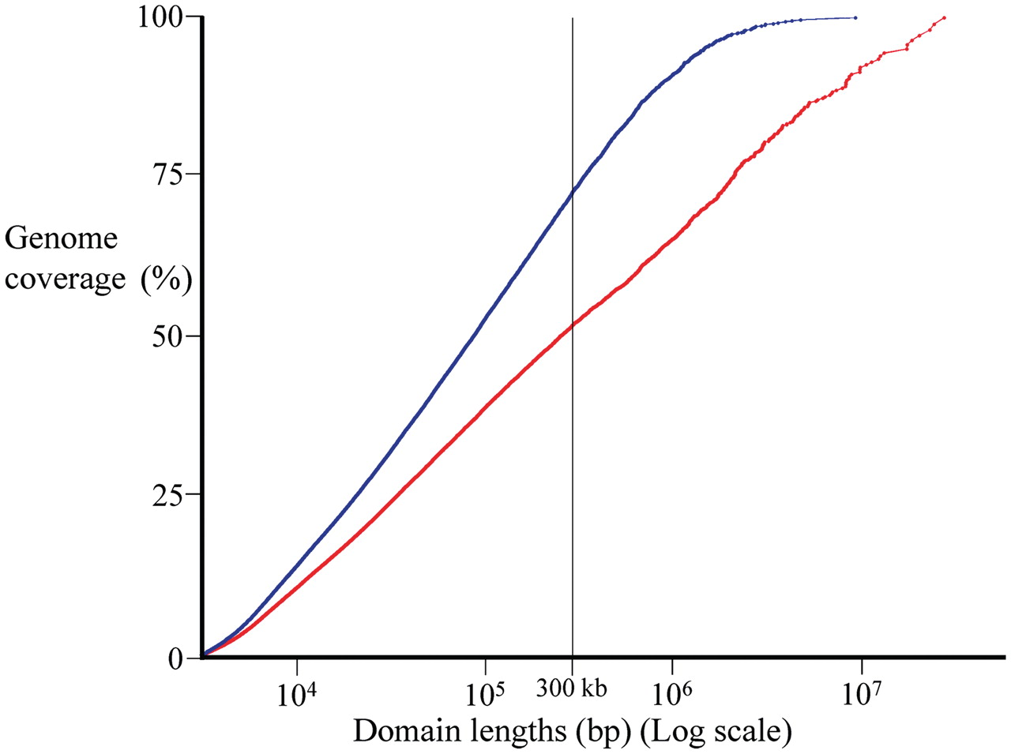
Figure 6. Cumulative spatial coverage for human genome using all domains inferred by IsoPlotter (blue) and D ...
Notes:
Figure 6. Cumulative spatial coverage for human genome using all domains inferred by IsoPlotter (blue) and D JS (red). Seventy percent of IsoPlotter inferences were homogeneous compared to 67% for D JS .
Unless provided in the caption above, the following copyright applies to the content of this slide: © The Author(s) 2010. Published by Oxford University Press.This is an Open Access article distributed under the terms of the Creative Commons Attribution Non-Commercial License (http://creativecommons.org/licenses/by-nc/2.5), which permits unrestricted non-commercial use, distribution, and reproduction in any medium, provided the original work is properly cited.

Slide 7
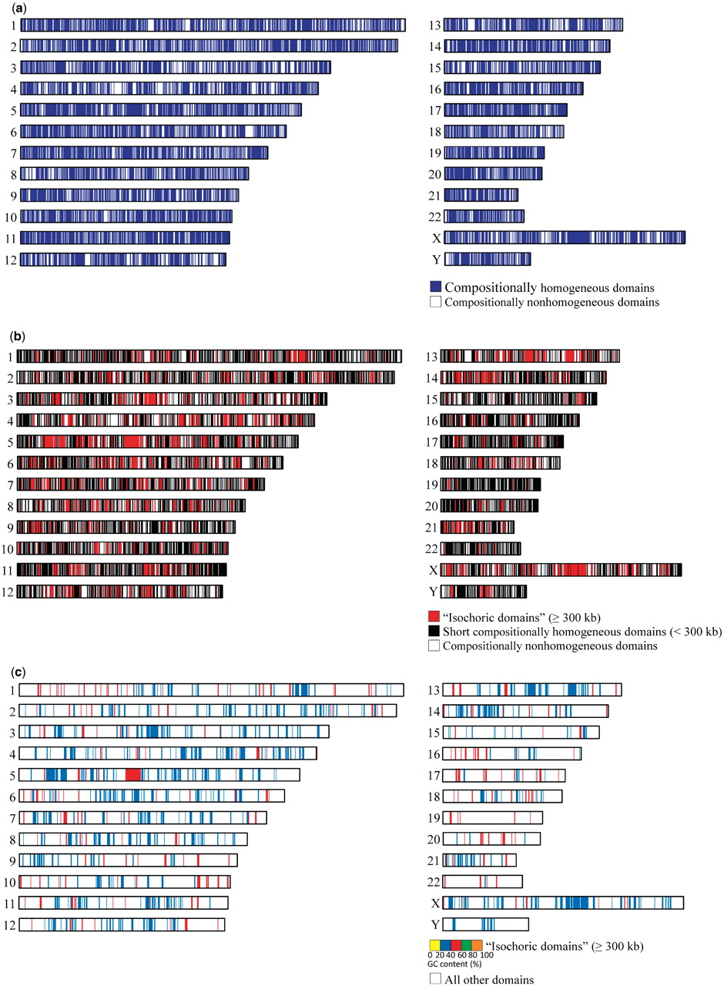
Figure 7. Ideograms of compositional domains inferred by IsoPlotter and mapped to chromosomes. Using data mining ...
Notes:
Figure 7. Ideograms of compositional domains inferred by IsoPlotter and mapped to chromosomes. Using data mining approach, the ideograms uncover the compositional patterns of long homogeneous domains (‘isochoric’) in three layers (from top to bottom): ( a ) compositionally homogeneous domains and nonhomogeneous domains; ( b ) long compositionally homogeneous domains (≥300 kb), short compositionally homogeneous domains (<300 kb) and compositionally nonhomogeneous domains; and ( c ) long compositionally homogeneous domains (≥300 kb) color coded by their mean GC content and all other domains (short compositionally homogeneous and nonhomogeneous domains).
Unless provided in the caption above, the following copyright applies to the content of this slide: © The Author(s) 2010. Published by Oxford University Press.This is an Open Access article distributed under the terms of the Creative Commons Attribution Non-Commercial License (http://creativecommons.org/licenses/by-nc/2.5), which permits unrestricted non-commercial use, distribution, and reproduction in any medium, provided the original work is properly cited.

