Slide 1
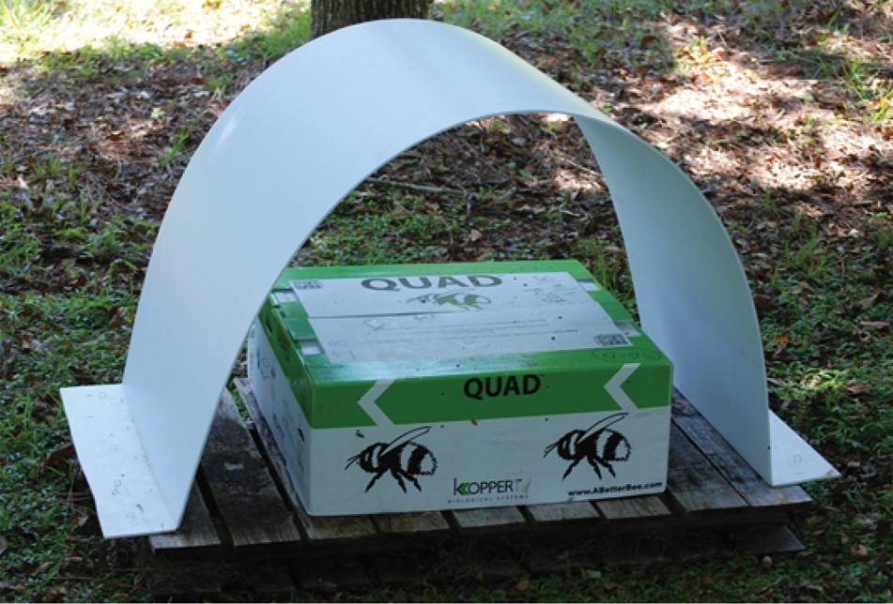
Fig. 1 Photo of Koppert quad box that contained one bumble bee hive placed within the high and low weight treatment ...
Notes:
Fig. 1 Photo of Koppert quad box that contained one bumble bee hive placed within the high and low weight treatment cages.
Unless provided in the caption above, the following copyright applies to the content of this slide: © The Authors 2017. Published by Oxford University Press on behalf of Entomological Society of America. All rights reserved. For Permissions, please email: journals.permissions@oup.com

Slide 2
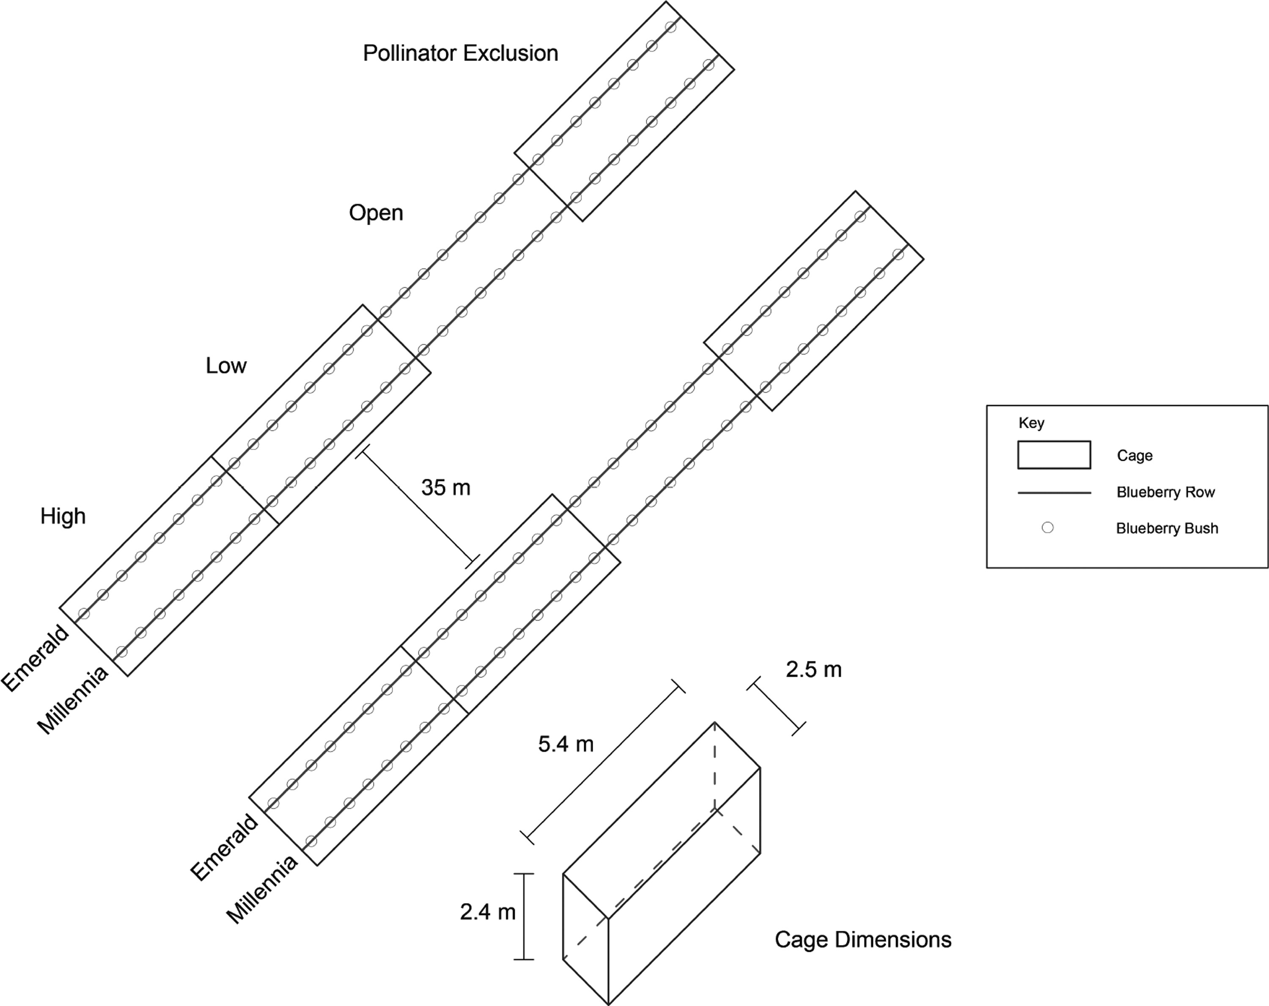
Fig. 2 Schematic drawing of blueberry field depicting the two cultivars of blueberry (‘Emerald’ and ‘Millennia’) and ...
Notes:
Fig. 2 Schematic drawing of blueberry field depicting the two cultivars of blueberry (‘Emerald’ and ‘Millennia’) and the four treatments used in this experiment.
Unless provided in the caption above, the following copyright applies to the content of this slide: © The Authors 2017. Published by Oxford University Press on behalf of Entomological Society of America. All rights reserved. For Permissions, please email: journals.permissions@oup.com

Slide 3
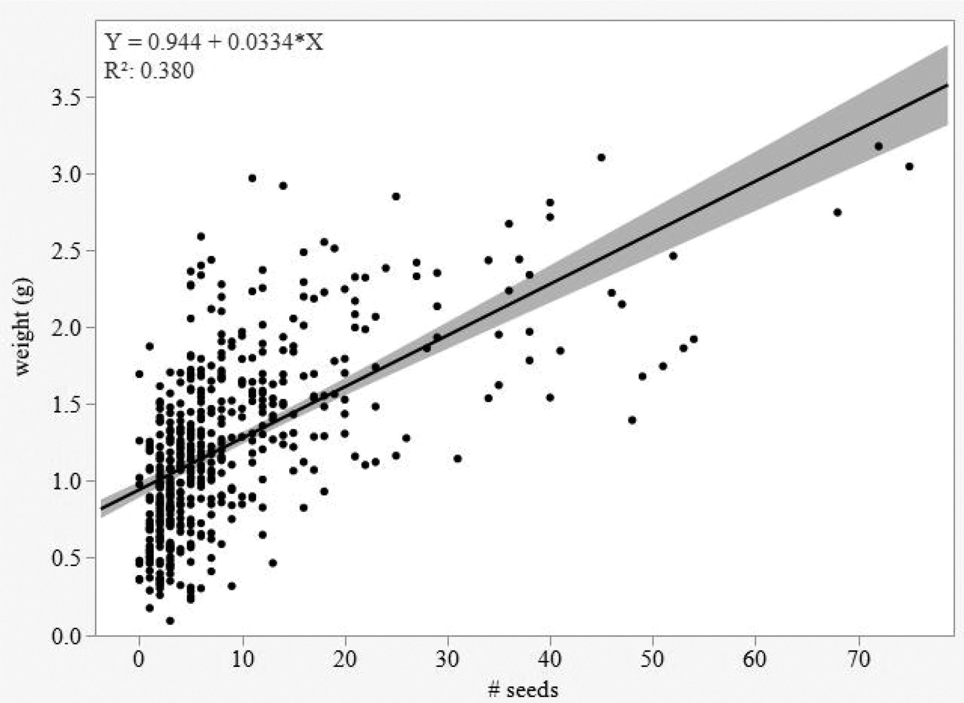
Fig. 3 Berry weight (g) in highbush blueberry cultivar ‘Emerald’ in relation to number of seeds ...
Notes:
Fig. 3 Berry weight (g) in highbush blueberry cultivar ‘Emerald’ in relation to number of seeds (R2= 0.38, P < 0.01). The best fit line with 95% confidence bands connects predicted values from the linear model.
Unless provided in the caption above, the following copyright applies to the content of this slide: © The Authors 2017. Published by Oxford University Press on behalf of Entomological Society of America. All rights reserved. For Permissions, please email: journals.permissions@oup.com

Slide 4
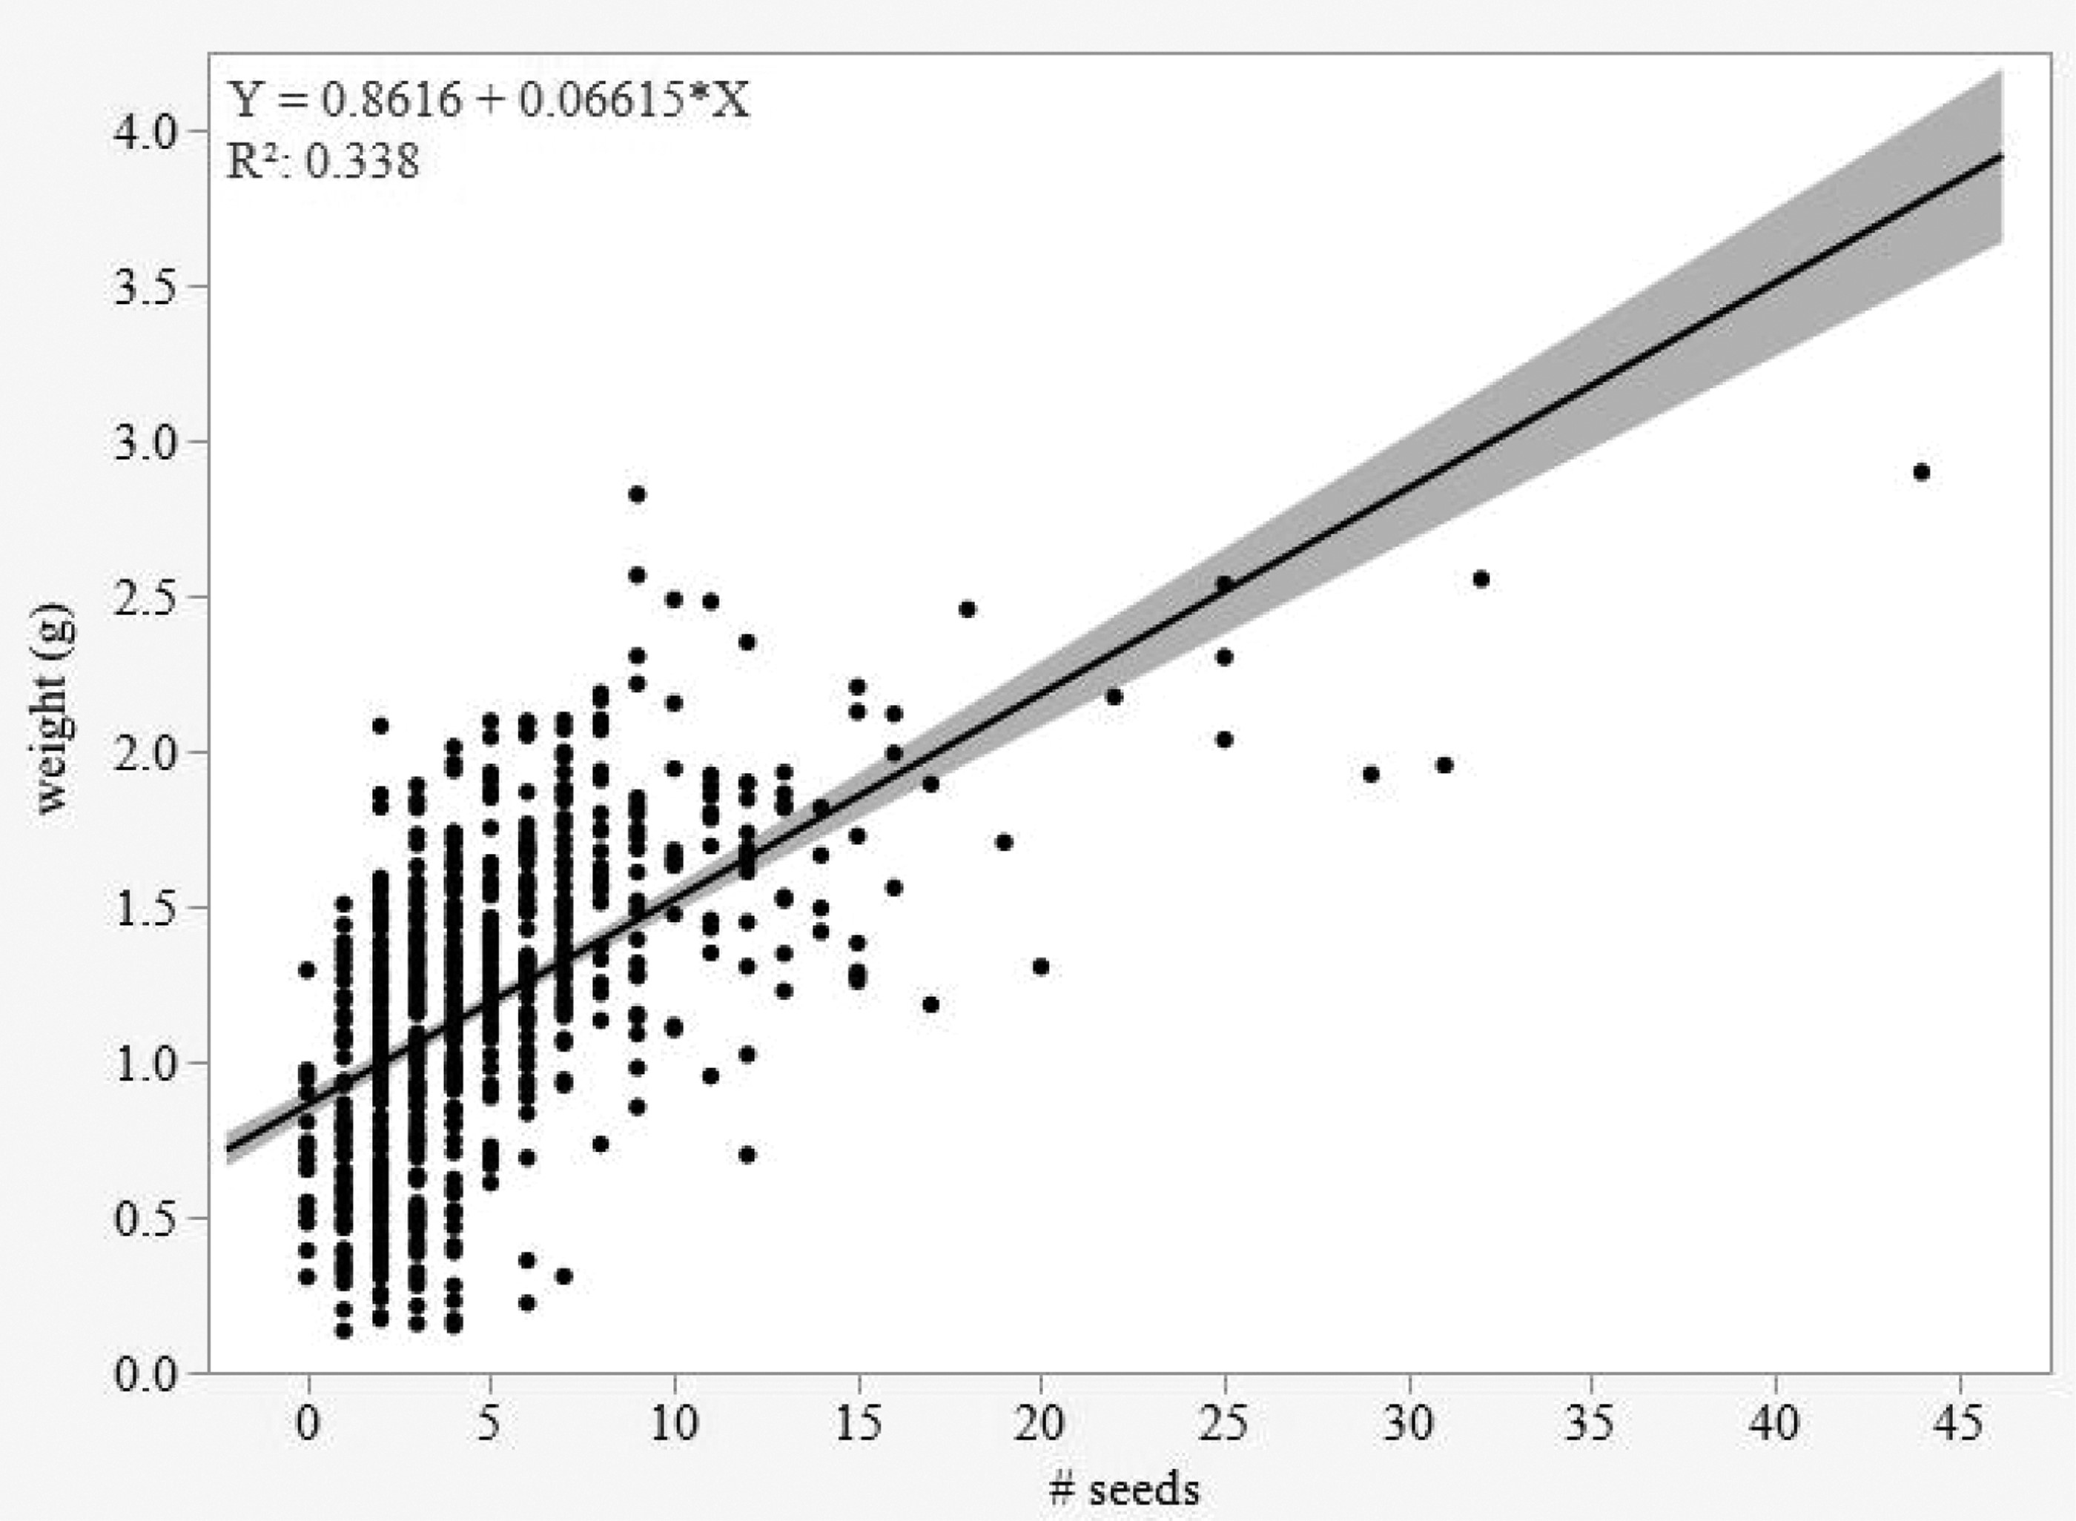
Fig. 4 Berry weight (g) in highbush blueberry cultivar ‘Millennia’ in relation to number of seeds ...
Notes:
Fig. 4 Berry weight (g) in highbush blueberry cultivar ‘Millennia’ in relation to number of seeds (R2= 0.34, P < 0.01). The best fit line with 95% confidence bands connects predicted values from the linear model.
Unless provided in the caption above, the following copyright applies to the content of this slide: © The Authors 2017. Published by Oxford University Press on behalf of Entomological Society of America. All rights reserved. For Permissions, please email: journals.permissions@oup.com

