Slide 1
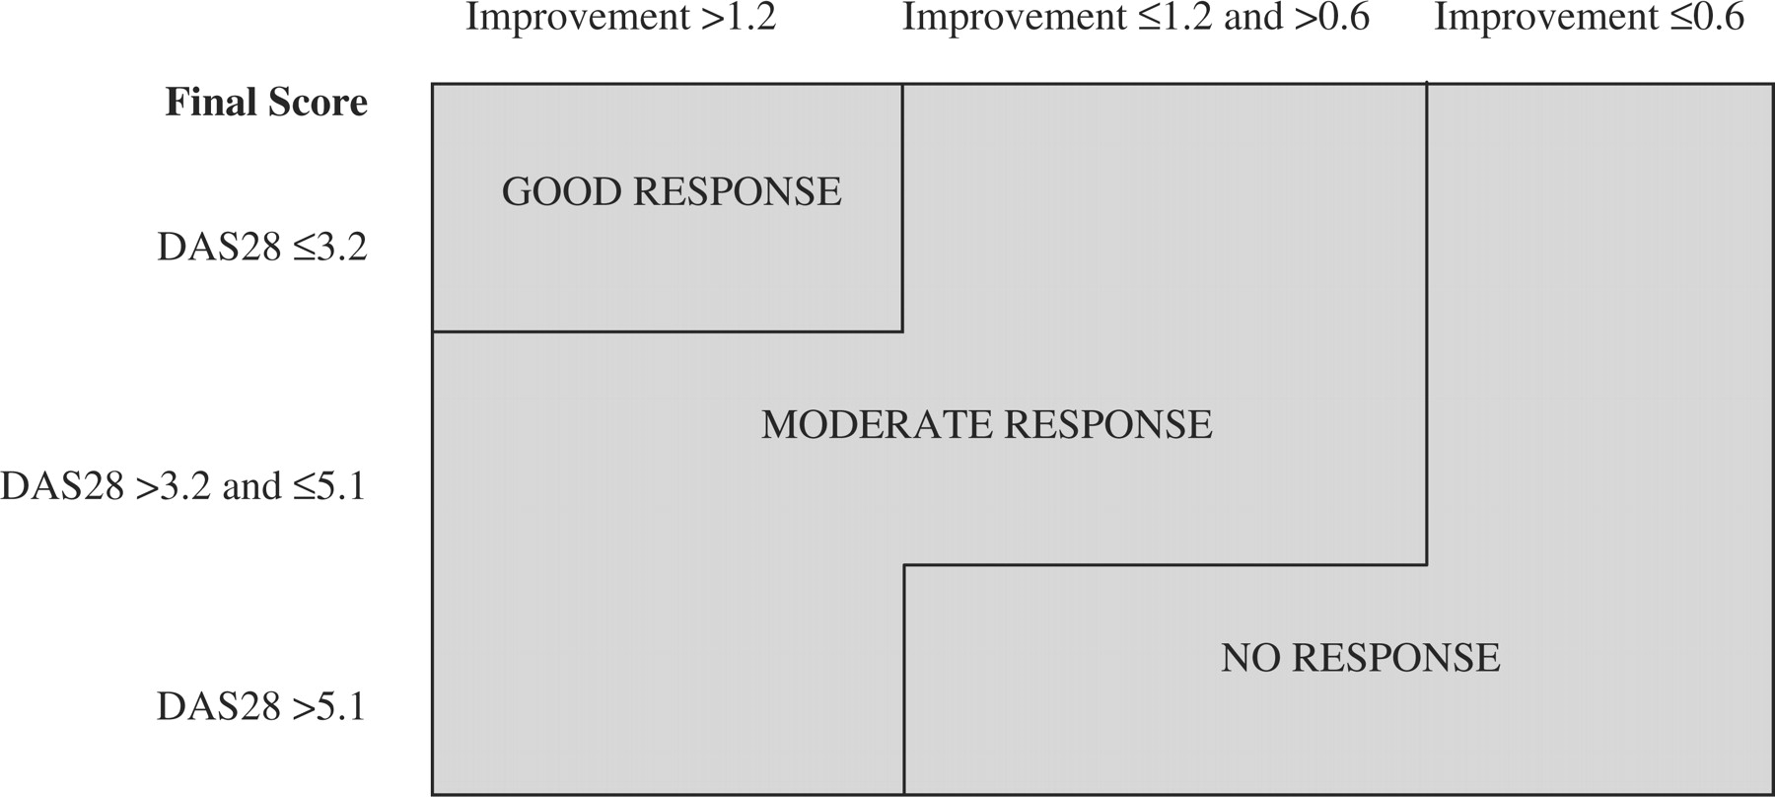
F ig . 1. EULAR improvement criteria.
Notes:
F ig . 1. EULAR improvement criteria.
Unless provided in the caption above, the following copyright applies to the content of this slide: © The Author 2006. Published by Oxford University Press on behalf of the British Society for Rheumatology. All rights reserved. For Permissions, please email: journals.permissions@oxfordjournals.org

Slide 2
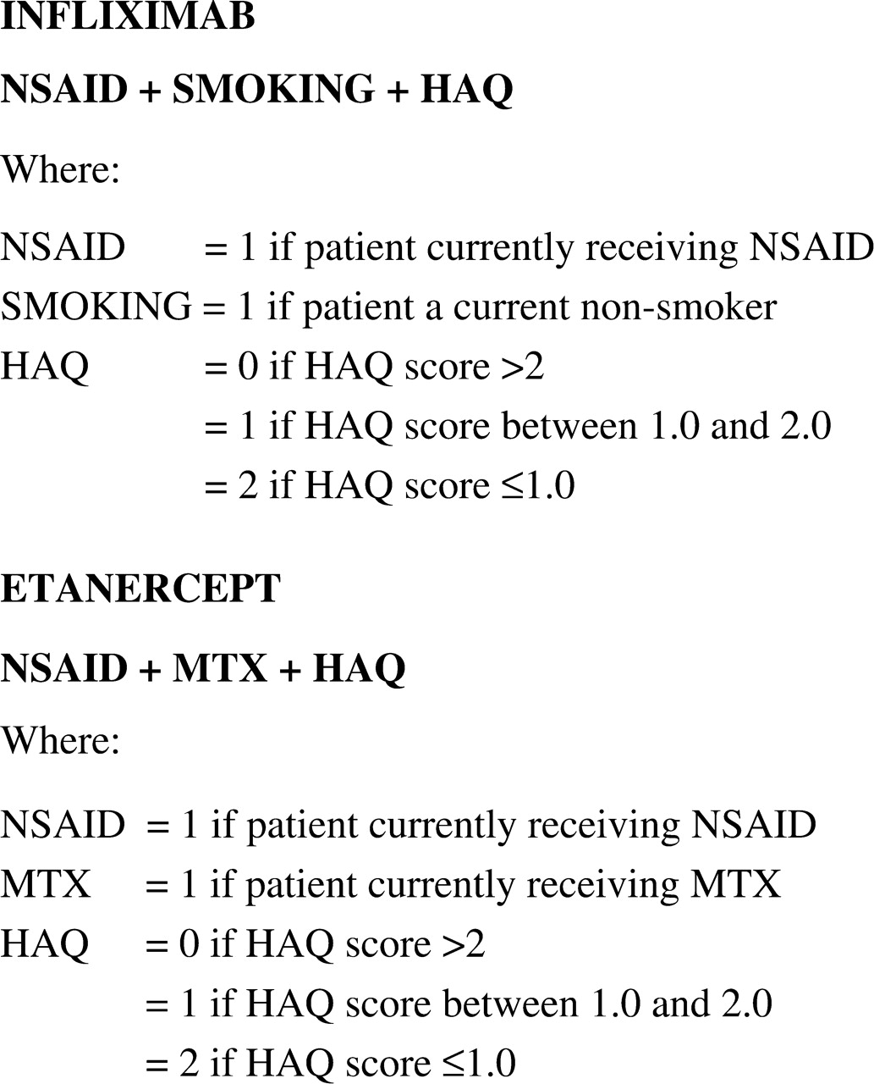
F ig . 2. Formulae for predicting response.
Notes:
F ig . 2. Formulae for predicting response.
Unless provided in the caption above, the following copyright applies to the content of this slide: © The Author 2006. Published by Oxford University Press on behalf of the British Society for Rheumatology. All rights reserved. For Permissions, please email: journals.permissions@oxfordjournals.org

Slide 3
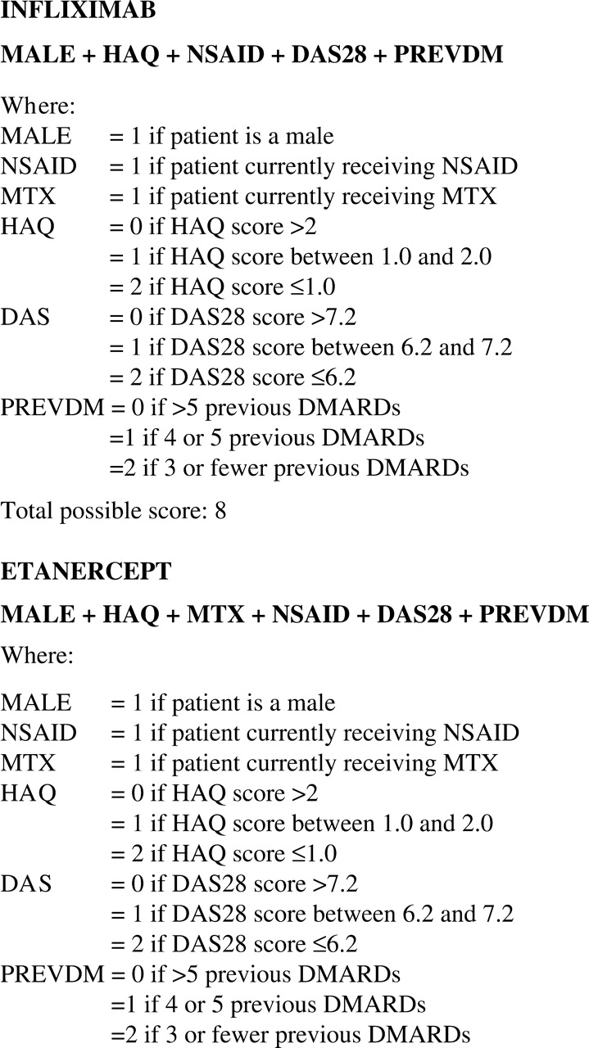
F ig . 3. Formulae for predicting remission.
Notes:
F ig . 3. Formulae for predicting remission.
Unless provided in the caption above, the following copyright applies to the content of this slide: © The Author 2006. Published by Oxford University Press on behalf of the British Society for Rheumatology. All rights reserved. For Permissions, please email: journals.permissions@oxfordjournals.org

