Slide 1
Figure 1. Morphological and biochemical analyses on tissue samples taken at 3 years of age. (A) Histochemical stain for ...
Notes:
Figure 1. Morphological and biochemical analyses on tissue samples taken at 3 years of age. (A) Histochemical stain for COX and SDH of the patient's muscle. (B) Histochemical stain for COX and SDH of fibroblasts from the patient and a healthy control. (C) Respiratory chain enzyme activities in patient's muscle and fibroblasts. Data are expressed as percentage of controls. ND, not determined.
Unless provided in the caption above, the following copyright applies to the content of this slide: © The Author 2008. Published by Oxford University Press. All rights reserved. For Permissions, please email: journals.permissions@oxfordjournals.org

Slide 2
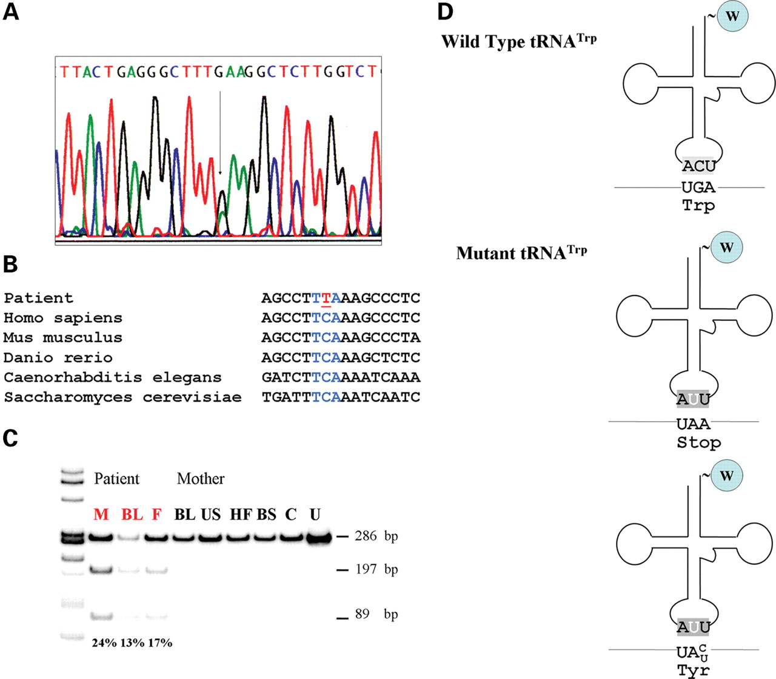
Figure 2. (A) Sequence of the mitochondrial tRNA^{Trp} gene in DNA isolated from the patient's muscle. The ...
Notes:
Figure 2. (A) Sequence of the mitochondrial tRNATrp gene in DNA isolated from the patient's muscle. The arrow indicates the C5545T mutation. (B) Alignment of sequences of the anticodon loop of tRNATrp from different eukaryotic species. (C) PCR–RFLP analysis of the mutation in different tissues of the patient and of his mother. Radiolabeled fragments, after digestion with DraI, were separated on a gel, visualized and quantitated using a BioRad phosphor imager. The wild-type yields a single fragment of 286 bp, the mutant two fragments of 197 and 89 bp. In red patient tissues. M, skeletal muscle; BL, blood leukocytes; F, hair follicles; US, urinary sediment; HF, hair follicles; BS, buccal smear; C, healthy control; U, uncut fragment. (D) Schematic representation of the structure of wild-type and mutant tRNATrp and the possible consequences of the mutation in the anticodon on codon recognition.
Unless provided in the caption above, the following copyright applies to the content of this slide: © The Author 2008. Published by Oxford University Press. All rights reserved. For Permissions, please email: journals.permissions@oxfordjournals.org

Slide 3
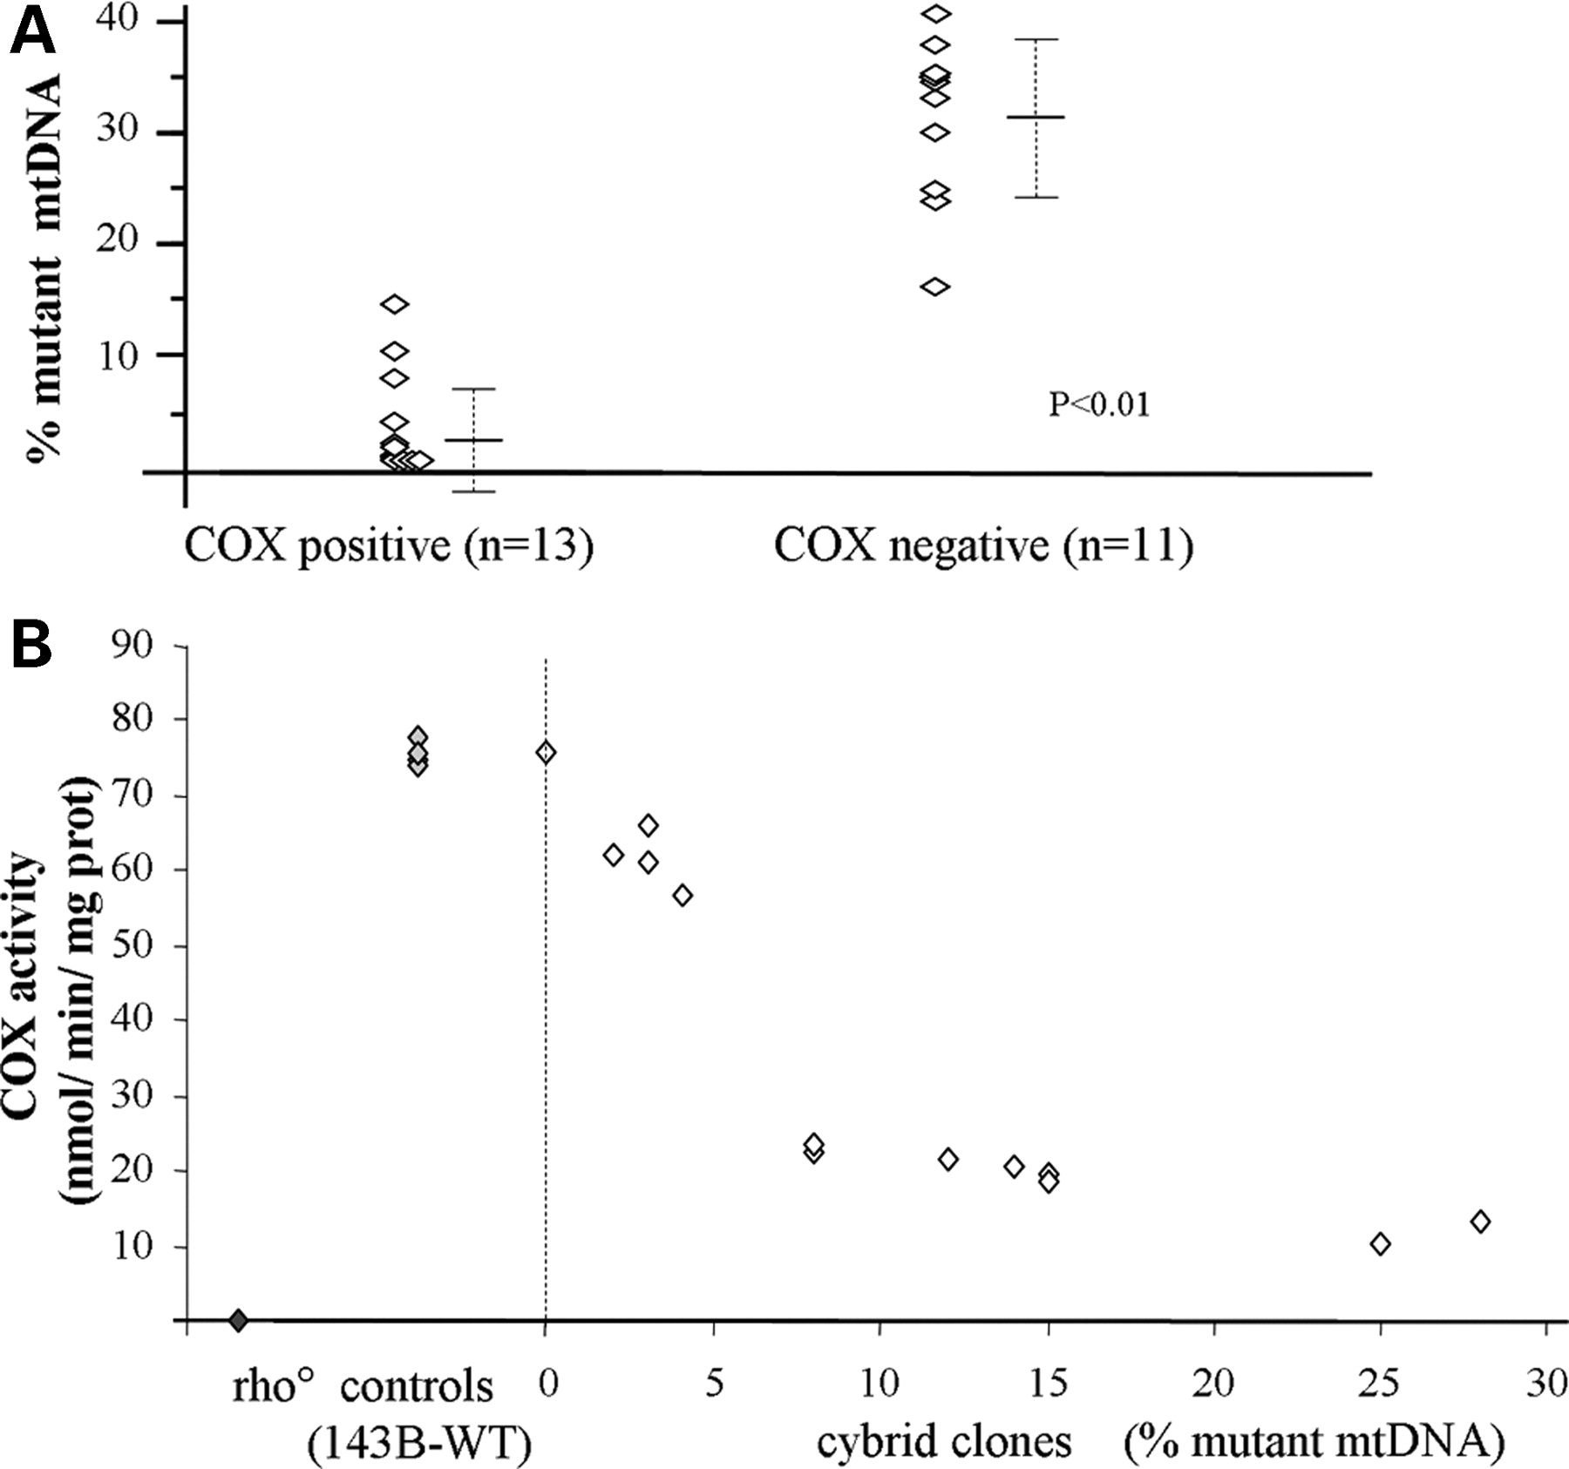
Figure 3. (A) Distribution of the C5545T mutation in COX-positive and COX-negative muscle fibers. Quantification of ...
Notes:
Figure 3. (A) Distribution of the C5545T mutation in COX-positive and COX-negative muscle fibers. Quantification of mutant mtDNA was performed by single fiber muscle PCR–RFLP analysis. (B) Correlation between mutational load and COX activity in cybrid cell lines, compared with parental 143B and rho° cells. Measurments were performed in triplicates.
Unless provided in the caption above, the following copyright applies to the content of this slide: © The Author 2008. Published by Oxford University Press. All rights reserved. For Permissions, please email: journals.permissions@oxfordjournals.org

Slide 4
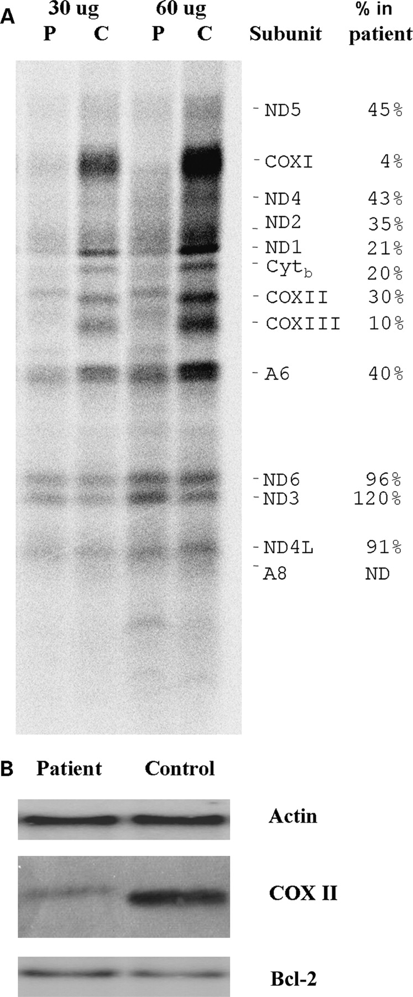
Figure 4. (A) In vivo³⁵S-labeling mitochondrial proteins of patient's fibroblast after blocking cytoplasmic ...
Notes:
Figure 4. (A) In vivo35S-labeling mitochondrial proteins of patient's fibroblast after blocking cytoplasmic protein synthesis with emetine (see Materials and Methods section in the text for details). Radiolabeled proteins were separated on a SDS–tris–glycine gel and visualized using a BioRad phosphor imager. The two sets of lanes represent two different amounts of protein from the same samples. P, patient, C, healthy control. (B) Equal amounts of unlabeled cellular extracts from patient and control fibroblasts were separated on a similar gel under the same conditions. After blotting, the membrane was probed with anti-COXII, anti-actin and anti-Bcl-2 antibodies.
Unless provided in the caption above, the following copyright applies to the content of this slide: © The Author 2008. Published by Oxford University Press. All rights reserved. For Permissions, please email: journals.permissions@oxfordjournals.org

