Slide 1
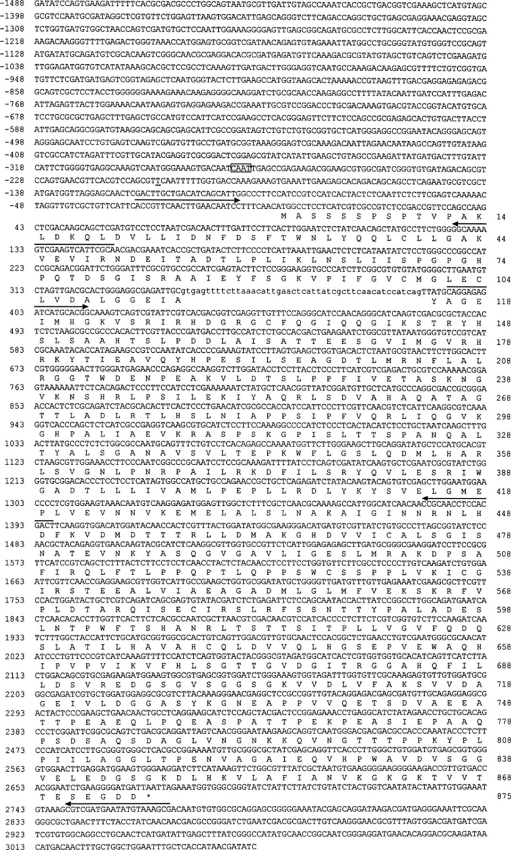
1 The complete nucleotide sequence of coding and flanking regions of F. velutipes TRP1 and the sequence of 875 ...
Notes:
1 The complete nucleotide sequence of coding and flanking regions of F. velutipes TRP1 and the sequence of 875 amino acid residues of the gene product. The position of intron is indicated by lower-case letters in the nucleotide sequence. The position of predicted transcription start point is indicated by a single-underline, the CAAT-box by a box, and the stop codon by an asterisk. Overlying arrows show the binding positions and directions of primers used. This sequence data will appear in DDBJ/EMBL/GenBank nucleotide sequence database with accession number AB028647.
Unless provided in the caption above, the following copyright applies to the content of this slide: © 2000 Federation of European Microbiological Societies

Slide 2
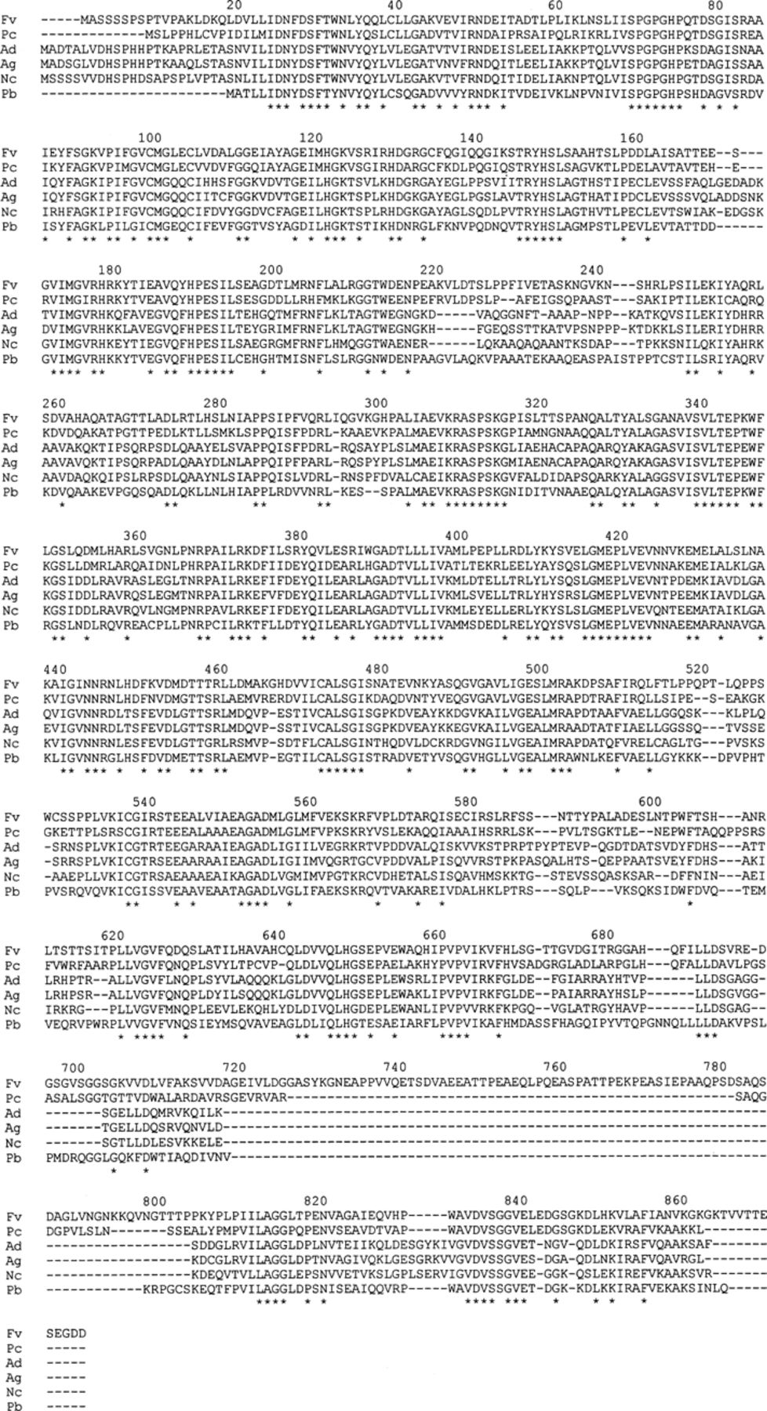
2 Comparison of the amino acid sequence deduced for the F. velutipes TRP1 protein with the corresponding ...
Notes:
2 Comparison of the amino acid sequence deduced for the F. velutipes TRP1 protein with the corresponding sequences from other filamentous fungi. Fv, F. velutipes TRP1; Pc, P. chrysosporium trpC; Ad, A. nidulans trpC; Ag, A. niger trpC; Nc, N. crassa trp-1; Pb, P. blakesleeanus trp1. Completely matched residues are indicated by asterisks.
Unless provided in the caption above, the following copyright applies to the content of this slide: © 2000 Federation of European Microbiological Societies

Slide 3
3 Comparison of the intron and flanking regions of F. velutipes TRP1 with those of P. chrysosporium trpC for ...
Notes:
3 Comparison of the intron and flanking regions of F. velutipes TRP1 with those of P. chrysosporium trpC for nucleotide and amino acid sequences. Identical residues are indicated by asterisks. Underlines represent a stop codon.
Unless provided in the caption above, the following copyright applies to the content of this slide: © 2000 Federation of European Microbiological Societies

Slide 4
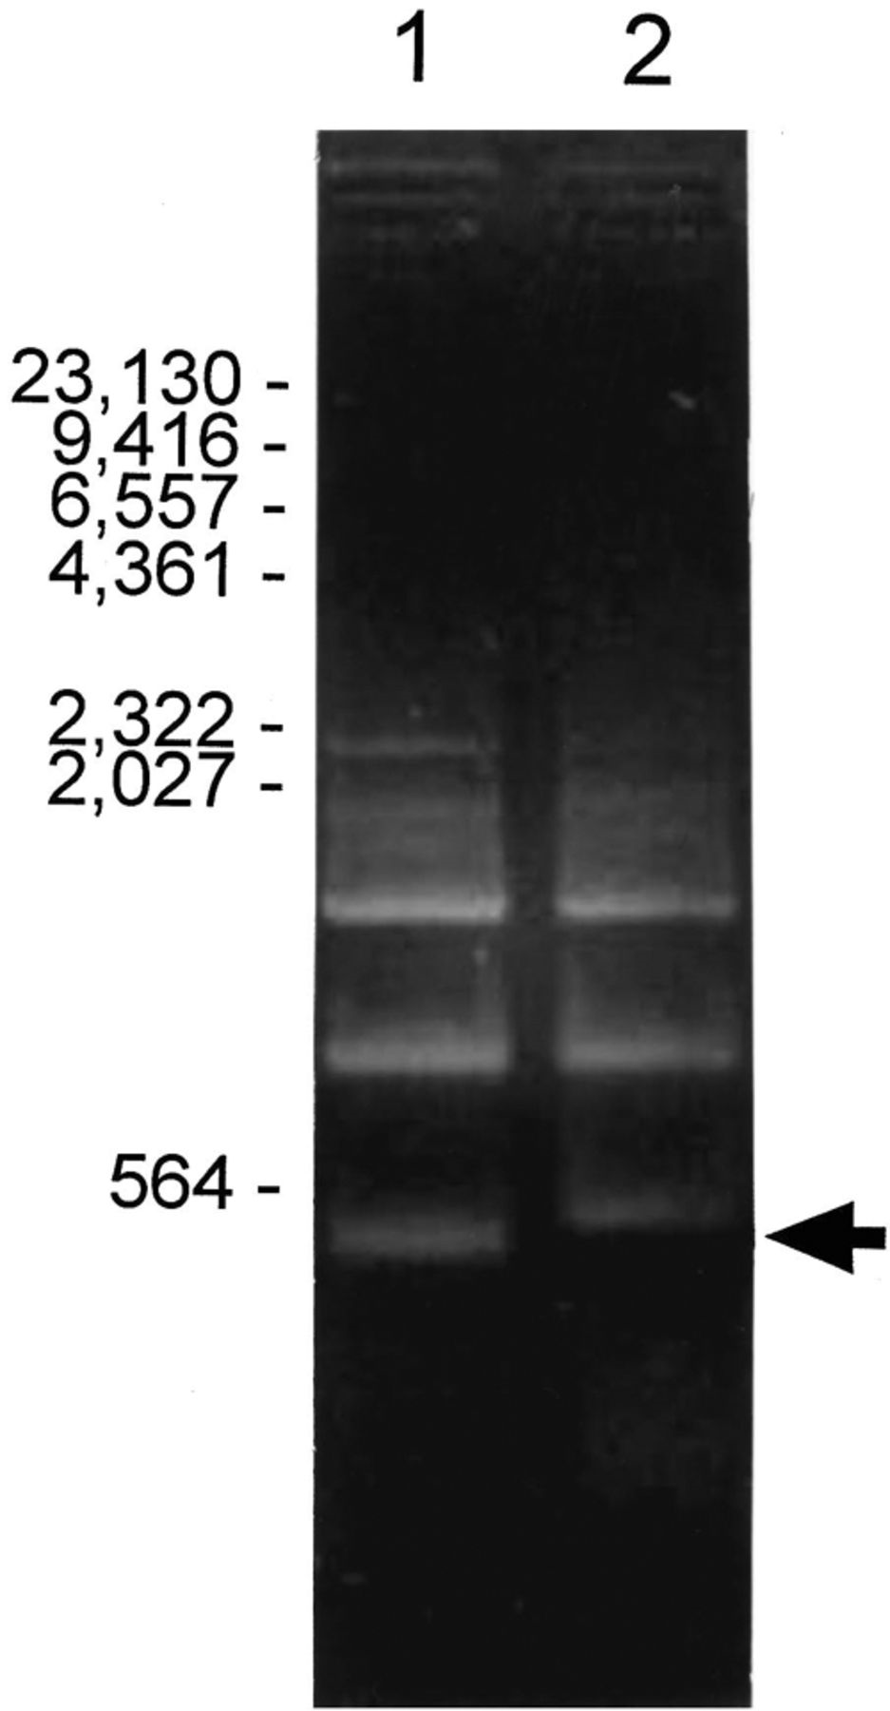
4 PCR analysis of the presumable intron of F. velutipes TRP1 gene. The SalI-digests of RT-PCR (lane 1) and ...
Notes:
4 PCR analysis of the presumable intron of F. velutipes TRP1 gene. The SalI-digests of RT-PCR (lane 1) and genomic-PCR (lane 2) products using T5′22S and T3′93A primers were loaded and separated on a 1.2% agarose gel. Arrow shows the DNA fragments differently migrated. The numbers to the left of figure indicate the molecular sizes (in base pairs).
Unless provided in the caption above, the following copyright applies to the content of this slide: © 2000 Federation of European Microbiological Societies

