Slide 1
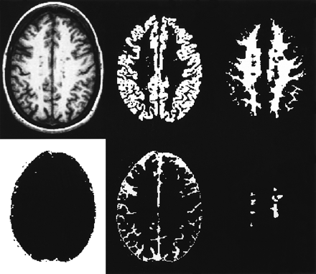
Fig. 1 Slices from a multiple sclerosis subject’s T₁‐weighted 3D FSPGR scan and the corresponding ...
Notes:
Fig. 1 Slices from a multiple sclerosis subject’s T1‐weighted 3D FSPGR scan and the corresponding segmentation masks derived from SPM99 and lesion contouring. Clockwise from top left: original 3D FSPGR image; GM mask; WM mask; lesion mask; CSF mask; and ‘other’ mask.
Unless provided in the caption above, the following copyright applies to the content of this slide:

Slide 2
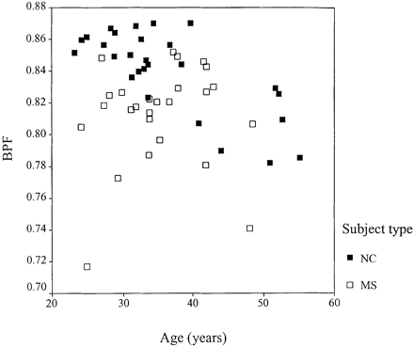
Fig. 2 BPF plotted against age for 27 control (NC) subjects and 26 subjects with multiple sclerosis (MS).
Notes:
Fig. 2 BPF plotted against age for 27 control (NC) subjects and 26 subjects with multiple sclerosis (MS).
Unless provided in the caption above, the following copyright applies to the content of this slide:

Slide 3
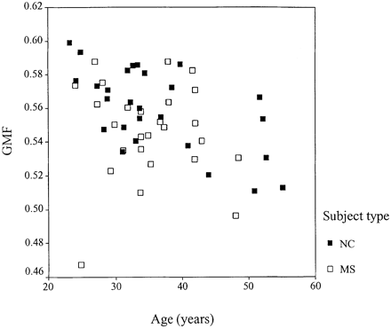
Fig. 3 GMF plotted against age for 27 control (NC) subjects and 26 subjects with multiple sclerosis (MS).
Notes:
Fig. 3 GMF plotted against age for 27 control (NC) subjects and 26 subjects with multiple sclerosis (MS).
Unless provided in the caption above, the following copyright applies to the content of this slide:

Slide 4
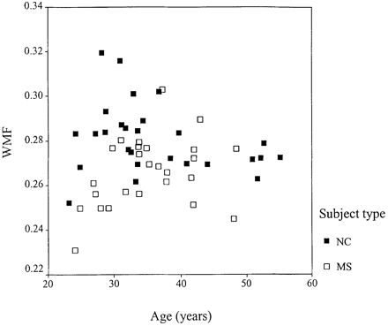
Fig. 4 WMF plotted against age in 27 control (NC) subjects and 26 subjects with multiple sclerosis (MS).
Notes:
Fig. 4 WMF plotted against age in 27 control (NC) subjects and 26 subjects with multiple sclerosis (MS).
Unless provided in the caption above, the following copyright applies to the content of this slide:

Slide 5
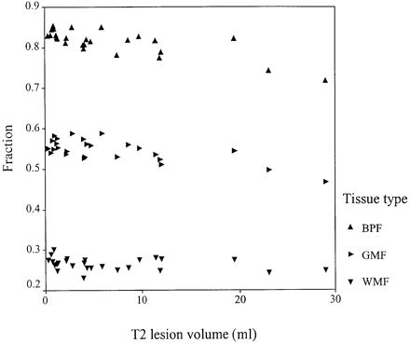
Fig. 5 BPF, GMF and WMF plotted against T₂ lesion volume (ml) for subjects with multiple ...
Notes:
Fig. 5 BPF, GMF and WMF plotted against T2 lesion volume (ml) for subjects with multiple sclerosis.
Unless provided in the caption above, the following copyright applies to the content of this slide:

