Slide 1
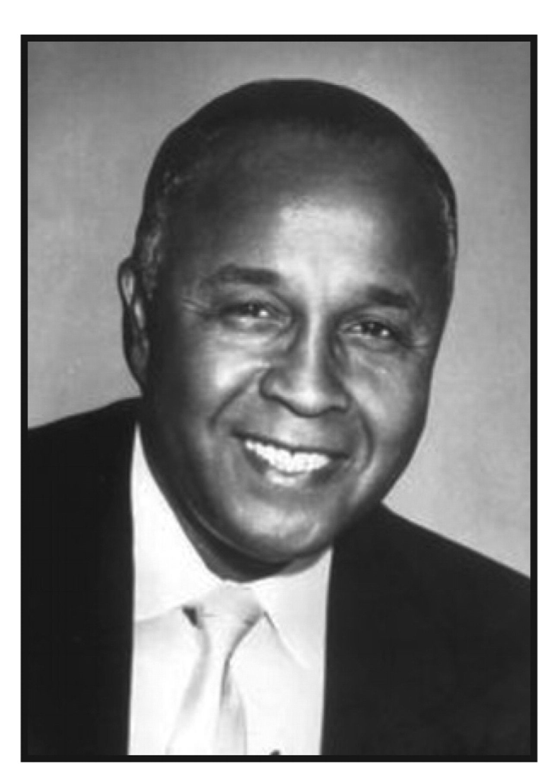
Percy Lavon Julian (1899–1975)
Notes:
Percy Lavon Julian (1899–1975)
Unless provided in the caption above, the following copyright applies to the content of this slide: © American Society of Clinical Pathologists

Slide 2
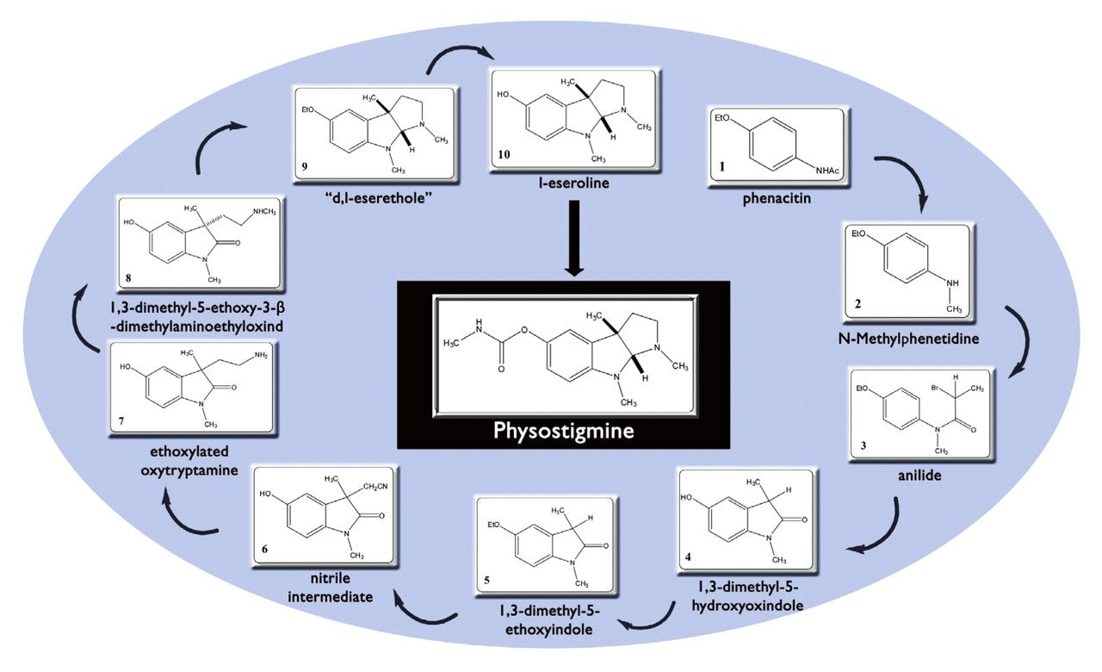
Figure 1 Overview of Dr. Julian’s complete synthesis of physostigmine. Considered a milestone, in 1999 the American ...
Notes:
Figure 1 Overview of Dr. Julian’s complete synthesis of physostigmine. Considered a milestone, in 1999 the American Chemical Society recognized Dr. Julian’s synthesis of the glaucoma drug physostigmine as 1 of the top 25 achievements in the history of American chemistry. This represents a “total synthesis”; that is, an assembly of a complex compound from basic intermediates. Compound 9 represents formation of d,l-eserethole, a key intermediate needed for the successful synthesis of physostigmine.6
Unless provided in the caption above, the following copyright applies to the content of this slide: © American Society of Clinical Pathologists

Slide 3
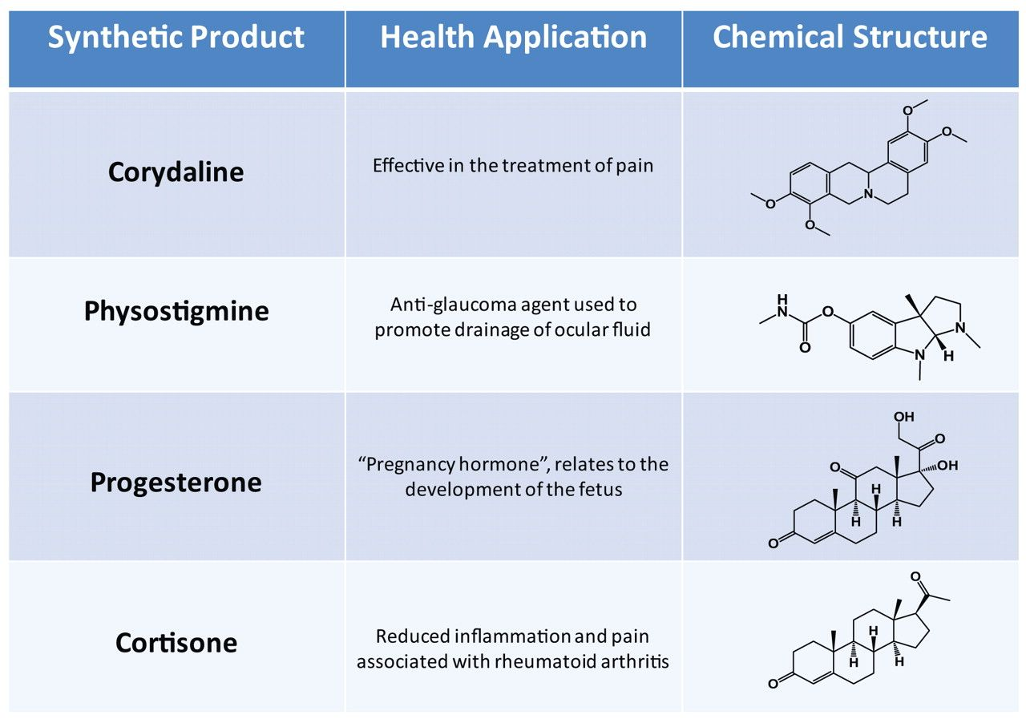
Figure 2 Synthetic pharmacological agents industrially produced by use of the syntheses generated by Dr. Julian. ...
Notes:
Figure 2 Synthetic pharmacological agents industrially produced by use of the syntheses generated by Dr. Julian. Corydaline and physostigmine are plant alkaloids Dr. Julian derived from the Austrian Corydalis cava and the West African Calabar bean Physostigma venenosum, respectively. Corydaline has been used to treat pain, while physostigmine was developed to treat glaucoma. Physostigmine’s parasympathomimetic activity inhibits the metabolism of acetylcholine, thereby promoting the drainage of ocular fluid. Dr. Julian subsequently developed the chemistry to synthesize progesterone from soybeans on an industrial scale, making his company the first to make sex hormones commercially available in the United States. Its wide application in medicine has been significant in many fields. Dr. Julian also helped develop the first mass production of cortisone from soybeans, a steroid hormone used to suppress the immune system in autoimmune diseases.
Unless provided in the caption above, the following copyright applies to the content of this slide: © American Society of Clinical Pathologists

