Slide 1
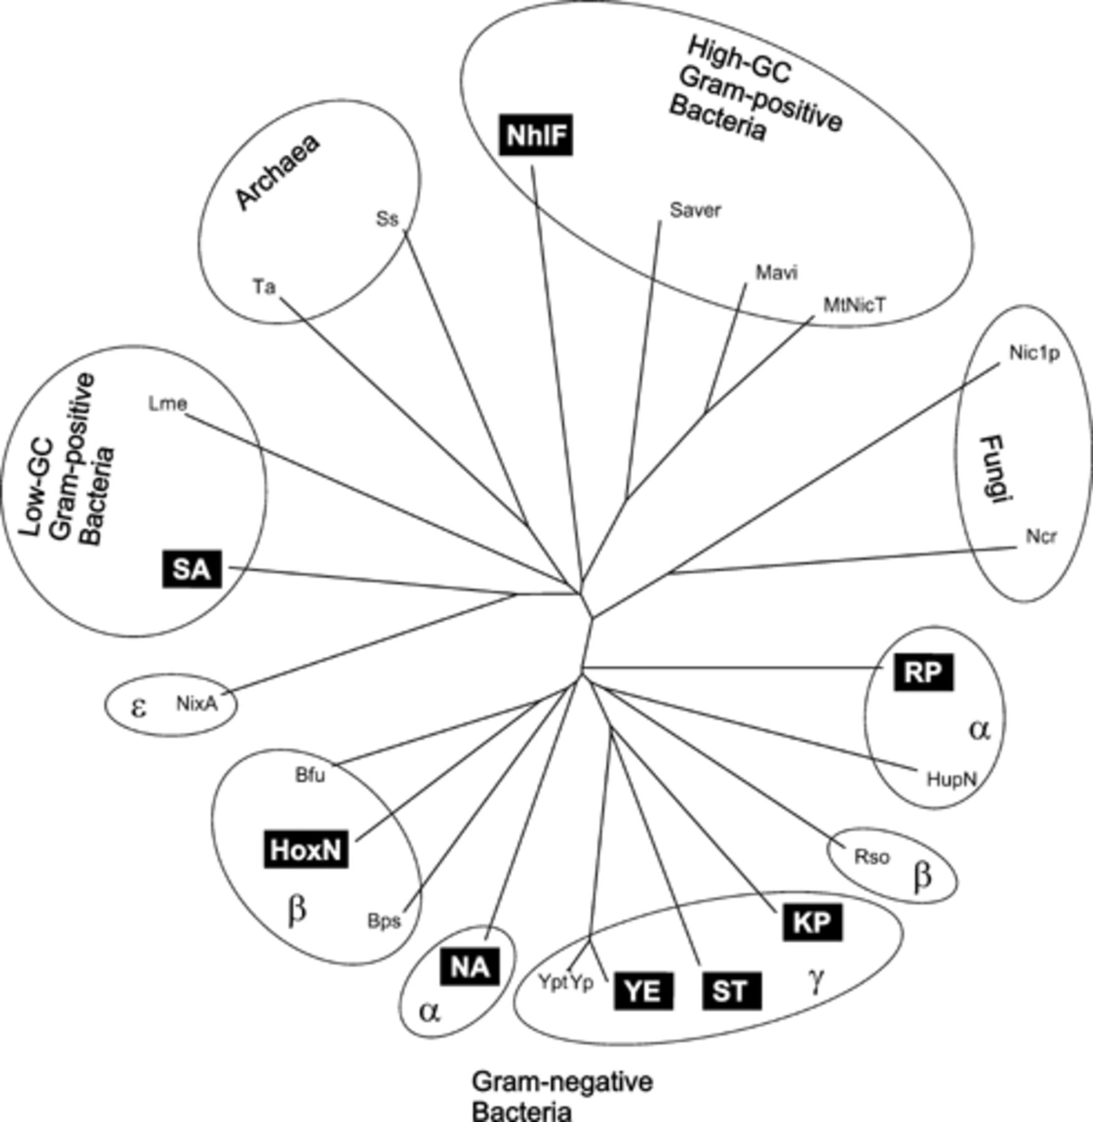
3 Dendrogram of NiCoTs from bacteria, archaea, and fungi. Permeases investigated in this study are boxed. Bfu, ...
Notes:
3 Dendrogram of NiCoTs from bacteria, archaea, and fungi. Permeases investigated in this study are boxed. Bfu, Burkholderia fungorum; Bps, Burkholderia pseudomallei; HoxN, Ralstonia eutropha; HupN, Bradyrhizobium japonicum; KP, Klebsiella pneumoniae; Lme, Leuconostoc mesenteroides; Mavi, Mycobacterium avium; MtNicT, Mycobacterium tuberculosis; NA, Novosphingobium aromaticivorans; Ncr, Neurospora crassa; NhlF, Rhodococcus rhodochrous; Nic1p, Schizosaccharomyces pombe; NixA, Helicobacter pylori; RP, Rhodopseudomonas palustris; Rso, Ralstonia solanacearum; SA, Staphylococcus aureus; Saver, Streptomyces avermitilis; Ss, Sulfolobus solfataricus; ST, Salmonella typhimurium; TA, Thermoplasma acidophilum; YE, Yersinia enterocolitica; Yp, Yersinia pestis; Ypt, Yersinia pseudotuberculosis. The greek letters indicate subgroups of the proteobacteria.
Unless provided in the caption above, the following copyright applies to the content of this slide: © 2003 Federation of European Microbiological Societies

Slide 2
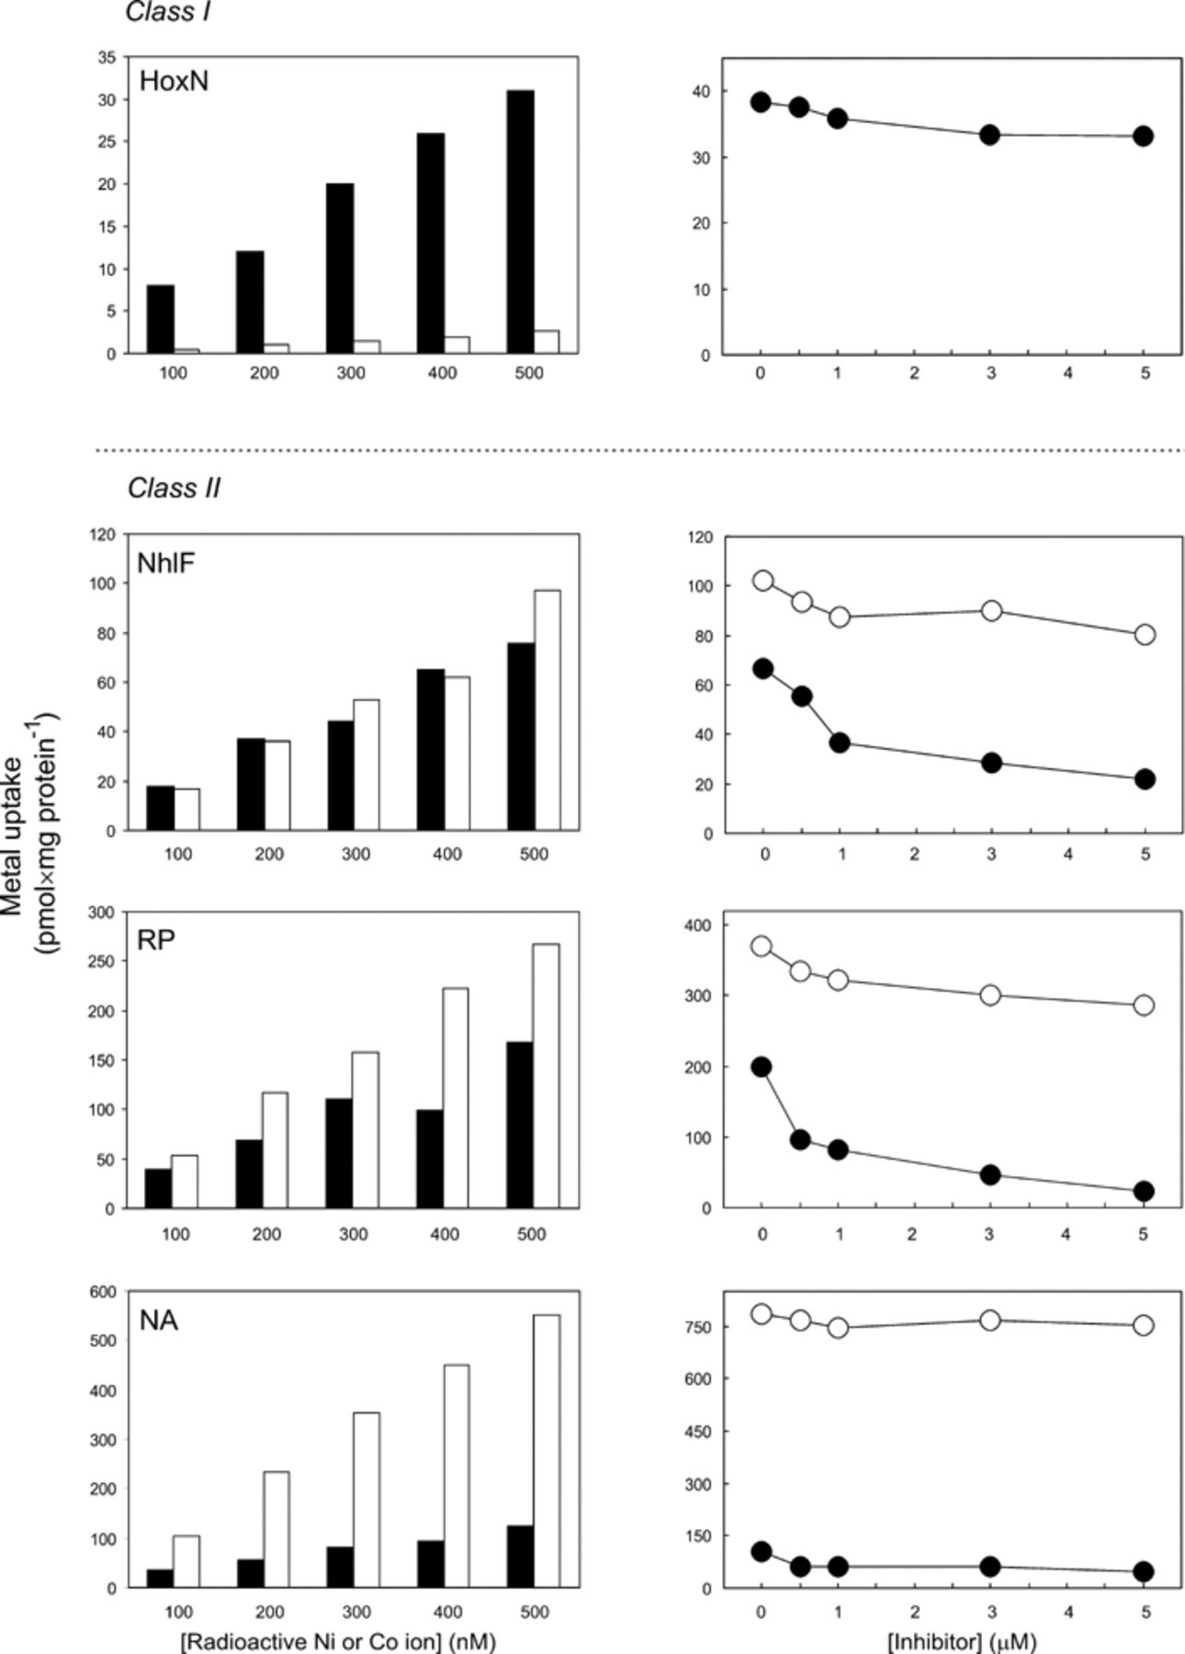
1 Selective metal uptake. ⁶³Ni²⁺ (black bars and black circles) and ...
Notes:
1 Selective metal uptake. 63Ni2+ (black bars and black circles) and 57Co2+ (open bars and open circles) accumulation of recombinant E. coli expressing bacterial NiCoT genes. NiCoTs other than HoxN and NhlF are identified by the first letters of the genus and species name of their source. Left panels: Concentration-dependent accumulation. Radiolabeled ions were supplied at concentrations between 100 and 500 nM. Right panels. Effect of cold Co2+ on 63Ni2+ accumulation (black circles) and of cold Ni2+ on 57Co2+ accumulation (open circles). The concentration of labeled ions was 500 nM. Non-labeled metal chlorides were added as indicated. 57Co2+ accumulation of the HoxN-producing strain was in the range of background activity (below 3 pmol mg protein−1). Based on selectivity the permeases were grouped in class I (specific for nickel), class II (preference for cobalt) and class III (preference for nickel).
Unless provided in the caption above, the following copyright applies to the content of this slide: © 2003 Federation of European Microbiological Societies

Slide 3
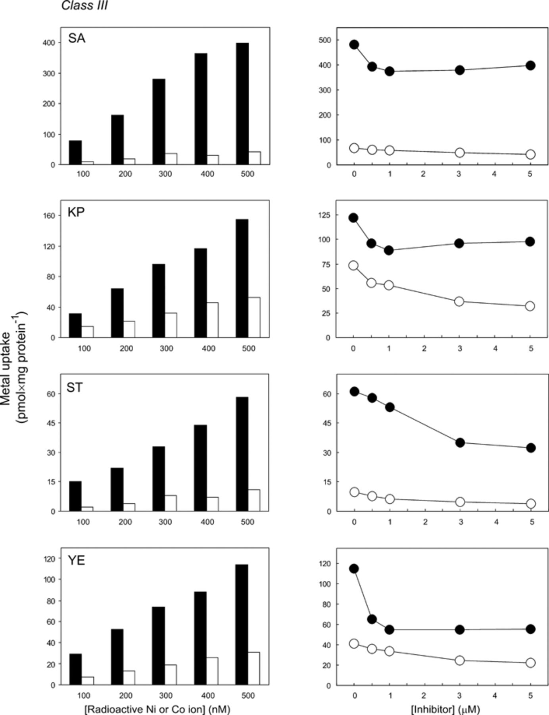
1 Selective metal uptake. ⁶³Ni²⁺ (black bars and black circles) and ...
Notes:
1 Selective metal uptake. 63Ni2+ (black bars and black circles) and 57Co2+ (open bars and open circles) accumulation of recombinant E. coli expressing bacterial NiCoT genes. NiCoTs other than HoxN and NhlF are identified by the first letters of the genus and species name of their source. Left panels: Concentration-dependent accumulation. Radiolabeled ions were supplied at concentrations between 100 and 500 nM. Right panels. Effect of cold Co2+ on 63Ni2+ accumulation (black circles) and of cold Ni2+ on 57Co2+ accumulation (open circles). The concentration of labeled ions was 500 nM. Non-labeled metal chlorides were added as indicated. 57Co2+ accumulation of the HoxN-producing strain was in the range of background activity (below 3 pmol mg protein−1). Based on selectivity the permeases were grouped in class I (specific for nickel), class II (preference for cobalt) and class III (preference for nickel).
Unless provided in the caption above, the following copyright applies to the content of this slide: © 2003 Federation of European Microbiological Societies

Slide 4
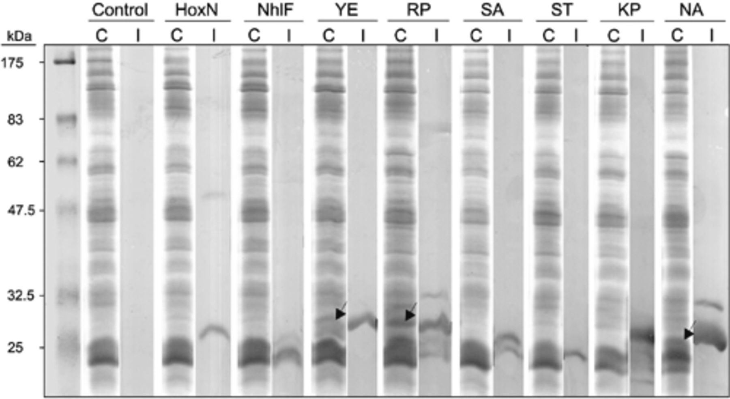
2 Detection of recombinant NiCoTs after sodium dodecylsulfate–polyacrylamide gel electrophoresis (SDS–PAGE) and ...
Notes:
2 Detection of recombinant NiCoTs after sodium dodecylsulfate–polyacrylamide gel electrophoresis (SDS–PAGE) and immunoblotting. Membrane protein (approximately 65 μg for Coomassie staining and 52 μg for immunoblotting) of recombinant strains and a control strain containing an empty vector, solubilized with lithium dodecylsulfate on ice in the presence of protease inhibitors, was separated by SDS–PAGE on 10% gels. One gel was stained with Coomassie blue, the other was electroblotted onto a nitrocellulose membrane. The blot was cut in strips and stained with 5-bromo-4-chloro-3-indolyl phosphate and nitro blue tetrazolium chloride after treatment with a conjugate of monoclonal anti-FLAG M2 antibody and alkaline phosphatase (Sigma). The strips were developed for various times depending on the strength of the signals. Arrows indicate dominant bands in the stained gel, which presumably represent main portions of YE, RP and NA, respectively. Multiple bands detected by immunoblotting of NhlF, RP, SA, KP and NA may be due to incomplete denaturation by dodecylsulfate or/and partial proteolysis. C, Coomassie-stained gel; I, immunoblot.
Unless provided in the caption above, the following copyright applies to the content of this slide: © 2003 Federation of European Microbiological Societies

