Slide 1
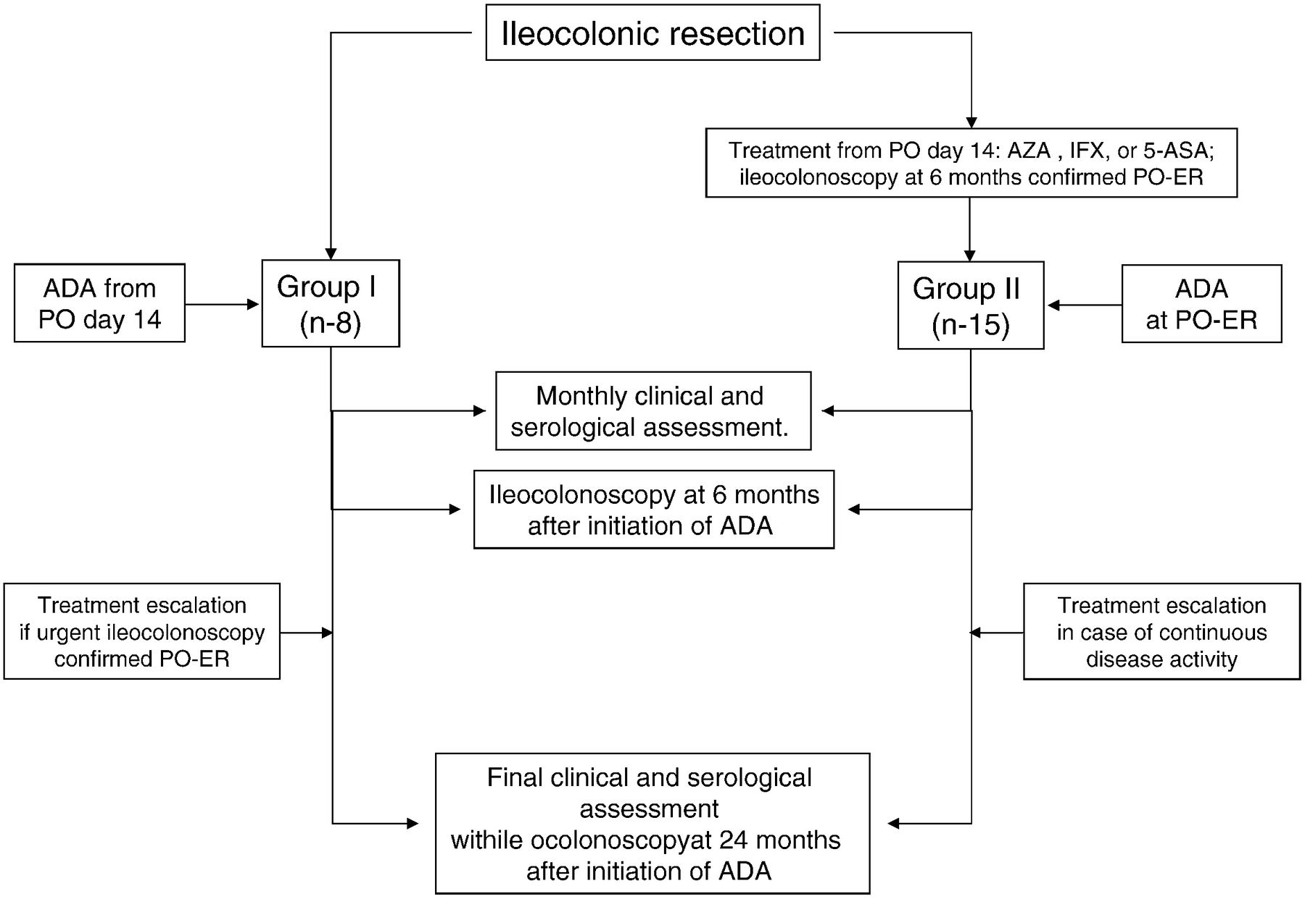
Figure 1 Flow-chart of patients treated with adalimumab to prevent (Group I) and heal (Group II) post-operative ...
Notes:
Figure 1 Flow-chart of patients treated with adalimumab to prevent (Group I) and heal (Group II) post-operative recurrence of Crohn's disease. ADA: adalimumab; 5-ASA: 5-aminosalicylic acid; AZA: azathioprine; IFX: infliximab; PO: post-operative; PO-ER: post-operative endoscopic recurrence.
Unless provided in the caption above, the following copyright applies to the content of this slide: © 2012 European Crohn's and Colitis Organisation

Slide 2
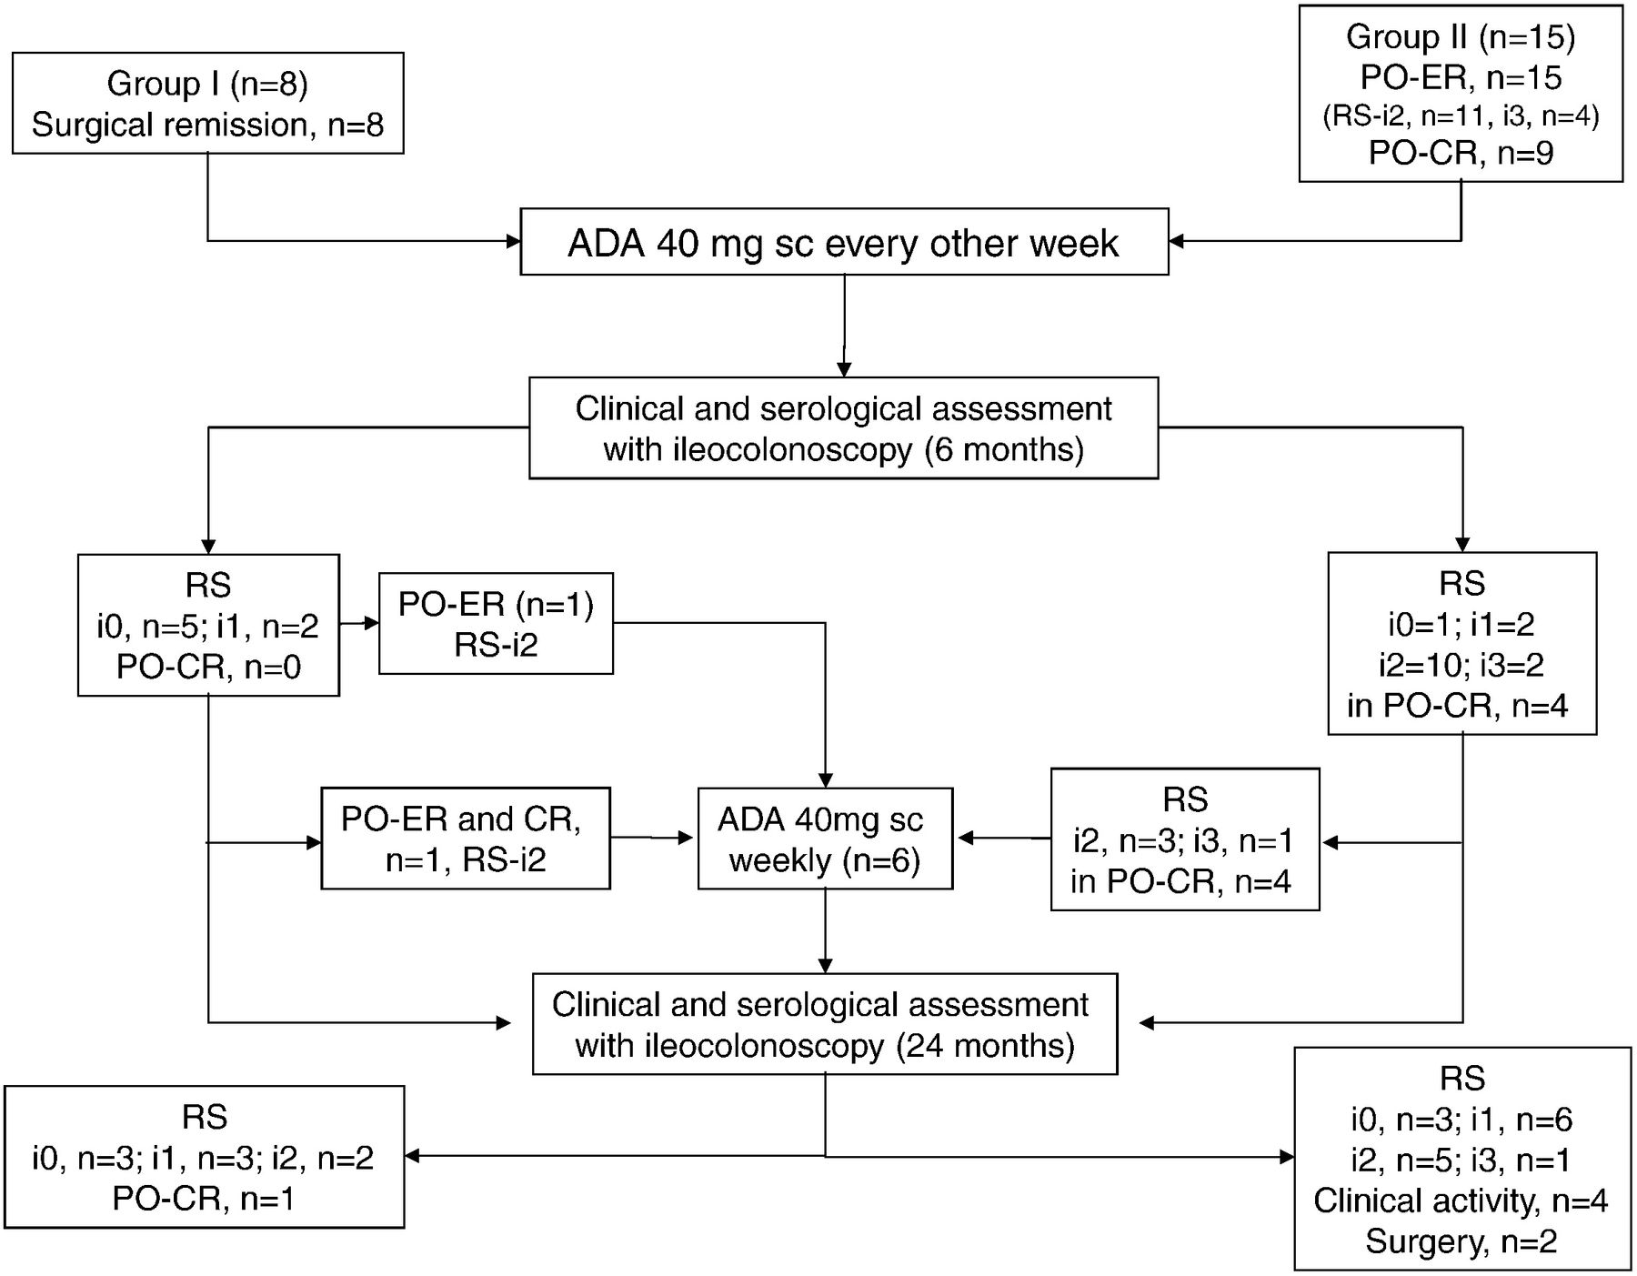
Figure 2 Flow-chart of outcome of treatment with adalimumab for the prevention (Group I) and treatment (Group II) of ...
Notes:
Figure 2 Flow-chart of outcome of treatment with adalimumab for the prevention (Group I) and treatment (Group II) of post-operative recurrence of Crohn's disease. ADA: adalimumab; sc: subcutaneously; RS: Rutgeerts score; i: ileal; PO-ER: post-operative endoscopic recurrence; PO-CR: post-operative clinical recurrence.
Unless provided in the caption above, the following copyright applies to the content of this slide: © 2012 European Crohn's and Colitis Organisation

