Slide 1
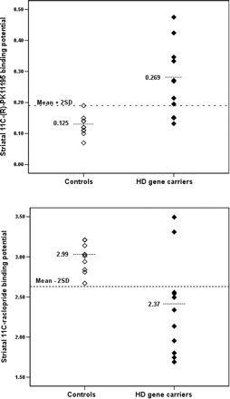
Fig. 1 Scatterplots showing the (A) striatal ¹¹C-(R)-PK11195 and (B) striatal ¹¹C-raclopride ...
Notes:
Fig. 1 Scatterplots showing the (A) striatal 11C-(R)-PK11195 and (B) striatal 11C-raclopride binding potential of presymptomatic Huntington's disease gene carriers and healthy controls. Three gene carriers had striatal 11C-(R)-PK11195 binding potentials and two gene carriers had striatal 11C-raclopride binding potentials within 2 standard deviations (SD) of controls’ mean. The short dotted lines indicate group means, and the long dotted lines indicate mean ± 2 standard deviations thresholds.
Unless provided in the caption above, the following copyright applies to the content of this slide: © The Author (2007). Published by Oxford University Press on behalf of the Guarantors of Brain. All rights reserved. For Permissions, please email: journals.permissions@oxfordjournals.org

Slide 2
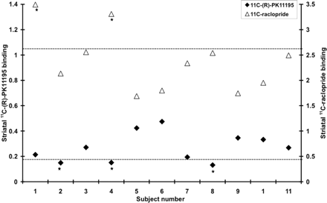
Fig. 2 The figure shows individual Huntington's disease gene carriers’ striatal ¹¹C-(R)-PK11195 (PK) and ...
Notes:
Fig. 2 The figure shows individual Huntington's disease gene carriers’ striatal 11C-(R)-PK11195 (PK) and 11C-raclopride (RAC) binding potentials. The dotted horizontal lines show the controls' mean − 2SD threshold (top) for RAC binding and mean + 2SD threshold (below) for PK binding. * = subjects with normal PK/RAC binding. Subjects 2, 4 and 8 had normal striatal PK binding, whilst subjects 1 and 4 had normal striatal RAC binding.
Unless provided in the caption above, the following copyright applies to the content of this slide: © The Author (2007). Published by Oxford University Press on behalf of the Guarantors of Brain. All rights reserved. For Permissions, please email: journals.permissions@oxfordjournals.org

Slide 3
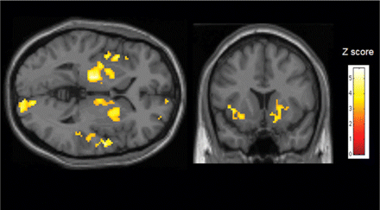
Fig. 3 A statistical parametric mapping (SPM) showing cortical and subcortical areas of significantly raised mean ...
Notes:
Fig. 3 A statistical parametric mapping (SPM) showing cortical and subcortical areas of significantly raised mean 11C-(R)-PK11195 binding in presymptomatic Huntington's disease gene carriers compared to controls (P < 0.05 corrected across whole brain). Transaxial (z = 1.5) and coronal (y = 13) projections were superimposed on the single-subject T1 MRI template.
Unless provided in the caption above, the following copyright applies to the content of this slide: © The Author (2007). Published by Oxford University Press on behalf of the Guarantors of Brain. All rights reserved. For Permissions, please email: journals.permissions@oxfordjournals.org

Slide 4
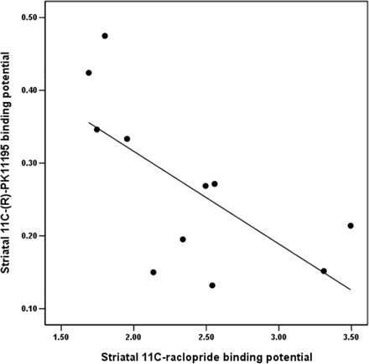
Fig. 4 Figure showing significant correlation between Huntington's disease gene carriers’ striatal ...
Notes:
Fig. 4 Figure showing significant correlation between Huntington's disease gene carriers’ striatal 11C-(R)-PK11195 and 11C-raclopride binding (ρ = − 0.65, P = 0.03).
Unless provided in the caption above, the following copyright applies to the content of this slide: © The Author (2007). Published by Oxford University Press on behalf of the Guarantors of Brain. All rights reserved. For Permissions, please email: journals.permissions@oxfordjournals.org

Slide 5
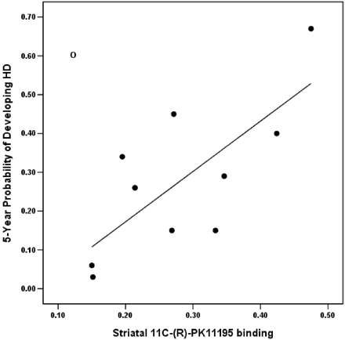
Fig. 5 Figure showing significant correlation between striatal ¹¹C-(R)-PK11195 binding of Huntington's ...
Notes:
Fig. 5 Figure showing significant correlation between striatal 11C-(R)-PK11195 binding of Huntington's disease gene carriers and their predicted 5-year probability of developing Huntington's disease (ρ = 0.71, P = 0.02) after excluding a subject (open circle) who had been taking high dose creatine, and was an outlier in this correlation.
Unless provided in the caption above, the following copyright applies to the content of this slide: © The Author (2007). Published by Oxford University Press on behalf of the Guarantors of Brain. All rights reserved. For Permissions, please email: journals.permissions@oxfordjournals.org

