Slide 1
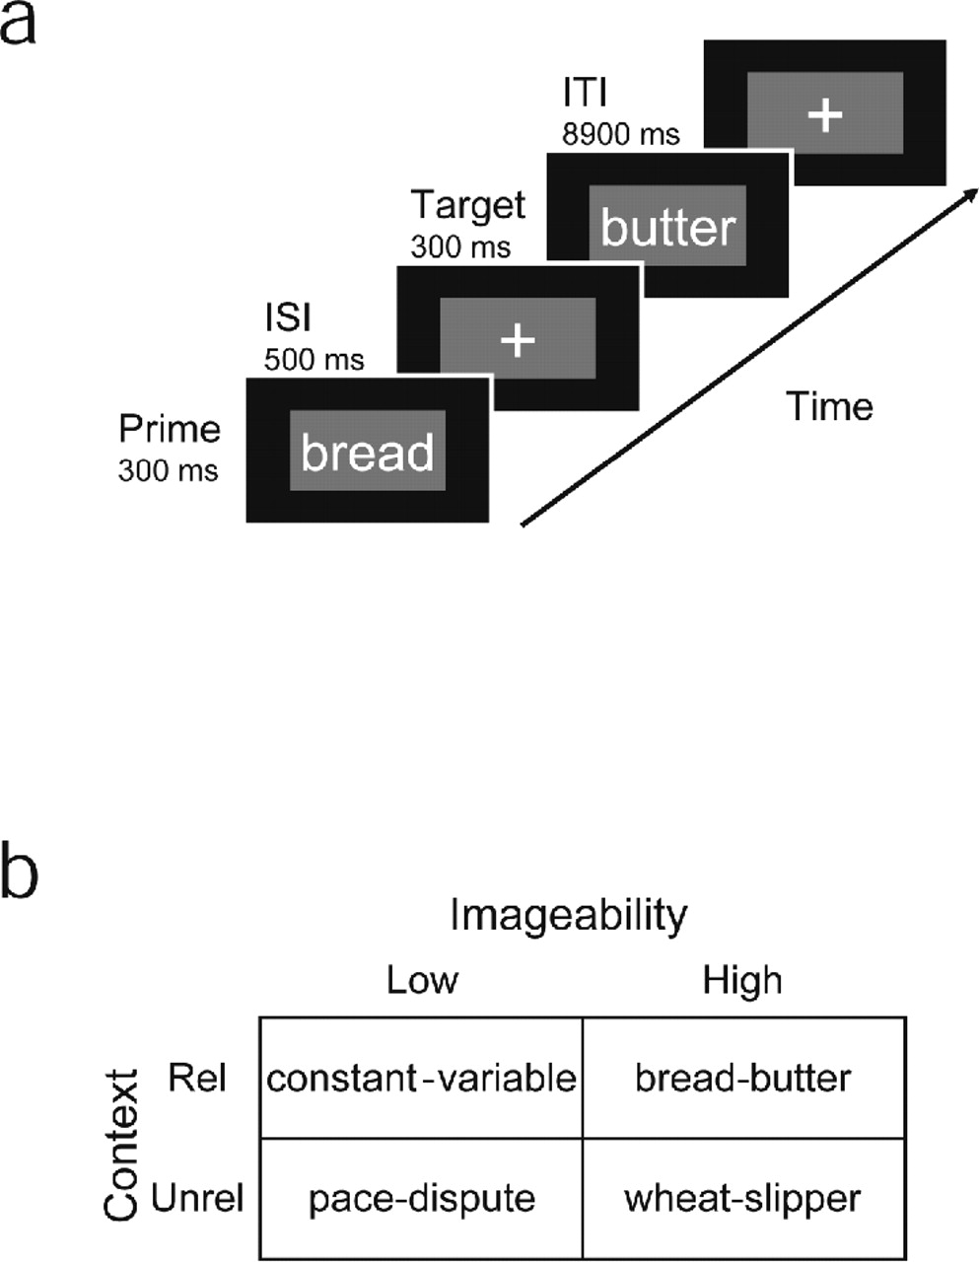
Figure 1. Priming task. (A) A schematic representation of the trial sequence. (B) Examples of the factorial ...
Notes:
Figure 1. Priming task. (A) A schematic representation of the trial sequence. (B) Examples of the factorial combination of prime–target contextual (Related or Unrelated) relationship and imageability (Low and High).
Unless provided in the caption above, the following copyright applies to the content of this slide:

Slide 2
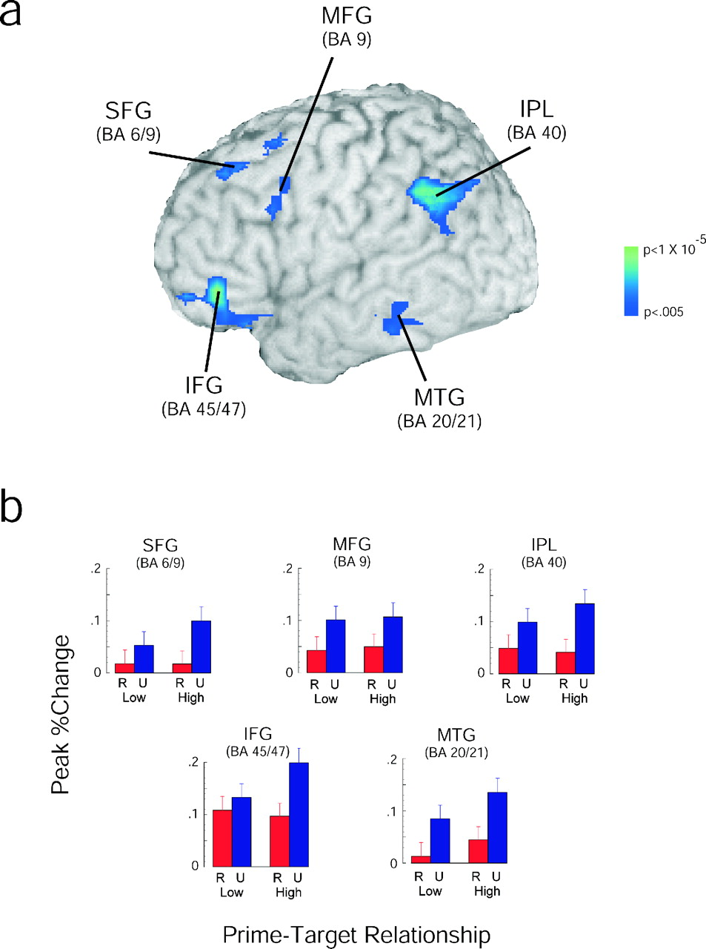
Figure 2. Results of context manipulation. (A) Areas that were significantly more active on unrelated than on ...
Notes:
Figure 2. Results of context manipulation. (A) Areas that were significantly more active on unrelated than on related trials are overlaid onto a 3-D rendering of a single subject’s high resolution anatomical image. These regions were significantly activated at the fixed and random effects levels (see Methods). Color bar represents P-value of fixed-effects analysis. See Table 1 for statistics for random effects analysis. (B) Averaged peak per cent signal change in each of the regions shown in A shown as a function of prime–target relationship, i.e. imageability (High/Low) and relatedness (Related/Unrelated). Error bars represent standard error of the mean. Abbreviations are as in Table 1.
Unless provided in the caption above, the following copyright applies to the content of this slide:

Slide 3
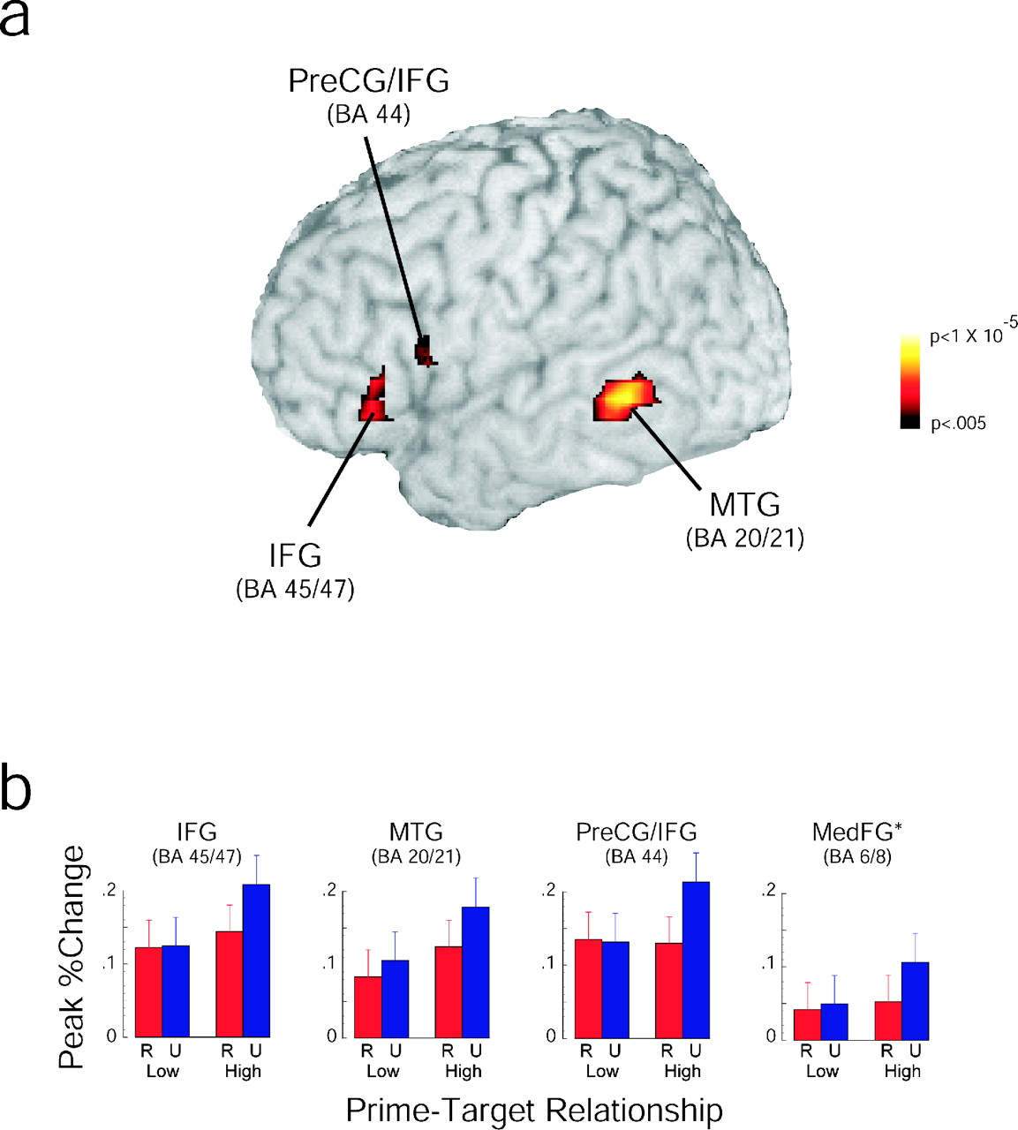
Figure 3. Results of imageability manipulation. (A) Areas that were significantly more active on high ...
Notes:
Figure 3. Results of imageability manipulation. (A) Areas that were significantly more active on high imageable than low imageable trials are overlaid onto a 3-D rendering of a single subject’s high resolution anatomical image. These regions were significantly activated at the fixed and random effects levels (see Methods). Color bar represents P-value of fixed-effects analysis. See Table 2 for statistics for random effects analysis. (B) Averaged peak per cent signal change in each of the regions shown in A shown as a function of prime–target relationship, i.e. imageability (High/Low) and relatedness (Related/Unrelated). *Activation not shown in Panel A. Error bars represent standard error of the mean. Abbreviations are as in Tables 1 and 2.
Unless provided in the caption above, the following copyright applies to the content of this slide:

Slide 4
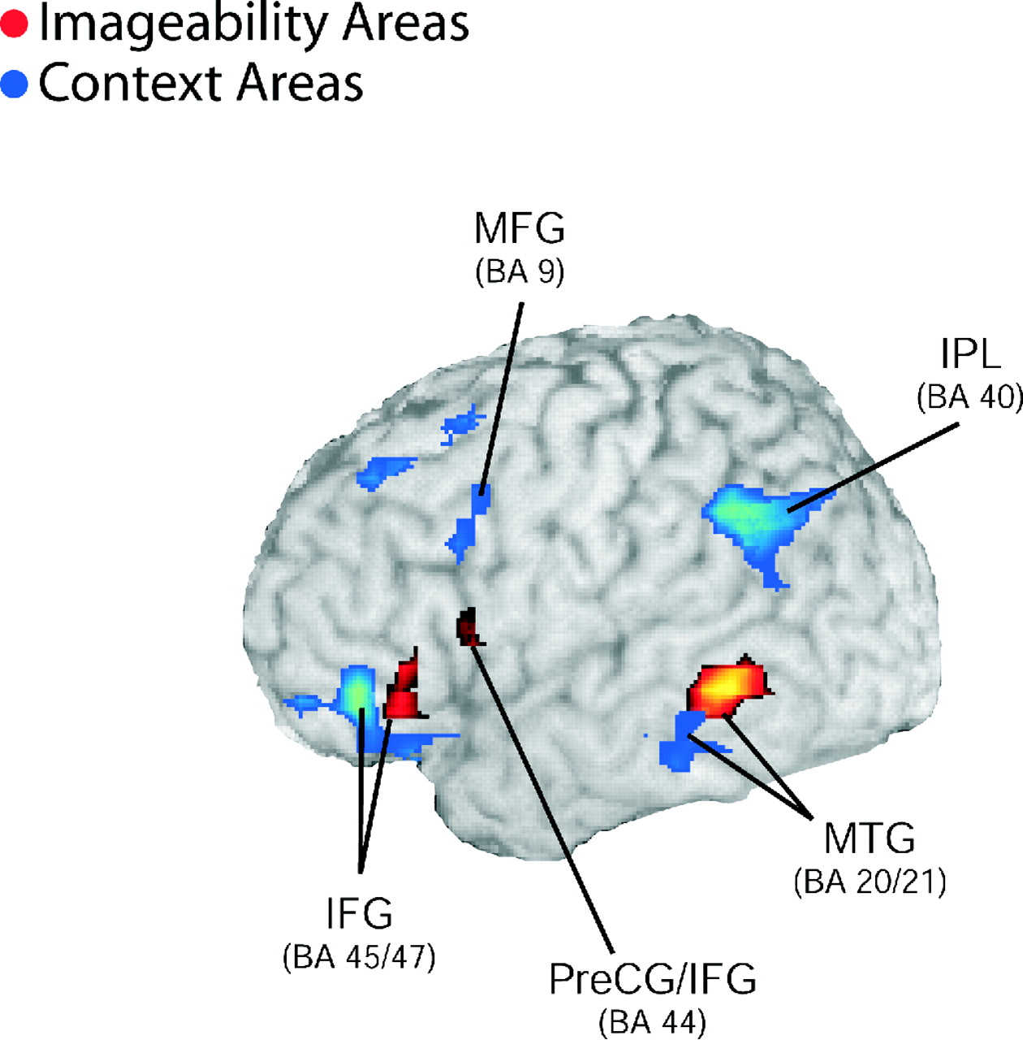
Figure 4. Combined results. Shown are the data from Figure 2 and Figure 3 overlaid onto a 3-D rendering of a ...
Notes:
Figure 4. Combined results. Shown are the data from Figure 2 and Figure 3 overlaid onto a 3-D rendering of a single subject’s high resolution anatomical image. Areas showing effects of priming/context are shown in blue and areas showing effects of imageability are shown in red. Abbreviations are as in Tables 1 and 2.
Unless provided in the caption above, the following copyright applies to the content of this slide:

