Slide 1
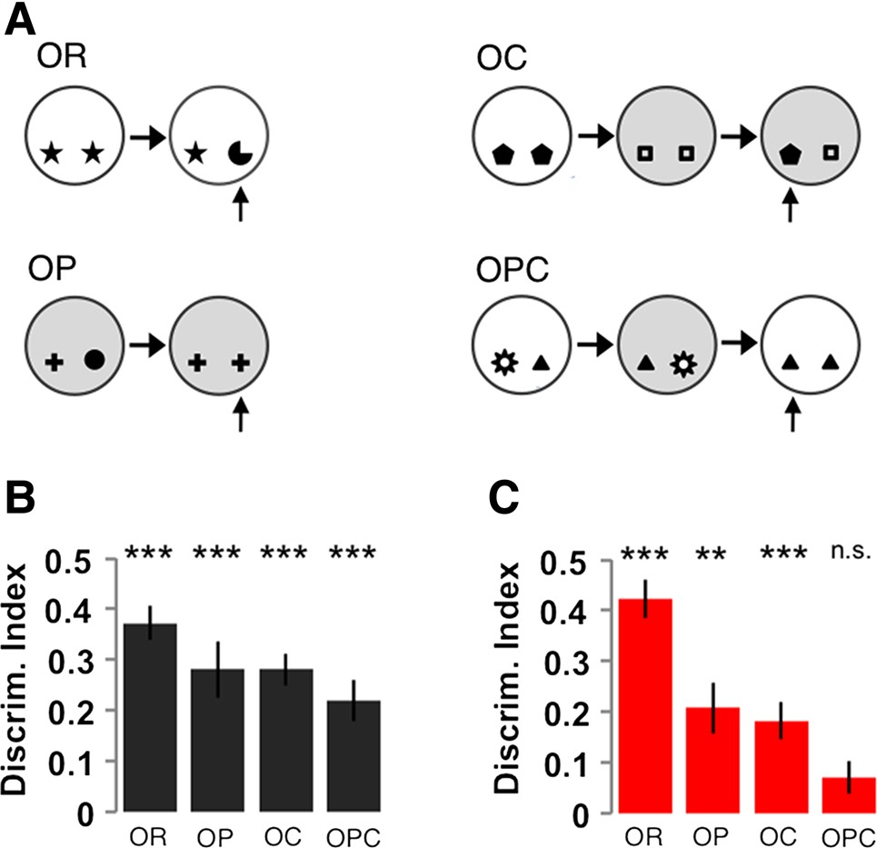
Figure 6. Loss of FMRP results in impaired performance on a hippocampus-dependent novelty preference task. (A) A ...
Notes:
Figure 6. Loss of FMRP results in impaired performance on a hippocampus-dependent novelty preference task. (A) A schematic of the spontaneous exploration tasks for novelty preference. (B) WT rats exhibit memory for all four tasks as measured by above chance performance. (C) In contrast, Fmr1 KO rats do not perform above chance levels in an OPC task that requires the ability to form associations between objects, their locations and the context, but do exhibit memory for the individual components as measured by above chance performance in object recognition, object-place and object-context tasks.
Unless provided in the caption above, the following copyright applies to the content of this slide: © The Author 2015. Published by Oxford University PressThis is an Open Access article distributed under the terms of the Creative Commons Attribution Non-Commercial License (http://creativecommons.org/licenses/by-nc/4.0/), which permits non-commercial re-use, distribution, and reproduction in any medium, provided the original work is properly cited. For commercial re-use, please contact journals.permissions@oup.com

Slide 2
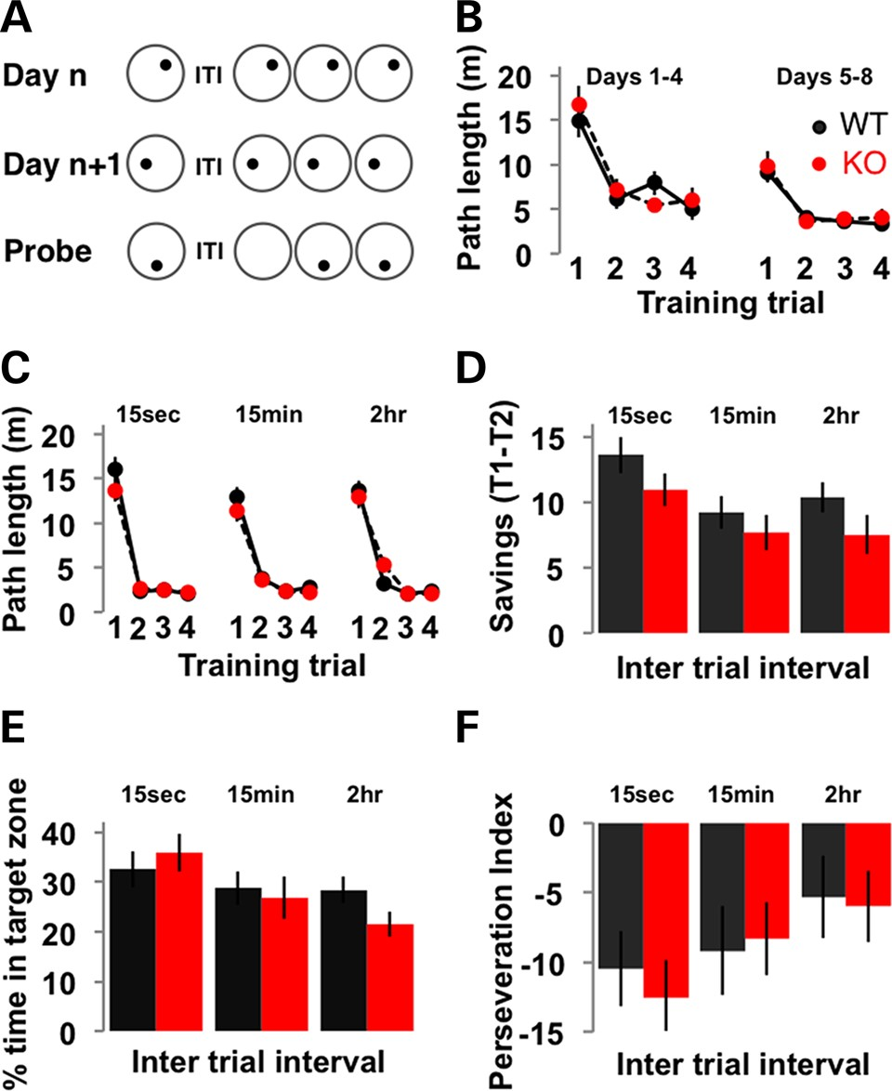
Figure 5. One-trial spatial learning is intact in Fmr1 KO rats. (A) A schematic of the DMP version of the water maze ...
Notes:
Figure 5. One-trial spatial learning is intact in Fmr1 KO rats. (A) A schematic of the DMP version of the water maze task. (B) Fmr1 KO rats learn the DMP task similarly to WT littermates as measured by a decrease in the path length taken to escape over trials within a day. Introducing a variable time delay between the first and second trials of the day does not affect performance of Fmr1 KO rats compared with WT as measured by path length to escape (C), savings (D), time spent searching in the target zone on probe trials (E) or perseveration around the location of the target on the previous day on probe trials (F).
Unless provided in the caption above, the following copyright applies to the content of this slide: © The Author 2015. Published by Oxford University PressThis is an Open Access article distributed under the terms of the Creative Commons Attribution Non-Commercial License (http://creativecommons.org/licenses/by-nc/4.0/), which permits non-commercial re-use, distribution, and reproduction in any medium, provided the original work is properly cited. For commercial re-use, please contact journals.permissions@oup.com

Slide 3
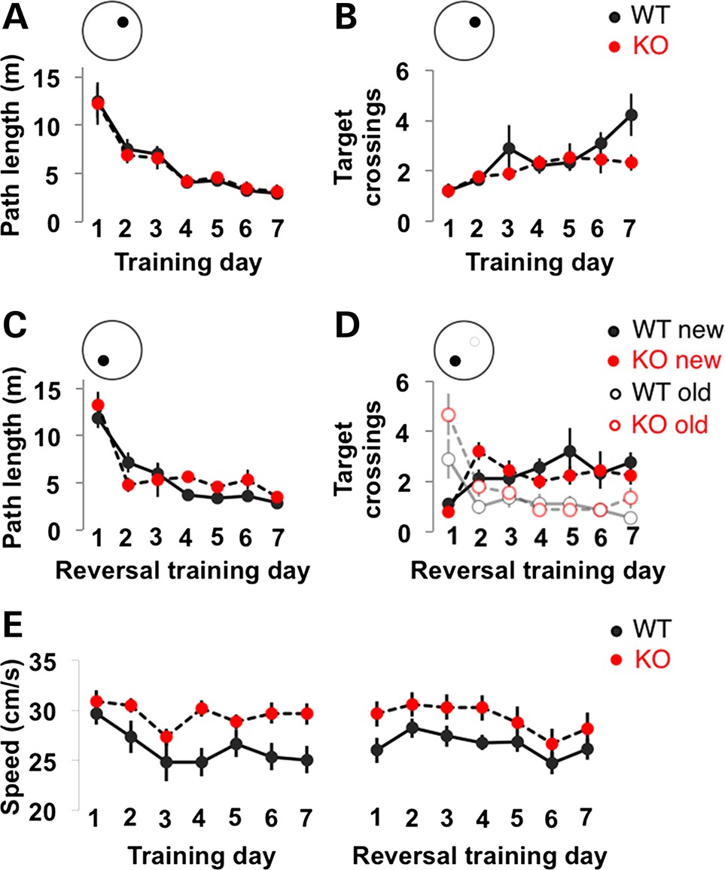
Figure 4. Fmr1 KO rats have normal spatial reference memory acquisition and reversal learning. (A) Fmr1 KO rats learn ...
Notes:
Figure 4. Fmr1 KO rats have normal spatial reference memory acquisition and reversal learning. (A) Fmr1 KO rats learn the hidden-platform version of the water maze similarly to WT littermates as measured by a decrease over days in the path taken to escape (A) and the number of crossings over the platform location on daily probe trials (B). Performance during reversal learning was comparable between genotypes as measured by path to escape (C) and the number of crossings over the old and new platform locations during probe trials (D). (E) Fmr1 KO rats swim faster than WT littermates over all days tested.
Unless provided in the caption above, the following copyright applies to the content of this slide: © The Author 2015. Published by Oxford University PressThis is an Open Access article distributed under the terms of the Creative Commons Attribution Non-Commercial License (http://creativecommons.org/licenses/by-nc/4.0/), which permits non-commercial re-use, distribution, and reproduction in any medium, provided the original work is properly cited. For commercial re-use, please contact journals.permissions@oup.com

Slide 4
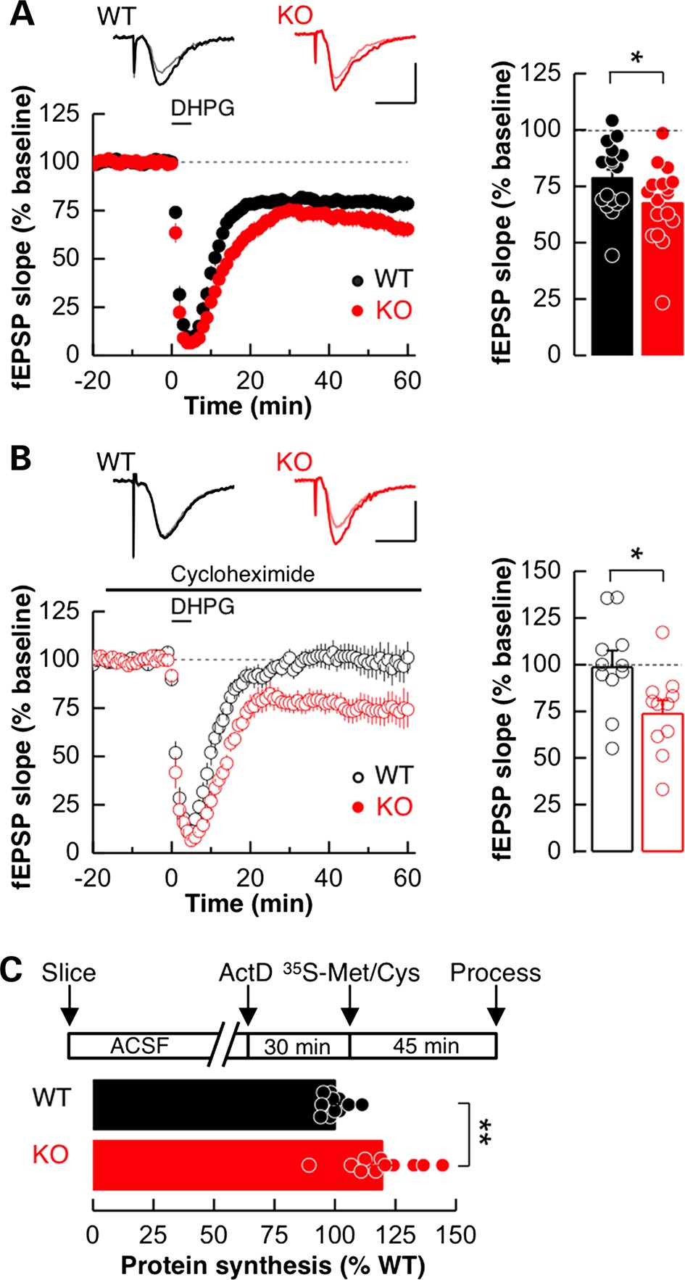
Figure 3. Loss of FMRP alters synaptic plasticity and basal protein synthesis in the rat hippocampus. (A) Sample fEPSP ...
Notes:
Figure 3. Loss of FMRP alters synaptic plasticity and basal protein synthesis in the rat hippocampus. (A) Sample fEPSP traces from 5 min pre- and 55 min post-DHPG treatment are shown above average fEPSP plots for both WT and Fmr1 KO slices normalized to pre-DHPG baseline. (A) The magnitude of DHPG-induced LTD in WT and Fmr1 KO rats was not significantly different between genotypes. (B) While the persistent expression of mGluR-LTD did not require new protein synthesis in Fmr1 KO rats, mGluR-LTD was not maintained in WT rats in the presence of protein synthesis inhibitor cycloheximide. (C) Basal protein synthesis levels are excessive in dorsal hippocampal slices from Fmr1 KO rats compared with WT littermate controls. Calibration bars for A and B: 0.5 mV, 10 ms.
Unless provided in the caption above, the following copyright applies to the content of this slide: © The Author 2015. Published by Oxford University PressThis is an Open Access article distributed under the terms of the Creative Commons Attribution Non-Commercial License (http://creativecommons.org/licenses/by-nc/4.0/), which permits non-commercial re-use, distribution, and reproduction in any medium, provided the original work is properly cited. For commercial re-use, please contact journals.permissions@oup.com

Slide 5
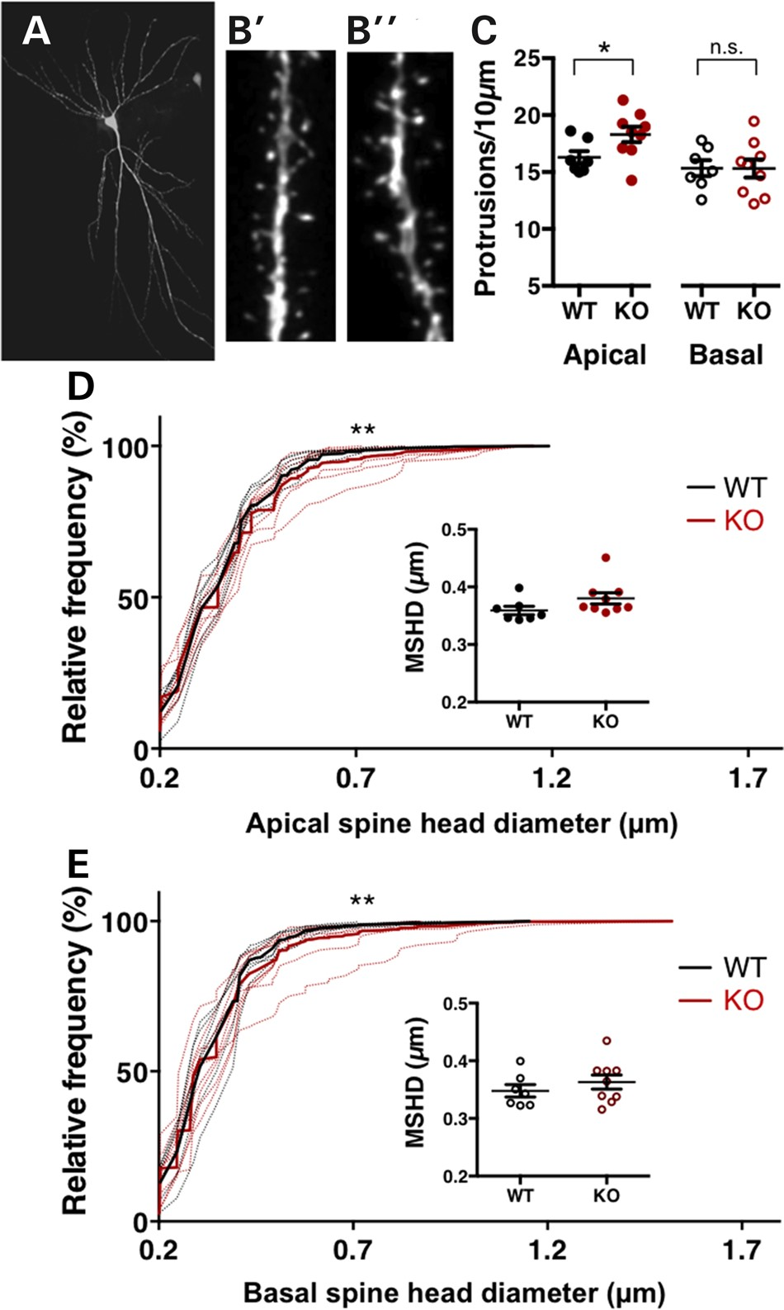
Figure 2. Altered dendritic spine density and shape in the hippocampus of Fmr1 KO rats. An example Alexafluor 568 ...
Notes:
Figure 2. Altered dendritic spine density and shape in the hippocampus of Fmr1 KO rats. An example Alexafluor 568 filled hippocampal CA1 pyramidal neuron (A) and representative apical oblique dendritic segments from WT (B′) and Fmr1 KO rats (B″). (C) Quantification of the density of dendritic protrusions reveals a significant increase on secondary apical obliques in Fmr1 KO rats compared with WT control littermates. In contrast, spine density of secondary basal dendrites is comparable between genotypes. KS-tests of the cumulative frequency distributions indicate differences in the distribution profiles of spine head diameters on apical (D) and basal (E) CA1 dendrites between Fmr1 KO and WT rats. Dotted lines show the cumulative distribution for each animal, solid lines represent group means. The MSHD is not significantly different between genotypes.
Unless provided in the caption above, the following copyright applies to the content of this slide: © The Author 2015. Published by Oxford University PressThis is an Open Access article distributed under the terms of the Creative Commons Attribution Non-Commercial License (http://creativecommons.org/licenses/by-nc/4.0/), which permits non-commercial re-use, distribution, and reproduction in any medium, provided the original work is properly cited. For commercial re-use, please contact journals.permissions@oup.com

Slide 6
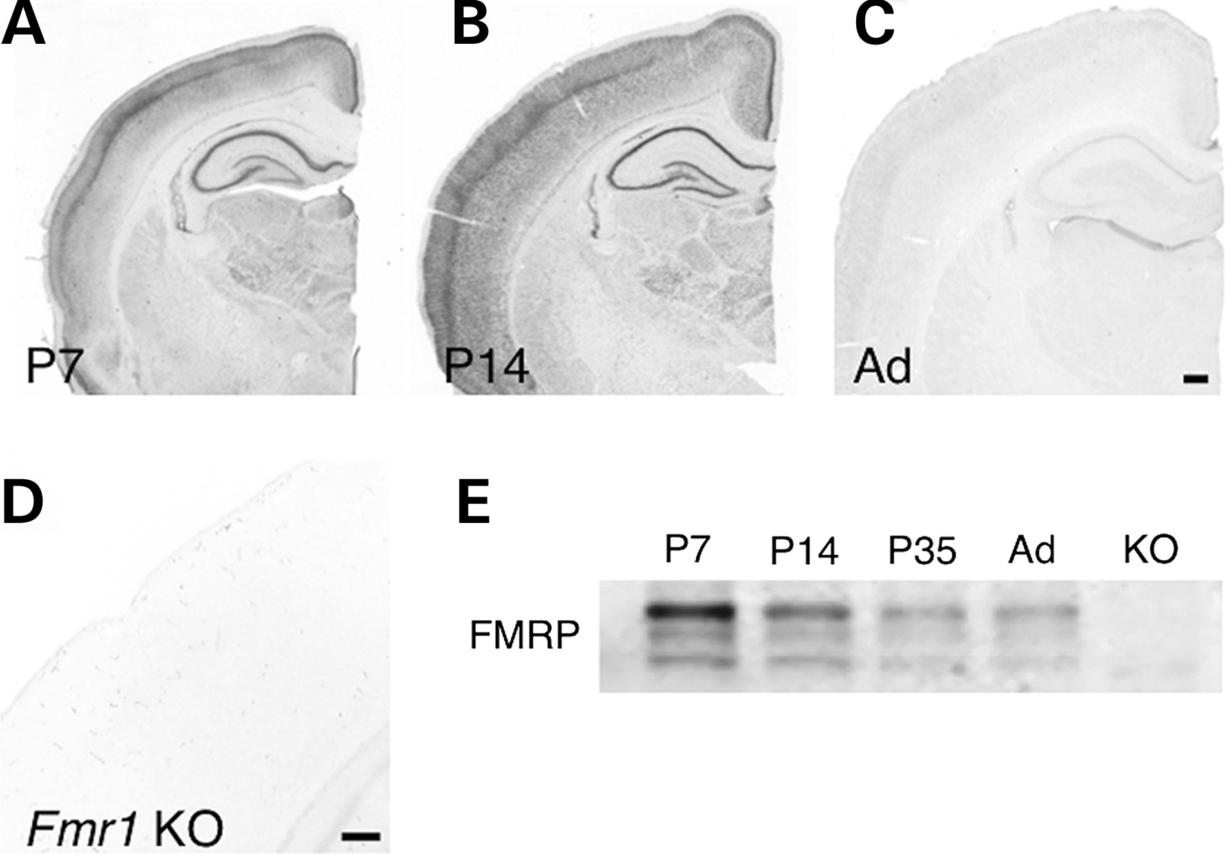
Figure 1. Developmental expression profile of FMRP in rats. Immunohisto-chemical localization of FMRP in P7 (A), P14 ...
Notes:
Figure 1. Developmental expression profile of FMRP in rats. Immunohisto-chemical localization of FMRP in P7 (A), P14 (B) and adult (C) WT SD rats. Immunolabelling of a P10 Fmr1 KO shows specificity of antibody for FMRP (D). Western blot analysis of FMRP expression levels in hippocampus homogenates from WT SD rats littermates over postnatal development compared with P10 Fmr1 KO rat (E). Scale bars: (A–C): 500 µm; (D) 250 µm.
Unless provided in the caption above, the following copyright applies to the content of this slide: © The Author 2015. Published by Oxford University PressThis is an Open Access article distributed under the terms of the Creative Commons Attribution Non-Commercial License (http://creativecommons.org/licenses/by-nc/4.0/), which permits non-commercial re-use, distribution, and reproduction in any medium, provided the original work is properly cited. For commercial re-use, please contact journals.permissions@oup.com

