Slide 1
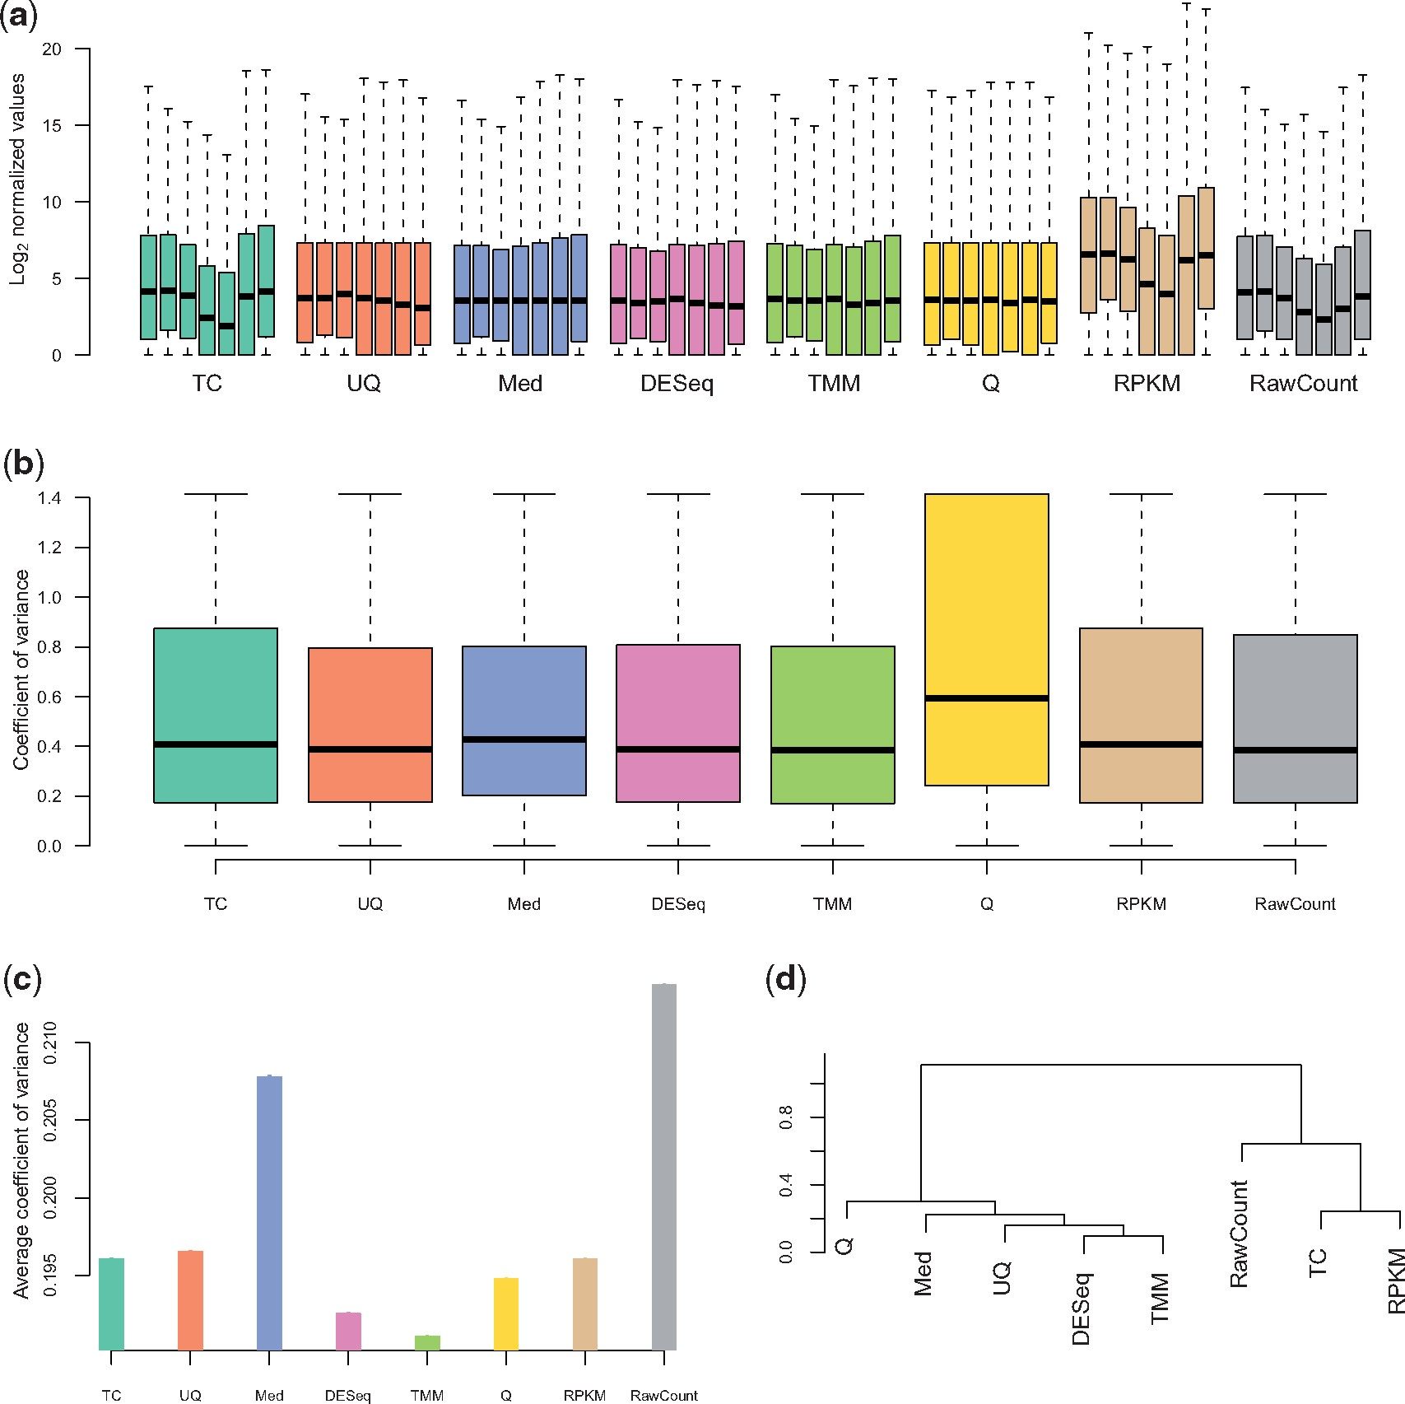
Figure 1: Comparison of normalization methods for real data. (A) Boxplots of log2(counts + 1) for all conditions and ...
Notes:
Figure 1: Comparison of normalization methods for real data. (A) Boxplots of log2(counts + 1) for all conditions and replicates in the M. musculus data, by normalization method. (B) Boxplots of intra-group variance for one of the conditions (labeled ‘B’ in the corresponding data found in Supplementary Data) in the M. musculus data, by normalization method. (C) Analysis of housekeeping genes for the H. sapiens data. (D) Consensus dendrogram of differential analysis results, using the DESeq Bioconductor package, for all normalization methods across the four datasets under consideration.
Unless provided in the caption above, the following copyright applies to the content of this slide: © The Author 2012. Published by Oxford University Press.This is an Open Access article distributed under the terms of the Creative Commons Attribution Non-Commercial License (http://creativecommons.org/licenses/by-nc/3.0/), which permits non-commercial re-use, distribution, and reproduction in any medium, provided the original work is properly cited. For commercial re-use, please contact journals.permissions@oup.com

Slide 2
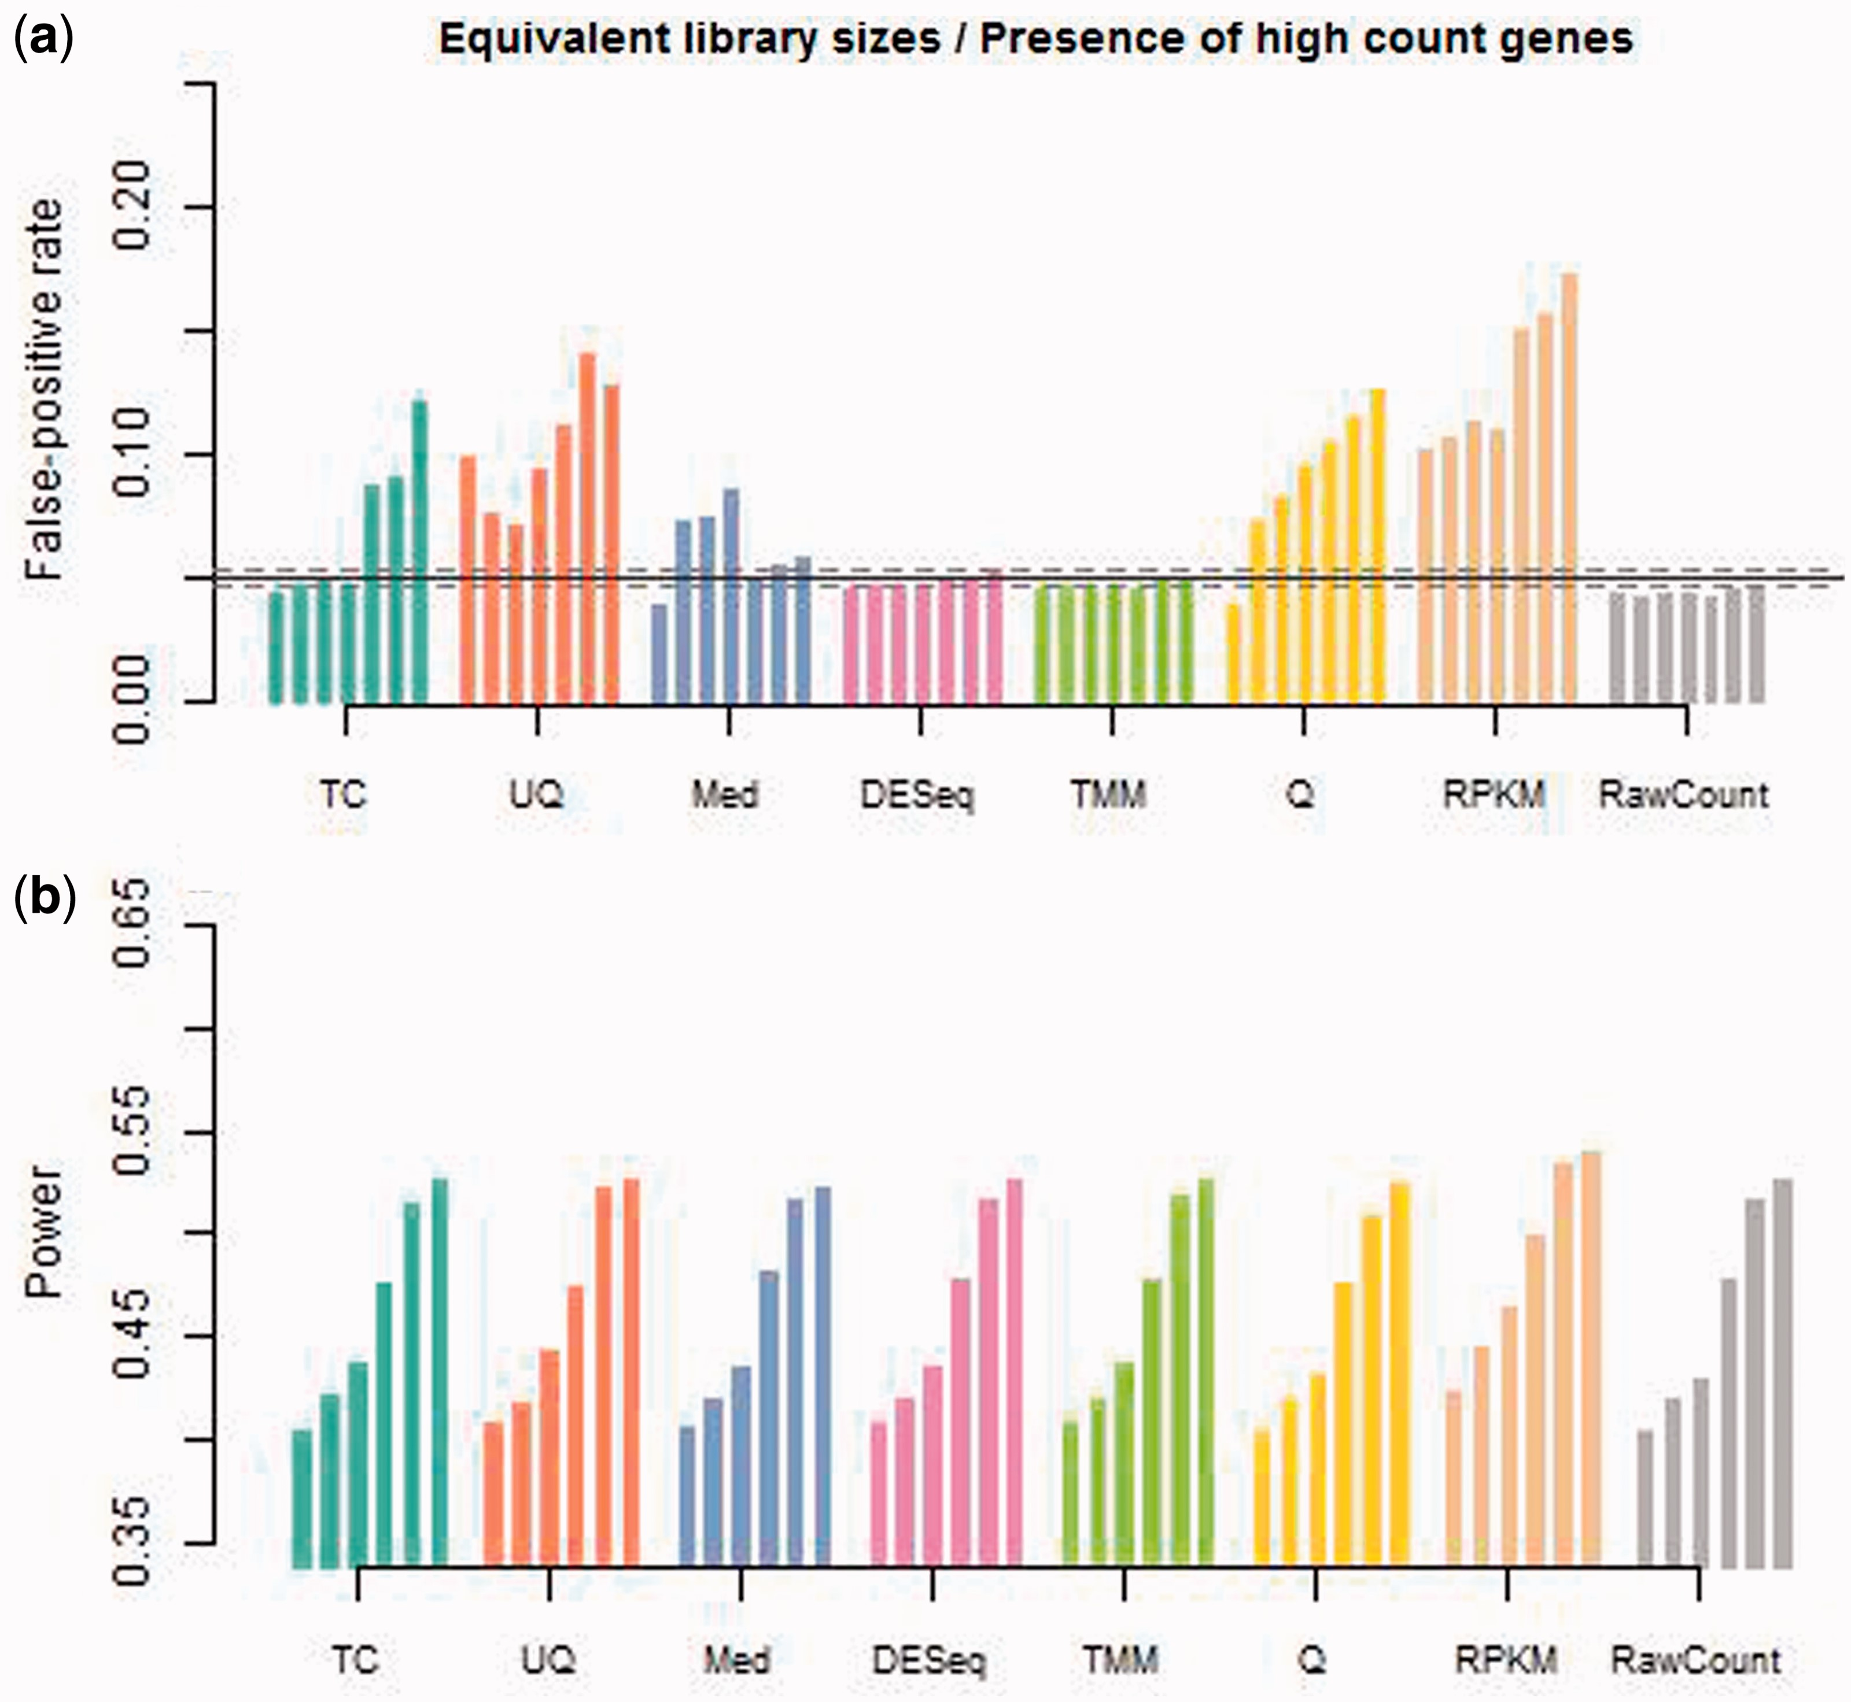
Figure 2: Comparison of normalization methods for simulated data with equal library sizes and the presence of ...
Notes:
Figure 2: Comparison of normalization methods for simulated data with equal library sizes and the presence of high-count genes. (A) Average false-positive rate over 10 independent datasets simulated with varying proportions of differentially expressed genes (from 0% to 30% for each normalization method). (B) Power over 10 independent datasets simulated with varying proportions of differentially expressed genes (from 5% to 30% for each normalization method).
Unless provided in the caption above, the following copyright applies to the content of this slide: © The Author 2012. Published by Oxford University Press.This is an Open Access article distributed under the terms of the Creative Commons Attribution Non-Commercial License (http://creativecommons.org/licenses/by-nc/3.0/), which permits non-commercial re-use, distribution, and reproduction in any medium, provided the original work is properly cited. For commercial re-use, please contact journals.permissions@oup.com

