Slide 1
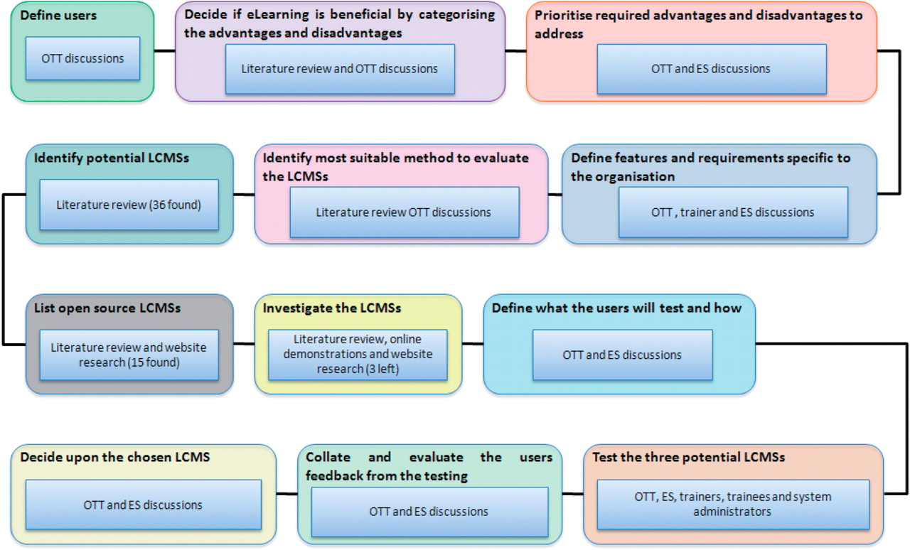
Figure 1: Flow diagram of the different phases of the project and the stakeholders at each stage. The inner square ...
Notes:
Figure 1: Flow diagram of the different phases of the project and the stakeholders at each stage. The inner square boxes describe which stakeholders had input in that phase. OTT is the EMBL-EBI’s Outreach and Training Team, which is responsible for coordinating our communications and training programmes; ES is the External Services Team, which is responsible for maintaining and developing the EMBL-EBI website.
Unless provided in the caption above, the following copyright applies to the content of this slide: © The Author 2010. Published by Oxford University Press. For Permissions, please email: journals.permissions@oxfordjournals.org

