Slide 1
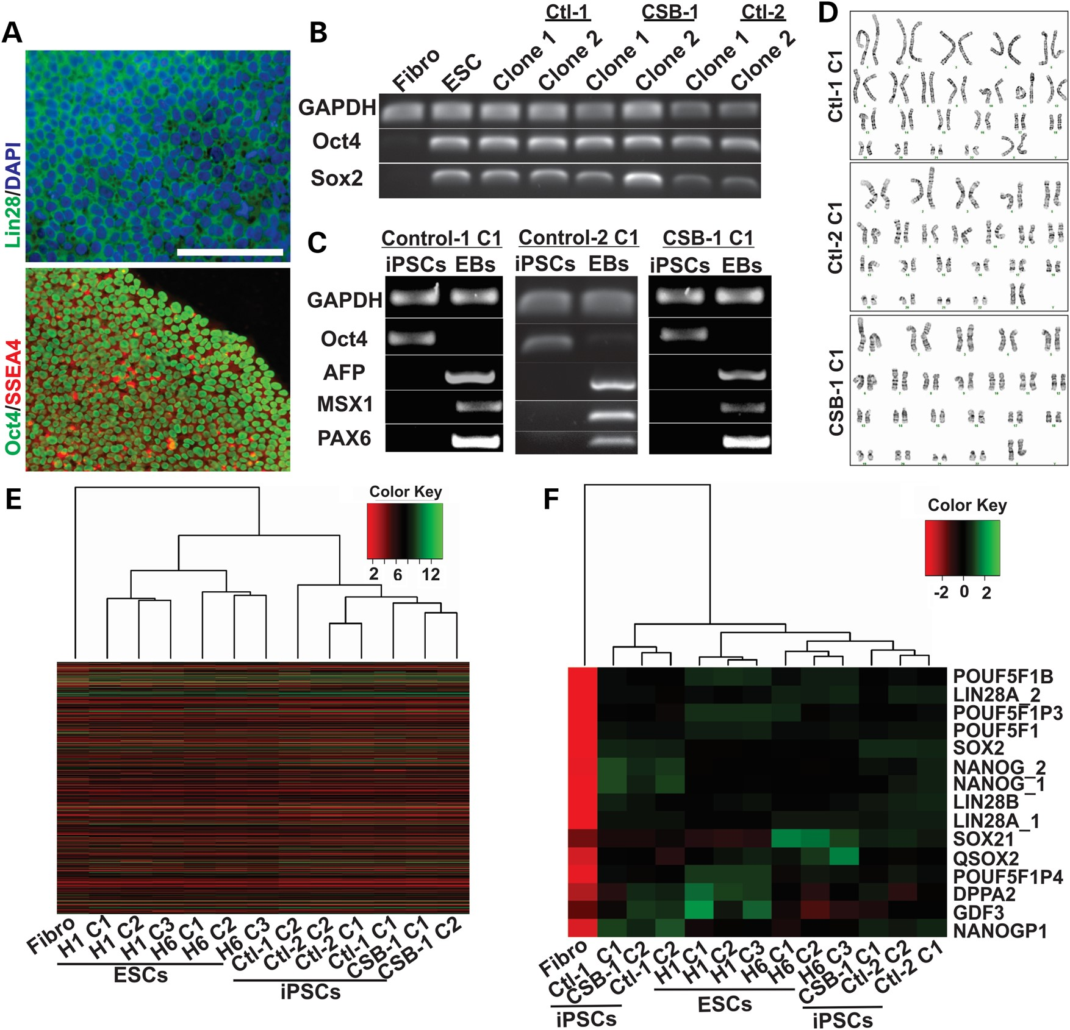
Figure 1. Generation and characterization of CSB-iPSCs. (A) Immunofluorescence analysis of Oct4, SSEA4 and Lin28 ...
Notes:
Figure 1. Generation and characterization of CSB-iPSCs. (A) Immunofluorescence analysis of Oct4, SSEA4 and Lin28 expression in iPSCs (representative images of clone 1 of Control-1-derived cells; scale bar = 100 µm). (B) Expression of OCT4, SOX2 and GAPDH in fibroblasts (Fibro), H1 Embryonic Stem cells (ESCs) and two clones of Control-1, Control-2 and CSB-1-derived iPSCs, as measured by RT-PCR. (Ctl: Control). (C) Expression of OCT4, AFP, MSX1, Pax6 and GAPDH in iPSCs and in the iPSC-derived embryoid bodies (EBs) of control and CSB cells. (D) Karyotype of clone 1 of each indicated iPSC line. Correlation distances (microarray) between fibroblast, ES cell and iPSC samples, based on global gene expression profile (E) or on pluripotency-associated genes (F).
Unless provided in the caption above, the following copyright applies to the content of this slide: © The Author 2016. Published by Oxford University Press. All rights reserved. For Permissions, please email: journals.permissions@oup.com

Slide 2
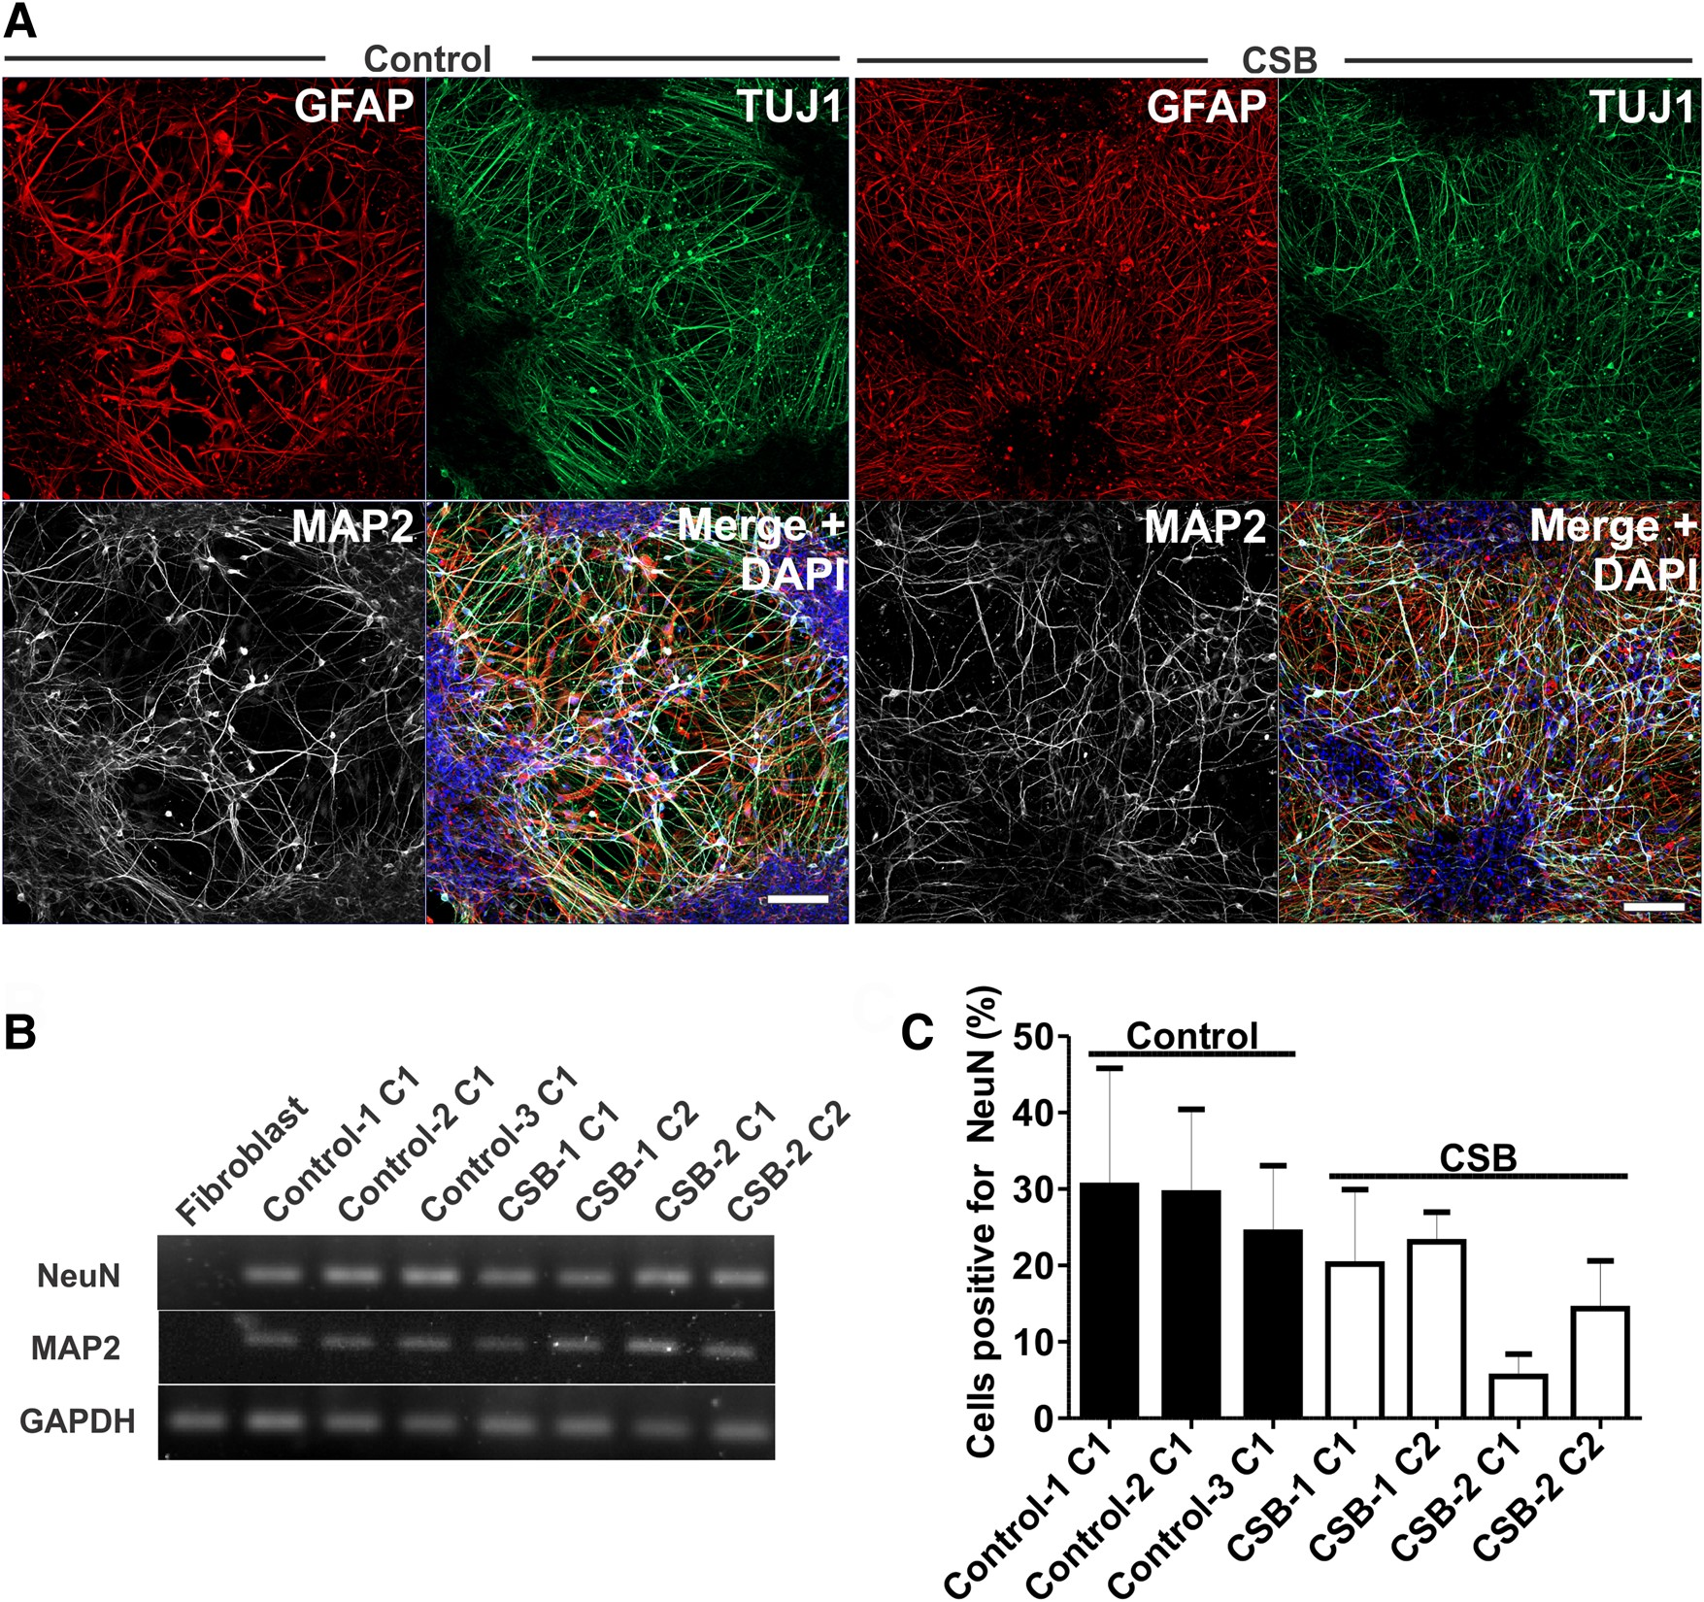
Figure 2. Characterization of CSB neurons. (A) Representative images of clones 1 of both Control-1 and CSB-1-derived ...
Notes:
Figure 2. Characterization of CSB neurons. (A) Representative images of clones 1 of both Control-1 and CSB-1-derived neurons, respectively, showing expression of TUJ1, MAP2 and GFAP. Bars: 100 µm. (B) Expression of MAP2, NEUN and GAPDH in fibroblasts, clones 1 of Control-1, Control-2 and Control-3, and clones 1 and 2 of CSB-1 and CSB-2 neuronal cell cultures by end point PCR. (C) Percentage of NEUN-positive nuclei (DAPI) as evidenced by immunofluorescence in 5-weeks old neuronal culture (at least 1000 nuclei were analyzed in two independent experiments for each clone).
Unless provided in the caption above, the following copyright applies to the content of this slide: © The Author 2016. Published by Oxford University Press. All rights reserved. For Permissions, please email: journals.permissions@oup.com

Slide 3
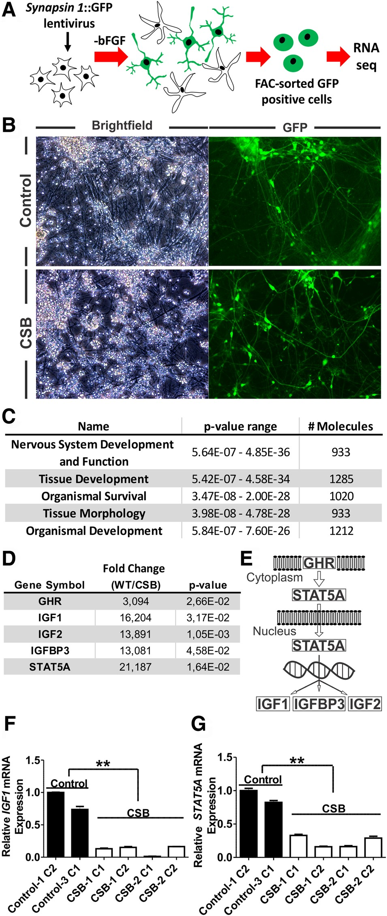
Figure 3. Transcriptional dysregulation of the GH/IGF-1 pathway in CSB neurons. (A) Scheme of the methodology employed ...
Notes:
Figure 3. Transcriptional dysregulation of the GH/IGF-1 pathway in CSB neurons. (A) Scheme of the methodology employed to isolate neurons and extract RNA for sequencing. (B) Brightfield and GFP-channel images of clone 1 of both Control-1 and CSB-1-derived neurons expressing GFP under the control of the neuron-specific SYN1 promoter. (C) Top significant ‘Physiological System Development and Function’ categories evidenced by the Ingenuity Pathway Analysis software. (D) Expression of GH/IGF-1 pathway-related genes. Results are expressed as fold change of controls (WT) to affected (CSB). Key components of this pathway are shown in (E). Relative expression of IGF1 and STAT5A as measured by qPCR (F and G). Statistical analysis (unpaired t-test) expresses mean ± SEM of clones 1 of both Control-1 and Control-2 versus two clones of CSB-1 and CSB-2 neurons (**P < 0.01).
Unless provided in the caption above, the following copyright applies to the content of this slide: © The Author 2016. Published by Oxford University Press. All rights reserved. For Permissions, please email: journals.permissions@oup.com

Slide 4
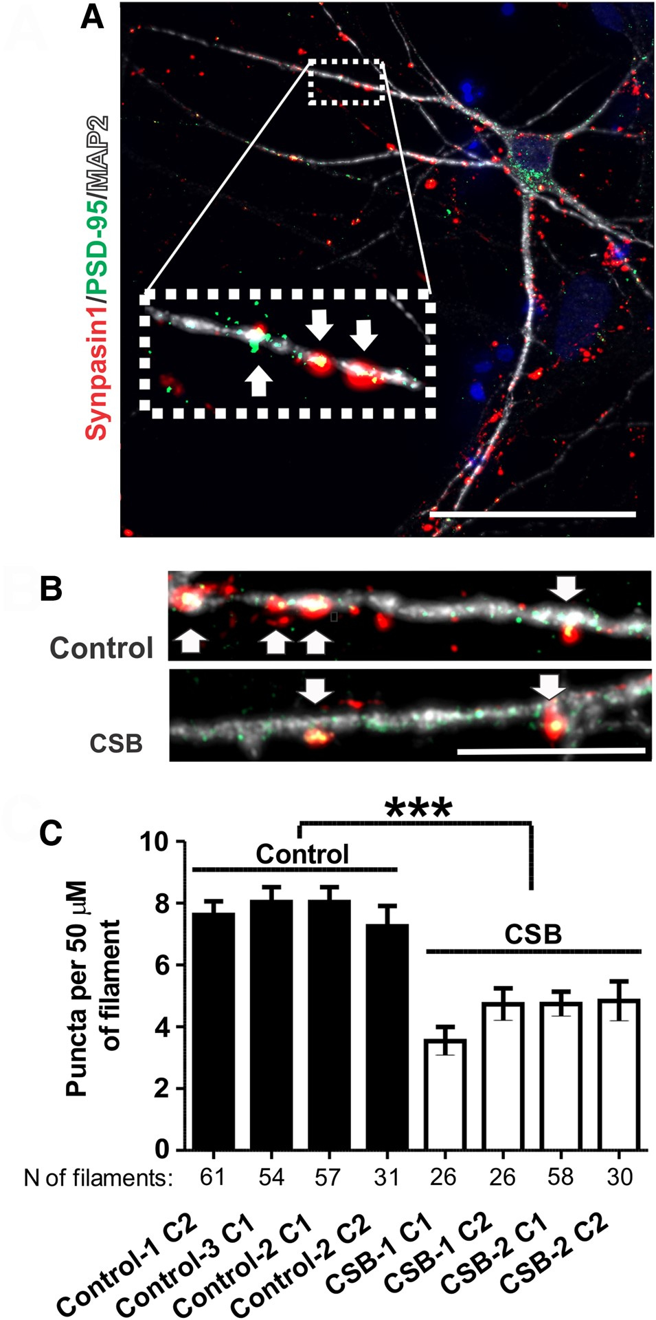
Figure 4. CSB neurons have reduced synapse density. (A) Illustrative picture of co-localization of synapsin I to PSD-95 ...
Notes:
Figure 4. CSB neurons have reduced synapse density. (A) Illustrative picture of co-localization of synapsin I to PSD-95 on neuronal filaments (Map2), as evidenced by fluorescence microscopy; scale bar: 50 µm. (B) Illustrative images of puncta in clones 1 of Control-1 and CSB-1 neurons; scale bar: 10 µm. (C) Number of synapse per 50 µm of filament for each clone analyzed [two independent experiments and total number (N) of filaments analyzed are indicated). Statistical analysis (unpaired t-test) expresses mean ± SEM of the four unaffected clones (clones 1 and 2 of Control-1, clones 1 of Control-2 and Control-3 neurons) versus the four affected clones (clones 1 and 2 of CSB-1 and CSB-2) (***P < 0.001).
Unless provided in the caption above, the following copyright applies to the content of this slide: © The Author 2016. Published by Oxford University Press. All rights reserved. For Permissions, please email: journals.permissions@oup.com

Slide 5
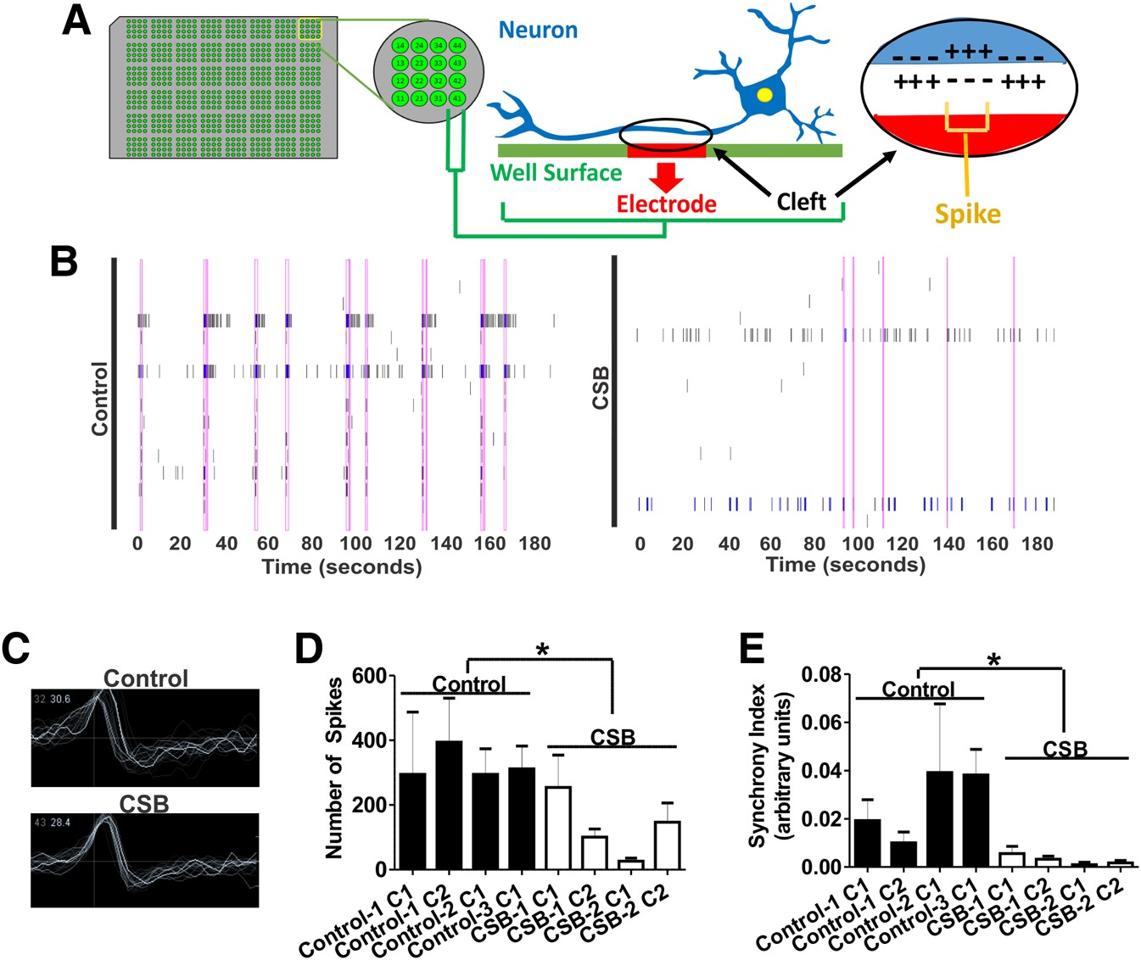
Figure 5. CSB neuronal cultures exhibit reduced number of spikes and network synchrony. (A) Illustrative representation ...
Notes:
Figure 5. CSB neuronal cultures exhibit reduced number of spikes and network synchrony. (A) Illustrative representation of a neuron plated on top of an electrode and the generation of field potential changes (spikes). (B) Representative temporal raster plots of unaffected (Control-3 clone 1) or CSB (CSB-1 clone 1) neurons over a 3-min recording from the MEA. Vertical rectangles spanning the graphs indicate synchronized spikes/bursts. (C) Overlay of representative successive wave forms of spikes in one electrode of each unaffected (W83) or CSB (GM00739) neuronal cultures. Total number of spikes (D) and synchrony index (E). At least three independent experiments in quadruplicate were carried out for all clones. Statistical analysis (unpaired t-test) expresses mean ± SEM of the four unaffected clones (clones 1 and 2 of Control-1, clones 1 of Control-2 and Control-3 neurons) versus the four affected clones (clones 1 and 2 of CSB-1 and CSB-2) (*P < 0.05).
Unless provided in the caption above, the following copyright applies to the content of this slide: © The Author 2016. Published by Oxford University Press. All rights reserved. For Permissions, please email: journals.permissions@oup.com

