Slide 1
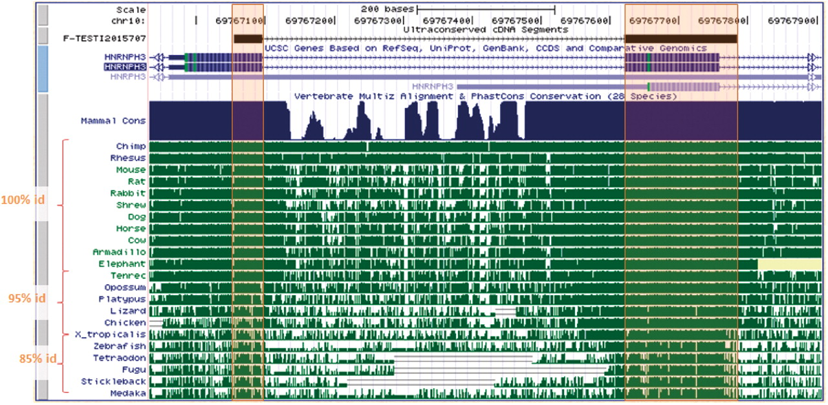
Figure 1. A cross-exon UCS, not previously found in UCE, exhibits extreme conservation across vertebrate genomes and ...
Notes:
Figure 1. A cross-exon UCS, not previously found in UCE, exhibits extreme conservation across vertebrate genomes and overlaps the start codon of an alternatively spliced isoform.
Unless provided in the caption above, the following copyright applies to the content of this slide: © The Author(s) 2010. Published by Oxford University Press.This is an Open Access article distributed under the terms of the Creative Commons Attribution Non-Commercial License (http://creativecommons.org/licenses/by-nc/2.5), which permits unrestricted non-commercial use, distribution, and reproduction in any medium, provided the original work is properly cited.

Slide 2
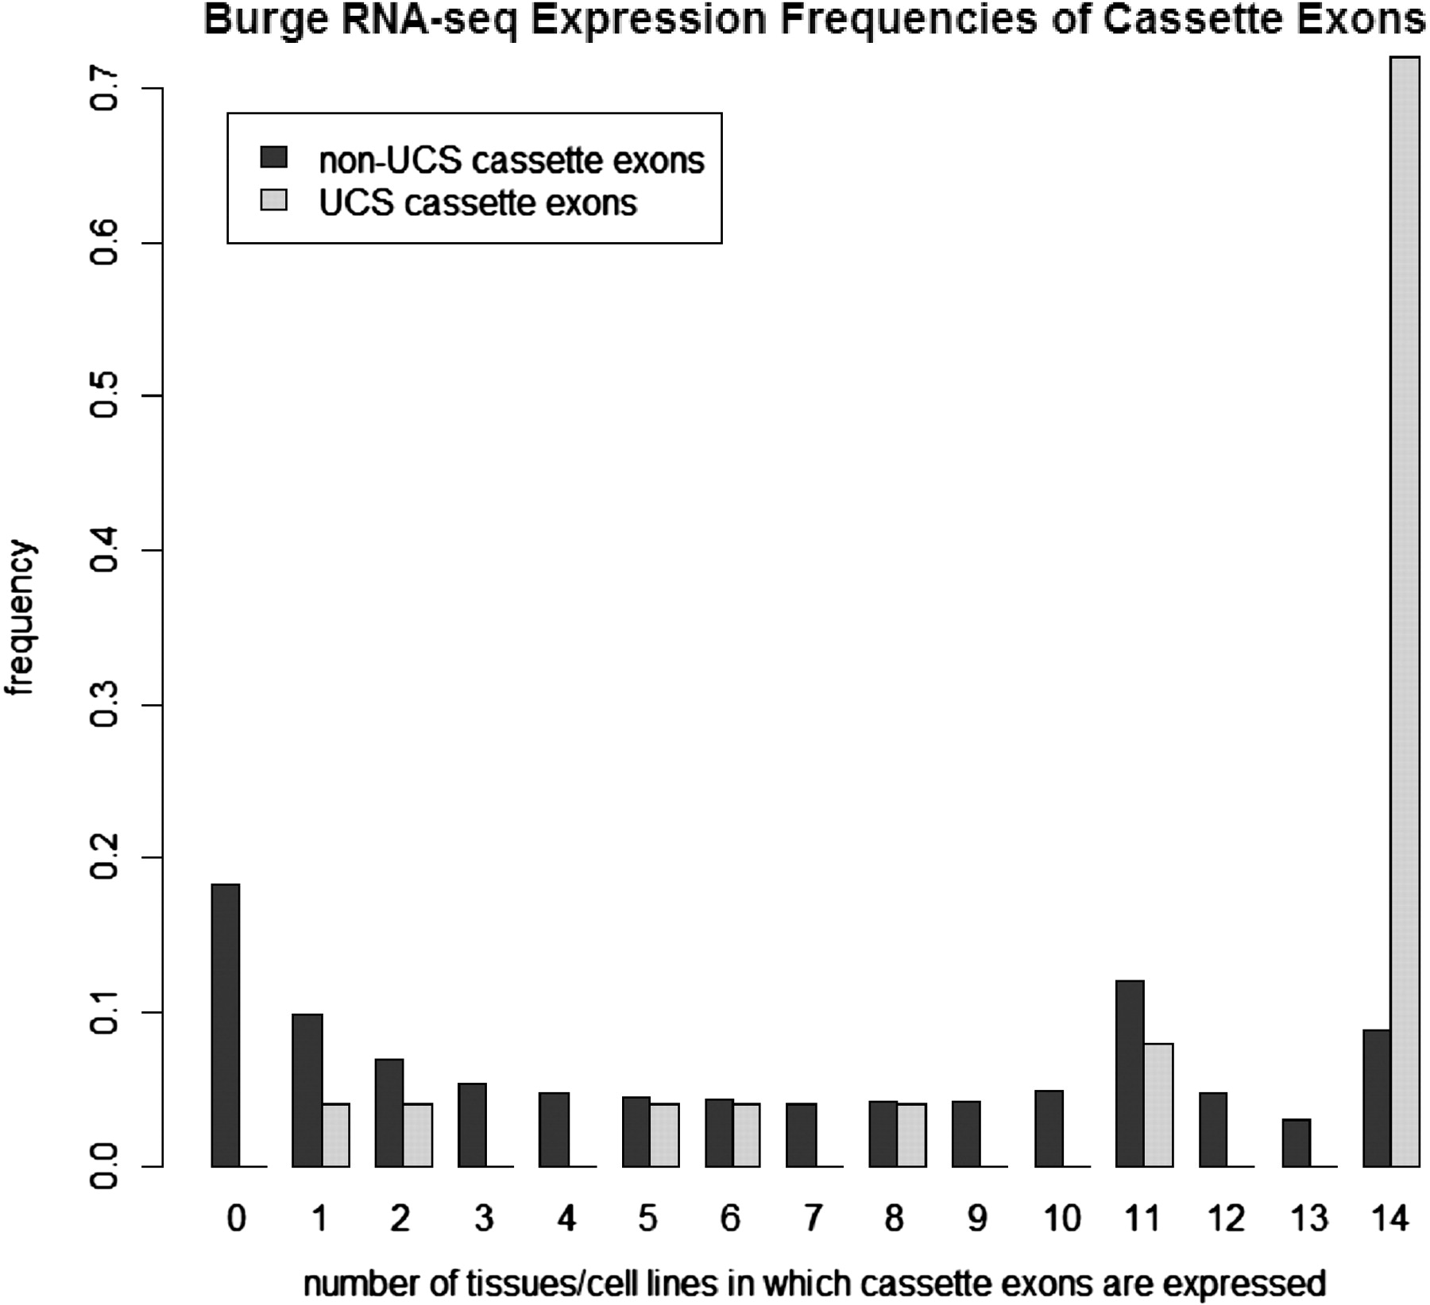
Figure 2. Expression patterns of cassette exons. Cassette exons containing cross-exon UCSs tend to be more ubiquitously ...
Notes:
Figure 2. Expression patterns of cassette exons. Cassette exons containing cross-exon UCSs tend to be more ubiquitously expressed. This means UCS cassette exons are often spliced together with their neighboring UCS exons, forming one functional unit.
Unless provided in the caption above, the following copyright applies to the content of this slide: © The Author(s) 2010. Published by Oxford University Press.This is an Open Access article distributed under the terms of the Creative Commons Attribution Non-Commercial License (http://creativecommons.org/licenses/by-nc/2.5), which permits unrestricted non-commercial use, distribution, and reproduction in any medium, provided the original work is properly cited.

Slide 3
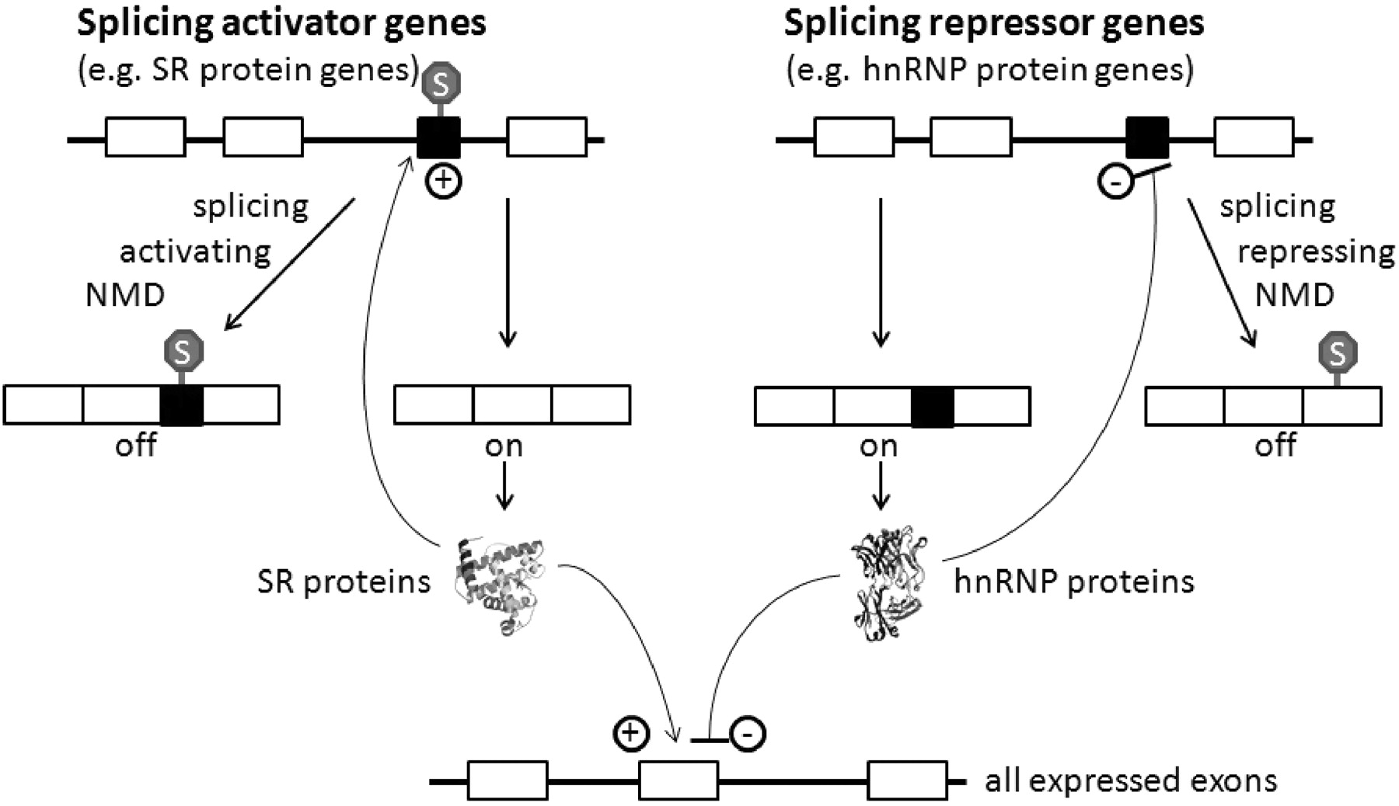
Figure 3. Mechanism through which stop codon-containing exons are alternatively spliced and degraded by means of NMD. ...
Notes:
Figure 3. Mechanism through which stop codon-containing exons are alternatively spliced and degraded by means of NMD. This regulatory mechanism is prevalent in splicing regulators such as the SR and hnRNP protein genes. Figured inspired by ( 12 ).
Unless provided in the caption above, the following copyright applies to the content of this slide: © The Author(s) 2010. Published by Oxford University Press.This is an Open Access article distributed under the terms of the Creative Commons Attribution Non-Commercial License (http://creativecommons.org/licenses/by-nc/2.5), which permits unrestricted non-commercial use, distribution, and reproduction in any medium, provided the original work is properly cited.

Slide 4
Figure 4. SR protein gene SRP54 contains two UCSs, one of which is the same as UCE uc.28; the other is a cross-exon UCS ...
Notes:
Figure 4. SR protein gene SRP54 contains two UCSs, one of which is the same as UCE uc.28; the other is a cross-exon UCS KDN02407. Two alternative splicing events are associated with KDN02407, while none are found in uc.28. However, because of the upstream position of uc.28 from the alternative promoter, it may play role in regulating alternative transcription initiation instead.
Unless provided in the caption above, the following copyright applies to the content of this slide: © The Author(s) 2010. Published by Oxford University Press.This is an Open Access article distributed under the terms of the Creative Commons Attribution Non-Commercial License (http://creativecommons.org/licenses/by-nc/2.5), which permits unrestricted non-commercial use, distribution, and reproduction in any medium, provided the original work is properly cited.

Slide 5
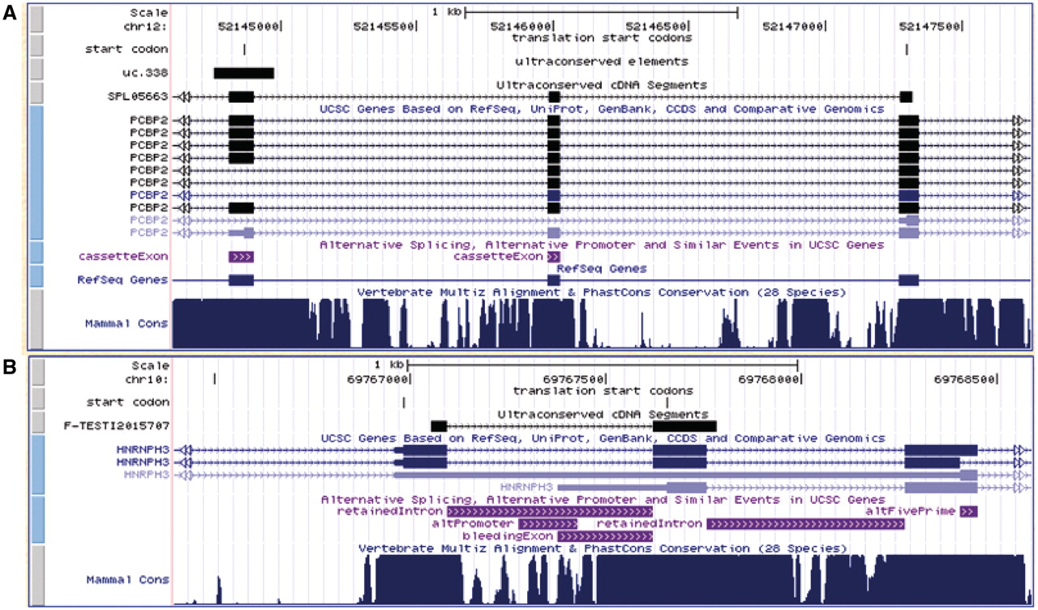
Figure 5. Examples of 5′-UTR diversity created through cassette exons, bleeding exons and retained introns. ( A ) ...
Notes:
Figure 5. Examples of 5′-UTR diversity created through cassette exons, bleeding exons and retained introns. ( A ) 5′-UTR diversity (two light blue isoforms) is created through selective inclusion and exclusion of two ultraconserved cassette exons. The corresponding start codons are also contained within the UCS. ( B ) 5′-UTR diversity (two light blue isoforms) is created through retained introns and a bleeding exon. The start codon in one isoform becomes uAUG of the other. These exemplify how uAUG and alternative splicing might regulate translation efficiency.
Unless provided in the caption above, the following copyright applies to the content of this slide: © The Author(s) 2010. Published by Oxford University Press.This is an Open Access article distributed under the terms of the Creative Commons Attribution Non-Commercial License (http://creativecommons.org/licenses/by-nc/2.5), which permits unrestricted non-commercial use, distribution, and reproduction in any medium, provided the original work is properly cited.

Slide 6
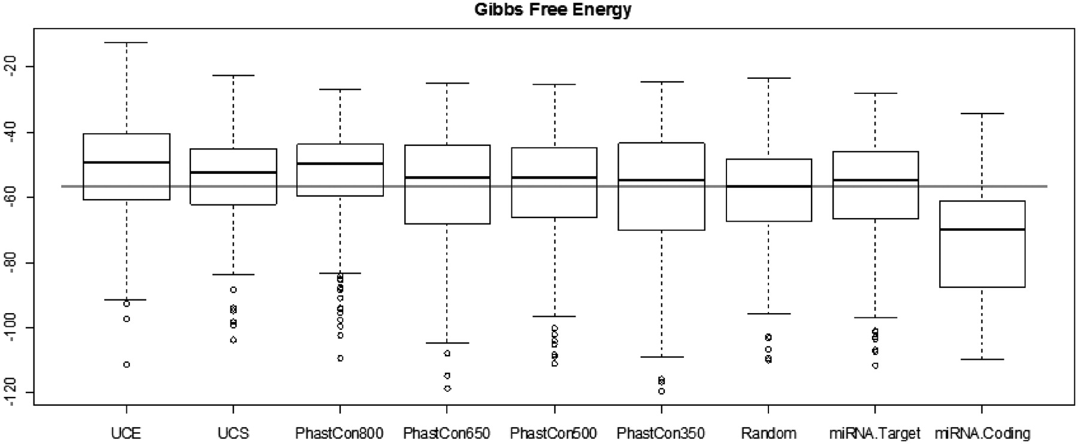
Figure 6. Gibbs free folding energy comparison shows significant fold resistance of ultra- and highly conserved ...
Notes:
Figure 6. Gibbs free folding energy comparison shows significant fold resistance of ultra- and highly conserved elements as compared with random cDNA sequences. The gray horizontal line marks the mean of the fold energy of random sequences. miRNA coding sequences form significantly more stable structures while miRNA target sequences exhibit resistance to folding similar to conserved elements and suggesting an open structure for regulatory functions.
Unless provided in the caption above, the following copyright applies to the content of this slide: © The Author(s) 2010. Published by Oxford University Press.This is an Open Access article distributed under the terms of the Creative Commons Attribution Non-Commercial License (http://creativecommons.org/licenses/by-nc/2.5), which permits unrestricted non-commercial use, distribution, and reproduction in any medium, provided the original work is properly cited.

Slide 7
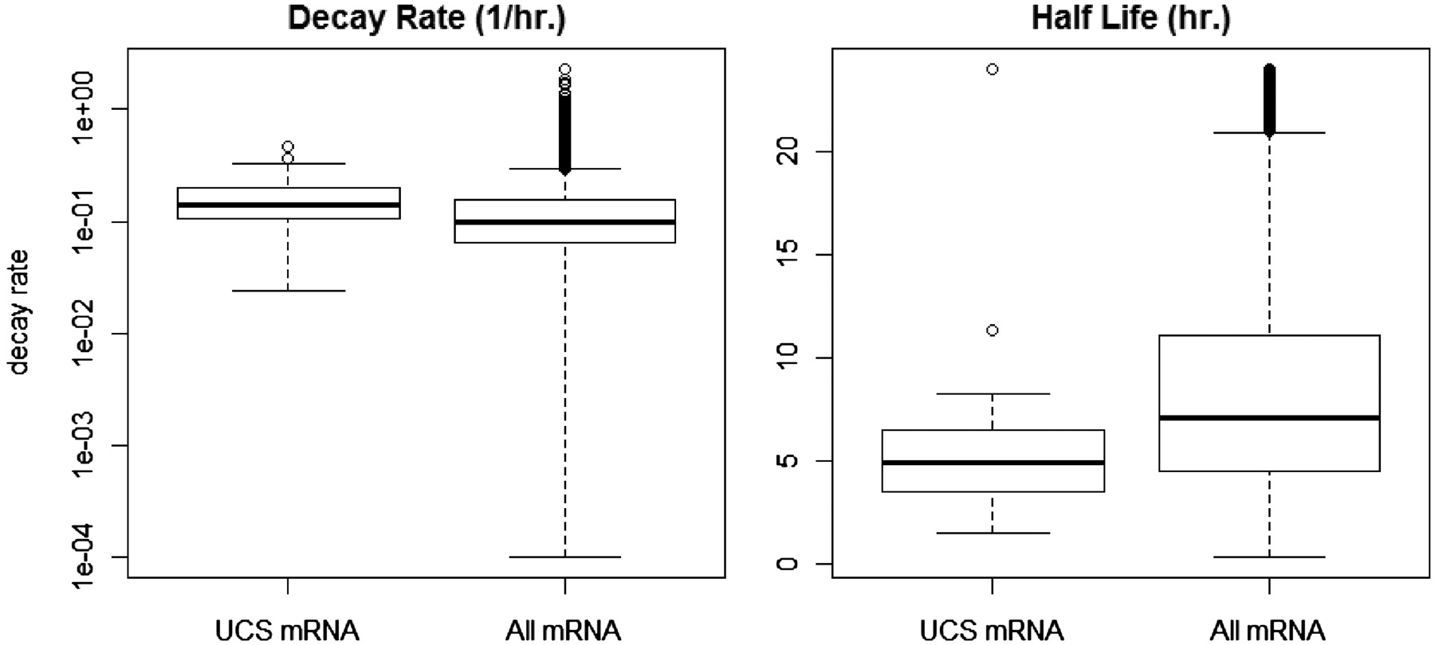
Figure 7. UCS-containing mRNAs degrade at faster rates and have shorter half-life than average mRNAs. Note that decay ...
Notes:
Figure 7. UCS-containing mRNAs degrade at faster rates and have shorter half-life than average mRNAs. Note that decay rate is presented in log scale.
Unless provided in the caption above, the following copyright applies to the content of this slide: © The Author(s) 2010. Published by Oxford University Press.This is an Open Access article distributed under the terms of the Creative Commons Attribution Non-Commercial License (http://creativecommons.org/licenses/by-nc/2.5), which permits unrestricted non-commercial use, distribution, and reproduction in any medium, provided the original work is properly cited.

