Slide 1
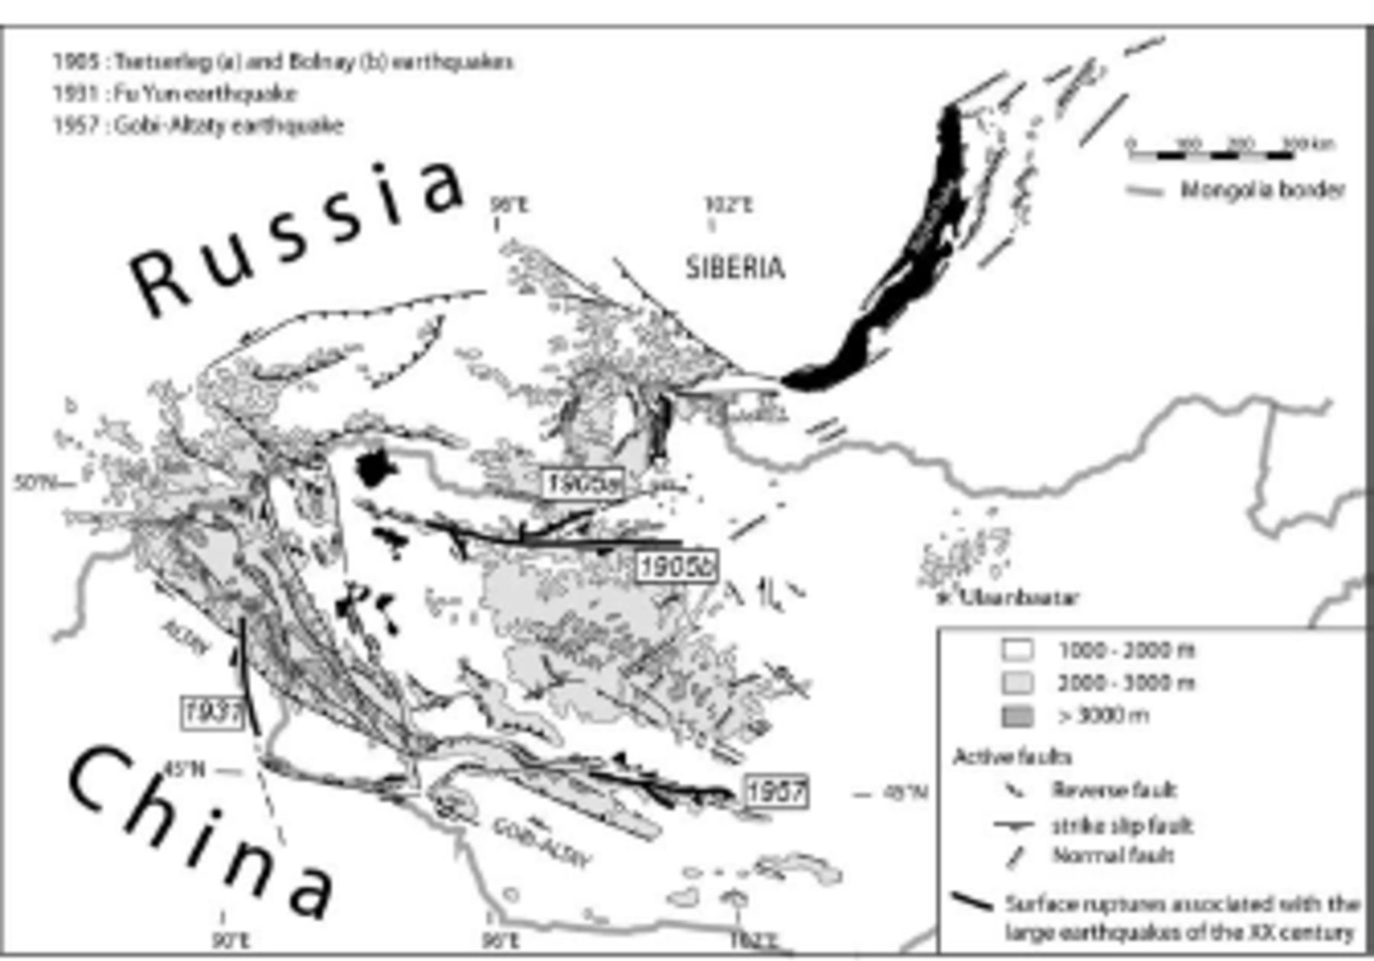
Figure 1. Main active faults in Mongolia and the large earthquakes of the XX century (after Schlupp 1996).
Notes:
Figure 1. Main active faults in Mongolia and the large earthquakes of the XX century (after Schlupp 1996).
Unless provided in the caption above, the following copyright applies to the content of this slide: © 2007 The Author Journal compilation © 2007 RAS

Slide 2
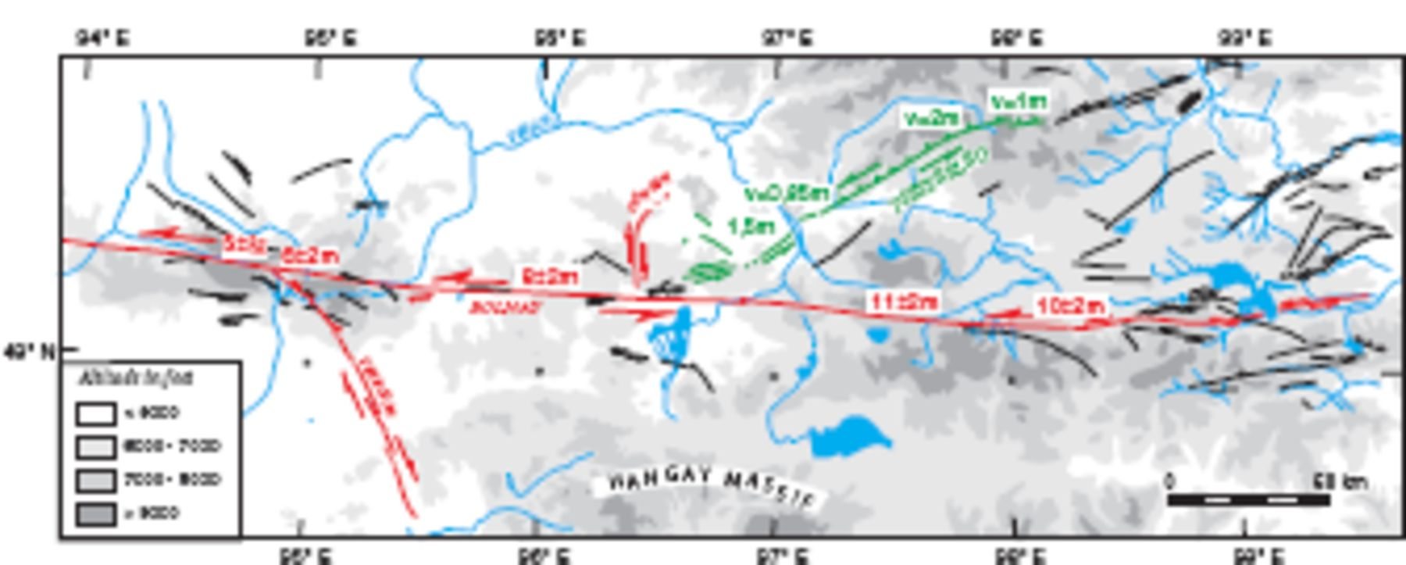
Figure 2. Surface ruptures associated with the Tsetserleg earthquake (1905 July 9, in green) and the Bolnay earthquake ...
Notes:
Figure 2. Surface ruptures associated with the Tsetserleg earthquake (1905 July 9, in green) and the Bolnay earthquake (1905 July 23, in red). Active faults in Hangay region are in black.
Unless provided in the caption above, the following copyright applies to the content of this slide: © 2007 The Author Journal compilation © 2007 RAS

Slide 3
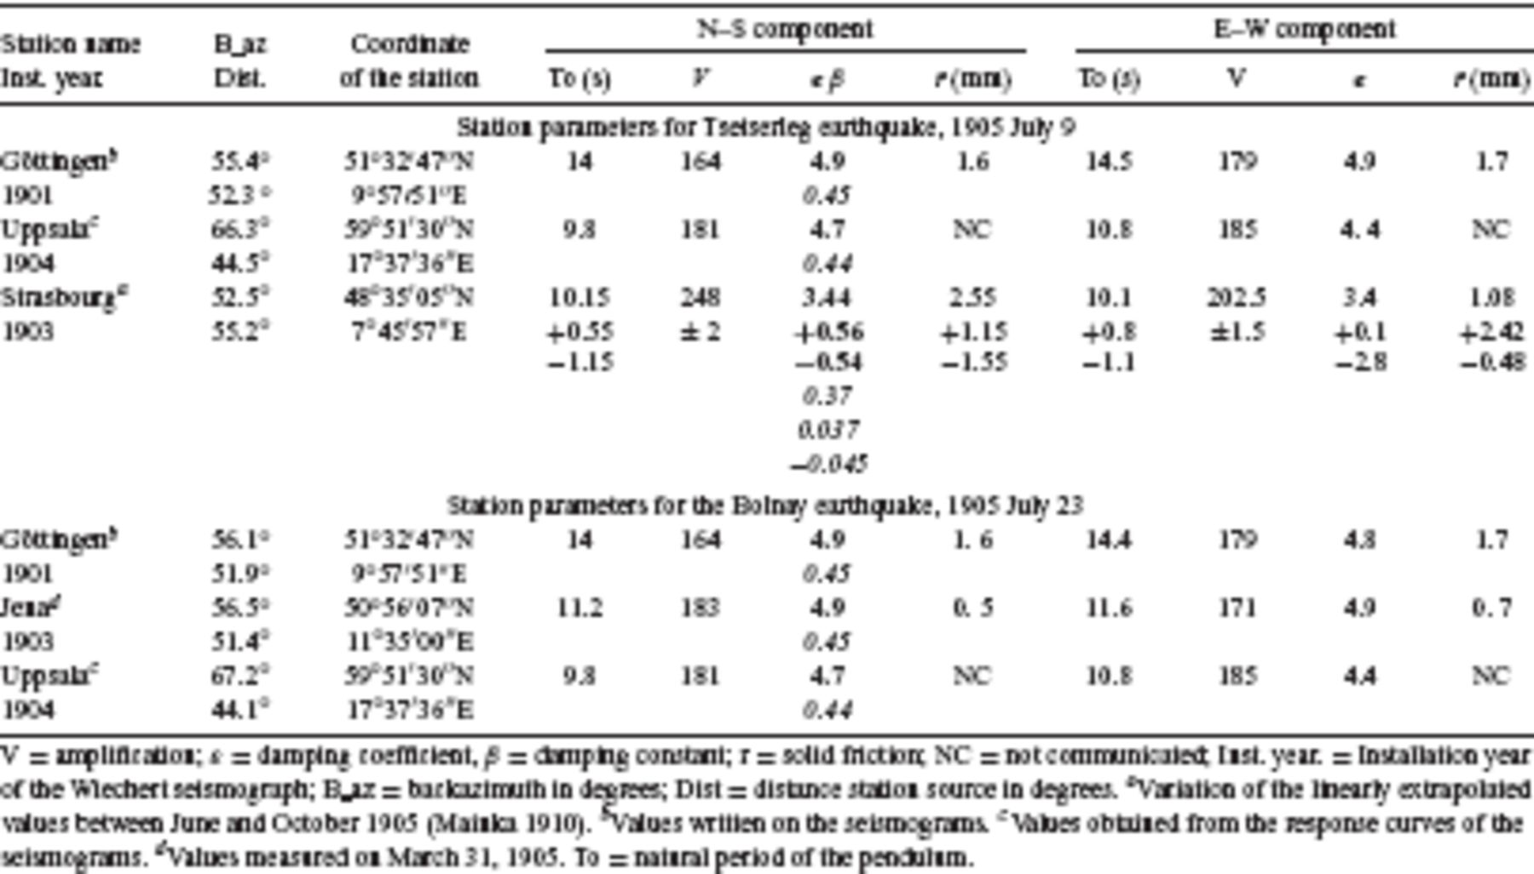
Table 1. Station parameters for Tsetserleg and Bolnay earthquakes, 1905 July 9 and 23.
Notes:
Table 1. Station parameters for Tsetserleg and Bolnay earthquakes, 1905 July 9 and 23.
Unless provided in the caption above, the following copyright applies to the content of this slide: © 2007 The Author Journal compilation © 2007 RAS

Slide 4
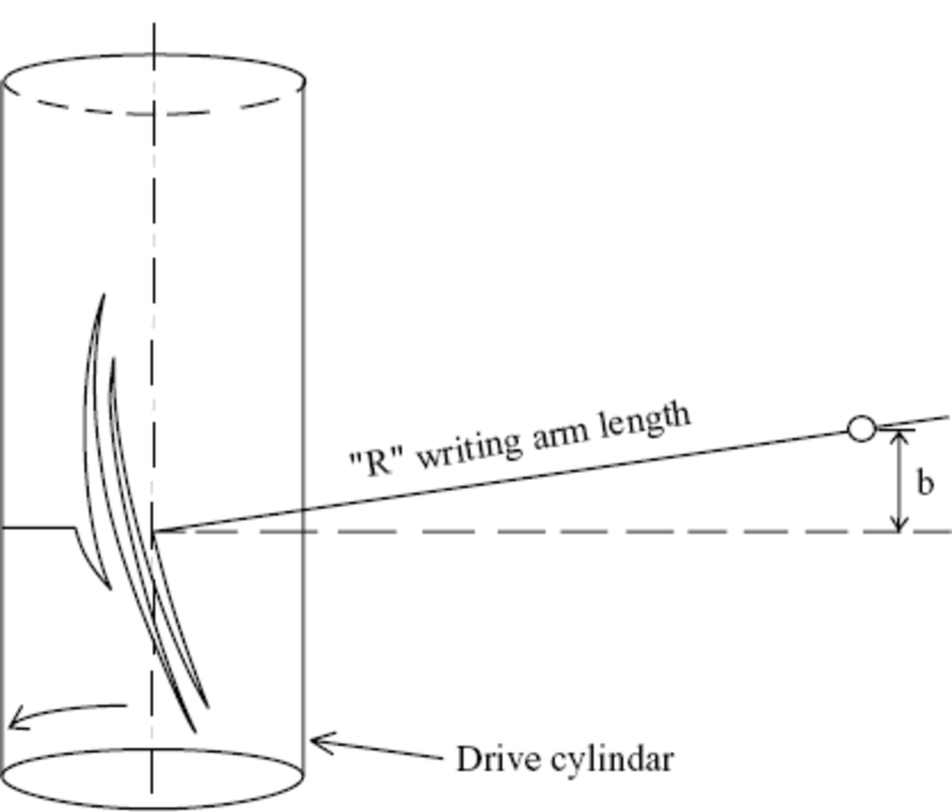
Figure 3. Geometrical deformations induced by the shift ‘b’ of the writing arm (after Cadek 1987).
Notes:
Figure 3. Geometrical deformations induced by the shift ‘b’ of the writing arm (after Cadek 1987).
Unless provided in the caption above, the following copyright applies to the content of this slide: © 2007 The Author Journal compilation © 2007 RAS

Slide 5
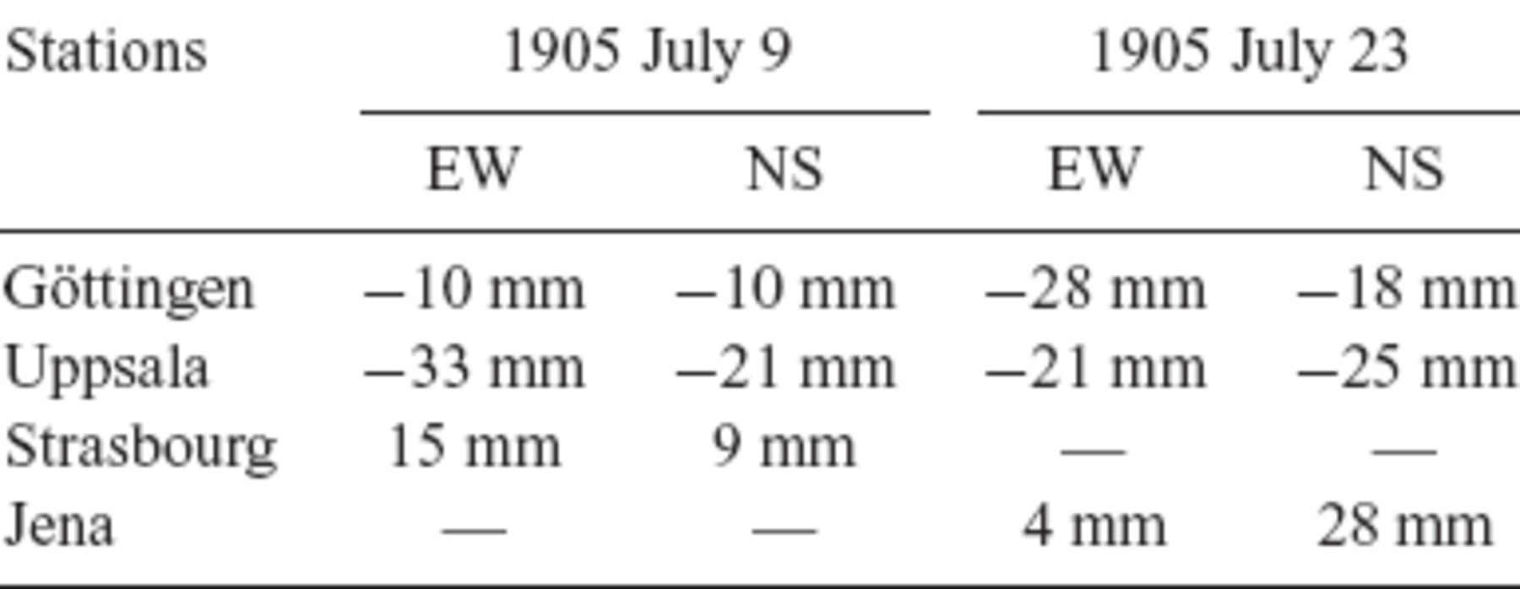
Table 2. ‘b’ values chosen for the geometrical correction of the data. The sign (-) is used when the writing arm is ...
Notes:
Table 2. ‘b’ values chosen for the geometrical correction of the data. The sign (-) is used when the writing arm is displaced to the north or the east.
Unless provided in the caption above, the following copyright applies to the content of this slide: © 2007 The Author Journal compilation © 2007 RAS

Slide 6
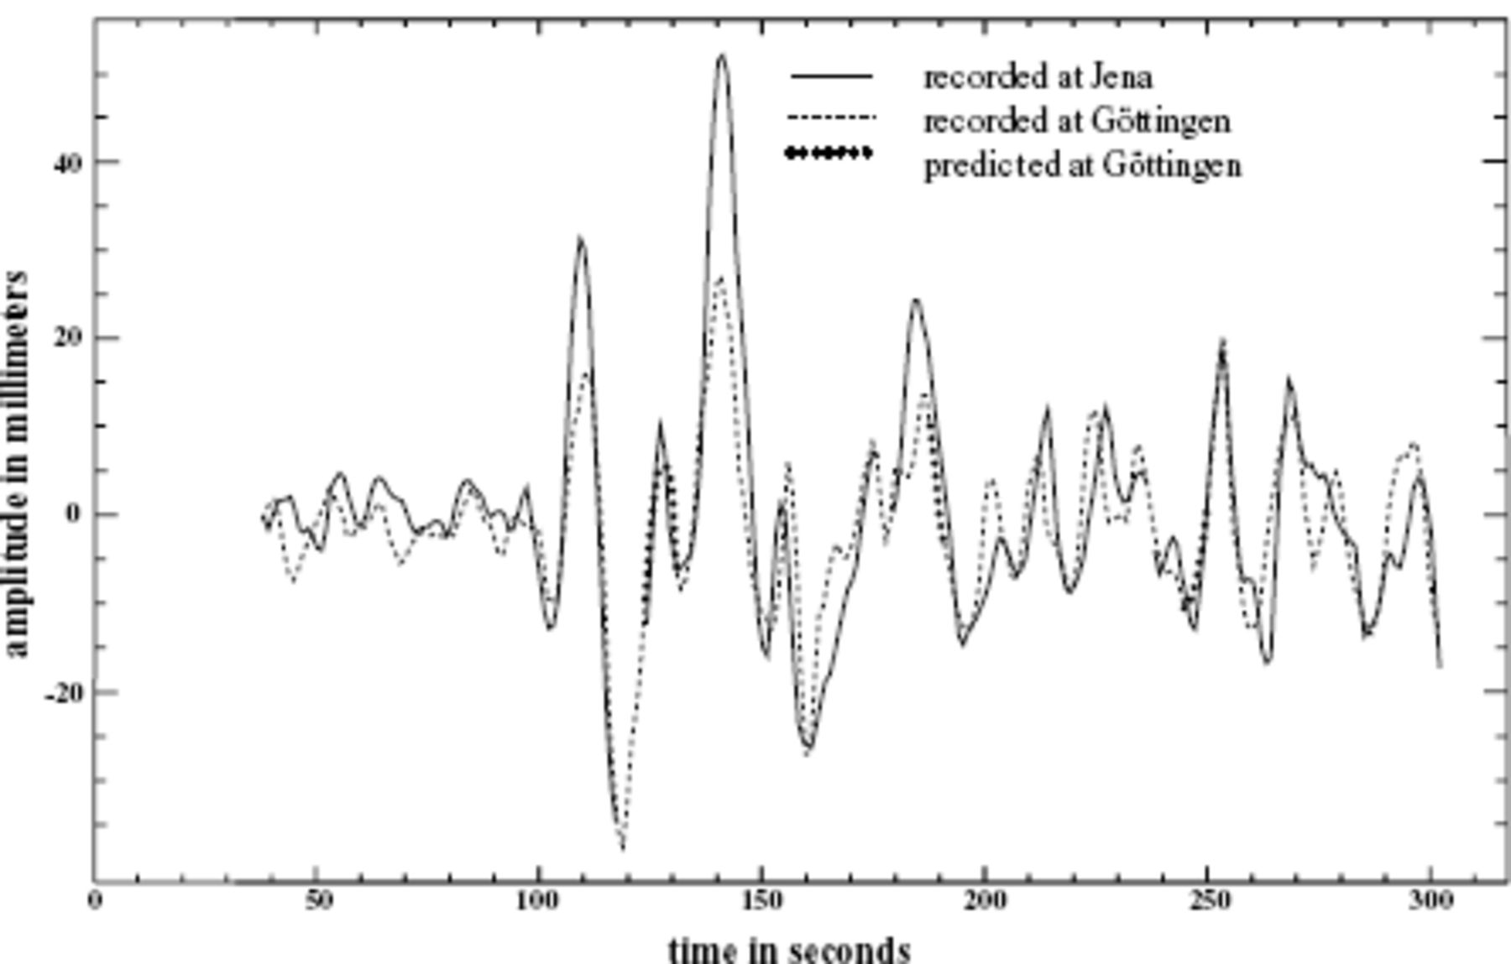
Figure 4. Comparison between the Göttingen and Jena ‘S’ waveforms (Bolnay earthquake). The minute gaps at Göttingen are ...
Notes:
Figure 4. Comparison between the Göttingen and Jena ‘S’ waveforms (Bolnay earthquake). The minute gaps at Göttingen are corrected by using predictive filters.
Unless provided in the caption above, the following copyright applies to the content of this slide: © 2007 The Author Journal compilation © 2007 RAS

Slide 7
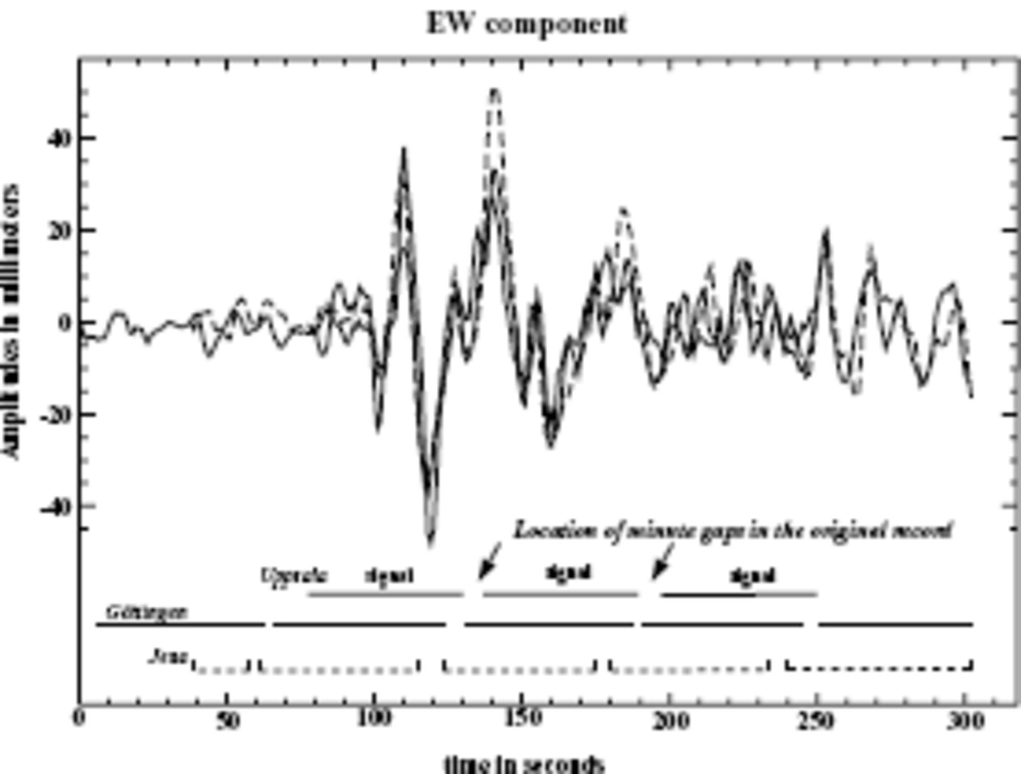
Figure 5. Comparison of the Bolnay ‘S’ waveforms recorded at Jena, Uppsala and Göttingen after doing all corrections.
Notes:
Figure 5. Comparison of the Bolnay ‘S’ waveforms recorded at Jena, Uppsala and Göttingen after doing all corrections.
Unless provided in the caption above, the following copyright applies to the content of this slide: © 2007 The Author Journal compilation © 2007 RAS

Slide 8
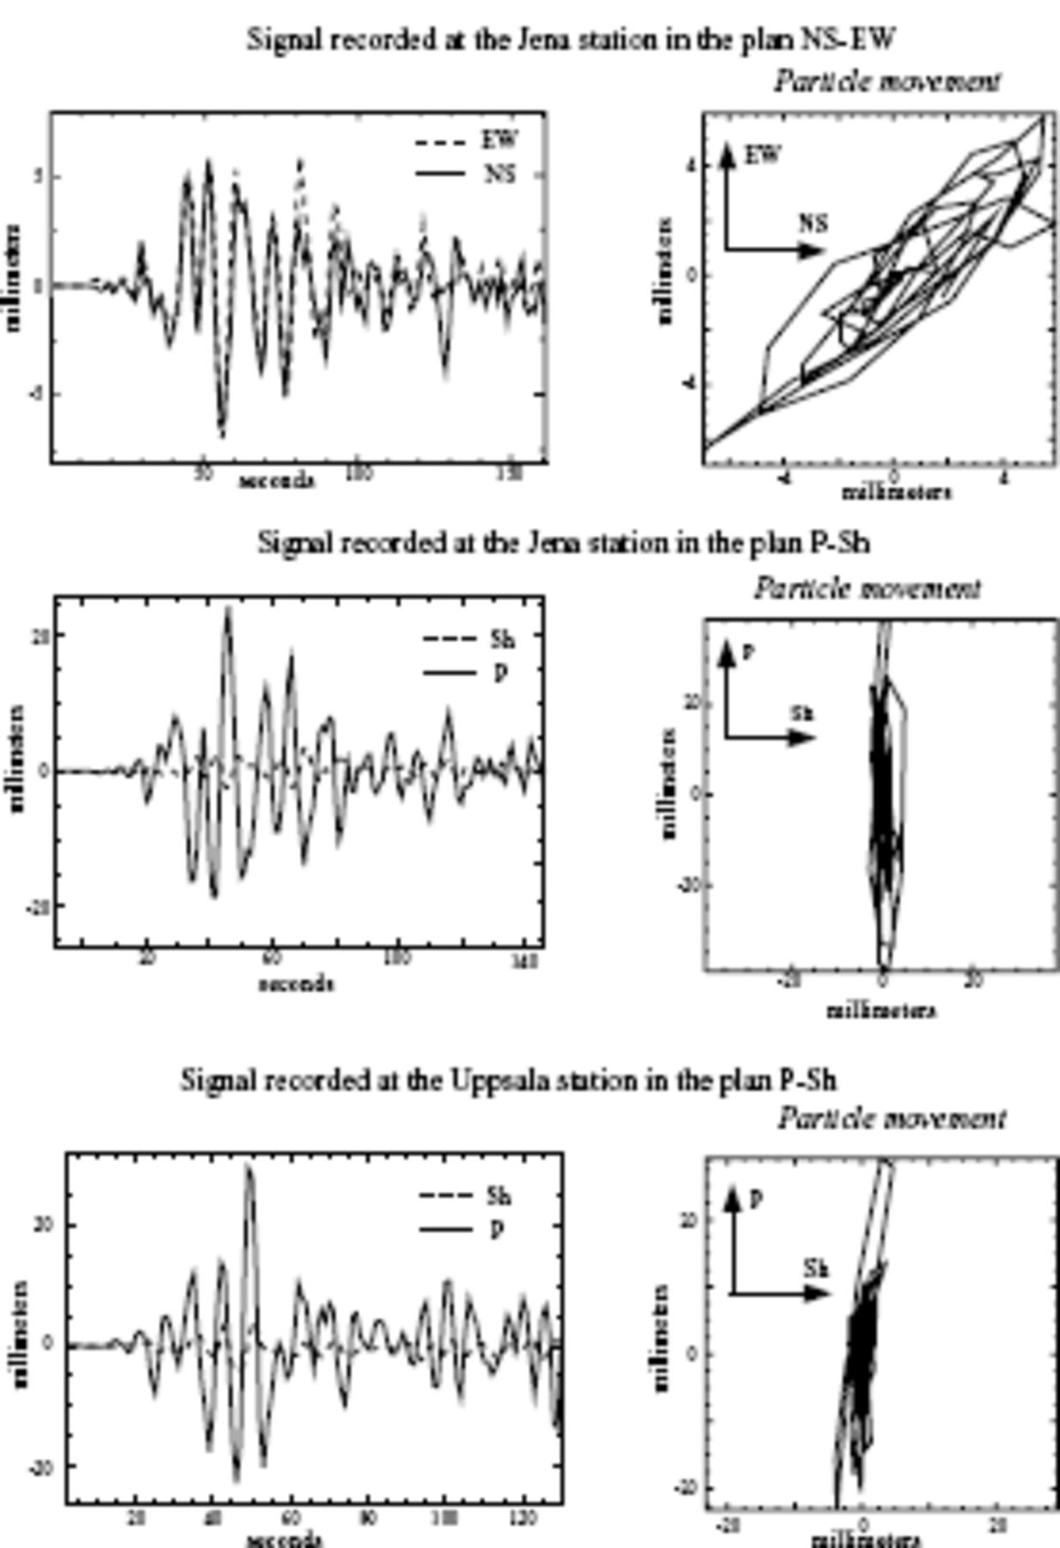
Figure 6. P-wave polarization—Bolnay 1905 earthquake.
Notes:
Figure 6. P-wave polarization—Bolnay 1905 earthquake.
Unless provided in the caption above, the following copyright applies to the content of this slide: © 2007 The Author Journal compilation © 2007 RAS

Slide 9
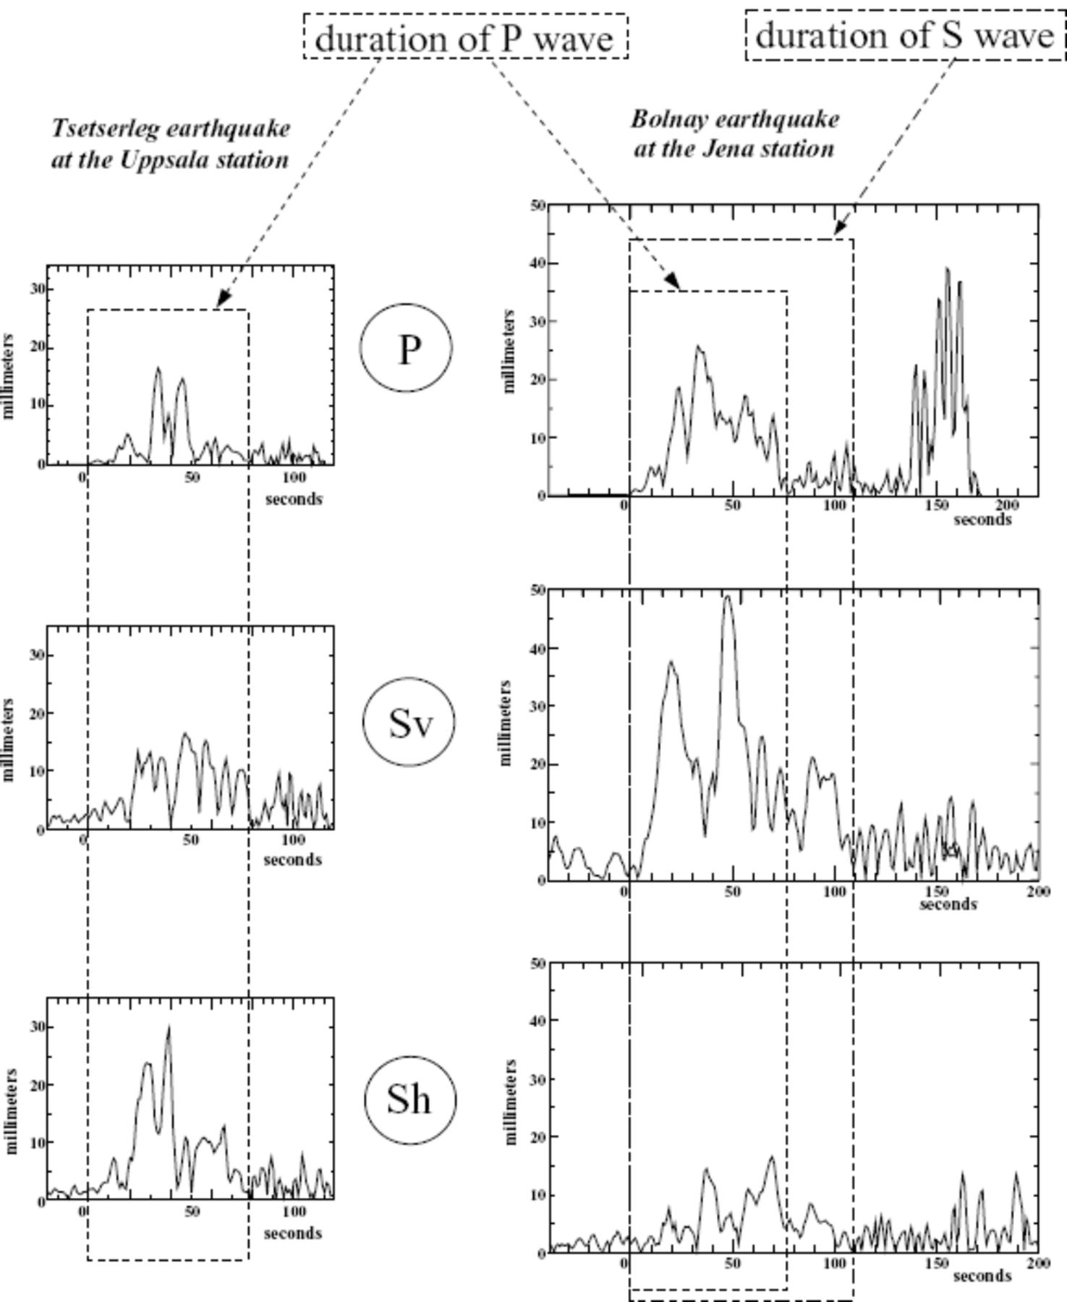
Figure 7. Signal envelope for the Tsetserleg and Bolnay 1905 earthquakes.
Notes:
Figure 7. Signal envelope for the Tsetserleg and Bolnay 1905 earthquakes.
Unless provided in the caption above, the following copyright applies to the content of this slide: © 2007 The Author Journal compilation © 2007 RAS

Slide 10
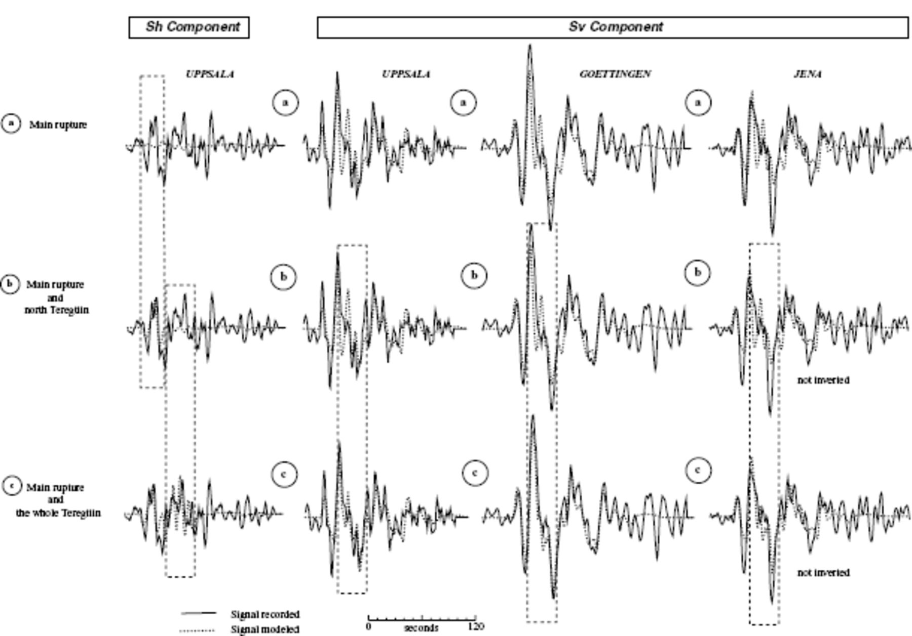
Figure 8. Influence of the Teregtiin segments on the modelled S-waveforms for the Bolnay earthquake.
Notes:
Figure 8. Influence of the Teregtiin segments on the modelled S-waveforms for the Bolnay earthquake.
Unless provided in the caption above, the following copyright applies to the content of this slide: © 2007 The Author Journal compilation © 2007 RAS

Slide 11
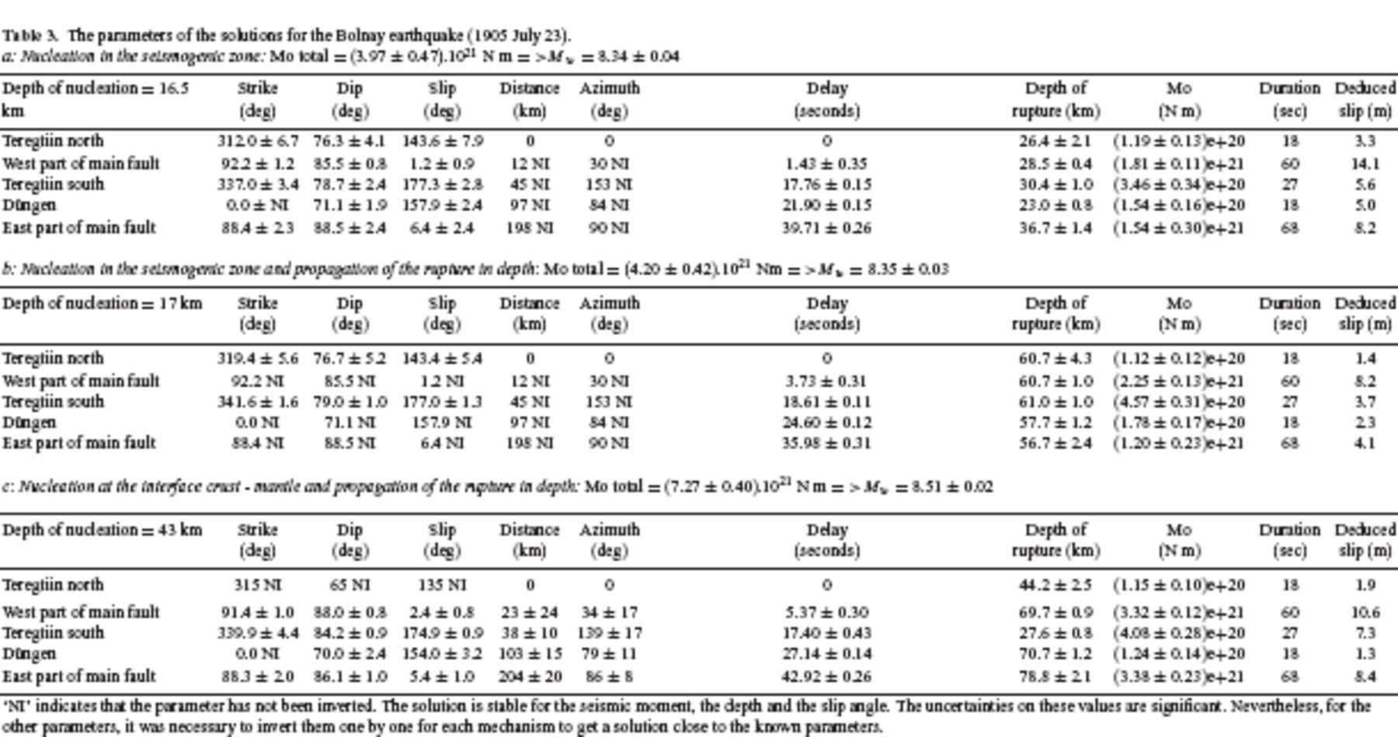
Table 3. The parameters of the solutions for the Bolnay earthquake (1905 July 23). a: Nucleation in the seismogenic ...
Notes:
Table 3. The parameters of the solutions for the Bolnay earthquake (1905 July 23). a: Nucleation in the seismogenic zone: Mo total = (3.97 ± 0.47).1021 N m = >;Mw = 8.34 ± 0.04
Unless provided in the caption above, the following copyright applies to the content of this slide: © 2007 The Author Journal compilation © 2007 RAS

Slide 12
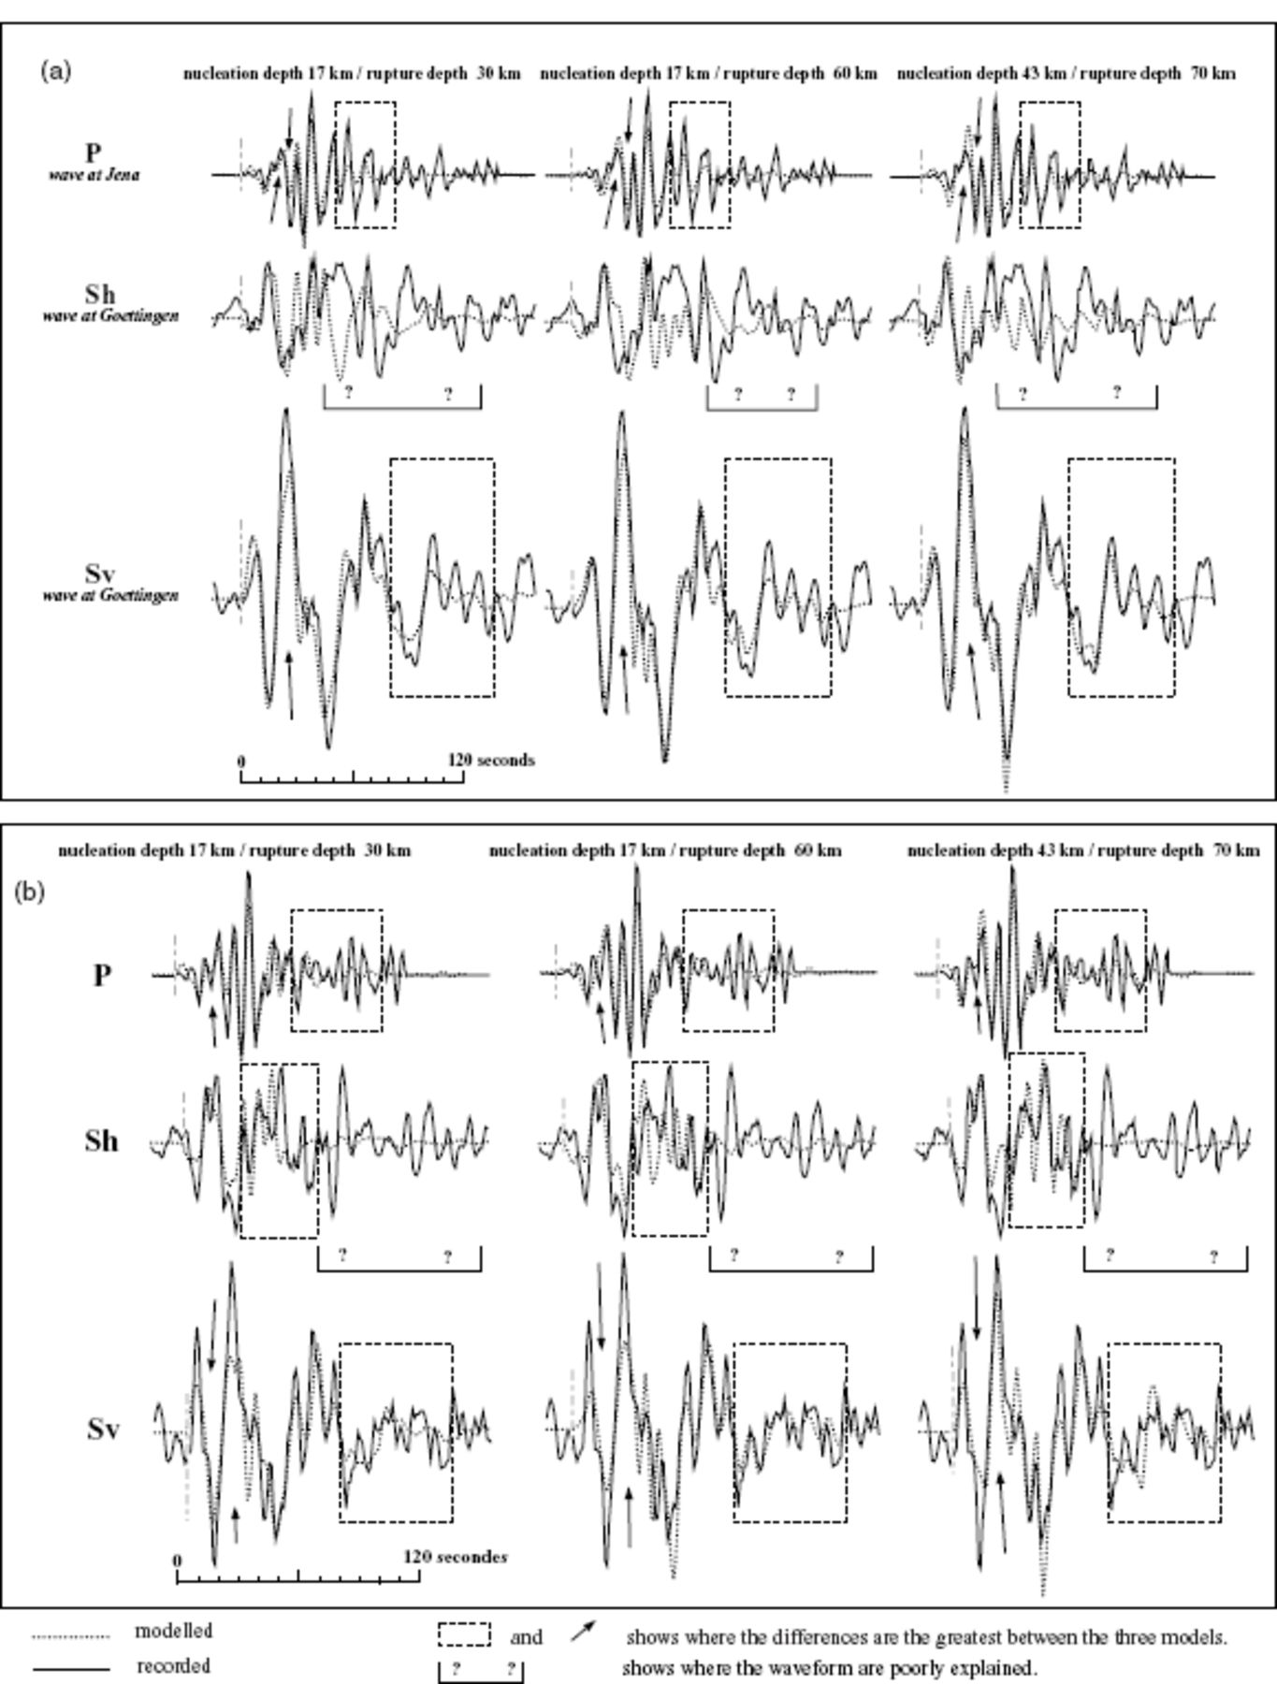
Figure 9. (a) Effect of the nucleation and rupture depths on the modelled body waveforms at Jena and Göttingen (Bolnay ...
Notes:
Figure 9. (a) Effect of the nucleation and rupture depths on the modelled body waveforms at Jena and Göttingen (Bolnay earthquake). (b) Effect of the nucleation and rupture depths on the modelled body waveforms at Uppsala (Bolnay earthquake).
Unless provided in the caption above, the following copyright applies to the content of this slide: © 2007 The Author Journal compilation © 2007 RAS

Slide 13
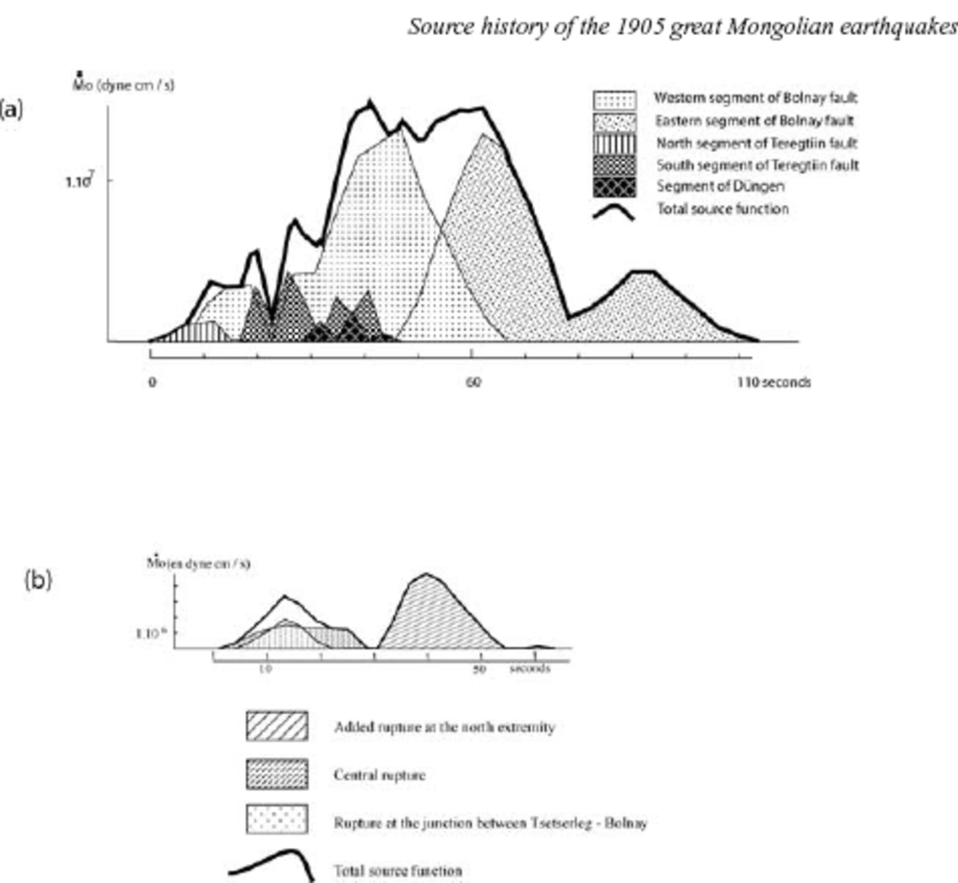
Figure 10. (a) Source function of the Bolnay earthquake. (b) Source function of the Tsetserleg earthquake with an ...
Notes:
Figure 10. (a) Source function of the Bolnay earthquake. (b) Source function of the Tsetserleg earthquake with an eastward rupture propagation.
Unless provided in the caption above, the following copyright applies to the content of this slide: © 2007 The Author Journal compilation © 2007 RAS

Slide 14
Table 4. The parameters of the solutions for the Tsetserleg earthquake (1905 July 9). a: Model with an eastward ...
Notes:
Table 4. The parameters of the solutions for the Tsetserleg earthquake (1905 July 9). a: Model with an eastward rupture propagation: Mo total = 1.06 ± 0.05 1021 N m = >;Mw = 7.95 ± 0.02
Unless provided in the caption above, the following copyright applies to the content of this slide: © 2007 The Author Journal compilation © 2007 RAS

Slide 15
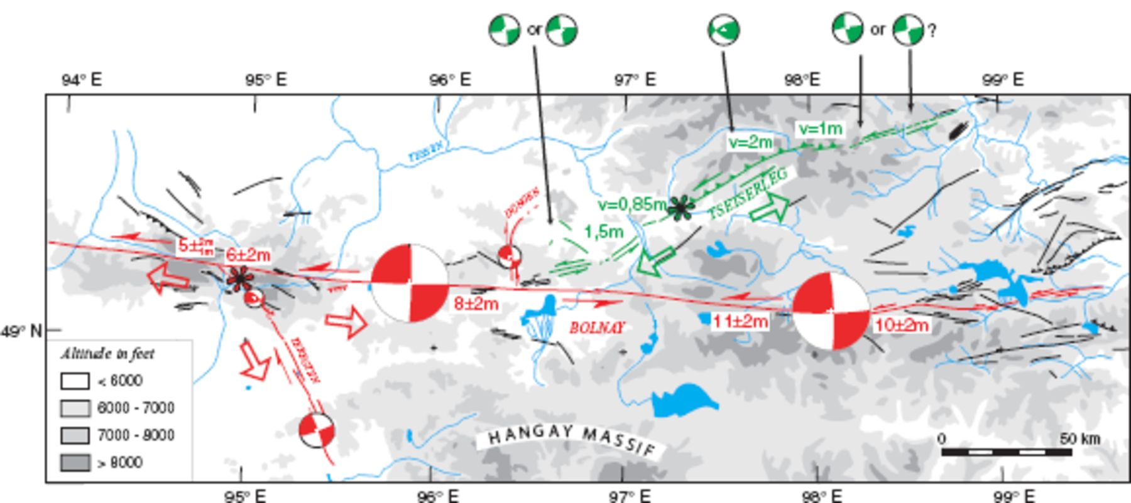
Figure 11. Surface ruptures, epicentre (star), focal mechanism of each segment, and rupture propagation direction (open ...
Notes:
Figure 11. Surface ruptures, epicentre (star), focal mechanism of each segment, and rupture propagation direction (open arrows) for Tsetserleg (green) and Bolnay (red) earthquakes.
Unless provided in the caption above, the following copyright applies to the content of this slide: © 2007 The Author Journal compilation © 2007 RAS

Slide 16
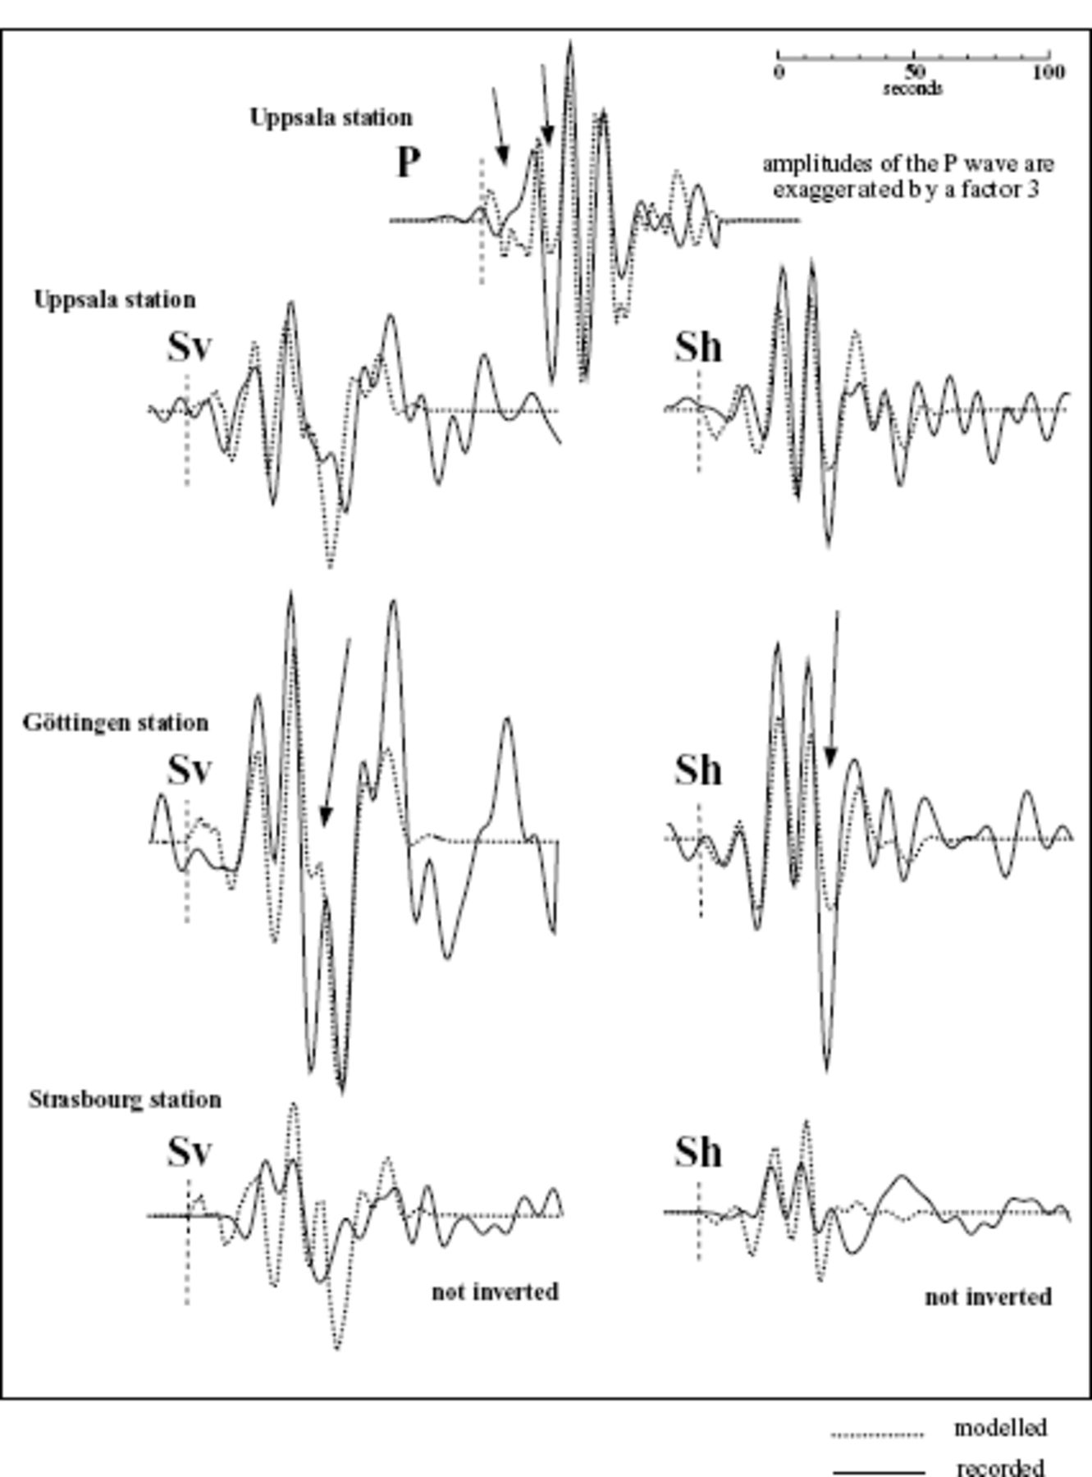
Figure 12. Solutions for an eastward propagation during the Tsetserleg earthquake. Arrows show poorly explained ...
Notes:
Figure 12. Solutions for an eastward propagation during the Tsetserleg earthquake. Arrows show poorly explained waveforms.
Unless provided in the caption above, the following copyright applies to the content of this slide: © 2007 The Author Journal compilation © 2007 RAS

Slide 17
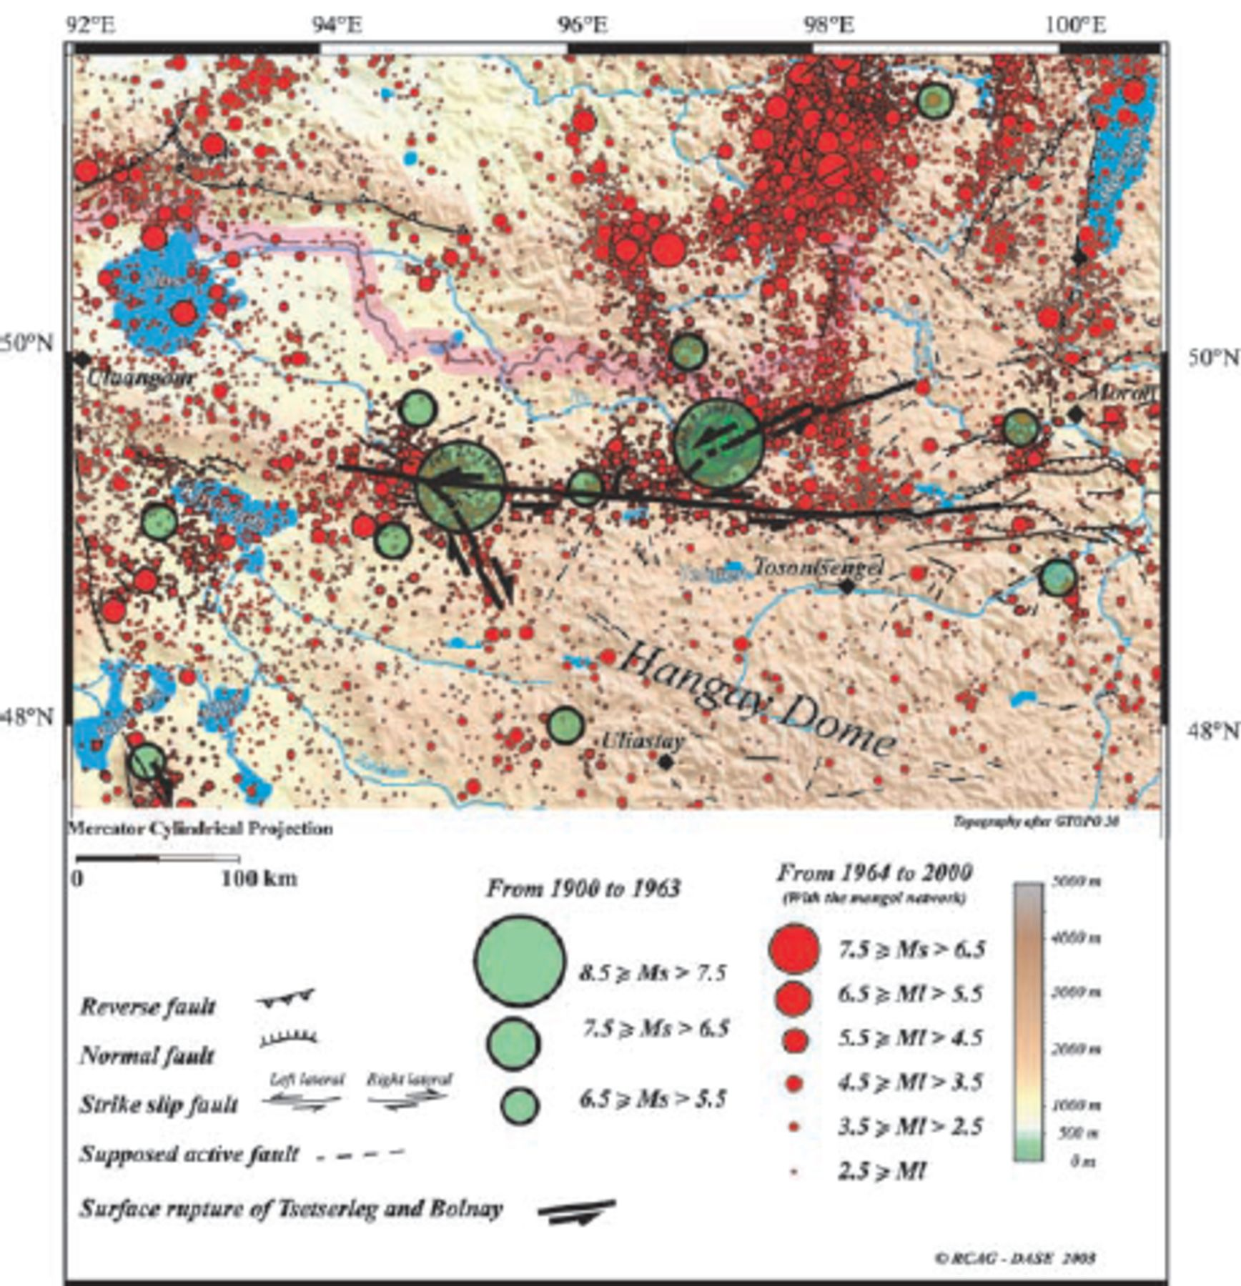
Figure 13. Recorded seismicity in the Bolnay—Tsetserleg region. After the map ‘ONE CENTURY OF SEISMICITY IN MONGOLIA ...
Notes:
Figure 13. Recorded seismicity in the Bolnay—Tsetserleg region. After the map ‘ONE CENTURY OF SEISMICITY IN MONGOLIA (1900–2000)’, Adiya et al. (2003).
Unless provided in the caption above, the following copyright applies to the content of this slide: © 2007 The Author Journal compilation © 2007 RAS

