Slide 1
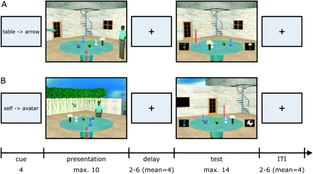
Figure 1. Design + trial structure and example stimuli. After the presentation of a cue for 4 s (which indicates the ...
Notes:
Figure 1. Design + trial structure and example stimuli. After the presentation of a cue for 4 s (which indicates the forthcoming movement to imagine), participants saw a table with 4 objects at different positions and a red pole set within a rich 3D environment (presentation phase). In addition, an arrow and an avatar are placed at varying locations around the table. The presentation image was shown for a maximum of 10 s. This was followed by a variable delay phase (2–6 s, mean 4 s). During the test phase (maximum 14 s), the scene was shown again and participants had to indicate which 1 of the 4 objects has been moved compared with the presentation image (a forced choice between 2 objects, see left and right bottom of the image). After an intertrial interval (ITI; 2–6 s, mean 4 s), the next trial started. Participants had either to imagine a table rotation to a new position (so that the pole is now at the avatar or arrow) or imagine a movement of viewpoint to the location indicated by the avatar or arrow. Examples scenes of the “table arrow” (A) and “self-avatar” conditions (B) are depicted. For the control condition (not shown), participants were simply asked to memorize the object locations (no change between presentation and test).
Unless provided in the caption above, the following copyright applies to the content of this slide: © The Author 2011. Published by Oxford University Press. All rights reserved. For permissions, please e-mail: journals.permissions@oup.com

Slide 2
Figure 2. Design and behavioral results. (A) Schematic of the 2 × 2 experimental design, with the factors rotation type ...
Notes:
Figure 2. Design and behavioral results. (A) Schematic of the 2 × 2 experimental design, with the factors rotation type (self- vs. table rotation) and cue type (avatar vs. arrow). Colors for the 4 cells of the design will be used in (B) and all subsequent figures. (B) Behavioral results. Mean RTs for both presentation and test phases and performance (percentage correct) during the test phase are plotted separately for the 4 conditions. ROT, rotation; se, self-rotation; ta, table rotation; av, avatar; ar, arrow; error bars ± standard error of the mean.
Unless provided in the caption above, the following copyright applies to the content of this slide: © The Author 2011. Published by Oxford University Press. All rights reserved. For permissions, please e-mail: journals.permissions@oup.com

Slide 3
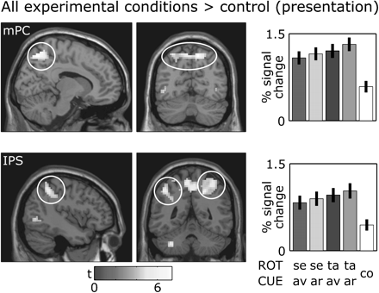
Figure 3. Comparison of the 4 experimental conditions and the control condition during the presentation phase. Regions ...
Notes:
Figure 3. Comparison of the 4 experimental conditions and the control condition during the presentation phase. Regions in medial (mPC; MNI coordinates of peak activity: 12/−66/54; peak z-score = 4.87) and lateral (intraparietal sulcus, IPS, −42/−48/48; z = 4.12) parietal cortex showed increased activity in the experimental conditions relative to the control condition. In this and all subsequent figures, plots show fMRI activation on aligned SPM structural template (shown at regional peak; left: sagittal section; right: coronal section; color bar indicates t value); bar plots show mean percentage fMRI signal change ( ±standard error of the mean) for peak voxel of respective region, separately for the 4 experimental conditions (white bar indicates mean activity in the control condition; current figure only); images are thresholded at P < 0.001 (≥ 3 voxels extent).
Unless provided in the caption above, the following copyright applies to the content of this slide: © The Author 2011. Published by Oxford University Press. All rights reserved. For permissions, please e-mail: journals.permissions@oup.com

Slide 4
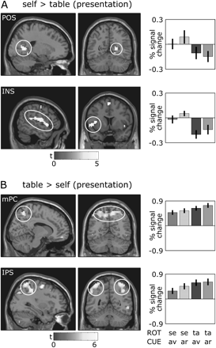
Figure 4. Main effect of rotation type during the presentation phase. (A) Parieto-occipital sulcus (POS) extending into ...
Notes:
Figure 4. Main effect of rotation type during the presentation phase. (A) Parieto-occipital sulcus (POS) extending into retrosplenial cortex (21/−57/6; z = 4.36) and insula (INS; −51/9/0; z = 4.50) activity was higher when participants imagined a self-rotation relative to the table rotation. (B) The reversed contrast revealed increased activity in medial (mPC; 12/−50/57; z = 4.42) and lateral parietal cortex (intraparietal cortex, IPS; 33/−51/63; z = 4.81). Note that these and the following effects of rotation type are independent of cue type.
Unless provided in the caption above, the following copyright applies to the content of this slide: © The Author 2011. Published by Oxford University Press. All rights reserved. For permissions, please e-mail: journals.permissions@oup.com

Slide 5
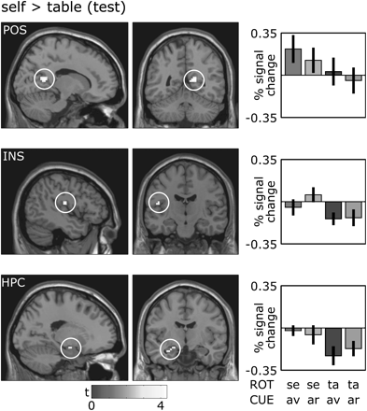
Figure 5. Main effect of rotation type during the test phase. In the test phase, we observed increased activity in ...
Notes:
Figure 5. Main effect of rotation type during the test phase. In the test phase, we observed increased activity in parieto-occipital sulcus (POS) extending into retrosplenial (15/−51/12; z = 3.98), insula (INS; −45/−15/15; z = 3.64), and hippocampus (HPC; −18/−9/−15; z = 3.47) during self-relative to table rotation.
Unless provided in the caption above, the following copyright applies to the content of this slide: © The Author 2011. Published by Oxford University Press. All rights reserved. For permissions, please e-mail: journals.permissions@oup.com

Slide 6
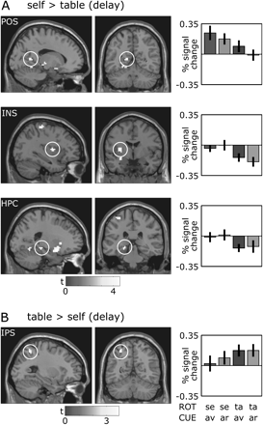
Figure 6. Main effect of rotation type during the delay phase. (A) Activity in both parieto-occipital sulcus (POS) ...
Notes:
Figure 6. Main effect of rotation type during the delay phase. (A) Activity in both parieto-occipital sulcus (POS) extending into retrosplenial cortex (−15/−54/6; z = 3.88), insula (INS; −33/−3/9; z = 3.97), and hippocampus (HPC; −21/−30/−9; z = 3.63) was also increased during the delay phase for self-rotation relative to table rotation trials. (B) Like during the presentation phase, we observed an increased activity in intraparietal sulcus (IPS; −27/−57/51; z = 3.63) during imagined table versus self-rotation.
Unless provided in the caption above, the following copyright applies to the content of this slide: © The Author 2011. Published by Oxford University Press. All rights reserved. For permissions, please e-mail: journals.permissions@oup.com

Slide 7
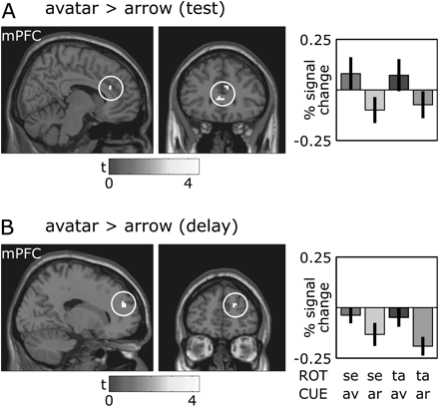
Figure 7. Effects of cue type. In both test (A) and delay (B) phases, we found increased activity in medial prefrontal ...
Notes:
Figure 7. Effects of cue type. In both test (A) and delay (B) phases, we found increased activity in medial prefrontal cortex (mPFC; test: 9/30/24; z = 3.29; delay: 18/51/21; z = 3.96) when participants imagined either self or table rotation relative to the avatar but not to the arrow. Note these effects of cue type are independent of rotation type.
Unless provided in the caption above, the following copyright applies to the content of this slide: © The Author 2011. Published by Oxford University Press. All rights reserved. For permissions, please e-mail: journals.permissions@oup.com

