Slide 1
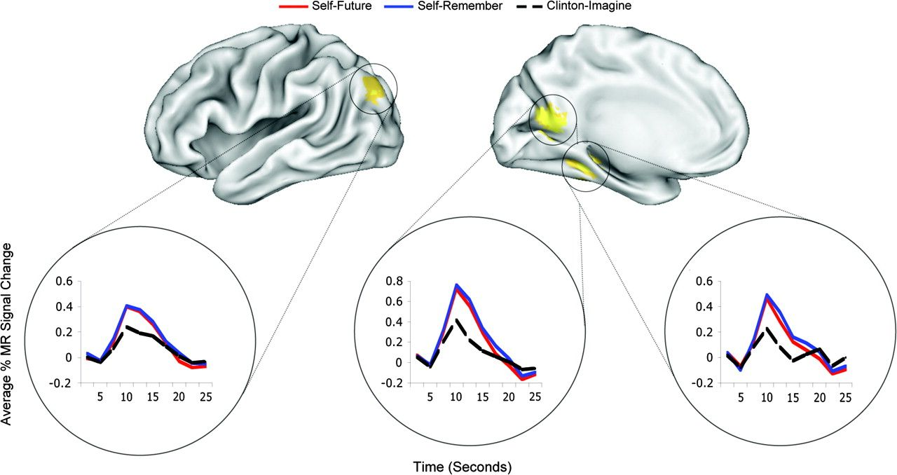
Figure 1. Percent signal change for brain regions exhibiting indistinguishable patterns of brain activity across time ...
Notes:
Figure 1. Percent signal change for brain regions exhibiting indistinguishable patterns of brain activity across time while participants envisioned their personal future and recollected the past. Imagining a familiar individual in similar scenarios resulted in a pattern of activity different from both the past and future tasks. Regions appear within (from left to right) superior occipital gyrus (SOG), posterior cingulate cortex (PCC), and parahippocampal cortex (PHC). Adapted from Szpunar et al. (2007).
Unless provided in the caption above, the following copyright applies to the content of this slide: © The Author 2008. Published by Oxford University Press. All rights reserved. For permissions, please e-mail: journals.permissions@oxfordjournals.org

Slide 2
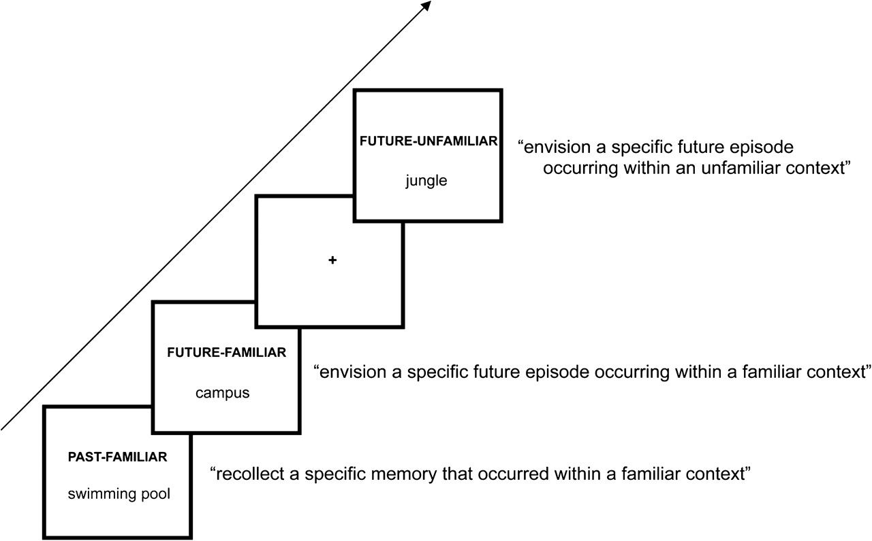
Figure 2. Experimental design.
Notes:
Figure 2. Experimental design.
Unless provided in the caption above, the following copyright applies to the content of this slide: © The Author 2008. Published by Oxford University Press. All rights reserved. For permissions, please e-mail: journals.permissions@oxfordjournals.org

Slide 3
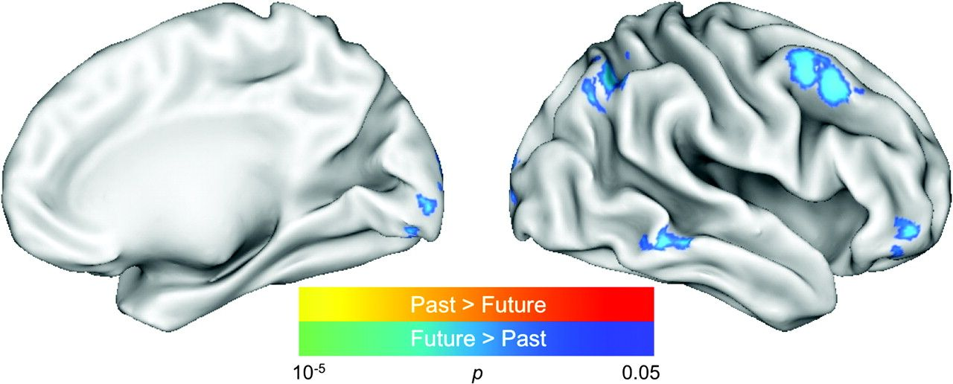
Figure 5. Statistical map demonstrating activity across the whole brain for the past (familiar context) versus future ...
Notes:
Figure 5. Statistical map demonstrating activity across the whole brain for the past (familiar context) versus future (familiar context) contrast. Colored pixels exceeded the statistical threshold of P < 0.05 (corrected). Activations were predominately bilateral (lateral and medial aspect of right hemisphere shown here). The color scales represent the significance level for past (relative to future) activations (from red [lowest] to yellow [highest]) and future (relative to past) activations (from blue [lowest] to green [highest]).
Unless provided in the caption above, the following copyright applies to the content of this slide: © The Author 2008. Published by Oxford University Press. All rights reserved. For permissions, please e-mail: journals.permissions@oxfordjournals.org

Slide 4
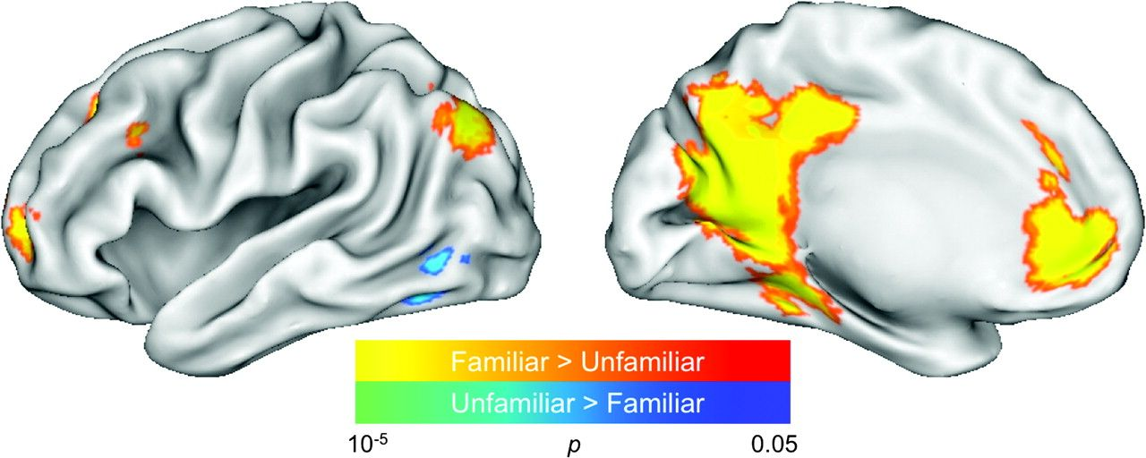
Figure 4. Statistical map demonstrating activity across the whole brain for the familiar (past + future) versus ...
Notes:
Figure 4. Statistical map demonstrating activity across the whole brain for the familiar (past + future) versus unfamiliar context contrast. Colored pixels exceeded the statistical threshold of P < 0.05 (corrected). Activations were predominantly left lateralized (lateral and medial aspect of left hemisphere shown here). The color scales represent the significance level for familiar (relative to unfamiliar) context activations (from red [lowest] to yellow [highest]) and unfamiliar (relative to familiar) context activations (from blue [lowest] to green [highest]).
Unless provided in the caption above, the following copyright applies to the content of this slide: © The Author 2008. Published by Oxford University Press. All rights reserved. For permissions, please e-mail: journals.permissions@oxfordjournals.org

Slide 5
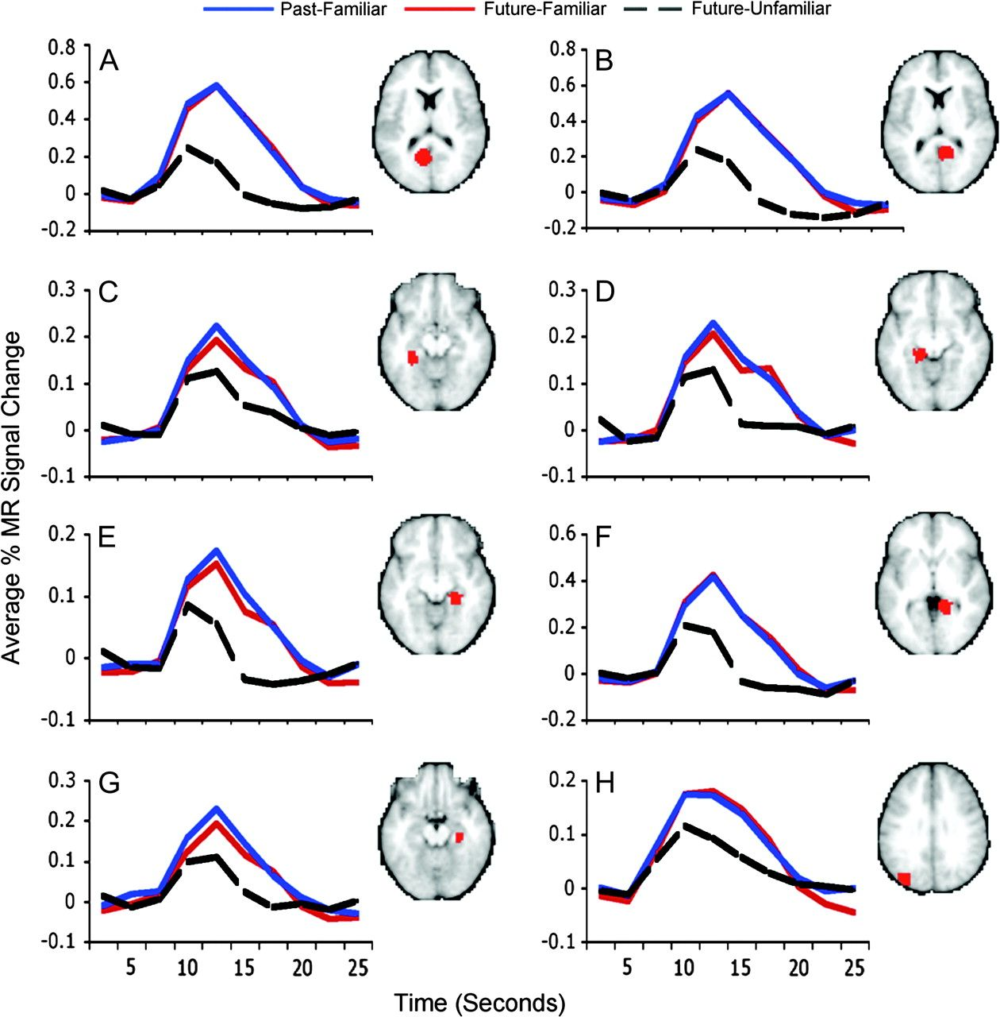
Figure 3. Percent signal change for regions from Table 1 showing a statistically indistinguishable pattern of activity ...
Notes:
Figure 3. Percent signal change for regions from Table 1 showing a statistically indistinguishable pattern of activity across time while participants envisioned their personal future and recollected the past in the context of familiar contextual cues (e.g., apartment). Imagining oneself in the future in an unfamiliar context (e.g., safari) resulted in a pattern of activity different from both the past and future tasks involving familiar contexts.
Unless provided in the caption above, the following copyright applies to the content of this slide: © The Author 2008. Published by Oxford University Press. All rights reserved. For permissions, please e-mail: journals.permissions@oxfordjournals.org

