Slide 1
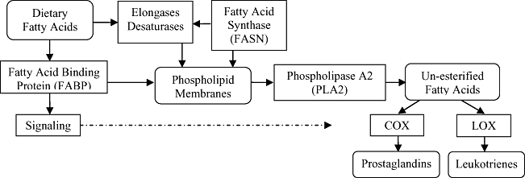
Figure 1 Metabolism of dietary fatty acids to eicosanoids. Metabolic processes modulate the effect of dietary changes ...
Notes:
Figure 1 Metabolism of dietary fatty acids to eicosanoids. Metabolic processes modulate the effect of dietary changes on fatty acid levels in membranes and on the eicosanoids that are formed.
Unless provided in the caption above, the following copyright applies to the content of this slide: © 2011 International Life Sciences Institute

Slide 2
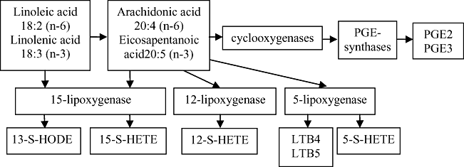
Figure 2 Formation of eicosanoids: select products. The other products shown are from n-6 fatty acids except for PGE3 ...
Notes:
Figure 2 Formation of eicosanoids: select products. The other products shown are from n-6 fatty acids except for PGE3 and LTB5, which are formed from n-3 fatty acids. Eicosapentaenoic acid inhibits oxygenation of arachidonic acid by cyclooxygenase 1 (COX-1), but this inhibition is modest with COX-2.197 The n-9 fatty acid oleic acid (18:1, n-9) forms 20:3 (n-9), which has not been studied as extensively (not shown), but it has been reported to form the unstable LTA3 via 5-lipoxygenase that, in turn, inhibits formation of LTB4.198,199
Unless provided in the caption above, the following copyright applies to the content of this slide: © 2011 International Life Sciences Institute

