Slide 1
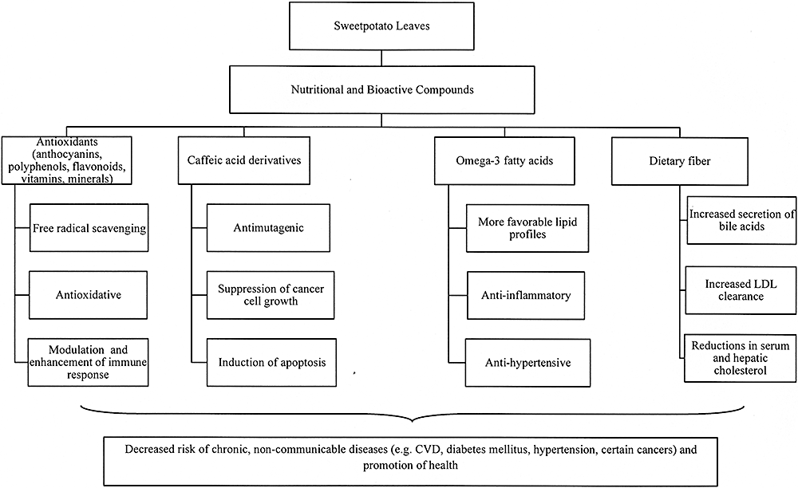
Figure 1 Synergistic effects of the major nutritional and bioactive compounds within sweet potato leaves in disease ...
Notes:
Figure 1 Synergistic effects of the major nutritional and bioactive compounds within sweet potato leaves in disease prevention and health promotion.
Unless provided in the caption above, the following copyright applies to the content of this slide: © 2010 International Life Sciences Institute

