Slide 1
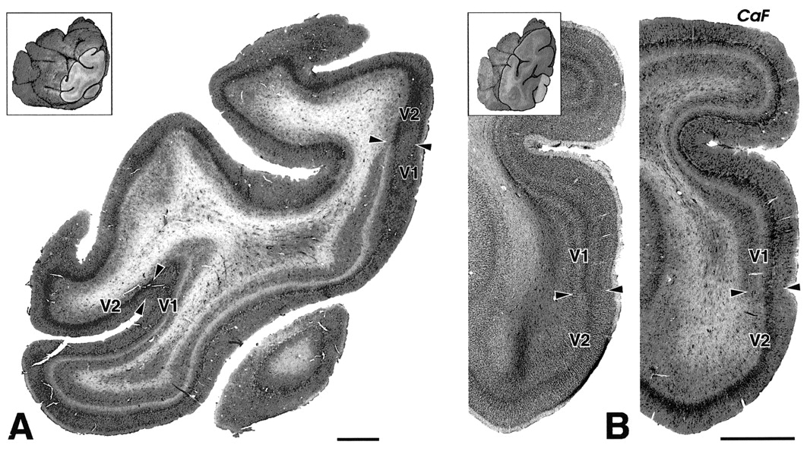
Figure 1. Low-magnification views of Cat-301 immunostaining in coronal sections through area V1 of a human left ...
Notes:
Figure 1. Low-magnification views of Cat-301 immunostaining in coronal sections through area V1 of a human left occipital lobe. (A) A Cat-301-stained section taken from a very posterior level of the occipital lobe, ∼4.5_mm anterior to the occipital pole. (B) A pair of sections stained for Nissl (left) and Cat-301 (right) taken from a more anterior level (∼10_mm anterior to the occipital pole), and magnified to show the ventral bank of the calcarine fissure (CaF) and mesial surface of the ventral occipital lobe. The insets indicate the locations of the sections in (A) and (B) within the tissue block, which is shown from a posterolateral perspective. Area V1 has a very well stratified appearance in Cat-301-stained sections, distinctly different from the neighboring second visual area (V2). The middle levels of cortex contain a very dark-staining band, and along the superficial margin of this band, irregularly shaped zones of light staining are embedded within zones of darker staining. These alternating light and dark territories are characteristic of human layer 4A in tissue stained for Cat-301. Scales: 2.5_mm.
Unless provided in the caption above, the following copyright applies to the content of this slide: © Oxford University Press

Slide 2
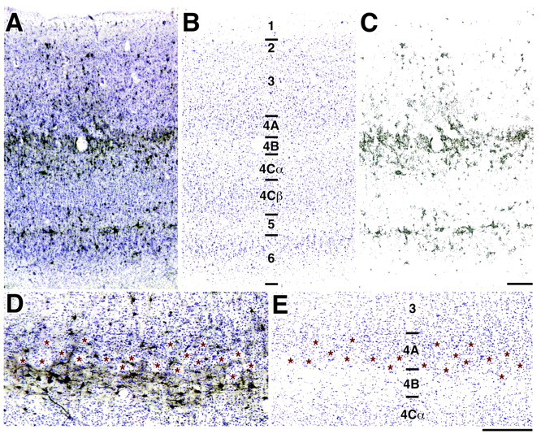
Figure 2. Laminar analysis of Cat-301 immunoreactivity in human area V1. (A) shows a photomicrograph of a section ...
Notes:
Figure 2. Laminar analysis of Cat-301 immunoreactivity in human area V1. (A) shows a photomicrograph of a section immunostained for Cat-301 and counterstained for Nissl. From this image, separate representations of Nissl staining (B) and Cat-301 immunoreactivity (C) have been extracted by selecting arrays of blue pixels and red–brown pixels, respectively. (D) shows a higher-magnification photomicrograph of a section stained for Cat-301 and for Nissl. The locations of light territories outlined by dark Cat-301 staining are marked with stars. (E) shows the location of blue pixels, representing Nissl-stained elements extracted from (D), along with stars marking the locations of territories that stain lightly for Cat-301. The mesh-like pattern of Cat-301 staining is located within layer 4A. Scales: 250 μm.
Unless provided in the caption above, the following copyright applies to the content of this slide: © Oxford University Press

Slide 3
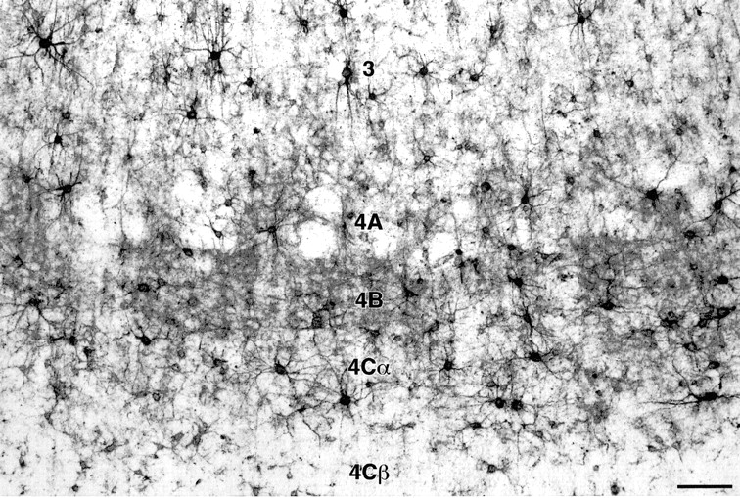
Figure 3. A higher-magnification photomicrograph of Cat-301 immunoreactivity in human primary visual cortex, showing ...
Notes:
Figure 3. A higher-magnification photomicrograph of Cat-301 immunoreactivity in human primary visual cortex, showing detail of the compartmentation of layer 4A. Cat-301 labels predominantly nonpyramidal neurons, spanning a wide range of soma size, in layer 4 and its subdivisions. Scale: 100 μm.
Unless provided in the caption above, the following copyright applies to the content of this slide: © Oxford University Press

Slide 4
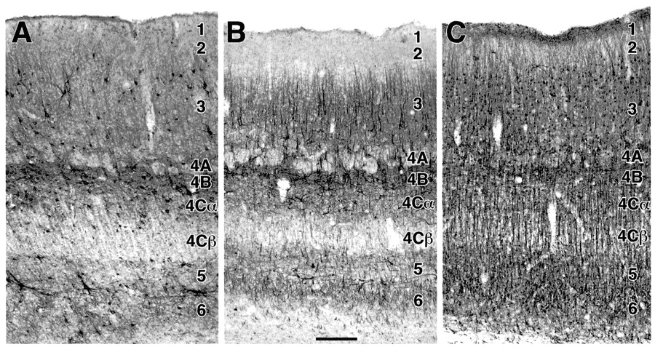
Figure 4. Sections from the calcarine fissure of a single human occipital lobe stained for (A) Cat-301, (B) NPNF and ...
Notes:
Figure 4. Sections from the calcarine fissure of a single human occipital lobe stained for (A) Cat-301, (B) NPNF and (C) MAP 2. The pattern of staining in layer 4A obtained with Cat-301 is similar to that seen with NPNF and MAP 2 immunoreactivity, with bands of dark-staining tissue surrounding irregularly sized pockets of lighter staining. Scale: 250 μm.
Unless provided in the caption above, the following copyright applies to the content of this slide: © Oxford University Press

Slide 5
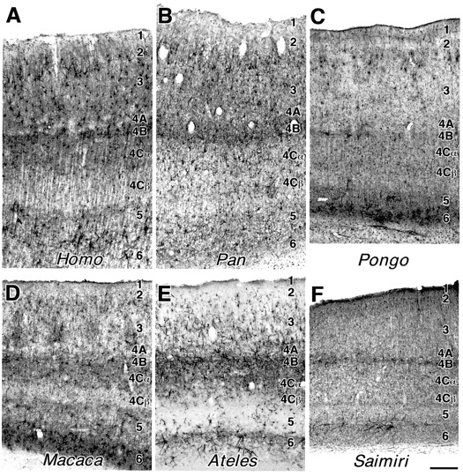
Figure 5. Distribution of Cat-301 immunoreactivity in area V1 of six primate taxa, specifically humans (Homo), ...
Notes:
Figure 5. Distribution of Cat-301 immunoreactivity in area V1 of six primate taxa, specifically humans (Homo), chimpanzee (Pan), orangutan (Pongo), macaque monkey (Macaca), spider monkey (Ateles) and squirrel monkey (Saimiri). Scale: 250 μm.
Unless provided in the caption above, the following copyright applies to the content of this slide: © Oxford University Press

Slide 6
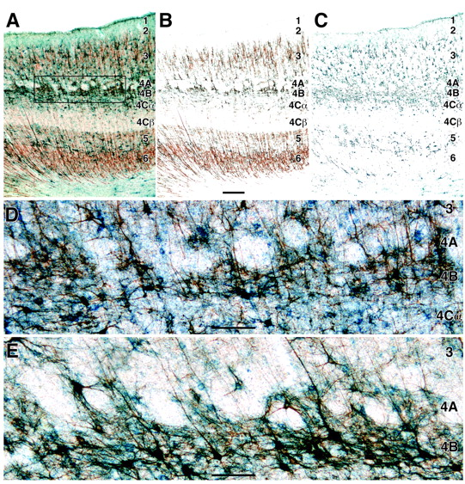
Figure 6. Photographs of double-immunostained sections from human area V1, illustrating the localization of NPNF and ...
Notes:
Figure 6. Photographs of double-immunostained sections from human area V1, illustrating the localization of NPNF and Cat-301 within the same tissue compartments of layer 4A. (A) A section stained for NPNF with TMB–DAB–Co, which yields a reddish reaction product, followed by incubation with Cat-301 and reaction with TMB only, which yields a blue reaction product. (B) An array of red–brown pixels selected from the image in (A), indicating the location of NPNF immunoreactivity. (C) An array of blue pixels, extracted from the image in (A), indicating the location of Cat-301 immunoreactivity. (D,E) Higher-magnification photomicrographs showing layers 4A and 4B in sections double-stained for NPNF (red) and Cat-301 (blue). (D) shows the region enclosed within the box in (A); (E) is from a different case. Scales: (A–C) = 250 μm; (D, E) = 100 μm.
Unless provided in the caption above, the following copyright applies to the content of this slide: © Oxford University Press

Slide 7
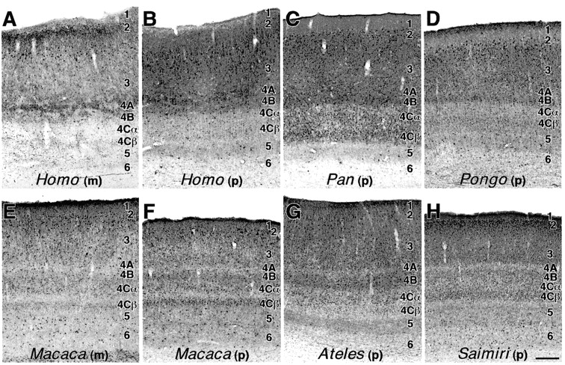
Figure 7. The distribution of calbindin immunoreactivity in area V1 of six primate taxa, stained with a monoclonal (m) ...
Notes:
Figure 7. The distribution of calbindin immunoreactivity in area V1 of six primate taxa, stained with a monoclonal (m) or a polyclonal (p) antibody. Pairs of sections illustrate the patterns of staining observed with the monoclonal and polyclonal antibody in Homo (A,B) and Macaca (E,F). The polyclonal typically produces more extensive neuropil staining than the monoclonal in Homo and Macaca, although the laminar distribution of staining is very similar and both antibodies clearly show separate zones of dark and light staining in layer 4A. In the other primate taxa examined, the density and distribution of immunostaining was very similar with the monoclonal and polyclonal antibodies, and only results with the polyclonal are illustrated here. The large, ovoid territories of relatively light staining located within layer 3 presumably correspond to CO blobs (Hendry and Carder, 1993). Scale: 250 μm.
Unless provided in the caption above, the following copyright applies to the content of this slide: © Oxford University Press

Slide 8
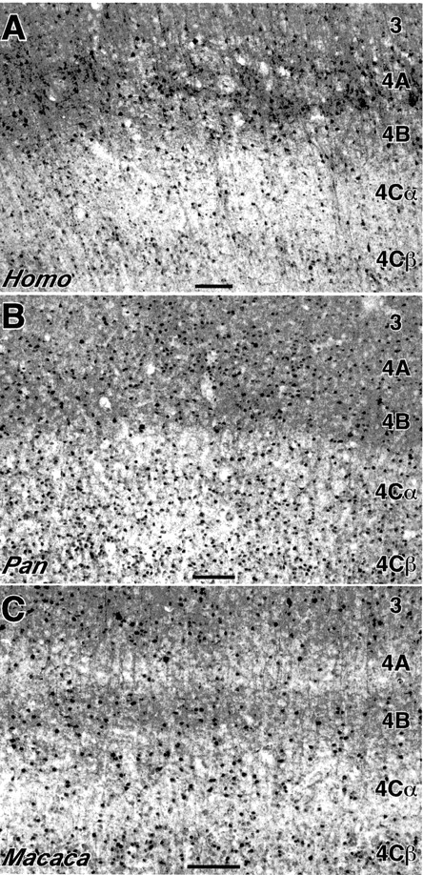
Figure 8. Calbindin immunoreactivity in layer 4 of humans (Homo), chimpanzees (Pan) and macaque monkeys (Macaca). There ...
Notes:
Figure 8. Calbindin immunoreactivity in layer 4 of humans (Homo), chimpanzees (Pan) and macaque monkeys (Macaca). There are strong species differences in the density and distribution of staining in layer 4A. In Homo (A), there are irregularly shaped territories of very darkly stained tissue in layer 4A, which are surrounded by tissue that stains at a density comparable to layer 4B. Pan (B), lacks the separate dark and light zones seen in humans; layer 4A has a more uniformly stained appearance, very similar to layer 4B. In Macaca (C), layer 4A stands out as a relatively light-staining band, as it does in the New World monkeys Ateles and Saimiri (see Fig. 7). Scales: 100 μm.
Unless provided in the caption above, the following copyright applies to the content of this slide: © Oxford University Press

Slide 9
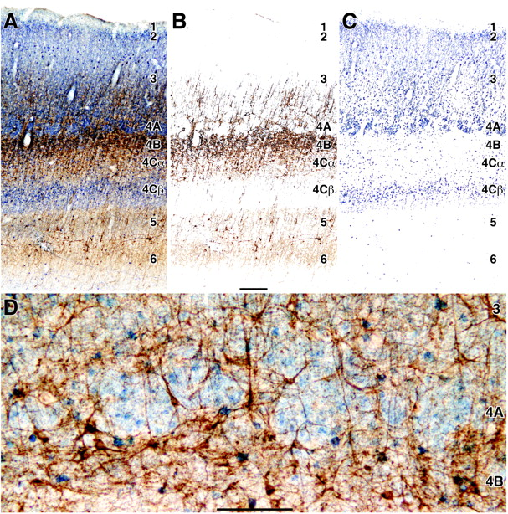
Figure 9. Double-immunostaining for NPNF and calbindin in human area V1, illustrating the complementary distribution of ...
Notes:
Figure 9. Double-immunostaining for NPNF and calbindin in human area V1, illustrating the complementary distribution of these proteins in layer 4A. NPNF is labeled with the reddish-brown TMB–DAB–Co reaction product, calbindin with the blue TMB reaction product. (A) A double-stained section, from which separate arrays of reddish-brown and blue pixels have been extracted to represent NPNF (B) and calbindin (C) immunoreactivity, respectively. (D) shows layer 4A at higher magnification in a section from a different case. Scales: (A–C) = 250μm; (D) = 100 μm.
Unless provided in the caption above, the following copyright applies to the content of this slide: © Oxford University Press

Slide 10
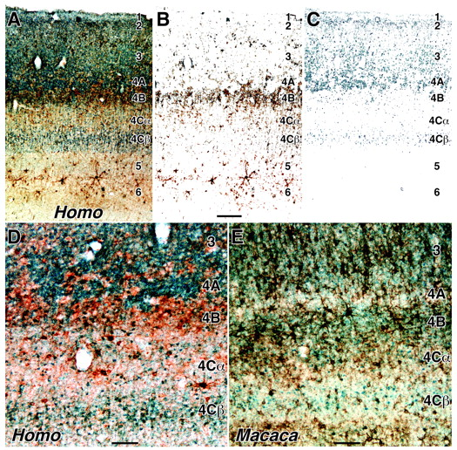
Figure 10. Double-immunostaining for Cat-301 and calbindin in area V1 in humans and macaques, illustrating the ...
Notes:
Figure 10. Double-immunostaining for Cat-301 and calbindin in area V1 in humans and macaques, illustrating the complementary distribution of these antigens in layer 4A. Cat-301 is labeled with the reddish-brown TMB–DAB–Co reaction product, calbindin with the blue TMB reaction product. (A) A double-stained section from human V1, from which reddish-brown and blue pixels have been extracted, as shown in (B) and (C), respectively. (D,E) Higher-magnification photomicrographs of the middle cortical layers of V1 in Homo and Macaca. Human layer 4A contains dense Cat-301 and calbindin immunoreactivity, concentrated in alternating compartments. Macaque layer 4A, by contrast, stands out as a relatively light band, lacking either strong Cat-301 or calbindin staining. Scales: (A–C) = 250 μm; (D,E) = 100 μm.
Unless provided in the caption above, the following copyright applies to the content of this slide: © Oxford University Press

Slide 11
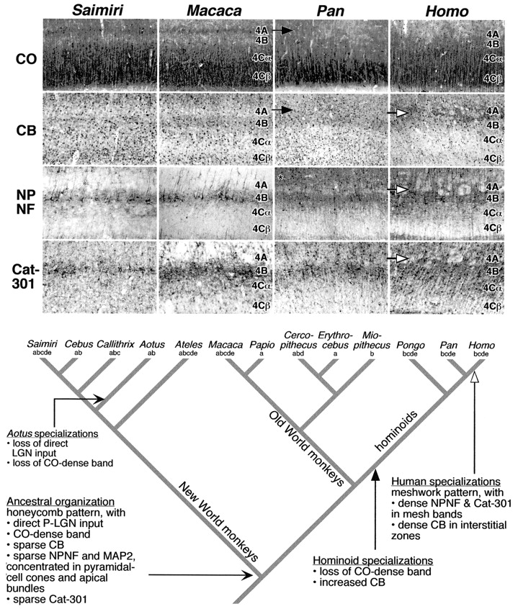
Figure 11. A reconstruction of layer 4A evolution in anthropoid primates. The photomicrograph set illustrates the ...
Notes:
Figure 11. A reconstruction of layer 4A evolution in anthropoid primates. The photomicrograph set illustrates the condition of layer 4A and adjacent layers in sections stained for CO, calbindin, NPNF and Cat-301 in a New World monkey (Saimiri), an Old World monkey (Macaca) and two hominoids (Pan and Homo). The phylogenetic diagram illustrates the branching tree of relationships among anthropoid primates as currently understood (Purvis, 1995). The letter code beneath the name of each genus represents the kinds of data published for that genus, as follows: (a) the presence or absence of direct projections from LGN to 4A, (b) the presence or absence of a CO-dense band, (c) level of expression of calbindin in 4A, (d) pattern of expression of NPNF, and (e) the pattern of expression of Cat-301. Data are available for 13 of the 36 anthropoid genera recognized by Purvis (Purvis, 1995). Some genera (Saimiri, Macaca) have been evaluated in all these aspects of organization, whereas for others (e.g. Erythrocebus) much more limited data are available. Citations are presented in the text. The reconstruction was generated using MacClade software (Maddison and Maddison, 1992), which is routinely used in studies of molecular and morphological evolution. The software takes as inputs the branching pattern of relationships among taxa and the state of each character for each taxon; missing data are permitted. The software then determines the sequence of change that yields the observed distribution of character states with the smallest number of changes (the maximum parsimony method). As an integral part of the analysis, the software reconstructs the ancestral set of character states and identifies branches in which transformations occurred. The reconstruction indicates that the last common ancestor of living anthropoid primates probably had a honeycomb-like layer 4A organization, similar to that present in modern macaque monkeys and most other Old World and New World monkeys that have been examined. The hallmarks of ancestral organization are direct LGN inputs, a CO-dense band, low expression of calbindin, limited expression of NPNF (largely restricted to pyramidal-cell cones and associated apical dendrites), and low expression of the Cat-301 antigen. This ancestral organization was modified at no fewer than two points in human phylogeny. The first set of changes (denoted by filled arrows in both the photograph set and the phylogenetic diagram), which occurred early in hominoid evolution, prior to the divergence of the Pongo, Pan and Homo lineages, entailed loss of the CO-dense band and increased expression of calbindin. The reduction of CO may have occurred in conjunction with the reduction or loss of the direct LGN afferents, as occurred in the evolution of owl monkeys (Aotus). Definitive connectional evidence for apes and humans is lacking, however. Also associated with the evolution of hominoids was a conspicuous increase in expression of NPNF in layer 3 (denoted with the asterisk), as discussed in Preuss et al. (Preuss et al., 1999). The second set of changes (denoted by open arrows), occurred more recently in human evolution, after the divergence of the Pan and Homo lineages, and were associated with the appearance of a mesh-like pattern of NPNF and Cat-301 expression, and the dense expression of calbindin in the interstitial tissue zones. Vernacular names for primate genera are as follows: Saimiri – squirrel monkeys, Cebus – capuchin monkeys, Callithrix – marmosets, Aotus – owl monkeys, Ateles – spider monkeys, Macaca – macaque monkeys, Papio – baboons, Cercopithecus – guenons (including green monkeys), Erythrocebus – patas monkeys, Miopithecus – talapoin monkeys, Pongo – orangutans, Pan – chimpanzees, Homo – humans.
Unless provided in the caption above, the following copyright applies to the content of this slide: © Oxford University Press

