Slide 1
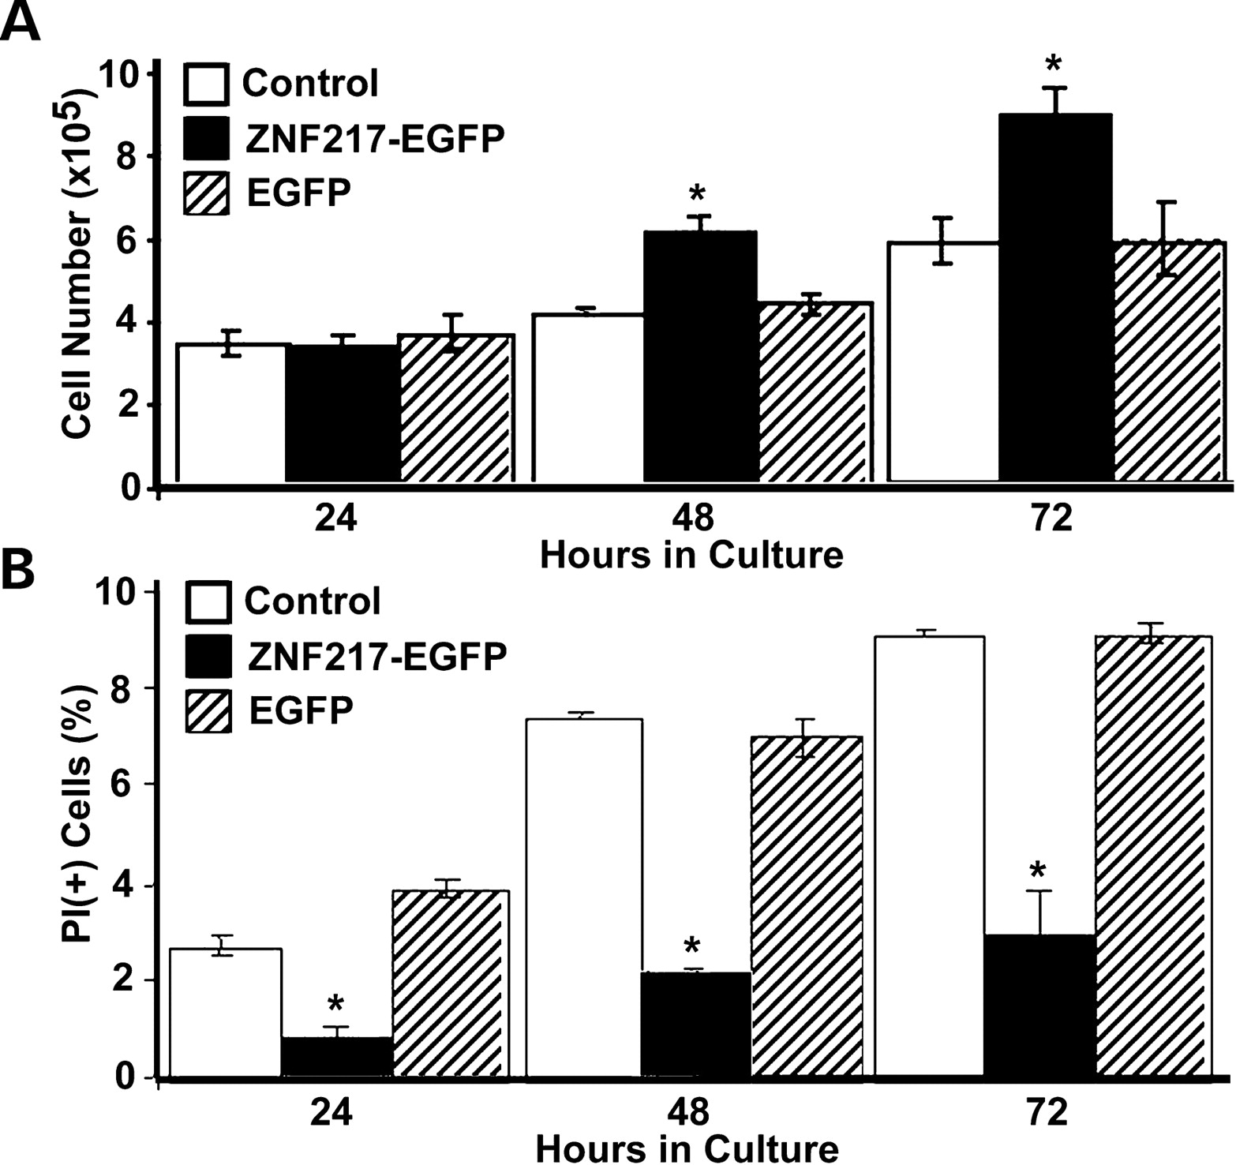
Figure 1. Cells accumulate faster in ZNF217 –EGFP-transfected HeLa cell cultures and undergo a lower rate of ...
Notes:
Figure 1. Cells accumulate faster in ZNF217 –EGFP-transfected HeLa cell cultures and undergo a lower rate of spontaneous cell death than that in parallel control cultures. ( A ) Non-transfected (white), ZNF217 –EGFP transfected (black) or EGFP vector transfected (striped) cells were plated in triplicate in six-well plates and grown in medium. At 24, 48 and 72 h after plating, cells were harvested and counted. ( B ) At indicated times, adherent and non-adherent cells were combined, stained with PI and analyzed by flow cytometry. The percentage of PI(+) cells corresponds to the percentage of dead cells in the respective cultures. Each experimental point represents the mean of at least three independent experiments ±standard deviation. An asterisk denotes P ≤0.005 for those cultures transfected with ZNF217 –EGFP when compared with EGFP alone.
Unless provided in the caption above, the following copyright applies to the content of this slide: © The Author 2005. Published by Oxford University Press. All rights reserved. For Permissions, please email: journals.permissions@oxfordjournals.org

Slide 2
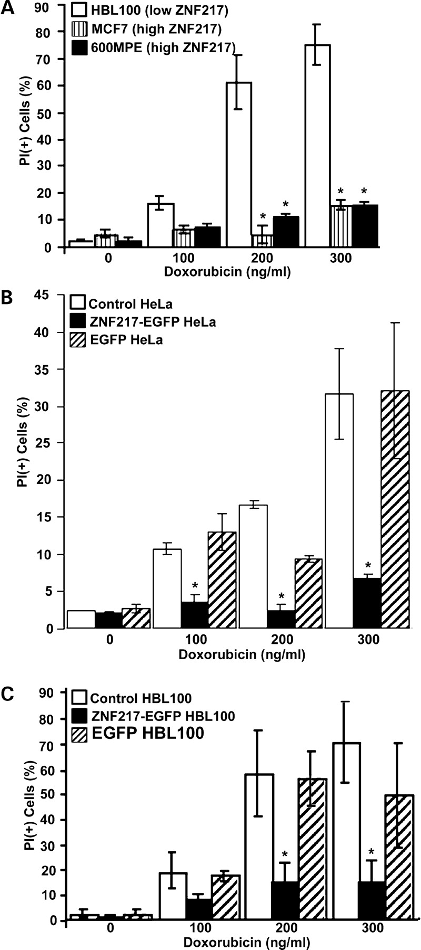
Figure 2. Cells expressing high levels of endogenous ZNF217 transcripts or exogenously introduced ZNF217 ...
Notes:
Figure 2. Cells expressing high levels of endogenous ZNF217 transcripts or exogenously introduced ZNF217 genes are resistant to doxorubicin-induced cell death. In ( A – C ), the cells were exposed to the indicated concentrations of doxorubicin for 72 h. The percentage of dead (PI + ) cells in each culture was then measured by flow cytometry. (A) HBL100 (white) shows no amplification and low expression of ZNF217 , whereas MCF7 (striped) shows amplification and high expression of ZNF217 and 600MPE (black) shows no amplification, but high expression of ZNF217 ( 10 ). (B and C) Control non-transfected (white), ZNF217 –EGFP transfected (black) and EGFP vector transfected (striped) HeLa (B) and HBL100 (C) cells were analyzed for sensitivity to doxorubicin. In (A), asterisk denotes P ≤0.005 when compared with HBL100. In (B and C), asterisk denotes P ≤0.005 for those cultures transfected with ZNF217 –EGFP when compared with EGFP alone. Representative primary flow cytometry data for (C) is provided as Supplementary Material.
Unless provided in the caption above, the following copyright applies to the content of this slide: © The Author 2005. Published by Oxford University Press. All rights reserved. For Permissions, please email: journals.permissions@oxfordjournals.org

Slide 3
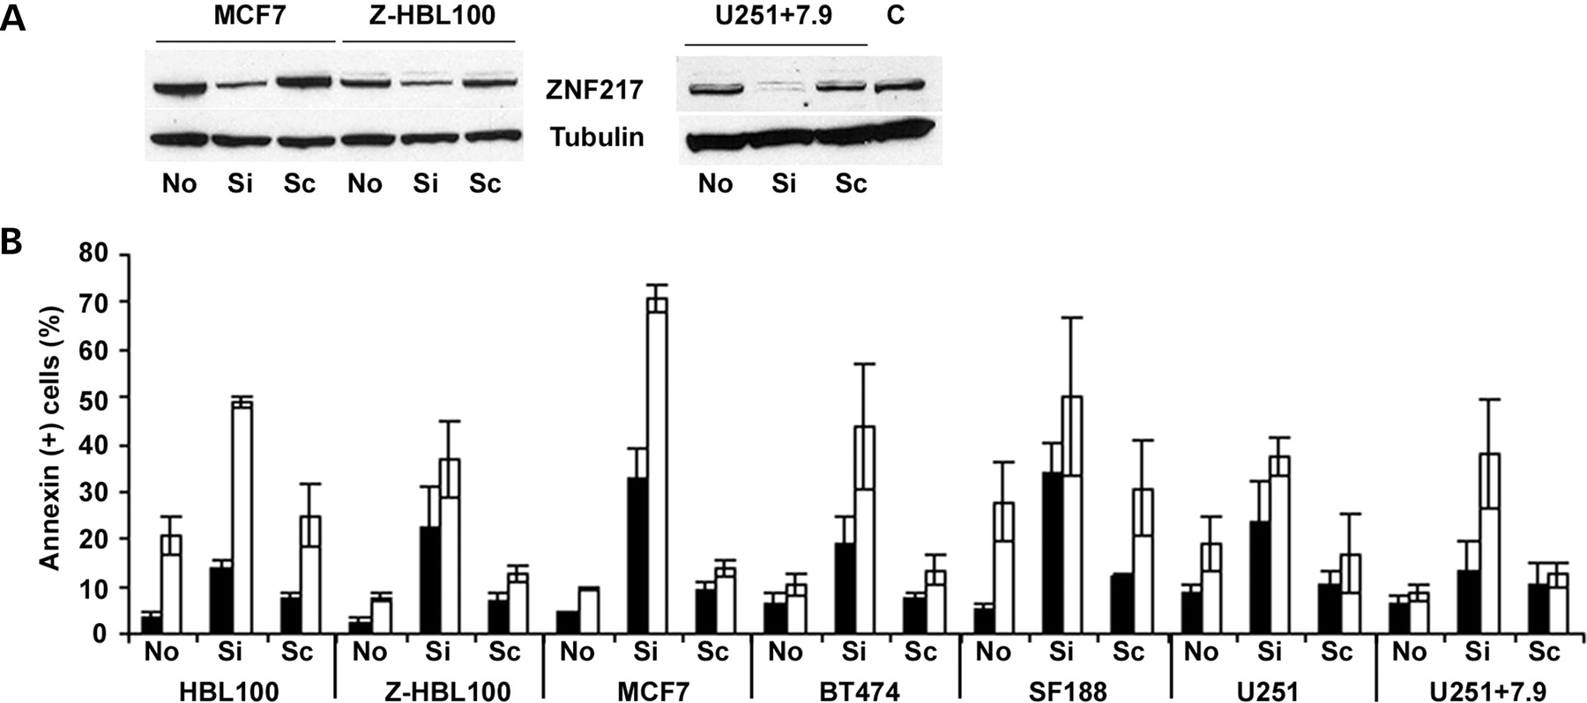
Figure 3.ZNF217 -targeted siRNA down-modulates ZNF217 protein levels and enhances cell killing by ...
Notes:
Figure 3.ZNF217 -targeted siRNA down-modulates ZNF217 protein levels and enhances cell killing by doxorubicin. ( A ) Levels of ZNF217 or tubulin protein were compared by immunoblotting of total cell lysates of human cell lines MCF7, ZNF217 –EGFP-transfected HBL100 (Z-HBL100) and U251+7.9 non-transfected (No), transfected with siRNA directed against ZNF217 transcripts (Si) or transfected with a control scrambled siRNA (Sc) for 72 h. C is a control lysate containing high levels of ZNF217 protein expressed from a retroviral promoter. ZNF217 protein was quantitated in total cell lysates by immunoblot analysis using an anti- ZNF217 antibody raised against a synthetic peptide. ( B ) The percentages of dead or dying cells staining positively with Annexin-V were plotted for the indicated cell lines non-transfected (No), transfected with siRNA directed against ZNF217 transcripts (Si) or transfected with a control scrambled dsRNA (Sc) for 72 h, then treated with 0 (black) or 100 ng/ml (white) doxorubicin for 16 h before harvest.
Unless provided in the caption above, the following copyright applies to the content of this slide: © The Author 2005. Published by Oxford University Press. All rights reserved. For Permissions, please email: journals.permissions@oxfordjournals.org

Slide 4
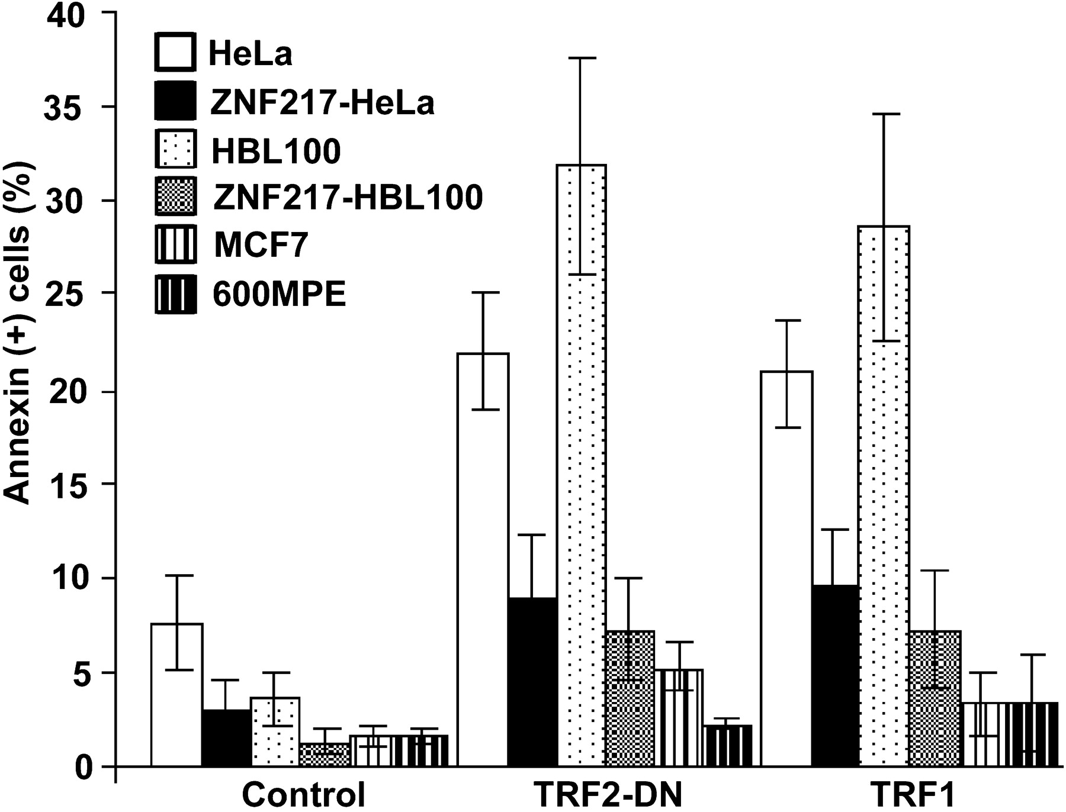
Figure 4.ZNF217 expression protects cells from cell death induced by functional inactivation of TRF2 or by ...
Notes:
Figure 4.ZNF217 expression protects cells from cell death induced by functional inactivation of TRF2 or by over-expression of TRF1. Cells were transfected with plasmids encoding TRF1 or TRF2 ΔBΔM , and after 24 h, the transfection reagent was removed. Apoptosis assays were performed 48 h later. The percentages of apoptotic (Annexin-V + ) HeLa (white), ZNF217 –EGFP transfected HeLa (black), HBL100 (light speckled), ZNF217 –EGFP transfected HBL100 (dark speckled), MCF7 (light striped) and 600MPE (dark striped) cells were measured by flow cytometry. Note that both MCF7 and 600MPE contain high levels of endogenous ZNF217 and are relatively resistant to cell death.
Unless provided in the caption above, the following copyright applies to the content of this slide: © The Author 2005. Published by Oxford University Press. All rights reserved. For Permissions, please email: journals.permissions@oxfordjournals.org

Slide 5
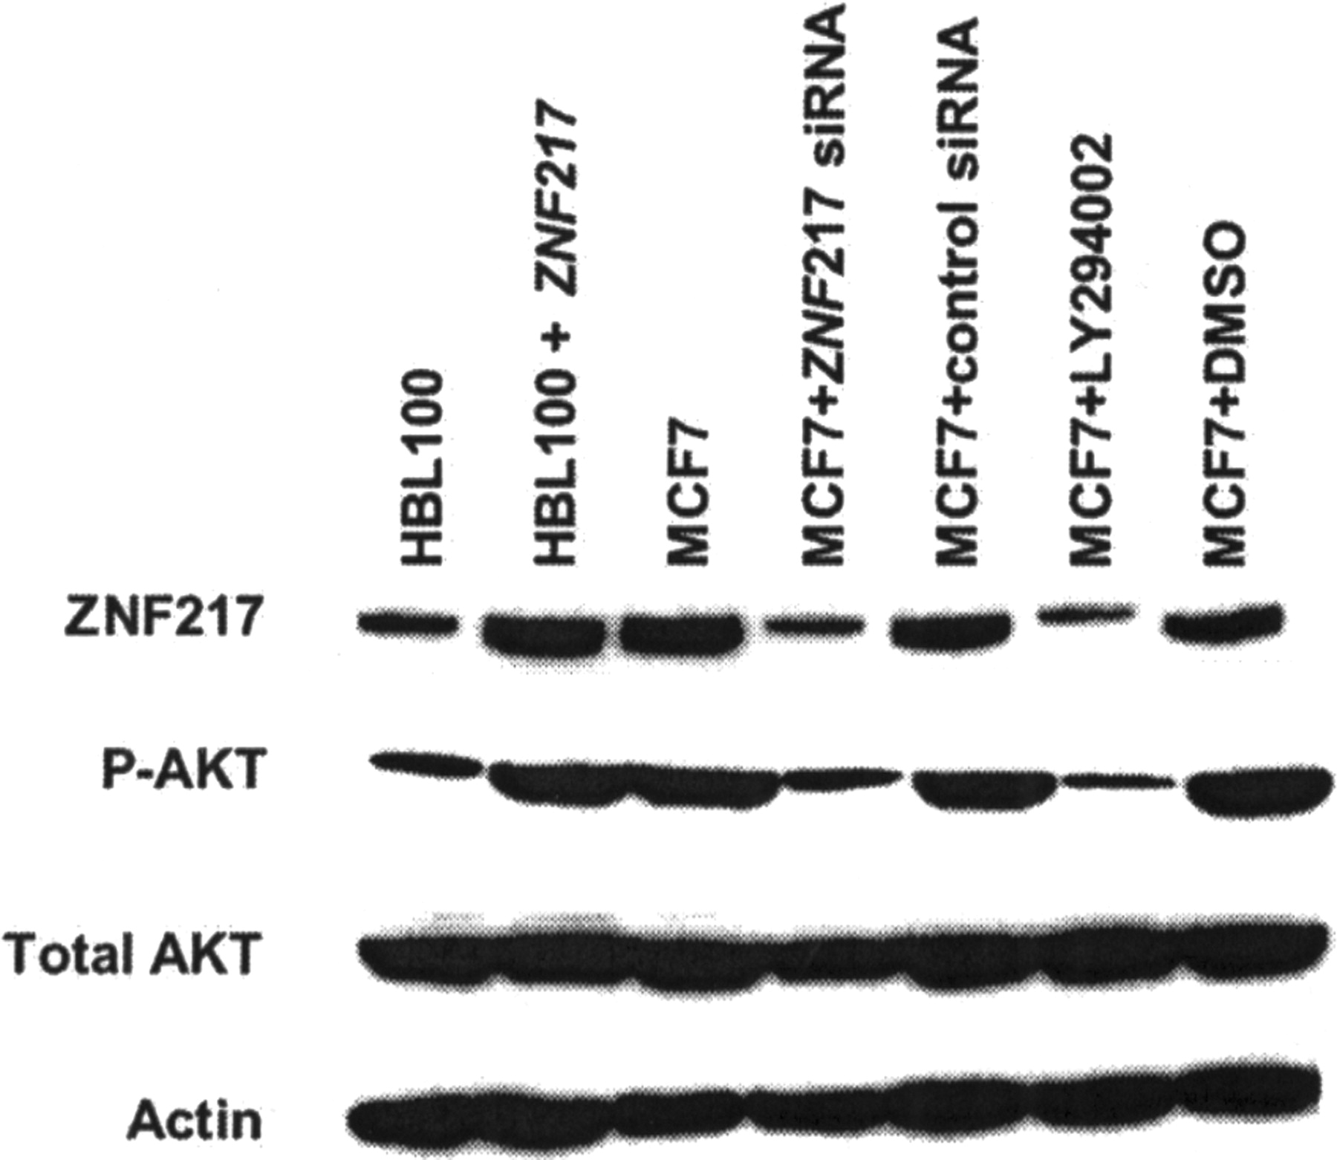
Figure 5.ZNF217 expression causes elevated Akt phosphorylation, whereas silencing of ZNF 217 causes a ...
Notes:
Figure 5.ZNF217 expression causes elevated Akt phosphorylation, whereas silencing of ZNF 217 causes a reduction of Akt phosphorylation and the inhibition of PI3K causes a reduction in ZNF217 levels. Levels of ZNF217 , phosphorylated Akt (Ser-473), total Akt or β-actin proteins were compared by immunoblotting of total cell lysates of human cell lines HBL100, ZNF217– EGFP transfected HBL100, MCF7, ZNF 217 siRNA transfected MCF7, control siRNA transfected MCF7, PI3K inhibitor LY294002 treated MCF7 and DMSO vehicle treated MCF7.
Unless provided in the caption above, the following copyright applies to the content of this slide: © The Author 2005. Published by Oxford University Press. All rights reserved. For Permissions, please email: journals.permissions@oxfordjournals.org

