Slide 1
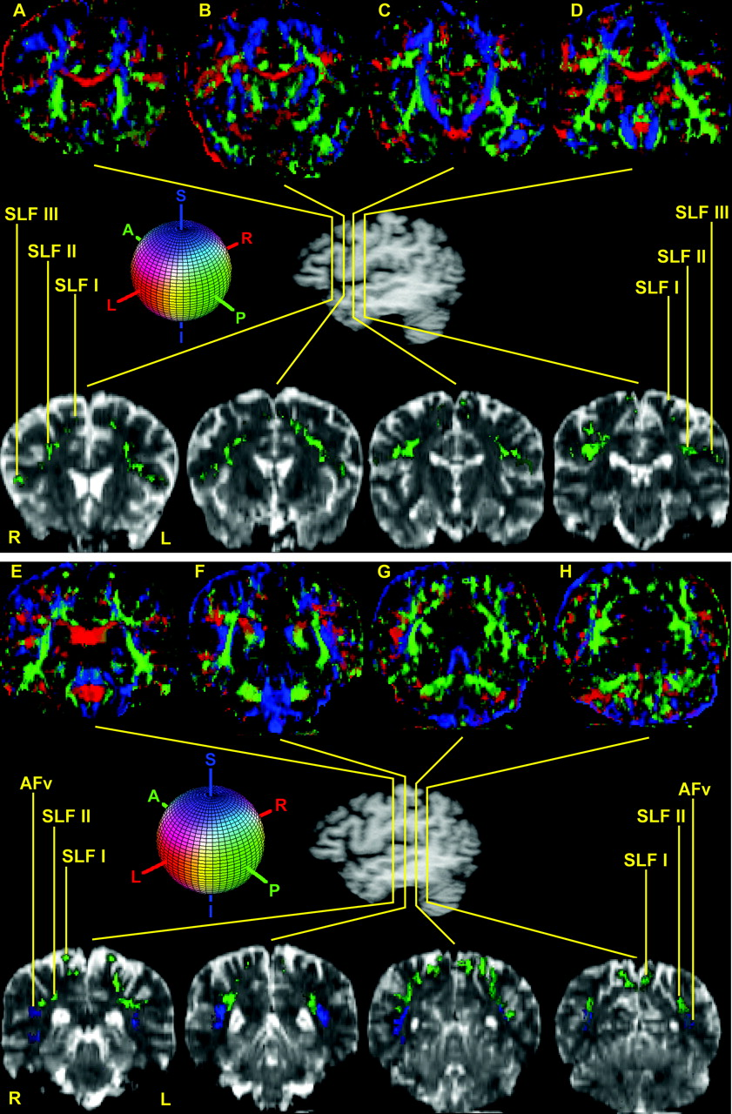
Figure 1. The course and topography of the different subcomponents of SLF, i.e. SLF I, SLF II, SLF III and AFv ...
Notes:
Figure 1. The course and topography of the different subcomponents of SLF, i.e. SLF I, SLF II, SLF III and AFv (vertical part of arcuate fascicle) are shown in 12 representative coronal sections (A–L) in the top and bottom panels. In the center of the figure is a lateral view of the hemisphere showing the rostrocaudal level of the selected sections (A–L). Coronal section A is the most rostral, located at the level of the frontal lobe, whereas section L is the most caudal, situated at the parieto-occipital transition. The upper row of images is composed of the principal eigenvector maps (PEMs). The lower row shows T2-weighted EPI sections corresponding to the DT-MRI of the upper panel to highlight the location and relative topography of the subdivisions of the SLF. In both rows, SLF I, SLF II and SLF III are generally contained in the green areas (i.e. runs anterior–posterior) and AFv is generally contained in the blue areas (i.e. runs superior–inferior). The colored sphere shows the color-coding scheme adopted in the DT-MRI data analysis. Red is right–left, green is anterior–posterior and blue is superior–inferior orientations. Abbreviations: AFv, vertical part of arcuate fascicle; SLF, superior longitudinal fascicle; L, left; R, right.
Unless provided in the caption above, the following copyright applies to the content of this slide: Cerebral Cortex V 15 N 6 © Oxford University Press 2004; all rights reserved

Slide 2
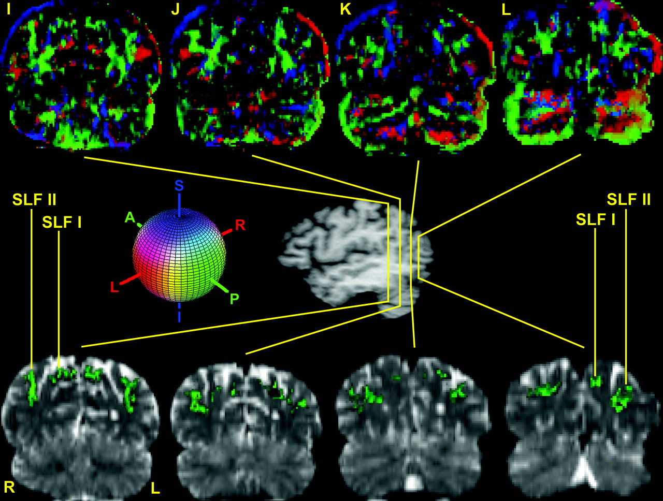
Figure 1. The course and topography of the different subcomponents of SLF, i.e. SLF I, SLF II, SLF III and AFv ...
Notes:
Figure 1. The course and topography of the different subcomponents of SLF, i.e. SLF I, SLF II, SLF III and AFv (vertical part of arcuate fascicle) are shown in 12 representative coronal sections (A–L) in the top and bottom panels. In the center of the figure is a lateral view of the hemisphere showing the rostrocaudal level of the selected sections (A–L). Coronal section A is the most rostral, located at the level of the frontal lobe, whereas section L is the most caudal, situated at the parieto-occipital transition. The upper row of images is composed of the principal eigenvector maps (PEMs). The lower row shows T2-weighted EPI sections corresponding to the DT-MRI of the upper panel to highlight the location and relative topography of the subdivisions of the SLF. In both rows, SLF I, SLF II and SLF III are generally contained in the green areas (i.e. runs anterior–posterior) and AFv is generally contained in the blue areas (i.e. runs superior–inferior). The colored sphere shows the color-coding scheme adopted in the DT-MRI data analysis. Red is right–left, green is anterior–posterior and blue is superior–inferior orientations. Abbreviations: AFv, vertical part of arcuate fascicle; SLF, superior longitudinal fascicle; L, left; R, right.
Unless provided in the caption above, the following copyright applies to the content of this slide: Cerebral Cortex V 15 N 6 © Oxford University Press 2004; all rights reserved

Slide 3
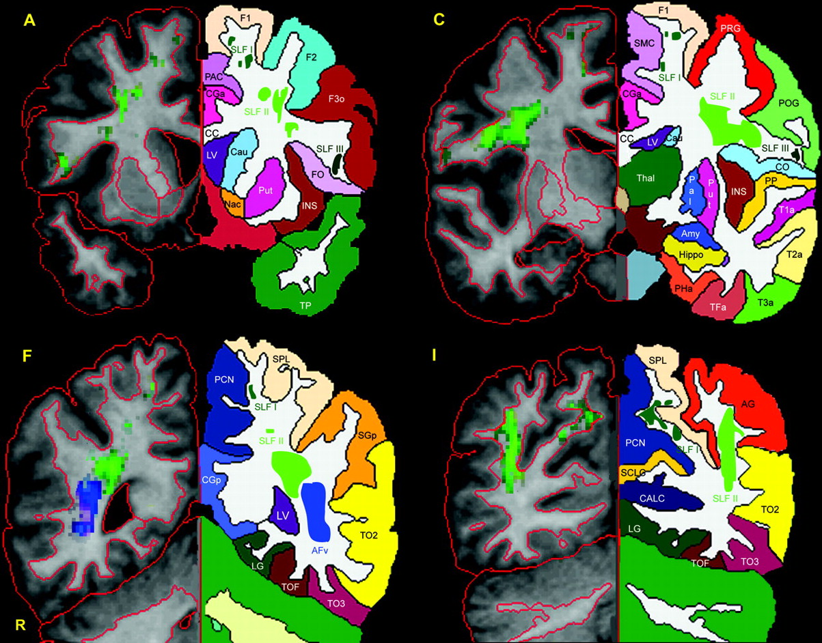
Figure 2. Four representative T₁ coronal sections that correspond to four of the coronal slices included in ...
Notes:
Figure 2. Four representative T1 coronal sections that correspond to four of the coronal slices included in Figure 1A, C, F and I are utilized to show the topographic anatomy and location of the four subcomponents of SLF, i.e. SLF I, SLF II, SLF III and AFv. To this end the individual brain was segmented and parcellated using the Center for Morphometric Analysis neuroanatomical framework (Filipek et al., 1994; Caviness et al., 1996). Thus the precise location of SLF I, SLF II, SLF III and AFv is indicated in relation to cortical and subcortical structures. On the left side of each panel (i.e. the radiological right side indicated as R) the contour outline of the cortical and subcortical structures is shown in red. On the opposite side of each panel the mirror images of the coronal section on the right are shown to demonstrate the parcellation of specific cortical and subcortical structures. Abbreviations: AFv, vertical part of arcuate fascicle; AG, angular gyrus; CALC, intracalcarine cortex; CC, corpus callosum; CGa, cingulate gyrus, anterior; CGp, cingulate gyrus, posterior; CN, cuneal cortex; CO, central operculum; F1, superior frontal gyrus; F2, middle frontal gyrus; F3o, inferior frontal gyrus, pars opercularis; F3t, inferior frontal gyrus, pars triangularis; FMC, frontal medial cortex; FO, frontal operculum; FOC, frontal orbital cortex; FP, frontal pole; H1, Heschl's gyrus; INS, insula; LG, lingual gyrus; OP, occipital pole; OF, occipital fusiform gyrus; OLi, lateral occipital cortex, inferior; OLs, lateral occipital cortex, superior; PAC, paracingulate cortex; PCN, precuneus; PHa, parahippocampal gyrus, anterior; PHp, parahippocampal gyrus, posterior; PO, parietal operculum; POG, postcentral gyrus; PP, planum polare; PRG, precentral gyrus; PT, planum temporale; SC, subcallosal cortex; SCLC, supracalcarine cortex; SGa, supramarginal gyrus, anterior; SGp, supramarginal gyrus, posterior; SLF, superior longitudinal fascicle; SMC, supplementary motor cortex; SPL, superior parietal lobule; T1a, superior temporal gyrus, anterior; T1p, superior temporal gyrus, posterior; T2a, middle temporal gyrus, anterior; T2p, middle temporal gyrus, posterior; T3a, inferior temporal gyrus, anterior; T3p, inferior temporal gyrus, posterior; TFa, temporal fusiform, anterior; TFp, temporal fusiform, posterior; TO2, middle temporal gyrus, temporooccipital; TO3, inferior temporal gyrus, temporooccipital; TOF, temporooccipital fusiform gyrus; TP, temporal pole; R, right.
Unless provided in the caption above, the following copyright applies to the content of this slide: Cerebral Cortex V 15 N 6 © Oxford University Press 2004; all rights reserved

Slide 4
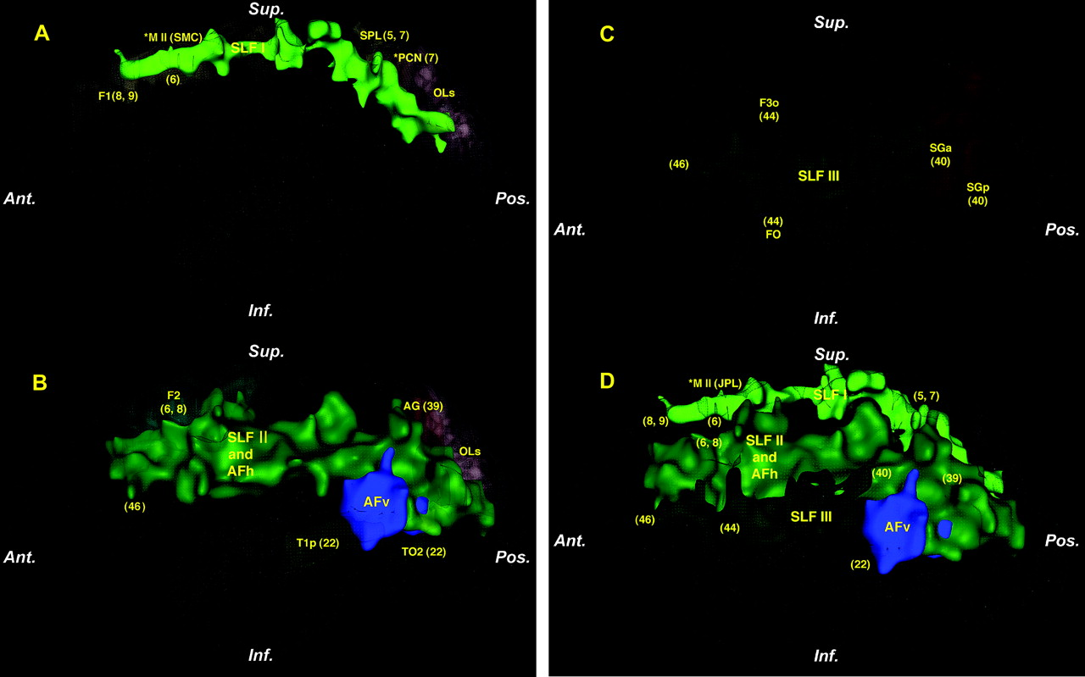
Figure 3. Three-dimensional renderings showing the course of the subcomponents of SLF, i.e. SLF I (A), SLF II ...
Notes:
Figure 3. Three-dimensional renderings showing the course of the subcomponents of SLF, i.e. SLF I (A), SLF II (including AFh) and AFv (B) and SLF III (C) in the context of cerebral cortical areas and the cerebral exterior in an individual human subject. (D) The four subcomponents of SLF in a composite configuration in the context of the cerebral exterior. The asterisk in A and D denotes that the related regions, i.e. M II (supplementary motor area, SMC), and PCN (precuneus) are projected on the plane of the figure from their actual location, which is in the medial aspect of the hemisphere. Numbers in parentheses represent Brodmann cytoarchitectonic areas to illustrate possible origins and terminations of each fiber pathway as inferred from the monkey connectional studies. See text for details. Abbreviations, AFh, horizontal part of arcuate fascicle; AFv, vertical part of arcuate fascicle; AG, angular gyrus; F1, superior frontal gyrus; F2, middle frontal gyrus; F3o, inferior frontal gyrus, pars opercularis; FO, frontal operculum; OLs, lateral occipital cortex, superior; SGa, supramarginal gyrus, anterior; SGp, supramarginal gyrus, posterior; SLF, superior longitudinal fascicle; SPL, superior parietal lobule; T1p, superior temporal gyrus, posterior; TO2, middle temporal gyrus, temporooccipital.
Unless provided in the caption above, the following copyright applies to the content of this slide: Cerebral Cortex V 15 N 6 © Oxford University Press 2004; all rights reserved

Slide 5
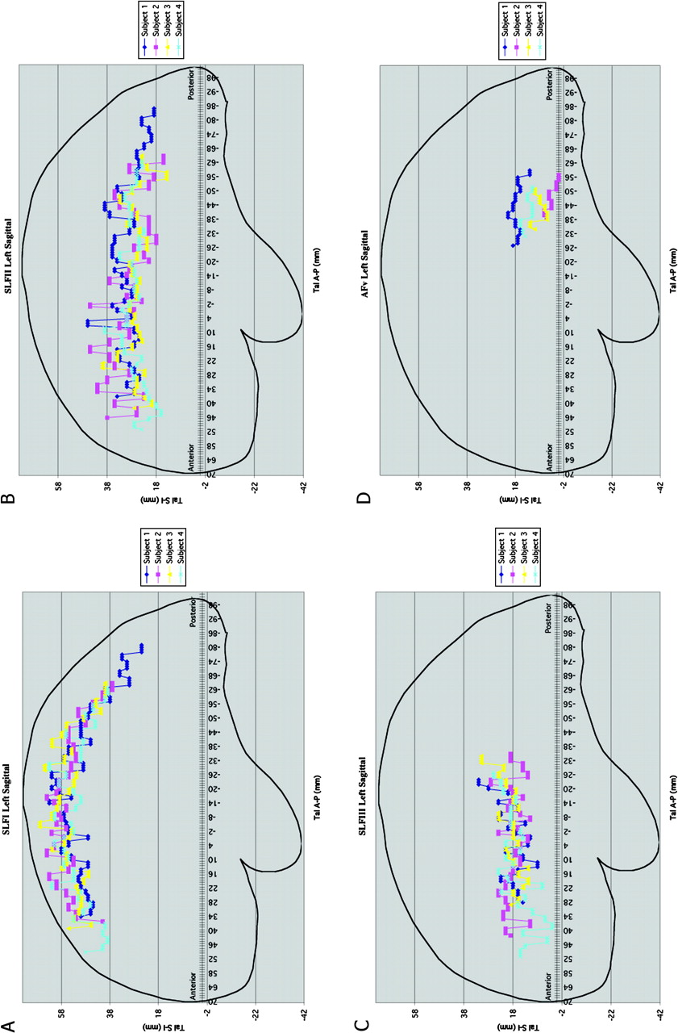
Figure 4. Composite representations (A–D) of lateral views of SLF I (A), SLF II (B), SLF III (C) and AFv (D) in four ...
Notes:
Figure 4. Composite representations (A–D) of lateral views of SLF I (A), SLF II (B), SLF III (C) and AFv (D) in four subjects in the Talairach space. The anterior commissure corresponds to 0 mm and the posterior commissure to −24 mm. For each individual subject each SLF component has been color coded. Abbreviations: SLF, superior longitudinal fascicle; AFv, vertical part of arcuate fascicle.
Unless provided in the caption above, the following copyright applies to the content of this slide: Cerebral Cortex V 15 N 6 © Oxford University Press 2004; all rights reserved

Slide 6
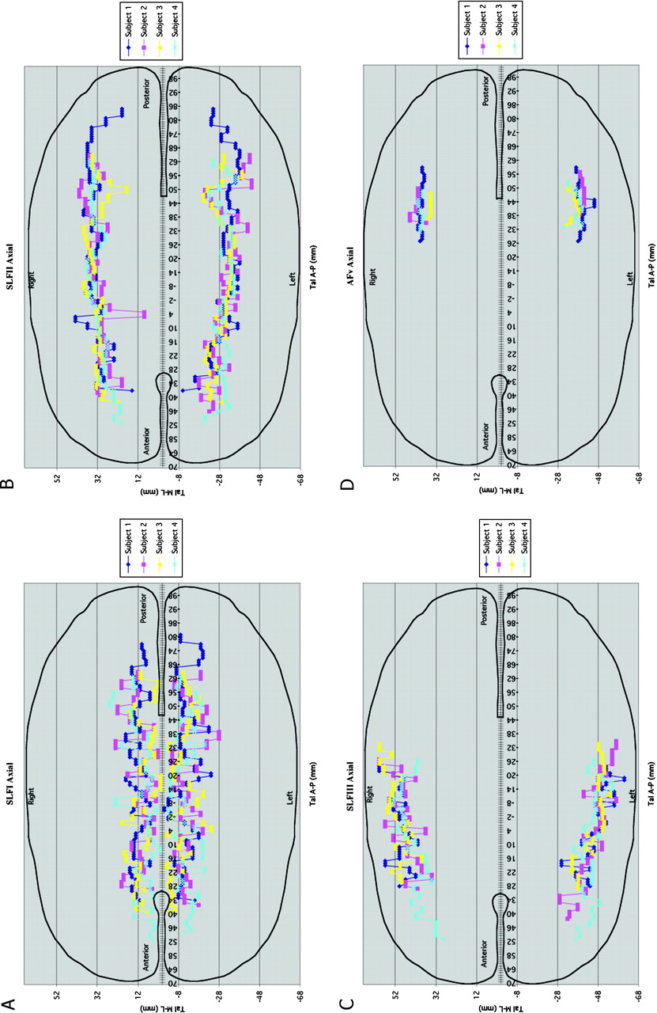
Figure 5. Composite representations (A–D) of axial views of the SLF I (A), SLF II (B), SLF III (C) and AFv (D) in four ...
Notes:
Figure 5. Composite representations (A–D) of axial views of the SLF I (A), SLF II (B), SLF III (C) and AFv (D) in four subjects in the Talairach space. The anterior commissure corresponds to 0 mm and the posterior commissure to −24 mm. For each individual subject each SLF component has been color coded. Abbreviations: SLF, superior longitudinal fascicle; AFv, vertical part of arcuate fascicle.
Unless provided in the caption above, the following copyright applies to the content of this slide: Cerebral Cortex V 15 N 6 © Oxford University Press 2004; all rights reserved

Slide 7
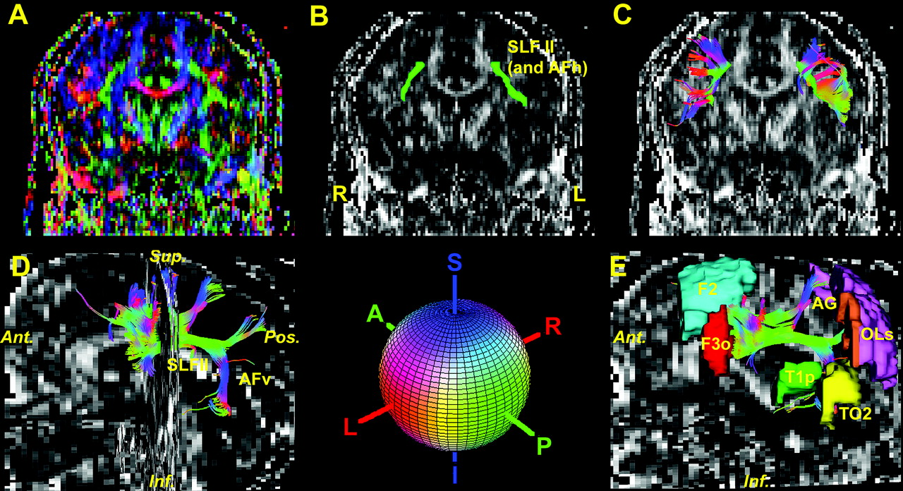
Figure 6. Illustration of tractographic results for SLF II (including AFh) and AFv. (A) The color fractional anisotropy ...
Notes:
Figure 6. Illustration of tractographic results for SLF II (including AFh) and AFv. (A) The color fractional anisotropy (fractional anisotropy) map or principal eigenvector map (PEM) in a coronal section. The grayscale FA map of the identical coronal section is used as background in (B) and (C). In (B), one region of interest (ROI) (shown in green), which is the SLF II (including the AFh) for each hemisphere was selected as seed location to initiate the fiber tracking process. In (C), the rostral portion of SLF II in each hemisphere is shown as resulted from the fiber-tracking process. The color gives the orientation of the eigenvector as shown in the colored sphere. Red is right–left, green is anterior–posterior and blue is superior–inferior orientations. (D) Three-dimensional representations of SLF II and AFv. SLF II (including AFh) and AFv are contrasted against a background consisting of a fractional anisotropy map of a mid-sagittal plane. The fractional anisotropy map of a coronal plane was added for reference. The cortical regions related to SLF II and AFv were added in (E). Abbreviations, AFh, horizontal part of arcuate fascicle; AFv, vertical part of arcuate fascicle; AG, angular gyrus; F2, middle frontal gyrus; F3o, inferior frontal gyrus, pars opercularis; OLs, lateral occipital cortex, superior; SLF, superior longitudinal fascicle; T1p, superior temporal gyrus, posterior; TO2, middle temporal gyrus, temporooccipital.
Unless provided in the caption above, the following copyright applies to the content of this slide: Cerebral Cortex V 15 N 6 © Oxford University Press 2004; all rights reserved

