Slide 1
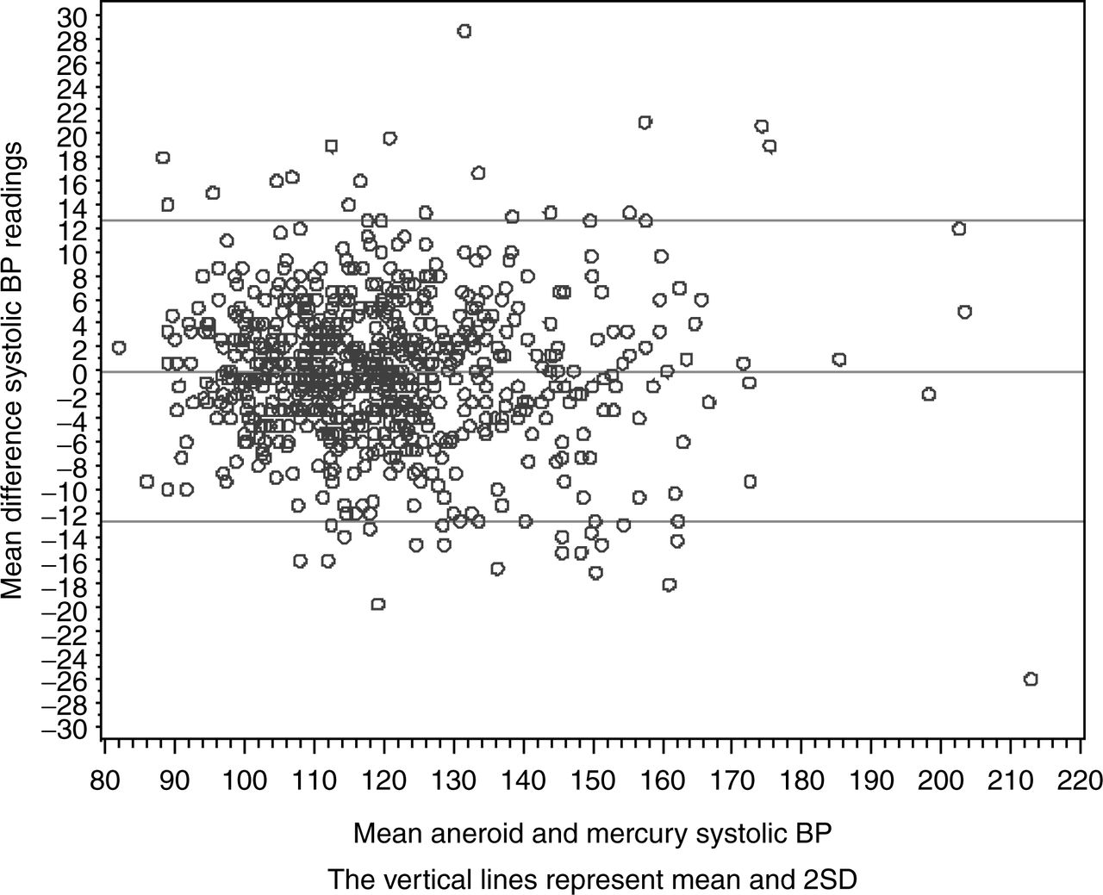
Figure 1. Bland Altman¹⁴ graph aneroid vs. mercury, systolic. BP, blood pressure.
Notes:
Figure 1. Bland Altman14 graph aneroid vs. mercury, systolic. BP, blood pressure.
Unless provided in the caption above, the following copyright applies to the content of this slide: © American Journal of Hypertension, Ltd. 2011

Slide 2
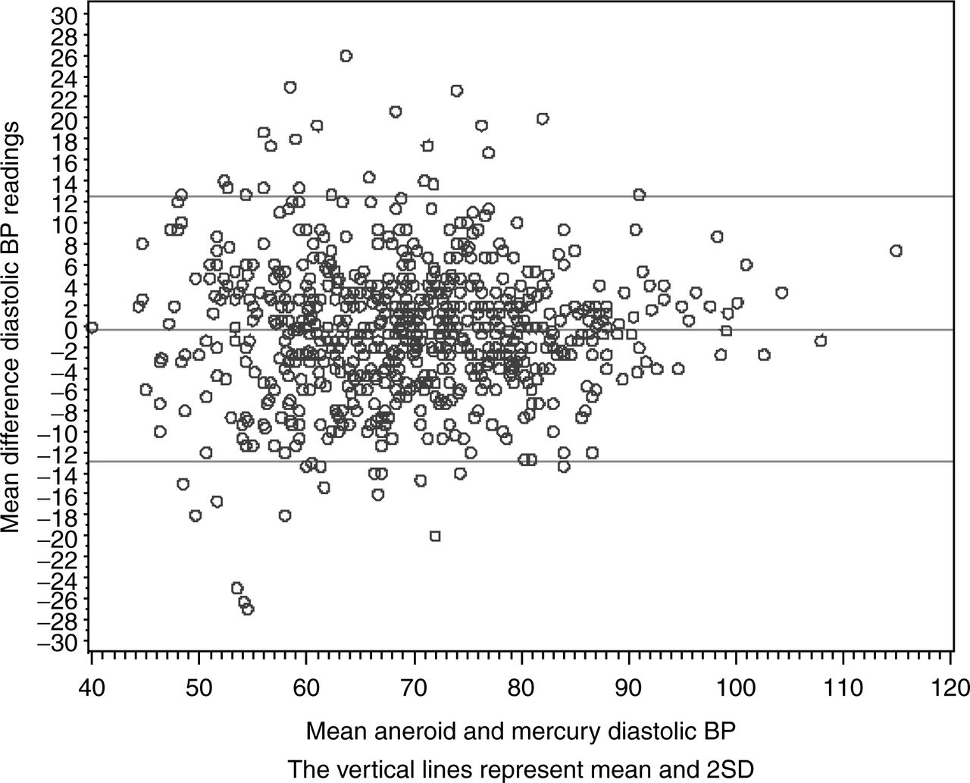
Figure 2. Bland Altman¹⁴ graph aneroid vs. mercury, diastolic. BP, blood pressure.
Notes:
Figure 2. Bland Altman14 graph aneroid vs. mercury, diastolic. BP, blood pressure.
Unless provided in the caption above, the following copyright applies to the content of this slide: © American Journal of Hypertension, Ltd. 2011

