Slide 1
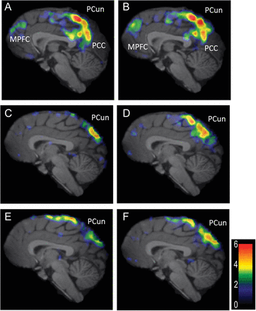
Figure 1. Imaging contrasts. t-Statistic maps are thresholded at P < 0.05, uncorrected for multiple comparisons. Color ...
Notes:
Figure 1. Imaging contrasts. t-Statistic maps are thresholded at P 6 are presented as red. Anterior medial prefrontal cortex (MPFC), precuneus (PCun), and posterior cingulate cortex (PCC) are labeled. The cerebellum and brainstem have been masked out of these analyses. (A) rest–social task #1 (3 mm right of midline). (B) rest–nonsocial task (3 mm right of midline). (C) social task #1–nonsocial task (midline). (D) social task #2–nonsocial (midline). (E) low social task–nonsocial task (midline). (F) All social tasks–nonsocial task (midline).
Unless provided in the caption above, the following copyright applies to the content of this slide: © The Author 2013. Published by Oxford University Press. All rights reserved. For Permissions, please e-mail: journals.permissions@oup.com

Slide 2
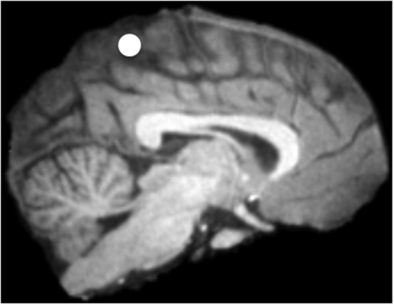
Figure 2. ROI centered around highest area of activation in precuneus.
Notes:
Figure 2. ROI centered around highest area of activation in precuneus.
Unless provided in the caption above, the following copyright applies to the content of this slide: © The Author 2013. Published by Oxford University Press. All rights reserved. For Permissions, please e-mail: journals.permissions@oup.com

Slide 3
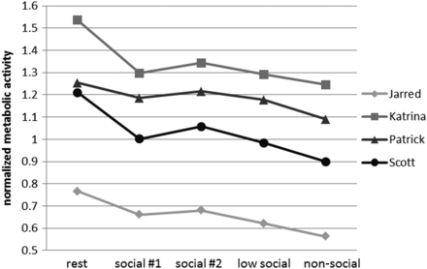
Figure 3. Levels of normalized metabolic activity in the precuneus ROI in each condition. Within subject ...
Notes:
Figure 3. Levels of normalized metabolic activity in the precuneus ROI in each condition. Within subject repeated-measures ANOVA, P < 0.009.
Unless provided in the caption above, the following copyright applies to the content of this slide: © The Author 2013. Published by Oxford University Press. All rights reserved. For Permissions, please e-mail: journals.permissions@oup.com

