Slide 1
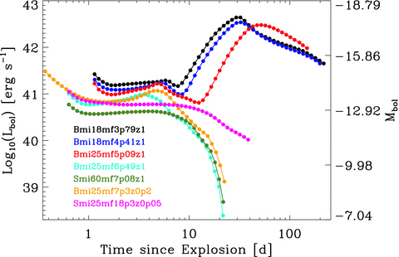
Figure 1 Synthetic bolometric light curves computed with our non-LTE time-dependent cmfgen simulations based on ...
Notes:
Figure 1 Synthetic bolometric light curves computed with our non-LTE time-dependent cmfgen simulations based on binary- and single-star WR progenitor models (see Tables 1 and 2). A colour coding is used to differentiate the models, and dots indicate the actual post-explosion times at which the computations are performed (in a time sequence). Simulations including unstable nuclei (here exclusively produced through the decay of 56Ni and 56Co isotopes) brighten about a weak after the onset of a post-breakout plateau, while all other simulations show a precipitous fading as the photosphere recedes to the deeper helium-deficient ejecta layers of increasing mean-atomic weight and original binding energy. For reference, we give the bolometric magnitude on the right-hand side ordinate axis.
Unless provided in the caption above, the following copyright applies to the content of this slide: © 2011 The Authors Monthly Notices of the Royal Astronomical Society © 2011 RAS

Slide 2
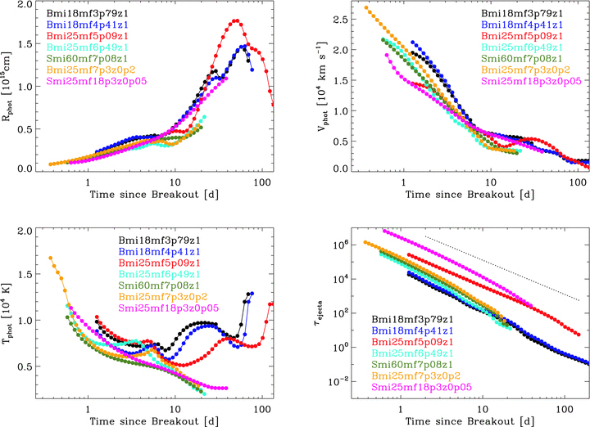
Figure 2 Same as Fig. 1, but now showing the evolution of the radius (R_{phot}; top left), the velocity ...
Notes:
Figure 2 Same as Fig. 1, but now showing the evolution of the radius (Rphot; top left), the velocity (Vphot; top right) and the temperature (Tphot; bottom left) at the photosphere. For reference, we also include the evolution of the total ejecta electron-scattering optical depth (τejecta; bottom right; the dotted black line indicates the 1/time2 evolution expected under constant ionization conditions).
Unless provided in the caption above, the following copyright applies to the content of this slide: © 2011 The Authors Monthly Notices of the Royal Astronomical Society © 2011 RAS

Slide 3
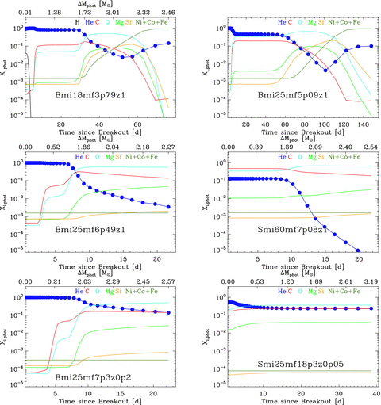
Figure 3 Evolution of the composition (given as mass fractions) at the photosphere for models Bmi18mf3p79z1 (top left; ...
Notes:
Figure 3 Evolution of the composition (given as mass fractions) at the photosphere for models Bmi18mf3p79z1 (top left; the time of peak brightness is ∼30 d; model Bmi18mf4p41z1 has a very similar chemical stratification and is not shown), Bmi25mf5p09z1 (top right; the time of peak brightness is ∼50 d; the top axis is not shown since ΔMphot is a non-monotonic function of time in this model), Bmi25mf6p49z1 (middle left), Smi60mf7p08z1 (middle right), Bmi25mf7p3z0p2 (bottom left) and Smi25mf18p3z0p05 (bottom right). The same colour coding is used in all panels of this figure to differentiate the species represented. Dots refer to the actual post-explosion times of the radiative-transfer computations (drawn on the curve corresponding to the helium mass fraction). Note that the time-span for 56Ni-deficient simulations is limited to ∼30 d, while 56Ni-rich models (top row) are evolved all the way to the nebular phase.
Unless provided in the caption above, the following copyright applies to the content of this slide: © 2011 The Authors Monthly Notices of the Royal Astronomical Society © 2011 RAS

Slide 4
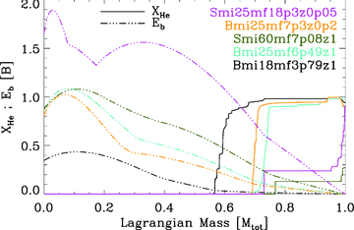
Figure 4 Illustration of the pre-SN envelope helium mass fraction (solid line) and binding energy (broken line), as a ...
Notes:
Figure 4 Illustration of the pre-SN envelope helium mass fraction (solid line) and binding energy (broken line), as a function of the Lagrangian mass (in units of the total ejecta mass) for our models Bmi18mf3p79z1 (black), Bmi25mf6p49z1 (turquoise), Smi60mf7p08z1 (olive), Bmi25mf7p3z0p2 (orange) and Smi25mf18p3z0p05 (magenta). Models with brighter post-breakout plateau luminosities are those whose progenitors have the least-bound outer envelopes, which also tend to be more helium-rich and stem from binary-star evolution.
Unless provided in the caption above, the following copyright applies to the content of this slide: © 2011 The Authors Monthly Notices of the Royal Astronomical Society © 2011 RAS

Slide 5
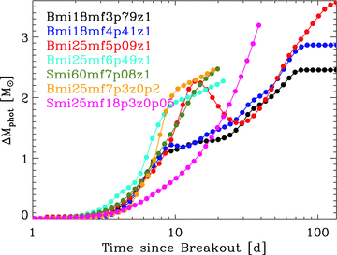
Figure 5 Same as Fig. 2, but now showing the evolution of the mass above the photosphere (ΔM_{phot}). Notice ...
Notes:
Figure 5 Same as Fig. 2, but now showing the evolution of the mass above the photosphere (ΔMphot). Notice the sizeable reversal of the photosphere trajectory in velocity/mass for model Bmi25mf5p09z1.
Unless provided in the caption above, the following copyright applies to the content of this slide: © 2011 The Authors Monthly Notices of the Royal Astronomical Society © 2011 RAS

Slide 6
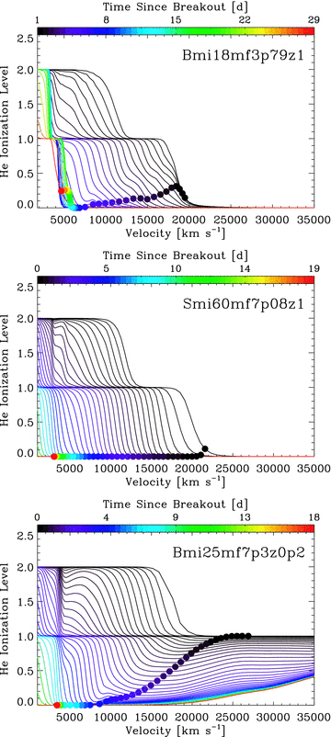
Figure 10 Illustration of the mean helium ionization level for models Bmi18mf3p79z1 (top), Smi60mf7p08z1 (middle) and ...
Notes:
Figure 10 Illustration of the mean helium ionization level for models Bmi18mf3p79z1 (top), Smi60mf7p08z1 (middle) and Bmi25mf7p3z0p2 (bottom). In each panel, the coloured dots refer to this ionization level at the photosphere and its evolution with time. An interesting feature is the systematic partial ionization of hydrogen and helium in models showing H i and/or He i lines at early times, even in the absence of 56Ni/56Co; the counterexample here is model Smi60mf7p08z1 (see text for discussion).
Unless provided in the caption above, the following copyright applies to the content of this slide: © 2011 The Authors Monthly Notices of the Royal Astronomical Society © 2011 RAS

Slide 7
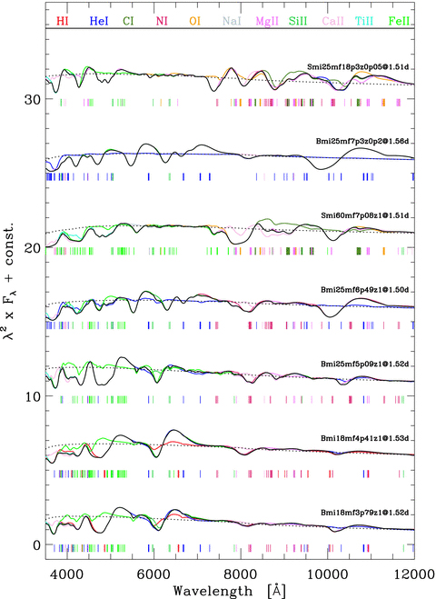
Figure 6 Scaled synthetic spectra (black) for each of our simulations at ∼1.5 d after explosion (we show the quantity ...
Notes:
Figure 6 Scaled synthetic spectra (black) for each of our simulations at ∼1.5 d after explosion (we show the quantity λ2×Fλ to better reveal the weaker features at longer wavelengths). At each epoch, we overplot the continuum-only synthetic flux (black dotted line; the same vertical scaling is applied), as well as the synthetic spectra obtained when bound–bound transitions of a given ion are omitted (see colour-coding at top). This highlights the relative importance of lines, and their associated ions, in different spectral regions. Coloured tick marks indicate the ion producing a line with a Sobolev EW of 10 Å (in absolute value), and with a thickness that reflects the magnitude of this EW on a logarithmic scale.
Unless provided in the caption above, the following copyright applies to the content of this slide: © 2011 The Authors Monthly Notices of the Royal Astronomical Society © 2011 RAS

Slide 8
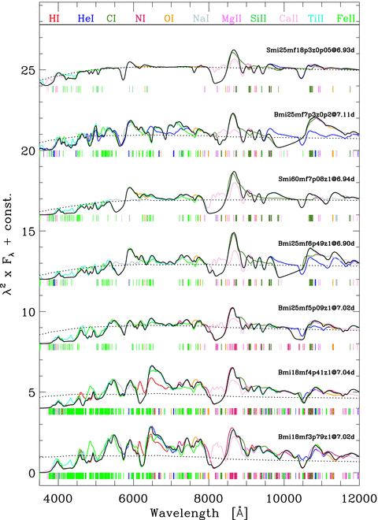
Figure 7 Same as Fig. 6, but now at ∼7.0 d after explosion.
Notes:
Figure 7 Same as Fig. 6, but now at ∼7.0 d after explosion.
Unless provided in the caption above, the following copyright applies to the content of this slide: © 2011 The Authors Monthly Notices of the Royal Astronomical Society © 2011 RAS

Slide 9
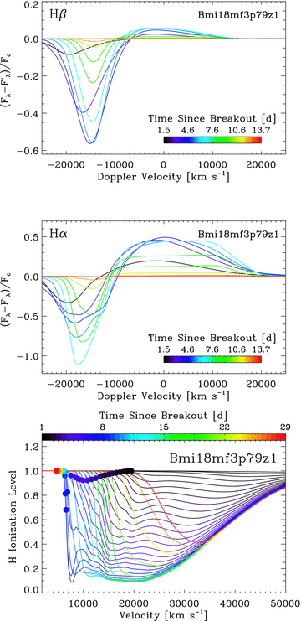
Figure 8 Top and middle: evolution of Hβ (top) and Hα (middle) line fluxes versus Doppler velocity from 1.5 to 13.7 d ...
Notes:
Figure 8 Top and middle: evolution of Hβ (top) and Hα (middle) line fluxes versus Doppler velocity from 1.5 to 13.7 d after shock breakout for model Bmi18mf3p79z1. More specifically, the quantity plotted is obtained by subtracting from the total flux (Fλ) the flux obtained by ignoring all bound–bound transitions due to H i (), and then normalizing by the continuum flux (Fc; i.e. the model flux obtained by accounting only for continuum processes). This approach illustrates the H i-line flux contribution to the total flux and its evolution with time. Bottom: illustration of the mean hydrogen ionization level for model Bmi18mf3p79z1. The coloured dots refer to this ionization level at the photosphere and its evolution with time. Notice the re-ionization of hydrogen above the photosphere after ≳7 d in model Bmi18mf3p79z1 caused by outward-diffusing decay energy released at depth, and which causes a kink in the Hα absorption profile (middle panel).
Unless provided in the caption above, the following copyright applies to the content of this slide: © 2011 The Authors Monthly Notices of the Royal Astronomical Society © 2011 RAS

Slide 10
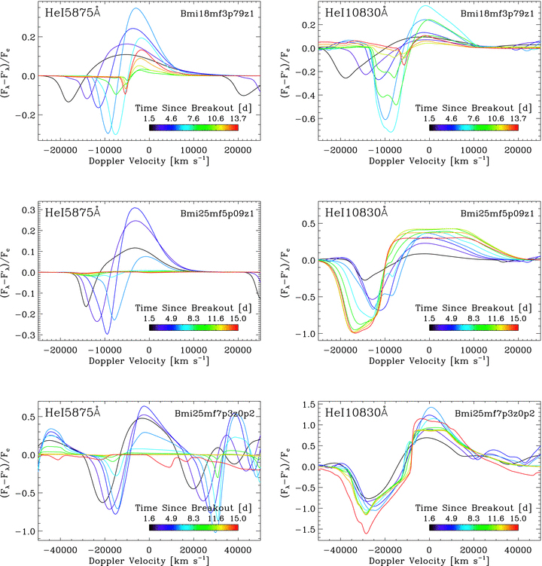
Figure 9 Top: same as Fig. 8, but now for the He i 5875 Å region (left; we also witness absorption from the 6678 Å ...
Notes:
Figure 9 Top: same as Fig. 8, but now for the He i 5875 Å region (left; we also witness absorption from the 6678 Å line to the red) and the He i 10830 Å region (right). The model depicted is Bmi18mf3p79z1. Middle: same as top, but now for model Bmi25mf5p09z1. Bottom: same as top, but now for model Bmi25mf7p3z0p2. In this low-metallicity model, He i lines are present at early times, and persist even for two weeks for the near-IR line, even in the absence of non-thermal excitation by high-energy electrons. Note that the abscissa scale now extends to 50 000 km s−1.
Unless provided in the caption above, the following copyright applies to the content of this slide: © 2011 The Authors Monthly Notices of the Royal Astronomical Society © 2011 RAS

Slide 11
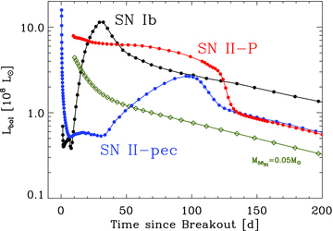
Figure 11 Comparison of the bolometric-luminosity evolution of SN Ib model Bmi18mf3p79z1 (0.184 M⊙ of ...
Notes:
Figure 11 Comparison of the bolometric-luminosity evolution of SN Ib model Bmi18mf3p79z1 (0.184 M⊙ of 56Ni), SN II-pec model ‘lm18Af’ of SN 1987A (0.084 M⊙ of 56Ni; Dessart & Hillier 2010) and SN II-P model s15e12 (0.086 M⊙ of 56Ni; Dessart & Hillier 2011). These three models have a similar ejecta kinetic energy of 1–1.2 B, and full γ-ray trapping is assumed (it does not hold for model Bmi18mf3p79z1 past ≳70 d; see Fig. 13). We also overplot the power associated with the decay of (initially) 0.05 M⊙ of 56Ni (olive curve). All models show an early-time luminosity plateau whose magnitude is a function of the progenitor radius and the H/He abundance ratio, and a late-time luminosity behaviour reflecting the initial amount of 56Ni. The distinct evolution is primarily conditioned by the progenitor-envelope properties, i.e. in particular whether the progenitor radius is ∼10 R⊙ (Bmi18mf3p79z1), ∼50 R⊙ (lm18a7Ad) or ∼800 R⊙ (s15e12).
Unless provided in the caption above, the following copyright applies to the content of this slide: © 2011 The Authors Monthly Notices of the Royal Astronomical Society © 2011 RAS

Slide 12
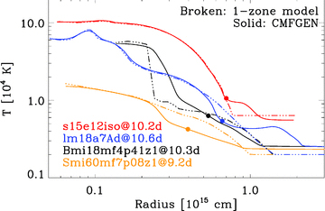
Figure 12 Ejecta-temperature distribution versus radius at ∼10 d after explosion for the SN Ic model Smi60mf7p08z1, SN ...
Notes:
Figure 12 Ejecta-temperature distribution versus radius at ∼10 d after explosion for the SN Ic model Smi60mf7p08z1, SN Ib model Bmi18mf4p41z1, SN II-pec model lm18a7Ad (Dessart & Hillier 2010) and SN II-P model s15e12iso (Dessart & Hillier 2011). We show cmfgen results (solid lines; the photosphere location is shown as a dot), as well as results from a separate code that assumes no diffusion of heat and pure adiabatic cooling (broken line; our ‘one-zone model’). The contrast in brightness between models (Figs 1 and 11) is reflected by the larger radii/temperatures of the corresponding ejecta and epoch, and nearly exclusively reflects modulations in (adiabatic) expansion losses.
Unless provided in the caption above, the following copyright applies to the content of this slide: © 2011 The Authors Monthly Notices of the Royal Astronomical Society © 2011 RAS

Slide 13
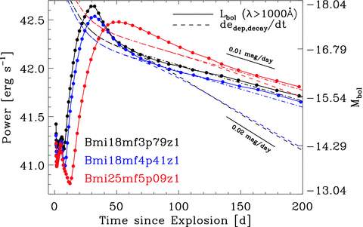
Figure 13 Evolution of the bolometric luminosity of our non-LTE time-dependent radiative-transfer simulations ...
Notes:
Figure 13 Evolution of the bolometric luminosity of our non-LTE time-dependent radiative-transfer simulations (Lbol; solid lines), which assume full-trapping of γ-ray photons, and based on the 56Ni-rich models Bmi18mf3p79z1(black), Bmi18mf4p41z1 (blue) and Bmi25mf5p09z1 (red). The dots correspond to the actual epochs computed. If we had instead used in cmfgen the γ-ray-energy deposition function output by our γ-ray Monte Carlo transport code, the bolometric luminosity would have turned over at ∼70 d in models Bmi18mf3p79z1 and Bmi25mf4p41z1 and fallen-off more steeply than the 0.01 mag d−1 rate for full trapping of 56Co-decay photons (it would have followed the dashed curve representing the energy effectively deposited per unit time in the ejecta dedep, decay/dt). The dot–dashed line corresponds to the total energy released, in the form of γ-rays and positrons, by radioactive decay in the Monte Carlo simulations (it is offset by ≲10 per cent from the cmfgen curves at very late times because of the numerical diffusion inherent to the necessary regridding at each time-step in cmfgen). The smaller the mass overlying the 56Ni-production site, the steeper is the luminosity-decline rate. A low ejecta mass may thus be one way of explaining naturally the rapidly fading light curves of most SNe IIb/Ib/Ic, without invoking the intervention of clumping, extreme mixing or jets.
Unless provided in the caption above, the following copyright applies to the content of this slide: © 2011 The Authors Monthly Notices of the Royal Astronomical Society © 2011 RAS

