Slide 1
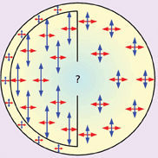
1: Cartoon of velocity anisotropy in Earth's inner core. (From Jessica Irving's University of Cambridge PhD ...
Notes:
1: Cartoon of velocity anisotropy in Earth's inner core. (From Jessica Irving's University of Cambridge PhD thesis 2009)
Unless provided in the caption above, the following copyright applies to the content of this slide: © Royal Astronomical Society 2009

Slide 2
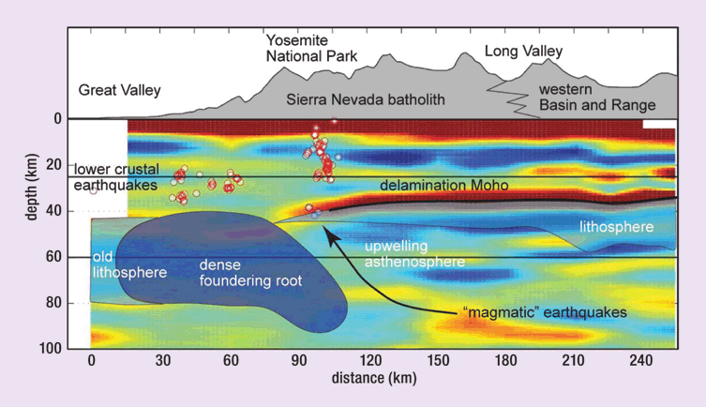
2: Structure beneath the Sierra Nevada, highlighting the complexities of the crust—mantle boundary revealed by ...
Notes:
2: Structure beneath the Sierra Nevada, highlighting the complexities of the crust—mantle boundary revealed by receiver function analysis and shear wave splitting. (Bastow)
Unless provided in the caption above, the following copyright applies to the content of this slide: © Royal Astronomical Society 2009

Slide 3
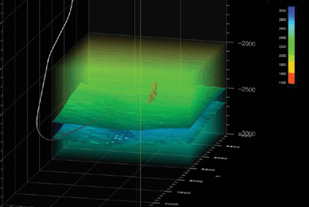
3: Perspective view showing locations of events (red circles) detected during hydraulic fracturing in a North ...
Notes:
3: Perspective view showing locations of events (red circles) detected during hydraulic fracturing in a North Sea oil reservoir. The background velocity model and path of the inject well are also shown for reference. (K Chambers, O Barkved and J-M Kendall 2009 Imaging induces seismicity with the LoFS permanent sensor surface array in prep.)
Unless provided in the caption above, the following copyright applies to the content of this slide: © Royal Astronomical Society 2009

Slide 4
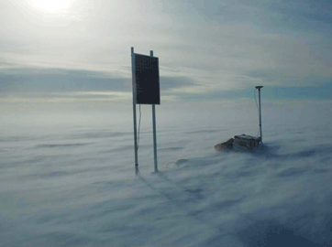
4: Glacier seismic and GPS station on the West Antarctic Ice Sheet. (A Smith)
Notes:
4: Glacier seismic and GPS station on the West Antarctic Ice Sheet. (A Smith)
Unless provided in the caption above, the following copyright applies to the content of this slide: © Royal Astronomical Society 2009

Slide 5
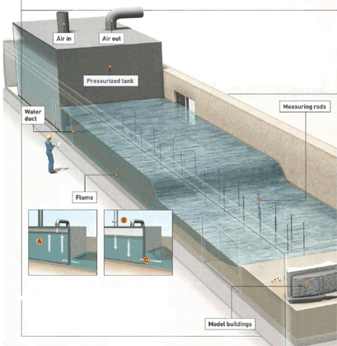
5: Modelling tsunamis and warning systems. (Anthony Hardwick)
Notes:
5: Modelling tsunamis and warning systems. (Anthony Hardwick)
Unless provided in the caption above, the following copyright applies to the content of this slide: © Royal Astronomical Society 2009

Slide 6
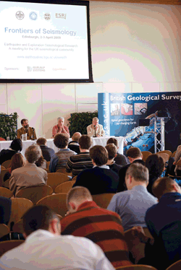
Feedback from participants' questionnaires made it clear that the opportunity to hear about activity in other ...
Notes:
Feedback from participants' questionnaires made it clear that the opportunity to hear about activity in other fields and in industry and the chance to make and reinforce contacts with researchers was widely appreciated. This sort of contact — focused but not overly specialist — should enable UK geophysicists to work more effectively in future. Participants at Edinburgh clearly want this meeting to happen again, and a two-yearly meeting was identified as most likely to be productive.
Unless provided in the caption above, the following copyright applies to the content of this slide: © Royal Astronomical Society 2009

Slide 7
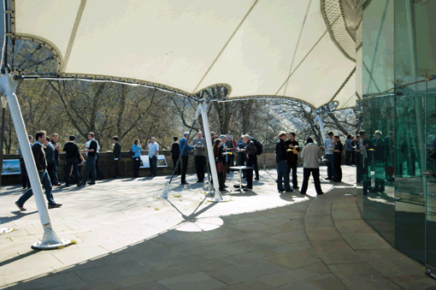
Feedback from participants' questionnaires made it clear that the opportunity to hear about activity in other ...
Notes:
Feedback from participants' questionnaires made it clear that the opportunity to hear about activity in other fields and in industry and the chance to make and reinforce contacts with researchers was widely appreciated. This sort of contact — focused but not overly specialist — should enable UK geophysicists to work more effectively in future. Participants at Edinburgh clearly want this meeting to happen again, and a two-yearly meeting was identified as most likely to be productive.
Unless provided in the caption above, the following copyright applies to the content of this slide: © Royal Astronomical Society 2009

