Slide 1
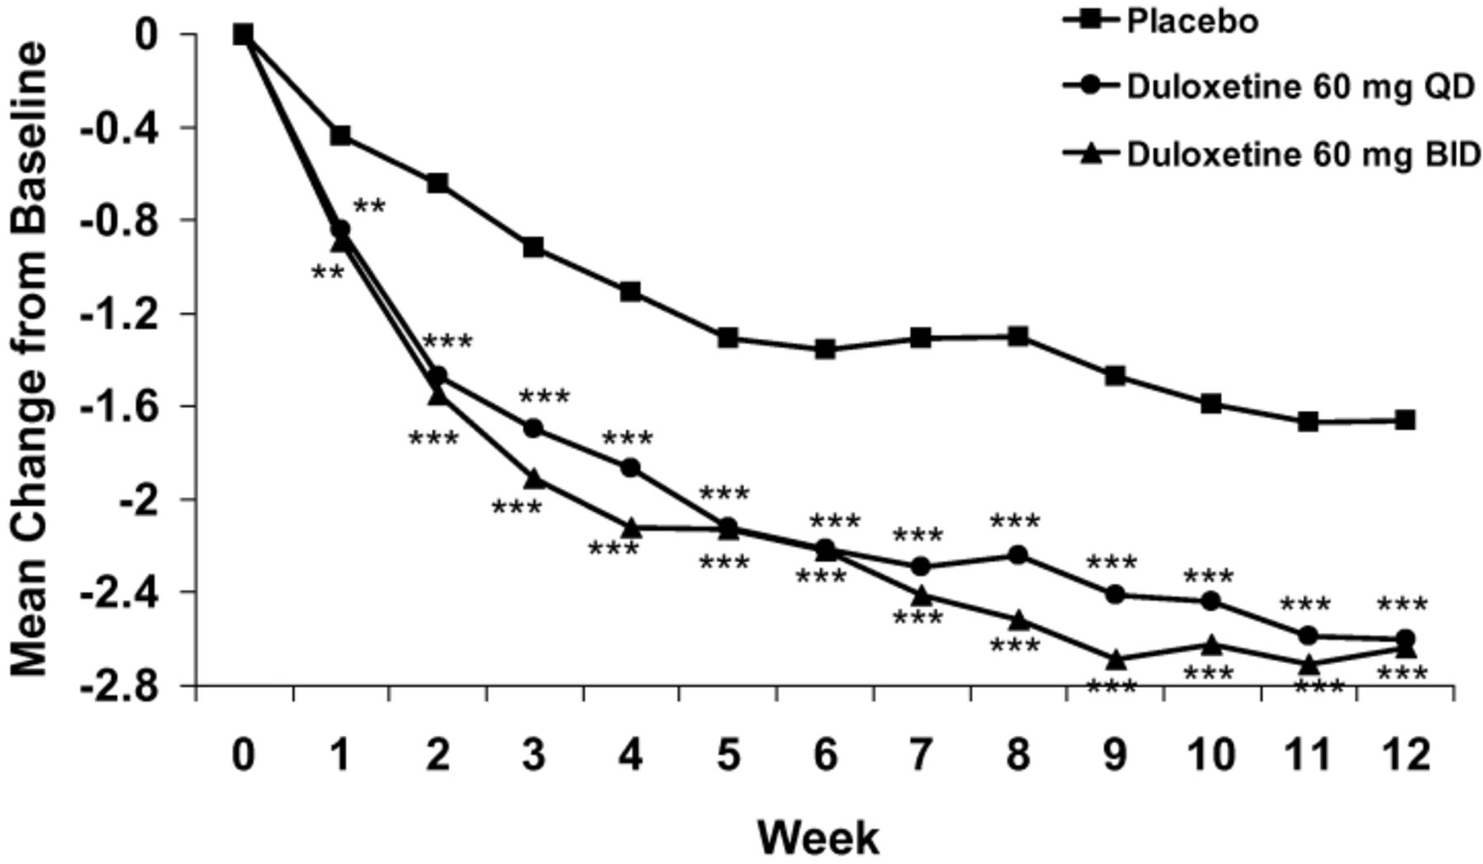
Figure 1 Mean change in 24-hour average pain severity score. **P ≤ 0.01 versus placebo; ***P ≤ 0.001 versus placebo.
Notes:
Figure 1 Mean change in 24-hour average pain severity score. **P ≤ 0.01 versus placebo; ***P ≤ 0.001 versus placebo.
Unless provided in the caption above, the following copyright applies to the content of this slide:

Slide 2
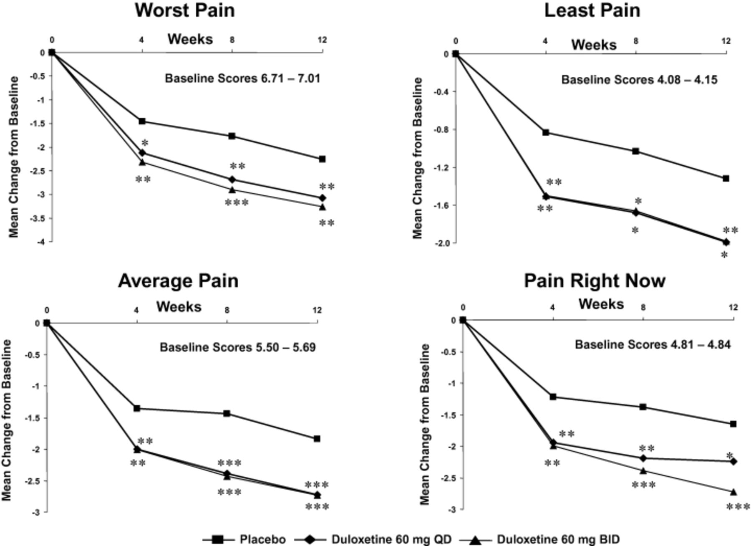
Figure 2 Brief Pain Inventory individual severity score. *P ≤ 0.05 versus placebo; **P ≤ 0.01 versus placebo; ***P ≤ ...
Notes:
Figure 2 Brief Pain Inventory individual severity score. *P ≤ 0.05 versus placebo; **P ≤ 0.01 versus placebo; ***P ≤ 0.001 versus placebo.
Unless provided in the caption above, the following copyright applies to the content of this slide:

