Slide 1
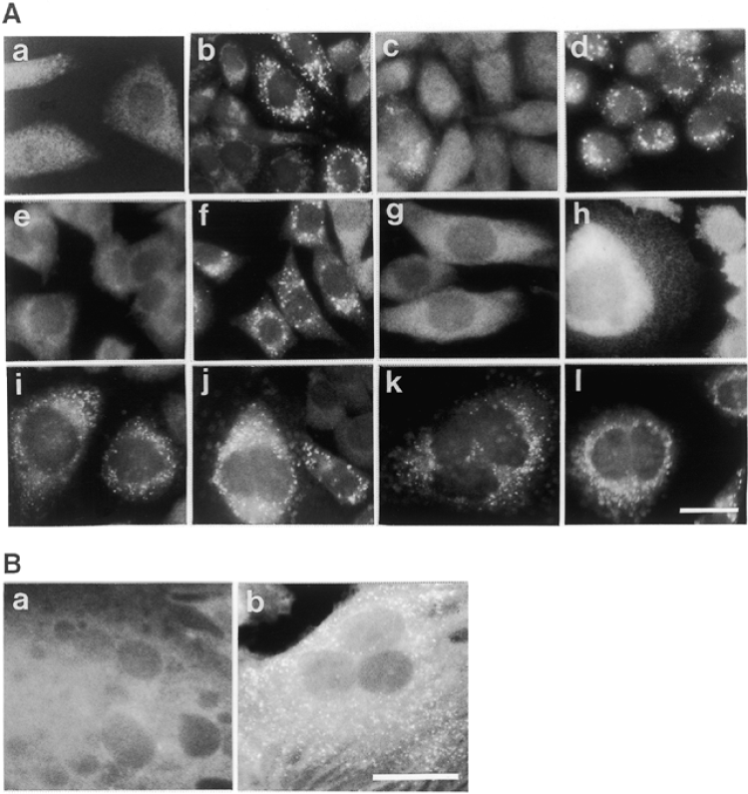
Figure 1 Immunofluorescent staining of CHO cell mutants, PEX transfectants and hybrid cells. (A) Cells: (a-d) CHO cell ...
Notes:
Figure 1 Immunofluorescent staining of CHO cell mutants, PEX transfectants and hybrid cells. (A) Cells: (a-d) CHO cell mutant ZP128; (e) ZP150; (f and g) ZP149 and ZP128 were transfected with rat PEX12; (h) fusion of ZP128 with ZP150 cells; (i and j) fused cells of ZP150 with ZP114 and ZP119, respectively; (k and l) cell hybrids of ZP128 and ZP150, respectively, with wild-type CHO-K1. Cells were stained with rabbit antibodies to rat catalase (a and e—l), PTS1 peptide (b), rat thiolase (c) and rat 70 kDa peroxisomal integral membrane protein (d). Magnification, ×630; bar, 20 µm. (B) ZP128 cells were fused with fibroblasts from a CG-H patient with neonatal adrenoleukodystrophy (13) (a) and a CG-G patient with Zellweger syndrome (b), respectively. Cells were stained with anti-human catalase antibody. Magnification, ×630; bar, 30 µm. Note that peroxisomes were not complemented in (a).
Unless provided in the caption above, the following copyright applies to the content of this slide: © 1999 Oxford University Press

Slide 2
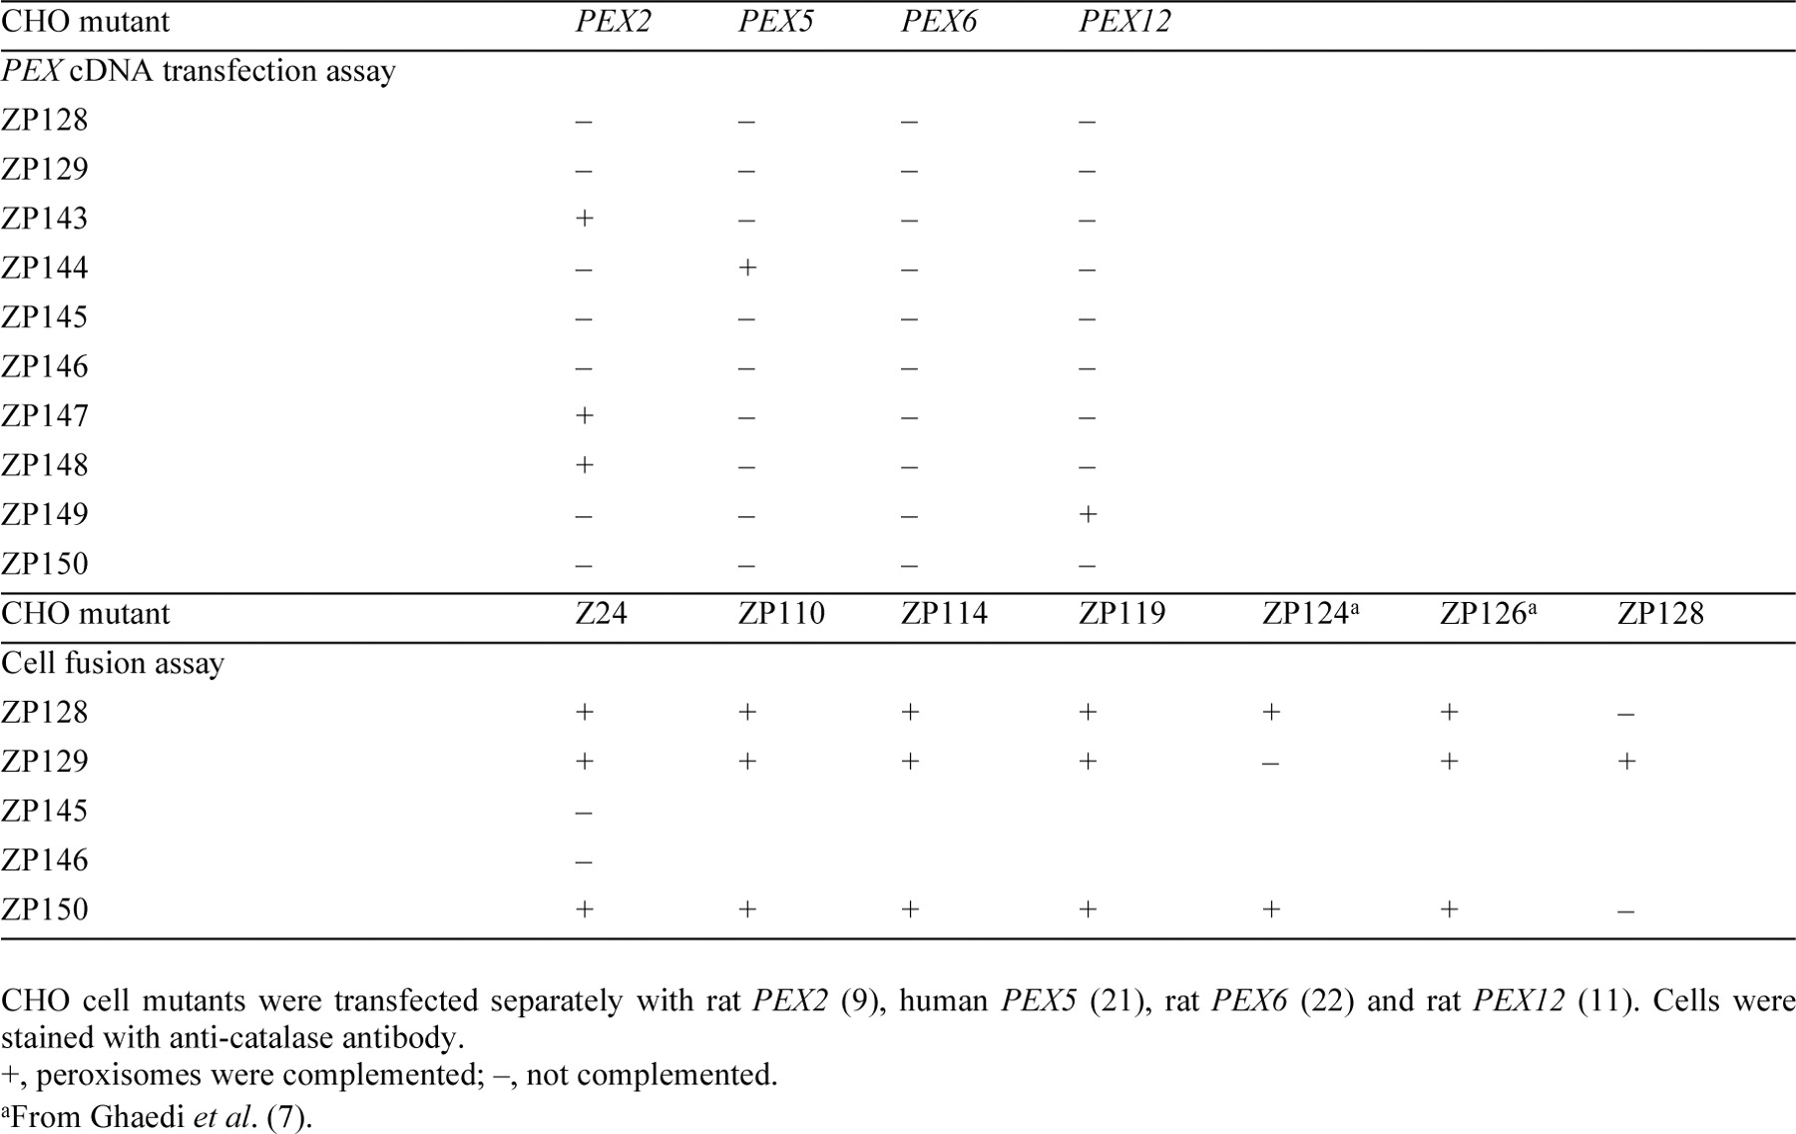
Table 1 CG analysis
Notes:
Table 1 CG analysis
Unless provided in the caption above, the following copyright applies to the content of this slide: © 1999 Oxford University Press

Slide 3
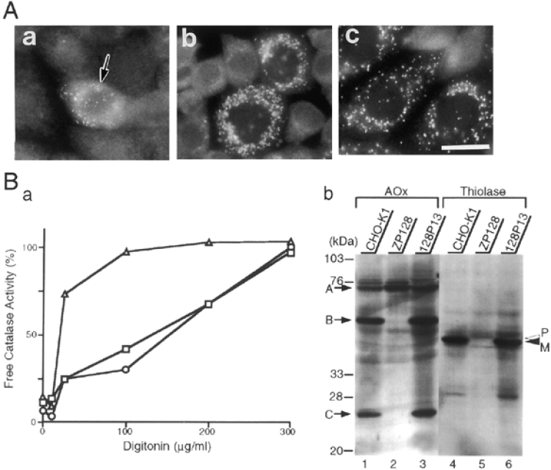
Figure 2 Restoration of peroxisomes in CG-H CHO mutant cells. (A) (a) ZP128 was transfected with an HsPEX13 clone ...
Notes:
Figure 2 Restoration of peroxisomes in CG-H CHO mutant cells. (A) (a) ZP128 was transfected with an HsPEX13 clone encoding the N-terminal 39 amino acid truncated Pex13p (see text). The arrow indicates a complemented cell. (b) ZP128 transfected with pUcD2HygHsPEX13. (c) ZP150 was transfected with Chinese hamster PEX13, pUcD2Hyg ClPEX13. Cells were stained with anti-catalase antibody. Magnification, ×630; bar, 20 µm. (B) Complementation of biogenesis of peroxisomal enzymes. (a) Latency of catalase activity in CHO-K1, ZP128 and 128P13 cells. Circles, CHO-K1; triangles, ZP128; squares, 128P13, a stable HsPEX13 transformant of ZP128. Relative free catalase activity is expressed as a percentage of the total activity measured in the presence of 1% Triton X-100 (5). The results represent the means of duplicate assays. (b) Biogenesis of peroxisomal proteins. Cell lysates (∼105 cells) were subjected to SDS-PAGE and transferred to polyvinylidene difluoride membrane. Immunoblot analysis was done using rabbit antibodies to AOx and thiolase. Lanes 1 and 4, CHO-K1; lanes 2 and 5, ZP128; lanes 3 and 6, 128P13. Arrows show AOx components A, B and C; open and solid arrowheads indicate a larger precursor (P) and mature protein (M) of thiolase, respectively.
Unless provided in the caption above, the following copyright applies to the content of this slide: © 1999 Oxford University Press

Slide 4
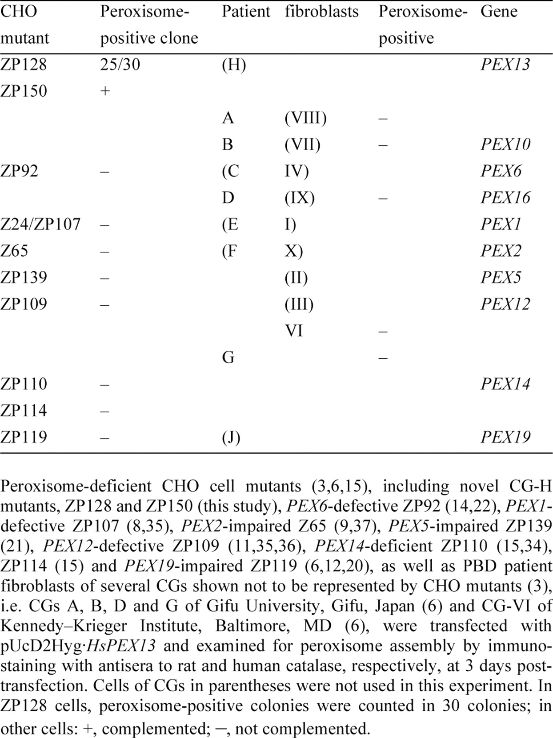
Table 2 Complementation of CHO cell mutants and PBD patient fibroblasts by HsPEX13
Notes:
Table 2 Complementation of CHO cell mutants and PBD patient fibroblasts by HsPEX13
Unless provided in the caption above, the following copyright applies to the content of this slide: © 1999 Oxford University Press

Slide 5
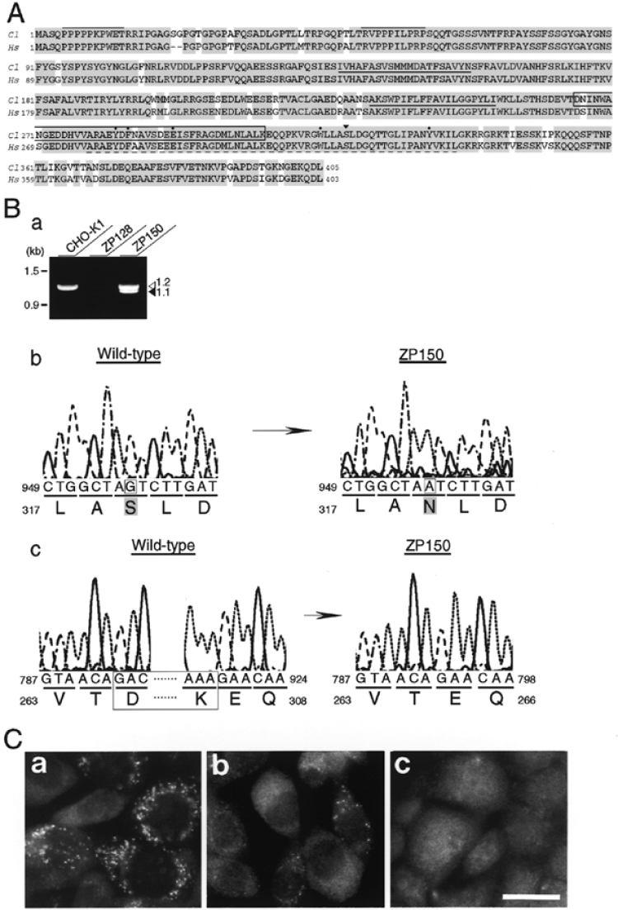
Figure 3 Chinese hamster Pex13 protein and mutation analysis. (A) Amino acid sequence alignment of Chinese hamster and ...
Notes:
Figure 3 Chinese hamster Pex13 protein and mutation analysis. (A) Amino acid sequence alignment of Chinese hamster and human Pex13 protein. The deduced amino acid sequence of Chinese hamster (Cl) Pex13p was compared with human (Hs) Pex13p. (−) is a space. Identical amino acids between species are shaded. Putative membrane-spanning segments are underlined; the dashed underline indicates a SH3 region, where conserved hydrophobic and acidic amino acids are marked by dots. Proline-rich regions are overlined. The solid arrowhead indicates the position of a missense mutation in one allele of ZP150; a 42 aminoacid truncation in another allele is boxed (see below). The GenBank database accession no. for the Chinese hamster PEX13 gene is AB022191. (B) Mutation analysis of PEX13 in ZP150. (a) RT-PCR products from CHO-K1, ZP128 and ZP150 cells were separated by 1% agarose gel electrophoresis. Molecular markers are on the left. Open and solid arrowheads indicate 1.2 and 1.1 kb PCR products, respectively. (b) Partial sequence and deduced amino acid sequence of PEX13 cDNA isolated from CHO-K1 (left) and a mutant ZP150 (right) are shown. A point mutation at nucleotide 956 changes a codon for Ser319 (solid arrowhead in A) to a codon for Asn319. (c) Truncation of 126 nucleotides from positions at 793–918 (boxed) or 792–917 results in a 42 amino acid deletion from Asp265 to Lys306 (boxed in A). (C) Transfection of mutated Chinese hamster PEX13. Chinese hamster PEX13, ClPEX13 (a) or ZP150-derived PEX13, CPEX13S319N (b) and ClPEX13e/s (c) were transfected into ZP128 cells. Cells were stained with anti-catalase antibody. Magnification, ×630; bar, 20 mm.
Unless provided in the caption above, the following copyright applies to the content of this slide: © 1999 Oxford University Press

Slide 6
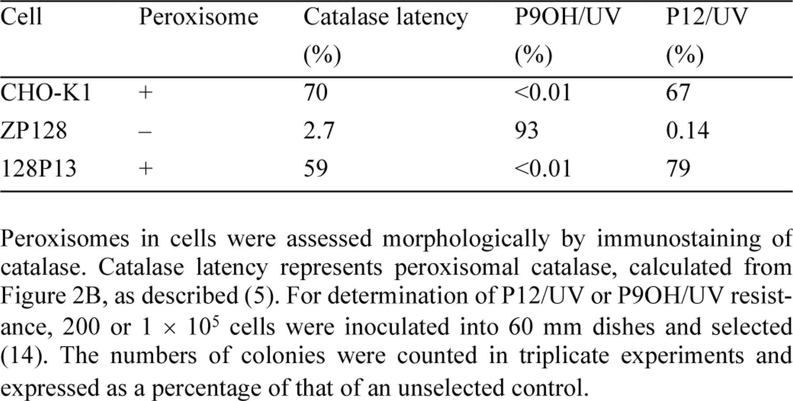
Table 3 Properties of wild-type CHO-K1, ZP128 and HsPEX13-transfected ZP128(128P13) cells
Notes:
Table 3 Properties of wild-type CHO-K1, ZP128 and HsPEX13-transfected ZP128(128P13) cells
Unless provided in the caption above, the following copyright applies to the content of this slide: © 1999 Oxford University Press

Slide 7
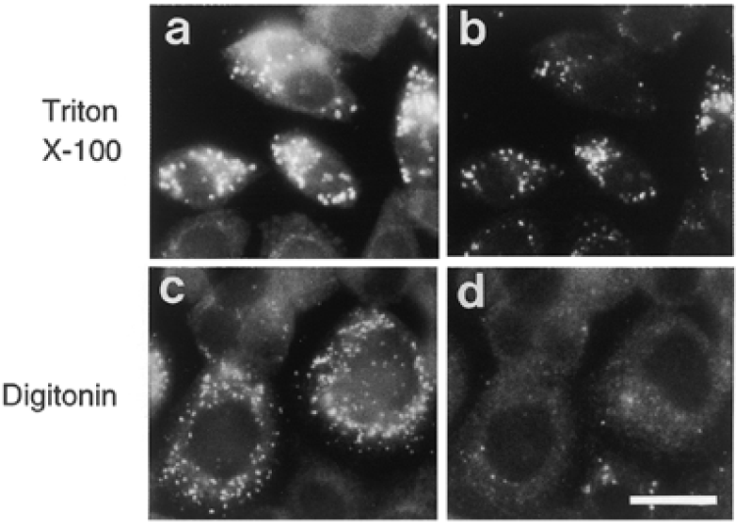
Figure 4 Intracellular localization and membrane topology of Pex13p. CHO-K1 cells transfected with flag-HsPEX13 were ...
Notes:
Figure 4 Intracellular localization and membrane topology of Pex13p. CHO-K1 cells transfected with flag-HsPEX13 were treated with 0.1% Triton X-100 (a and b)or 25 µg/ml of digitonin (c and d) by which the plasma membrane was specifically permeabilized (11,36). Cells were stained with antibodies to flag (a and c) and catalase (b and d). Note that Pex13p was detected after both types of treatment. Magnification, ×630; bar, 20 µm.
Unless provided in the caption above, the following copyright applies to the content of this slide: © 1999 Oxford University Press

