Slide 1
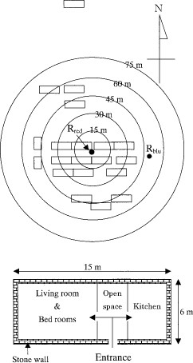
Fig. 1 Distribution of premises and two release sites for marked Ae. aegypti at He Gao village, Hainan Island, ...
Notes:
Fig. 1 Distribution of premises and two release sites for marked Ae. aegypti at He Gao village, Hainan Island, China, August 1997 (upper). Basic structure and size of each premise (lower).
Unless provided in the caption above, the following copyright applies to the content of this slide: © 2001 Entomological Society of America

Slide 2
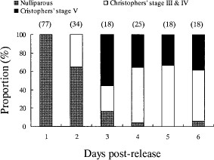
Fig. 2 Ovarian stage of recaptured Ae. aegypti at He Gao village, Hainan Island, China, August 1997. Number in ...
Notes:
Fig. 2 Ovarian stage of recaptured Ae. aegypti at He Gao village, Hainan Island, China, August 1997. Number in parentheses was the total number of females dissected.
Unless provided in the caption above, the following copyright applies to the content of this slide: © 2001 Entomological Society of America

Slide 3
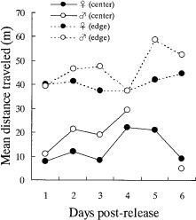
Fig. 3 Mean distance traveled by two cohorts of Ae. aegypti released at the edge and center of He Gao village, ...
Notes:
Fig. 3 Mean distance traveled by two cohorts of Ae. aegypti released at the edge and center of He Gao village, Hainan Island, China, August 1997.
Unless provided in the caption above, the following copyright applies to the content of this slide: © 2001 Entomological Society of America

