Slide 1
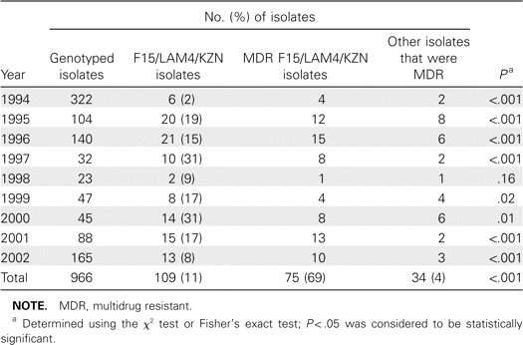
Table 1 Proportion of F15/LAM4/KZN strains among genotyped isolates of Mycobacterium tuberculosis in KwaZulu-Natal, ...
Notes:
Table 1 Proportion of F15/LAM4/KZN strains among genotyped isolates of Mycobacterium tuberculosis in KwaZulu-Natal, South Africa, 1994–2002.
Unless provided in the caption above, the following copyright applies to the content of this slide: © 2007 Infectious Diseases Society of America

Slide 2
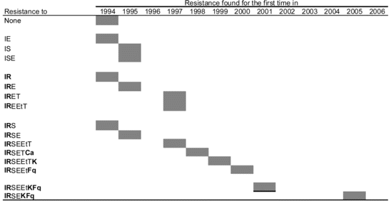
Figure 1 Development of drug resistance in the KwaZulu-Natal family of strains of Mycobacterium tuberculosis during ...
Notes:
Figure 1 Development of drug resistance in the KwaZulu-Natal family of strains of Mycobacterium tuberculosis during the period 1994–2006. Ca, capreomycin; E, ethambutol; Et, ethionamide; F, fluoroquinolones; I, isoniazid; K, kanamycin/amikacin; R, rifampicin; S, streptomycin; T, thiacetazone.
Unless provided in the caption above, the following copyright applies to the content of this slide: © 2007 Infectious Diseases Society of America

Slide 3
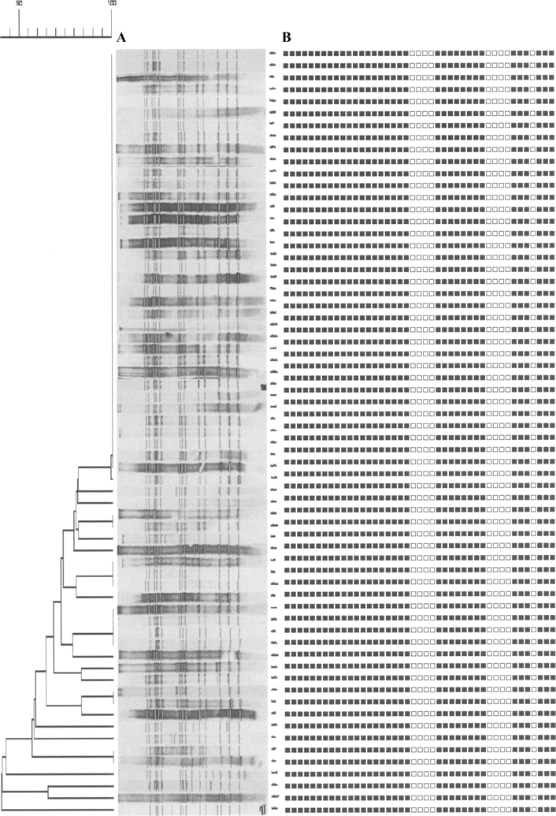
Figure 2 A, Dendrogram depicting restriction fragment-length polymorphism patterns determined using GelCompar, version ...
Notes:
Figure 2 A, Dendrogram depicting restriction fragment-length polymorphism patterns determined using GelCompar, version 4.0 (Applied Maths). B, Spoligopatterns of the KwaZulu-Natal family of Mycobacterium tuberculosis strains recovered from patients throughout KwaZulu-Natal, South Africa, during the period 1995–2000.
Unless provided in the caption above, the following copyright applies to the content of this slide: © 2007 Infectious Diseases Society of America

