Slide 1
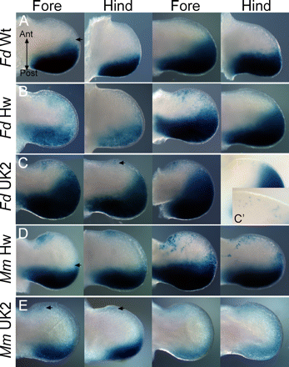
Figure 3. Limb bud expression in transgenic embryos expressing the cat mutations. The fore and hind limb buds from two ...
Notes:
Figure 3. Limb bud expression in transgenic embryos expressing the cat mutations. The fore and hind limb buds from two embryos for each transgenic construct are shown. (A) LacZ expression from the cat wild-type ZRS. In all limb buds shown, the view is from the dorsal side and the anterior and posterior axes are indicated. Posterior expression occasionally extended along the distal margin (indicated by arrow). (B and C) Expression of the Hemingway (Hw) and the UK2 cat mutations, respectively, which reside in a conserved nucleotide triple separated by one basepair. (B) Ectopic expression at the anterior margin is detected only in the fore limbs. Expression is lower in the anterior than the posterior and often appears in patches of cells. In (C) ectopic, anterior expression is also detected in the hindlimbs. The inset C' shows labelled cells scattered along the anterior margin at a higher magnification. (D and E) Expression of the Hw and the UK2 mutations, respectively, contained in the mouse ZRS. Expression in (D) occurs in the ectopic domain in both the hind and the fore limbs. UK2 mutation (E) shows low anterior expression in both fore and hind limbs.
Unless provided in the caption above, the following copyright applies to the content of this slide: © 2007 The Author(s)This is an Open Access article distributed under the terms of the Creative Commons Attribution Non-Commercial License (http://creativecommons.org/licenses/by-nc/2.0/uk/) which permits unrestricted non-commercial use, distribution, and reproduction in any medium, provided the original work is properly cited.

Slide 2
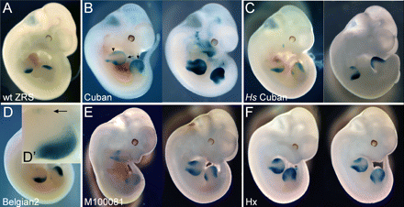
Figure 2. Transgenic analysis of the human and mouse mutations showing the variable expression output. All embryos are ...
Notes:
Figure 2. Transgenic analysis of the human and mouse mutations showing the variable expression output. All embryos are at approximate stage E11.5. (A) The typical pattern of LacZ in transgenic embryos carrying the mouse wild-type (wt) ZRS. The stain resides at the posterior margins of both the fore and hind limbs. (B) Transgenic embryos carrying the human Cuban mutation on the mouse ZRS. Two embryos are shown to indicate that the pattern is consistent in embryos even when the overall level of expression differs. One embryo is designated to show the position of the ectopic expression along the anterior margin indicated by an arrowhead and the extension of the posterior to the distal margin by an arrow. The Cuban mutation on the human ZRS (Hs) is shown in (C). The expression does not extend as far into the interior of the limb as seen in (B). The Belgian2 mutation in (D) reveals a low level of anterior expression. The arrow in the D’ inset points to the cells expressing LacZ. (E) Expression of the mouse M100081 mutation one nucleotide removed from the Cuban mutation. Note that the expression pattern is similar to Cuban showing the extension to the distal edge. (F) Expression pattern of the Hx mutation with appreciable ectopic expression but the distal expression is not apparent.
Unless provided in the caption above, the following copyright applies to the content of this slide: © 2007 The Author(s)This is an Open Access article distributed under the terms of the Creative Commons Attribution Non-Commercial License (http://creativecommons.org/licenses/by-nc/2.0/uk/) which permits unrestricted non-commercial use, distribution, and reproduction in any medium, provided the original work is properly cited.

Slide 3
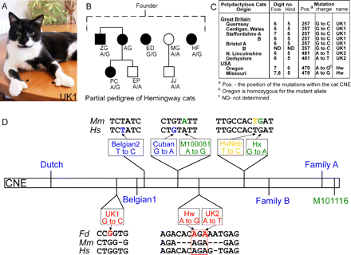
Figure 1. Genetic analysis of polydactylous cats and a summary of the mutations. (A) Picture of a polydactylous cat ...
Notes:
Figure 1. Genetic analysis of polydactylous cats and a summary of the mutations. (A) Picture of a polydactylous cat (carrying the UK1 mutation) showing the extra digits on the fore paws (arrows). (B) A partial pedigree of the Hemingway cats that were sampled. All affected cats are presumably derived from a single founder. The affected cats are depicted with solid squares (males) and circles (females). The initials for each individual cat are shown and the genotype of each cat is shown below the initials. The wild-type allele has an A at position 481 of the cat sequence and the mutant allele a G. (C) List of the polydactylous cats from Great Britain and the USA showing the origin of each, the limb phenotype and mutation that was determined. (D) Summary of the 12 mutations that reside in the ∼800 bp conserved non-coding element (CNE, represented by rectangle). The relative position of the cat mutations are shown below. The position of the mutation is designated by red nucleotide and the surrounding sequence and corresponding sequence in mouse and human are shown (Fd, Felis domesticus; Mm, Mus musculus; and Hs, Homo sapiens). The conserved nucleotide triplet is designated by the red box. Other mutations used in the analysis are shown above the CNE. The name and the position of the mutations are shown (mutations identified in Hs are indicated in blue while Mm mutations are in green). The relative position of the human Cuban mutation and the mouse M100081 are shown and are one nucleotide apart. The 11 bp Hx subdomain is shown and the position of the Hx and HxNeb mutations are indicated.
Unless provided in the caption above, the following copyright applies to the content of this slide: © 2007 The Author(s)This is an Open Access article distributed under the terms of the Creative Commons Attribution Non-Commercial License (http://creativecommons.org/licenses/by-nc/2.0/uk/) which permits unrestricted non-commercial use, distribution, and reproduction in any medium, provided the original work is properly cited.

