Slide 1
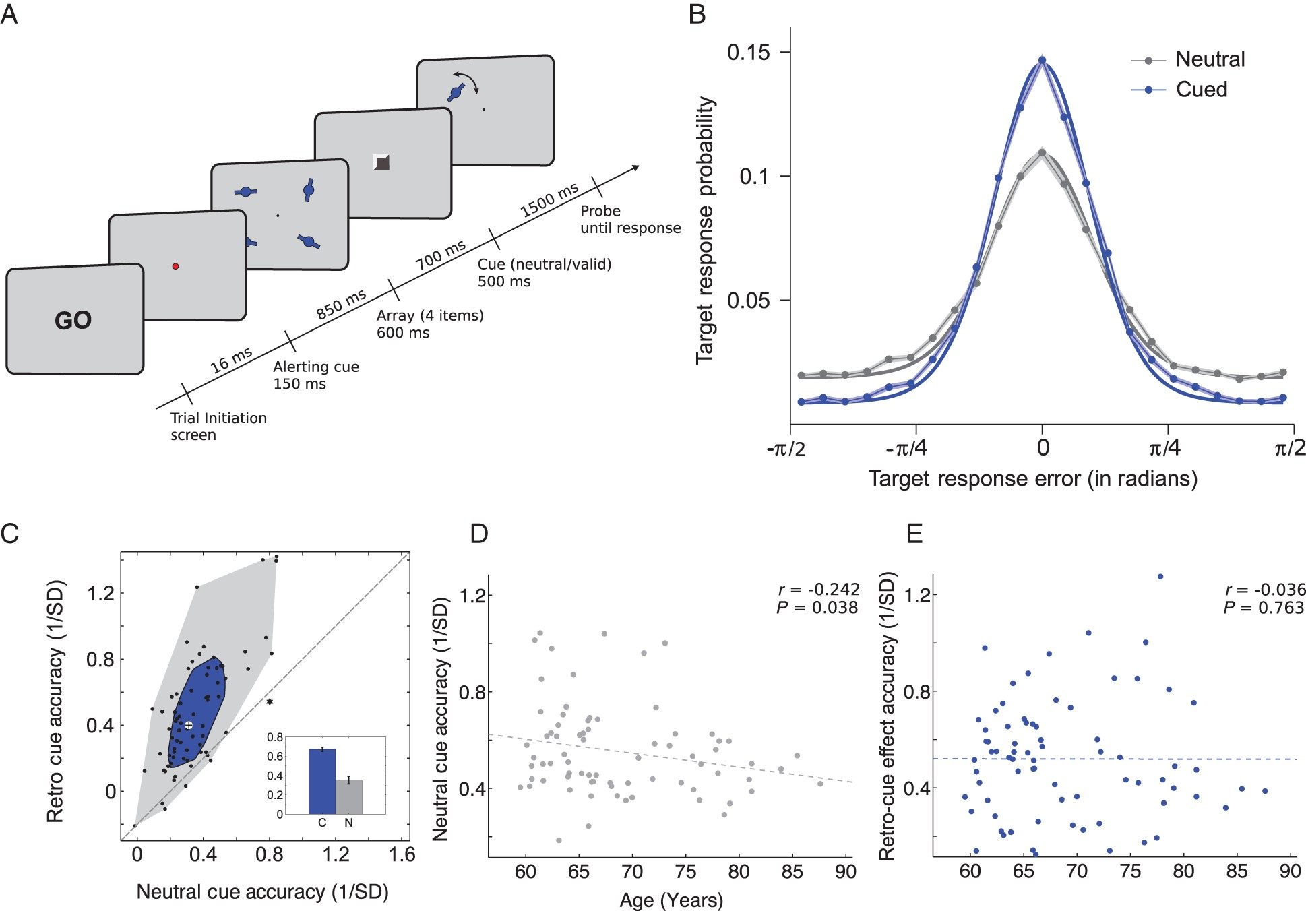
Figure 1. Task schematic and behavioral results for 74 participants. (A) Task schematic. Participants pressed a button ...
Notes:
Figure 1. Task schematic and behavioral results for 74 participants. (A) Task schematic. Participants pressed a button to initiate each trial at the “GO” screen. Participants encoded 4 orientation stimuli into WM. After a fixed delay of 700 ms, a retro-cue appeared. In half the trials, a spatial retro-cue (100% valid) appeared, indicating the location of the item that would subsequently be probed. In the other trials, a neutral retro-cue provided no predictive information about the location to be probed. After another fixed delay of 1500 ms, a randomly oriented probe bar appeared in one of the quadrants. Participants indicated the orientation of the item at that location in the memory array by rotating the bar and confirmed with a button press. After responding, the correct orientation of the memory-array item was overlaid as feedback (not shown here). (B) Response error distributions centered on the target for spatial and neutral retro-cue conditions. The mean error is plotted at each bin and connected by the lines for the spatial (blue) and neutral (gray) retro-cue condition and the shading shows the SEM. The smooth lines show the model fit (weighted mixture of the von Mises and uniform distribution). x-Axis shows response error in radians, and y-axis is the response error probability. (C) Scatter and bag plot and bar plot showing the effect of the spatial retro-cue on WM behavioral measures. The small bar-plot inset shows WM accuracy for the spatial (blue) and neutral (gray) cue conditions (***P < 0.0001). For the scatter and bag plot, dots represent individual participants, x-axis is accuracy on neutral retro-cue conditions and the y-axis is accuracy on spatial retro-cue conditions. Dots above the diagonal represent participants who exhibited an increase in WM accuracy in the retro-cue conditions relative to the neutral-cue conditions and dots below the diagonal represent a decrease in accuracy in the retro-cue relative to neutral-cue conditions. The inner blue bag includes 50% of the data with the largest depth, the outer gray polygon contains all other nonoutlier data points, and the Xs outside of the shaded areas represent outliers. The cross at the center of the bag plot represents the center of mass of the bivariate distribution of empirical data (Rousseeuw et al. 1999). (D,E) Age was negatively correlated with accuracy in the neutral-cue condition (D) but not with retro-cue benefit (E). Correlation values are Spearman's rank correlation coefficients.
Unless provided in the caption above, the following copyright applies to the content of this slide: © The Author 2016. Published by Oxford University PressThis is an Open Access article distributed under the terms of the Creative Commons Attribution License (http://creativecommons.org/licenses/by/4.0/), which permits unrestricted reuse, distribution, and reproduction in any medium, provided the original work is properly cited.

Slide 2
Figure 2. Significant retro-cue benefits in WM components from the mixture-model analysis for 74 participants. The ...
Notes:
Figure 2. Significant retro-cue benefits in WM components from the mixture-model analysis for 74 participants. The probability of target recall (A) and precision (D) were significantly higher in the retro-cue relative to the neutral-cue condition, and the probability of nontarget (B) and guess responses (C) were significantly lower in the retro-cue relative to the neutral-cue condition. ***P < 0.00001; **P < 0.01; *P < 0.05.
Unless provided in the caption above, the following copyright applies to the content of this slide: © The Author 2016. Published by Oxford University PressThis is an Open Access article distributed under the terms of the Creative Commons Attribution License (http://creativecommons.org/licenses/by/4.0/), which permits unrestricted reuse, distribution, and reproduction in any medium, provided the original work is properly cited.

Slide 3
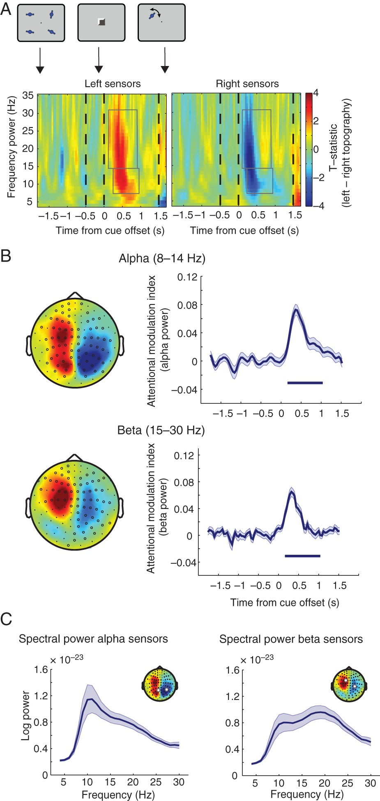
Figure 3. Alpha and beta lateralization. (A) Time course of alpha (8–14 Hz) and beta (15–30 Hz) power lateralization ...
Notes:
Figure 3. Alpha and beta lateralization. (A) Time course of alpha (8–14 Hz) and beta (15–30 Hz) power lateralization from sensors for the left minus right retro-cue contrast. Left: Increase of event-related synchronization (ERS) of alpha/beta power on the ipsilateral hemisphere to the attended side following a retro-cue. Right: Decrease of ERS of alpha/beta power on the contralateral hemisphere to the attended side following a retro-cue. Gray boxes denote significant increase/decrease in lateralization for alpha and beta bands. x-Axis is time from cue offset; y-axis is frequency power. (B) Left: Topography of alpha (top) and beta (bottom) power for the left minus right retro-cue contrast at 120–800 ms (alpha) and 8–840 ms (beta) after cue offset. Right: Time course of alpha (top) and beta (bottom) attention modulation index (AMI). The AMI is the average of the ipsilateral sensors minus average of the contralateral sensors' alpha or beta power, respectively (sensor selection via a leave-one-out method; see Materials and Methods). x-Axis is time from cue offset; y-axis is AMI. The bar below the AMI denotes significant lateralization compared with zero (both alpha and beta AMI: P < 1.0 × 10−4 cluster-corrected over time). (C) Spectral power for peak alpha and beta lateralization sensors. Mean log power for each frequency from 4 to 30 Hz in 1 Hz steps at sensors that exhibited peak modulation during the period of significant alpha lateralization (120–800 ms; left) and beta lateralization (8–840 ms; right) averaged over left and right retro-cue conditions, showing separate alpha and beta spectral peaks.
Unless provided in the caption above, the following copyright applies to the content of this slide: © The Author 2016. Published by Oxford University PressThis is an Open Access article distributed under the terms of the Creative Commons Attribution License (http://creativecommons.org/licenses/by/4.0/), which permits unrestricted reuse, distribution, and reproduction in any medium, provided the original work is properly cited.

Slide 4
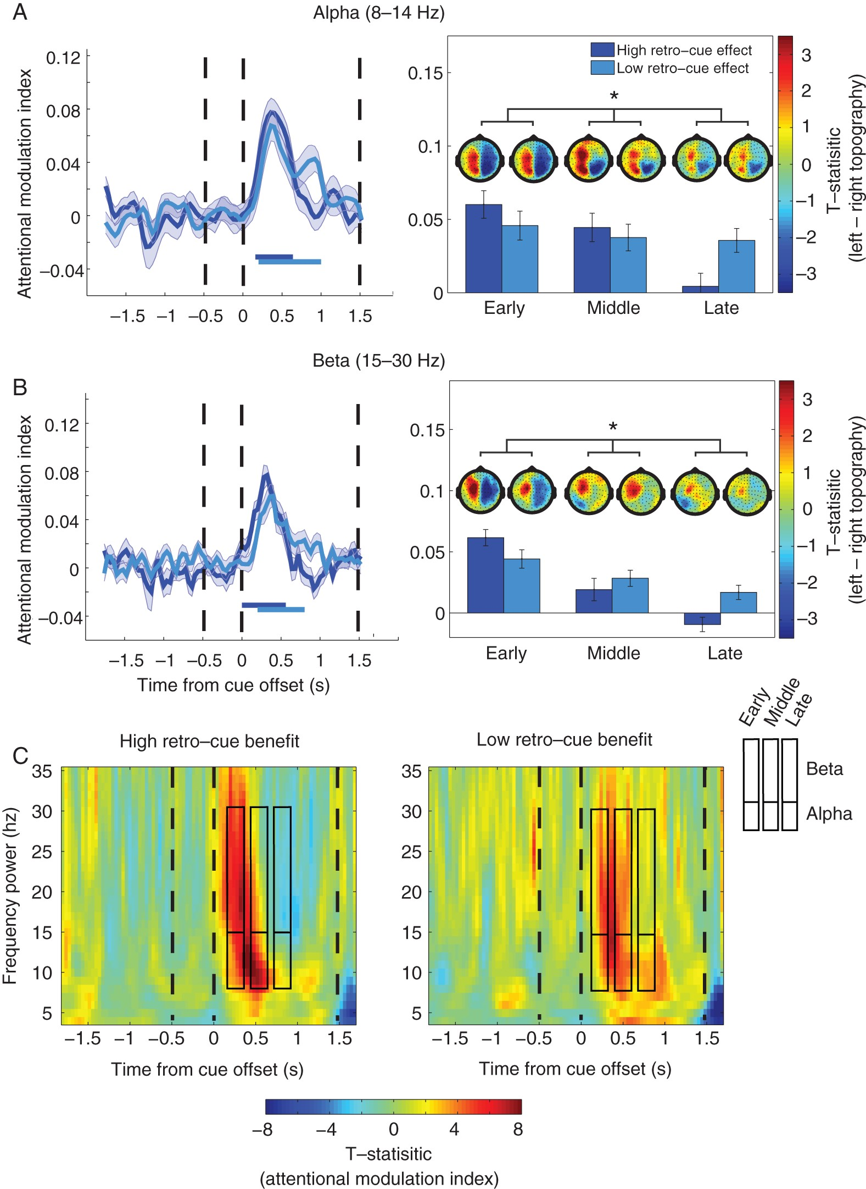
Figure 4. Temporal profile of alpha/beta lateralization reflects magnitude of retro-cue benefit in WM accuracy. (A) ...
Notes:
Figure 4. Temporal profile of alpha/beta lateralization reflects magnitude of retro-cue benefit in WM accuracy. (A) Left: Time course of the attentional modulation index (AMI) for high and low cueing benefit groups in the alpha band. The high cueing group exhibited a large increase of AMI after cue offset that shortly went back to baseline, whereas the low cueing group had a numerically smaller increase of AMI that lasted for longer. Right: Bar plots showing a significant interaction between groups for the AMI in the early, middle and late periods. Topographies display t-stat images of alpha power lateralization for each group and averaged over the early, middle, and late time points above each respective bar plot. Topography color scale is kept constant with t-values of −4 to 4. The bars below the AMI denote significant lateralization (AMI significantly different from zero) in each group. (B) The same analysis is presented for beta. *Significant interaction (P < 0.05). (C) Time–frequency plots of the AMI in participants with high retro-cue benefits (left) and low retro-cue benefits (right) for visualization. x-Axis is time from cue offset; y-axis is frequency power.
Unless provided in the caption above, the following copyright applies to the content of this slide: © The Author 2016. Published by Oxford University PressThis is an Open Access article distributed under the terms of the Creative Commons Attribution License (http://creativecommons.org/licenses/by/4.0/), which permits unrestricted reuse, distribution, and reproduction in any medium, provided the original work is properly cited.

