Slide 1
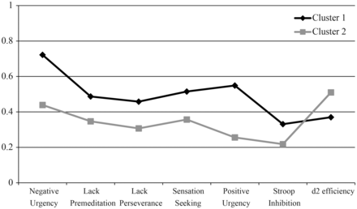
Fig. 1. Profile of impulsivity scores of the two classes after rescaling scores into a 0–1 scale.
Notes:
Fig. 1. Profile of impulsivity scores of the two classes after rescaling scores into a 0–1 scale.
Unless provided in the caption above, the following copyright applies to the content of this slide: © The Author 2013. Published by Oxford University Press. All rights reserved. For permissions, please e-mail: journals.permissions@oup.com.

