Slide 1
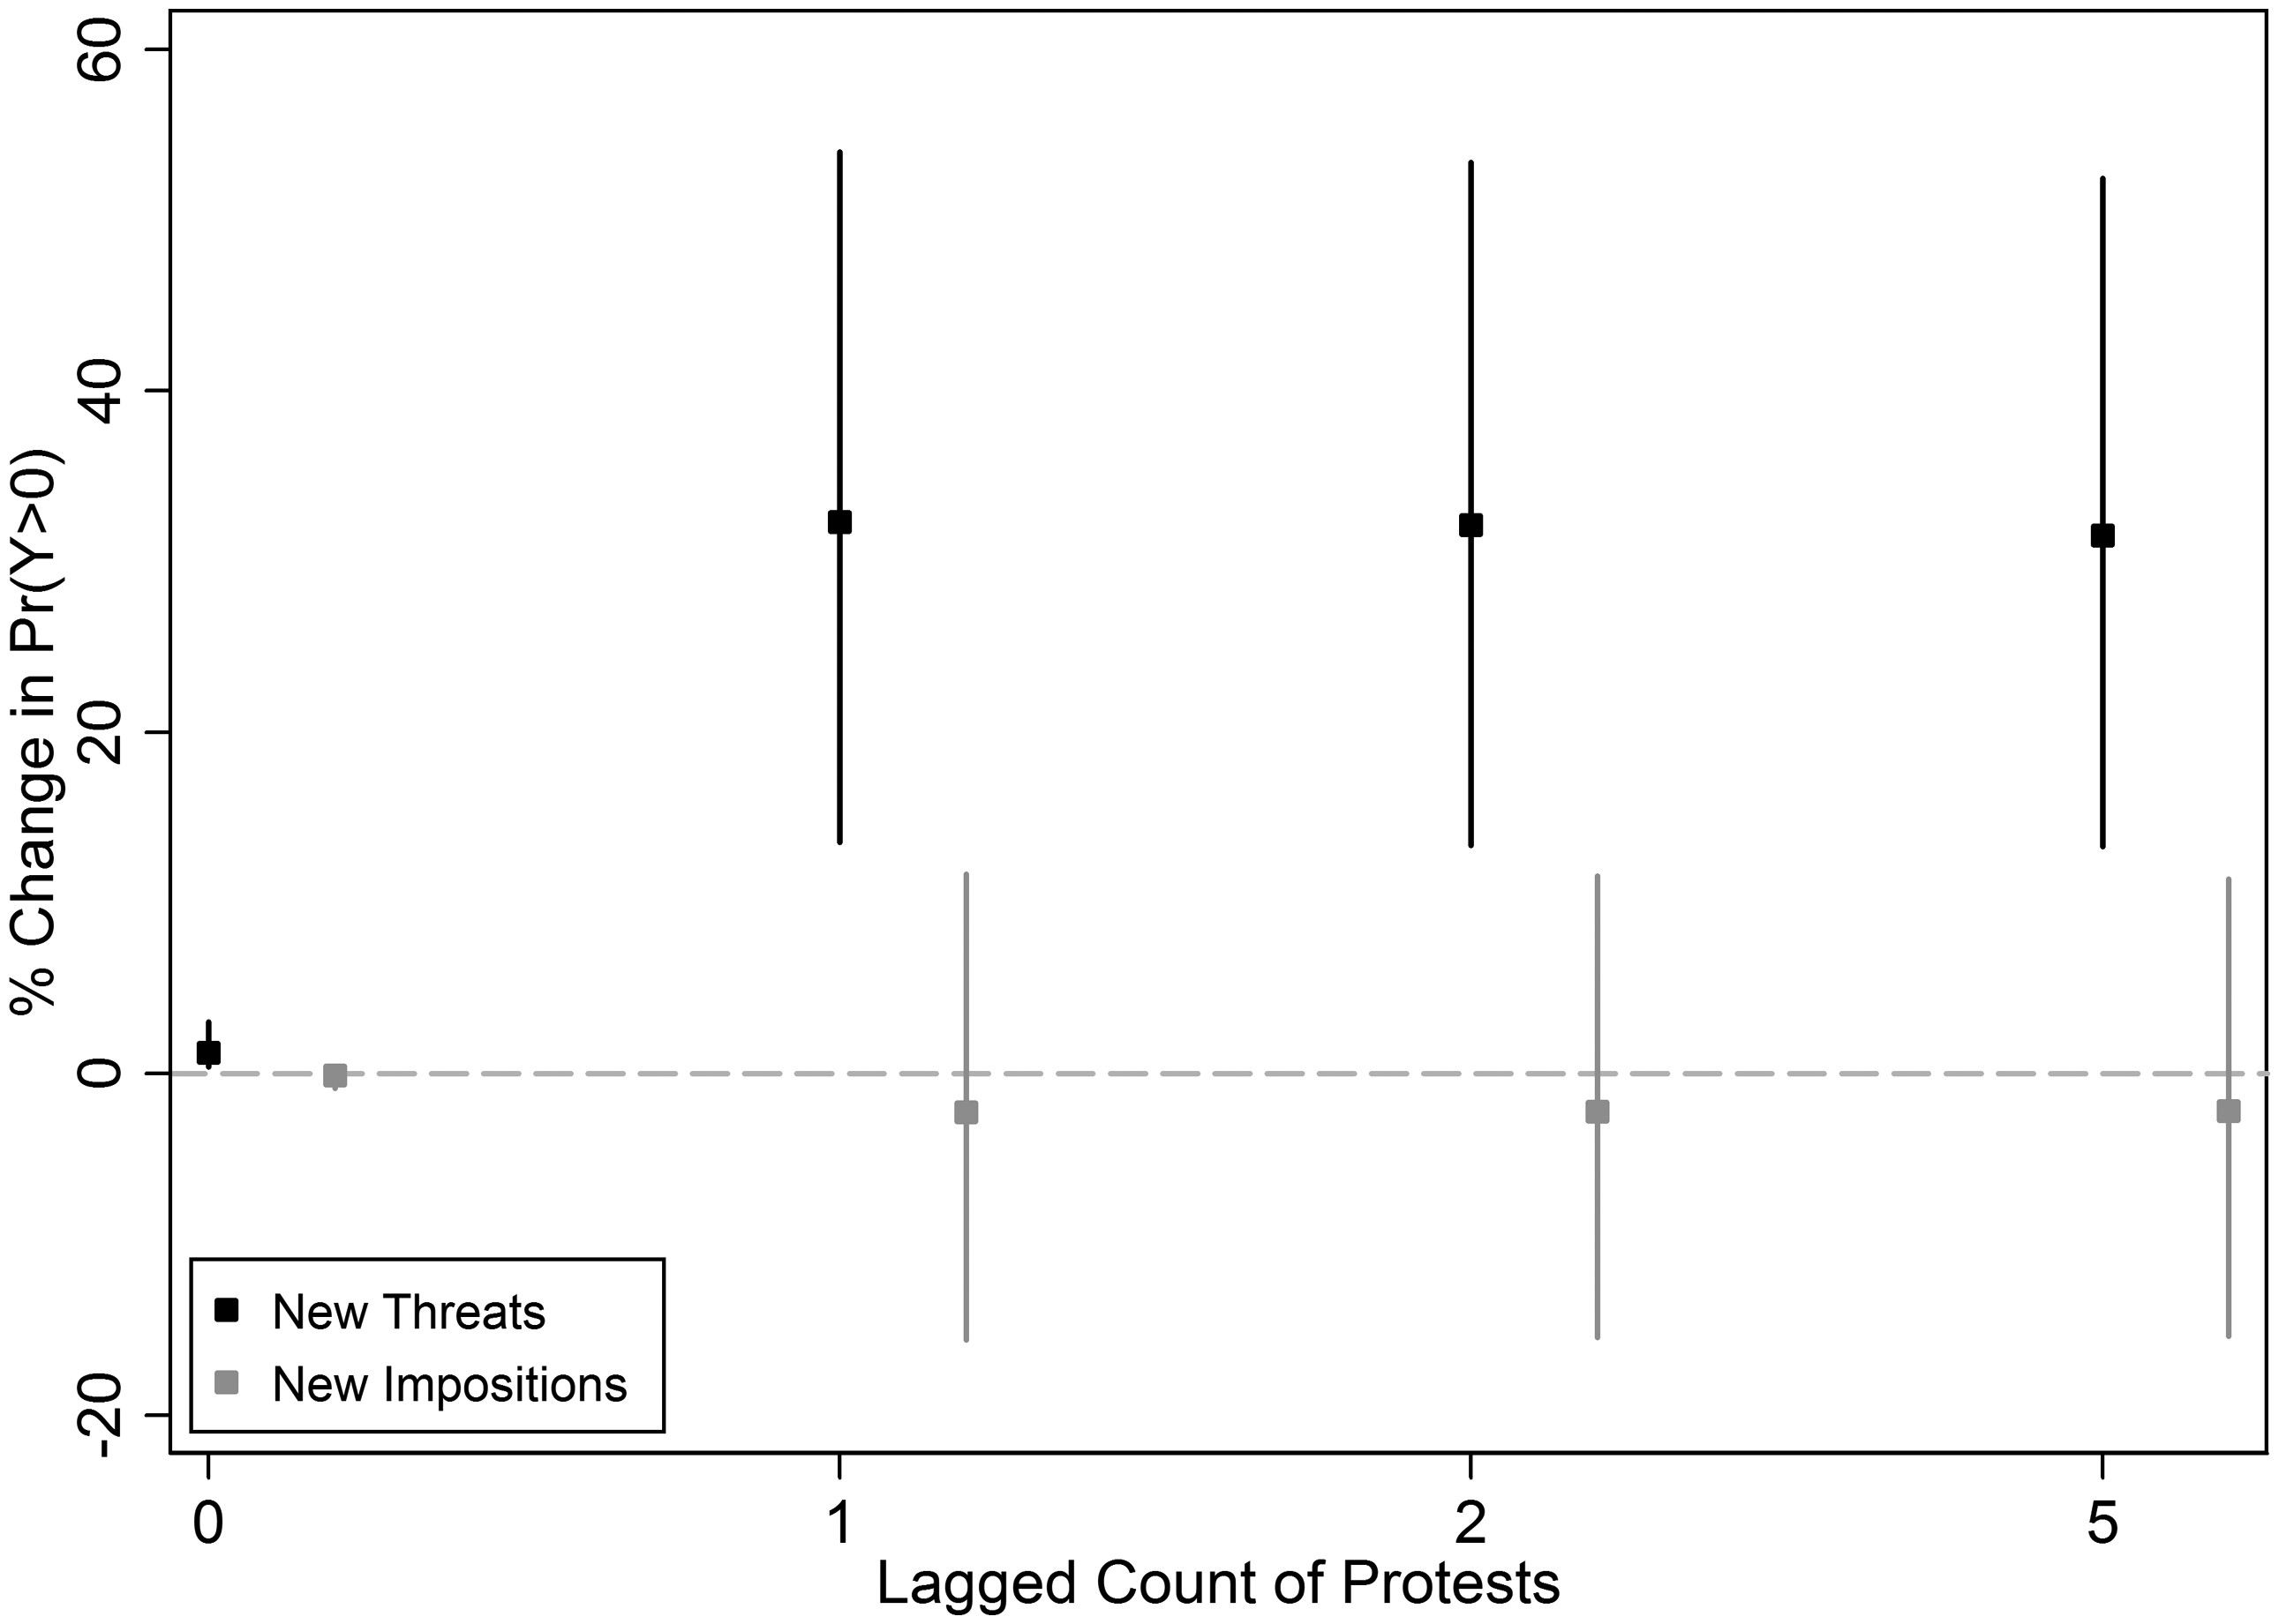
Figure 1. Relative differences in predicted probability of nonzero count of antigovernment protests by new sanctions ...
Notes:
Figure 1. Relative differences in predicted probability of nonzero count of antigovernment protests by new sanctions and previous levels Note: Spikes provide 95 percent credible intervals from simulated sampling distribution of 100,000 draws from the parameter matrices of the negative binomial reported as Model (1) in Table 1. The relative difference is the Pr⁡Y>0|sanction-Pr⁡Y>0|∼sanction/Pr⁡(Y>0|∼sanction).
Unless provided in the caption above, the following copyright applies to the content of this slide: © The Author (2017). Published by Oxford University Press on behalf of the International Studies Association.This is an Open Access article distributed under the terms of the Creative Commons Attribution License (http://creativecommons.org/licenses/by/4.0/), which permits unrestricted reuse, distribution, and reproduction in any medium, provided the original work is properly cited.

