Slide 1
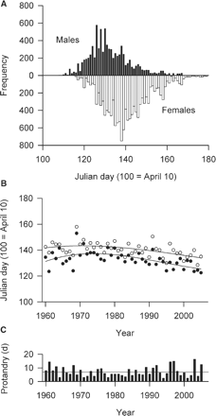
Fig. 1 Spring phenology of migrating male and female redstarts (Phoenicurus phoenicurus) caught between 1960 and ...
Notes:
Fig. 1 Spring phenology of migrating male and female redstarts (Phoenicurus phoenicurus) caught between 1960 and 2005 at Heligoland Island, German North Sea (54°12′N, 07°56′E). (A) Cumulative frequency distributions of daily trapping totals. (B) Year-wise median passage dates of males (closed circle) and females (open circles). Lines are polynomial regression lines. (C) Yearly protandry values defined as the time lag between the median passage dates of males and females. The line indicates the average protandry value.
Unless provided in the caption above, the following copyright applies to the content of this slide: © The Author 2009. Published by Oxford University Press on behalf of the Society for Integrative and Comparative Biology. All rights reserved. For permissions please email: journals.permissions@oxfordjournals.org.

Slide 2
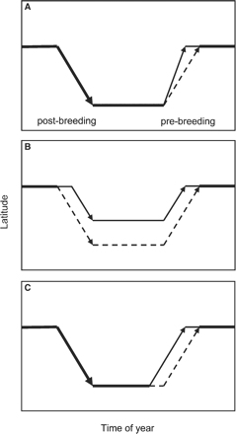
Fig. 2 Schematic representation of the three basic behavioral mechanisms controlling the timing of protandrous ...
Notes:
Fig. 2 Schematic representation of the three basic behavioral mechanisms controlling the timing of protandrous spring arrival: (A) Males (solid arrow) and females (dashed arrow) migrate from common wintering latitude but at different speeds. (B) Males and females segregate spatially during autumnal (postbreeding) migration, which leads to differential arrival in spring. (C) Males initiate spring (prebreeding) migration earlier than do females.
Unless provided in the caption above, the following copyright applies to the content of this slide: © The Author 2009. Published by Oxford University Press on behalf of the Society for Integrative and Comparative Biology. All rights reserved. For permissions please email: journals.permissions@oxfordjournals.org.

Slide 3
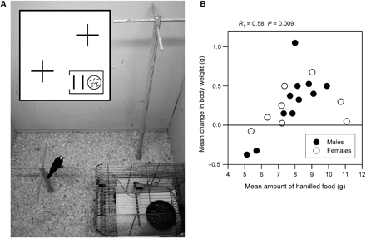
Fig. 3 Foraging and fuelling performance of migratory redstarts (Phoenicurus phoenicurus) at an artificial stopover ...
Notes:
Fig. 3 Foraging and fuelling performance of migratory redstarts (Phoenicurus phoenicurus) at an artificial stopover site. Eleven male and nine female redstarts were randomly sampled between 27 April and 28 May 2005 on Heligoland Island (54°12′N, 07°56′E). Upon capture, birds were transferred individually to indoor aviaries (A) equipped with two perches and a feeding dish providing 30 g mealworms (Tenebrio sp.) in an enclosure (transformed bird cage fitted with two movable perches and connected to an event recorder). As soon as a bird entered the cage, the timing and duration of its visit was registered. Birds were kept at 19–22°C and under simulated local photoperiod (LD 16:8 h; 5:00–21:00 CEST) for 4 days and were released thereafter. Each evening, the redstarts were weighed (nearest 0.1 g). The amount of food that was left over was also weighed. Before the lights went off in the evening, birds were moved to separate aviaries. Food was refilled to exactly 30 g each morning. Shortly after the lights went on in the morning, birds were released into the arena through a flap door that could be opened remotely. (B) The mean amount of food that birds handled over the 4 days was significantly positively correlated with the mean gain in body weight over the 4 days (level of significance of Spearman's rank correlation). One-way ANOVA with sex as a fixed factor yielded no significant sexual differences in the intake of food and change in body weight (P > 0.05). Models including body size and fat load at capture as covariates yielded the same result (no significant sexual differences, all P > 0.05).
Unless provided in the caption above, the following copyright applies to the content of this slide: © The Author 2009. Published by Oxford University Press on behalf of the Society for Integrative and Comparative Biology. All rights reserved. For permissions please email: journals.permissions@oxfordjournals.org.

Slide 4
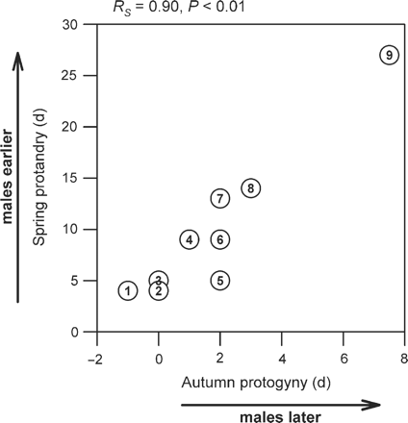
Fig. 4 Correlation between the extent of protandry during migration in the spring and the extent of protogyny in ...
Notes:
Fig. 4 Correlation between the extent of protandry during migration in the spring and the extent of protogyny in autumn among nine Palaearctic passerine migrants trapped between 1960 and 2000 at Heligoland. Ringing recoveries indicate that migrants caught on Heligoland originate from Scandinavian breeding populations (Zink 1973–1985; Zink and Bairlein 1995). (1) Blackcap, Sylvia atricapilla; (2) Linnet, Carduelis cannabina; (3) Common Whitethroat, Sylvia communis; (4) Redstart, Phoenicurus Phoenicurus; (5) Ring Ouzel, Turdus torquatus; (6) Blackbird, Turdus merula; (7) Goldcrest, Regulus regulus; (8) Chaffinch, Fringilla coelebs; and (9) Reed Bunting, Emberiza schoeniclus. Values derived from Hüppop and Hüppop (2004). Irruptive winter guests (Fieldfare, Turdus pilaris; Great Tit, Parus major; Brambling, Fringilla montifringilla; Greenfinch, Cardulelis chloris) were omitted from the analysis. The degree of protandry is defined as the difference between the median trapping date of females relative to that of males, with positive values signifying earlier passage of males. The degree of protogyny in autumn is defined as the difference between the median trapping date of males relative to that of females, with positive values signifying earlier migration by females. Level of significance of Spearman's rank correlation. Autumnal protogyny remained significantly positively correlated with vernal protandry after correcting for phylogenetic nonindependence (Pearson product-moment correlation, r = 0.95, two-tailed P < 0.0001), applying the PDAP module (Midford et al. 2005) implemented in Mesquite (Maddison and Maddison 2009).
Unless provided in the caption above, the following copyright applies to the content of this slide: © The Author 2009. Published by Oxford University Press on behalf of the Society for Integrative and Comparative Biology. All rights reserved. For permissions please email: journals.permissions@oxfordjournals.org.

Slide 5
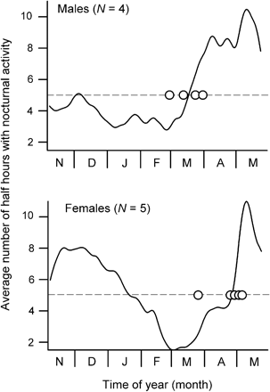
Fig. 5 Experimental evidence for a sex-specific difference in the onset of vernal migration in the Redstart ...
Notes:
Fig. 5 Experimental evidence for a sex-specific difference in the onset of vernal migration in the Redstart (Phoenicurus phoenicurus). During the migratory period, night-migrating songbirds develop nocturnal locomotory activity (German: Zugunruhe), which reflects the timing and extent of migratory behavior found in the wild (Gwinner 1996; Berthold 2001). Yearling redstarts were caught during autumnal migration on Heligoland Island and were kept for 8 months in individual registration cages under constant laboratory conditions (LD 12:12, ad libitum food and water, room temperature). The number of movements per unit of time was measured using event recorders connected to vibration detectors. Spline curves are locally weighted within optimal bandwidths and represent the average nocturnal activity in each sex over 7 months. Circles mark the individual onset dates of vernal migration, defined as the dates on which activity reached 5 half hour units on average. Male redstarts showed a significantly earlier onset of nocturnal activity (males, 16 March ± 14 days; females, 23 April ± 16 days; mean ± SD; Wilcoxon two-sample test, S = 11, Z = –2.08, P < 0.05), suggesting that they would have left the wintering site several days before females would have gone.
Unless provided in the caption above, the following copyright applies to the content of this slide: © The Author 2009. Published by Oxford University Press on behalf of the Society for Integrative and Comparative Biology. All rights reserved. For permissions please email: journals.permissions@oxfordjournals.org.

