Slide 1
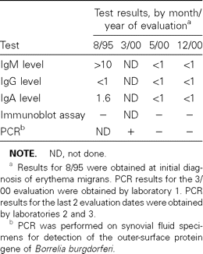
Table 1 Test results, by date of evaluation, for an adult man who was seen for evaluation for suspected Lyme ...
Notes:
Table 1 Test results, by date of evaluation, for an adult man who was seen for evaluation for suspected Lyme arthritis.
Unless provided in the caption above, the following copyright applies to the content of this slide: © 2001 by the Infectious Diseases Society of America

