Slide 1
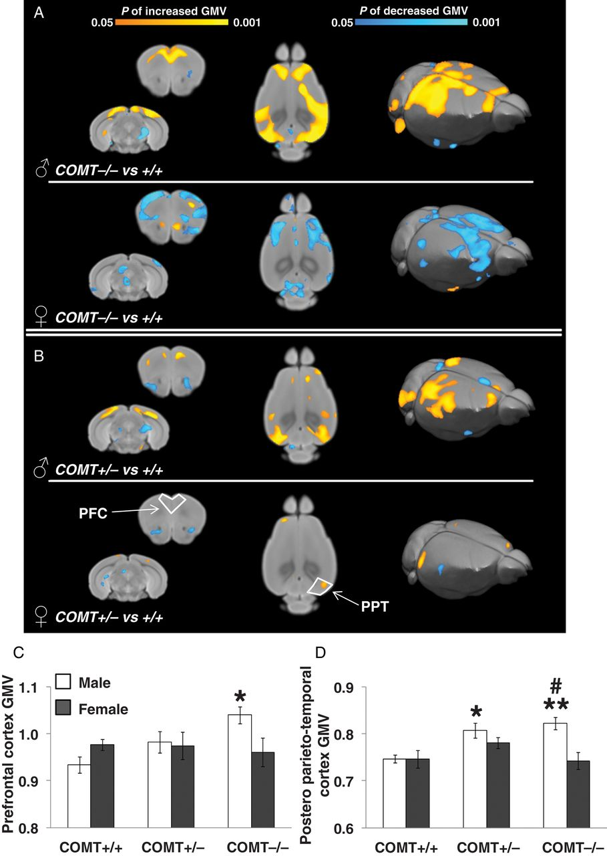
Figure 1. Increased prefrontal and postero-parieto-temporal gray-matter volume in male but not female COMT knockout ...
Notes:
Figure 1. Increased prefrontal and postero-parieto-temporal gray-matter volume in male but not female COMT knockout mice. (A, B) Representative coronal (left), horizontal (middle), and 3D volumetric reconstruction (right) of the areas showing statistically significant increased or decreased in gray-matter volume (GMV) (A) in COMT−/− and (B) in COMT+/− compared with wild-type COMT+/+ littermates (P < 0.05, TFCE corrected). Areas of increased gray-matter volume were apparent in prefrontal (PFC) and postero-parieto-temporal (PPT) cortical areas of male (♂) but not female (♀) mice. The arrows indicate the placement of region of interest for post hoc analyses in the PFC and PPT areas. Bar graphs illustrate mean GMV within (C) the PFC and (D) the PPT plotted as a function of genotype and sex. COMT+/+ males N = 7, females N = 6; COMT+/− males N = 6, females N = 8; COMT−/− males N = 7, females N = 4. Values represent mean ± SEM in all figures. *P < 0.05, **P < 0.01 versus COMT+/+. #P < 0.01 versus COMT−/− females.
Unless provided in the caption above, the following copyright applies to the content of this slide: © The Author 2014. Published by Oxford University Press. All rights reserved. For Permissions, please e-mail: journals.permissions@oup.com

Slide 2
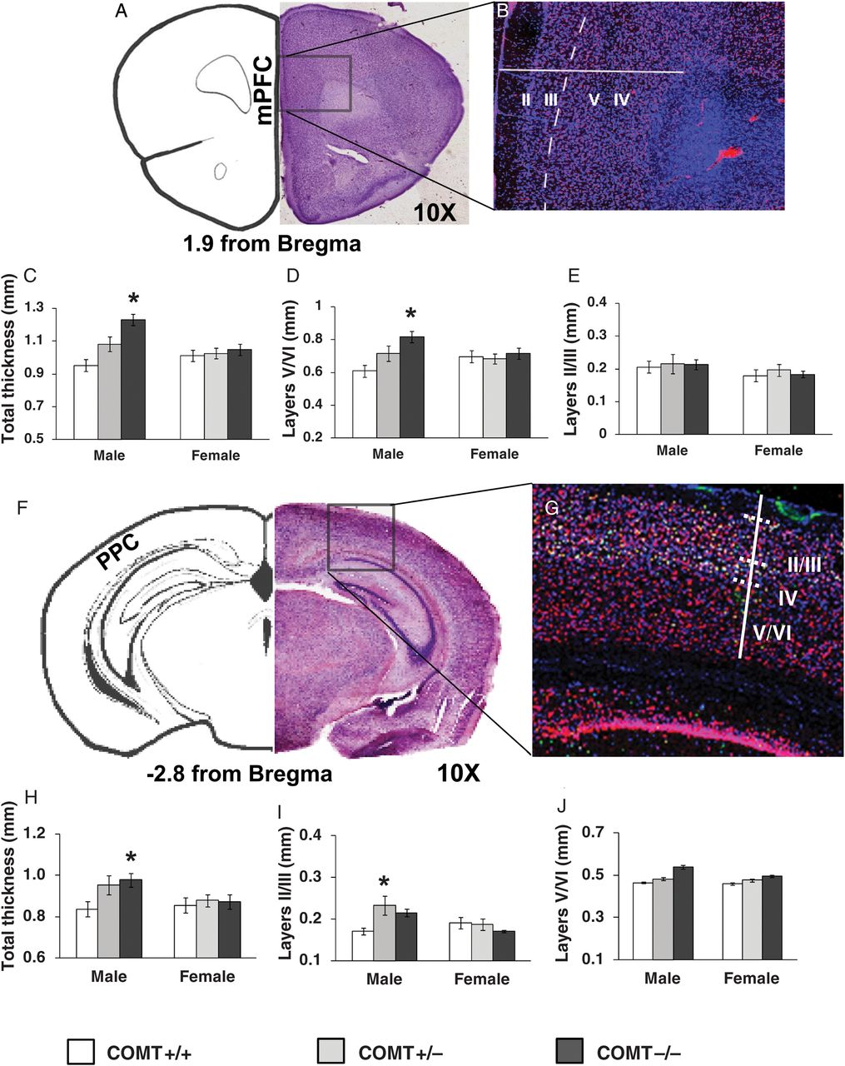
Figure 2. COMT knockout male mice show increased thickness in deeper layers V/VI of the medial PFC and in superficial ...
Notes:
Figure 2. COMT knockout male mice show increased thickness in deeper layers V/VI of the medial PFC and in superficial layers II/III of the posterio-parietal cortex. (A) Representative coronal section of mice mPFC. (B) Confocal image of the mPFC after staining for 2 cell markers: Hoechst (in blue) and NeuN (in red). The continuous white line represents the cortical thickness of the mPFC. The statistical analysis revealed an increased (C) total thickness of the PFC in males (*P < 0.05 vs. all other groups) and, in particular, (D) of layers V/VI (*P < 0.05 vs. +/+ male mice), but (E) not of layers II/III. COMT+/+ males N = 5, females N = 5; COMT+/− males N = 5, females N = 5; COMT−/− males N = 5, females N = 5. (F) Representative coronal section of mice posterior parietal cortex (PPC). (G) Confocal image of the PPC stained for: Hoechst (blue), NeuN (red), and Cux1 (white), note that the pattern of expression of Cux 1 helped to confirm the identification of layers V/VI from layers IV and II/III (see also Supplementary Data). The continuous white line represents the thickness of the PPC. The statistical analysis revealed an increase in (H) the total thickness of the PPC and, in particular, (I) of layers II/III, and (J) layers V/VI. COMT+/+ males N = 5, females N = 5; COMT+/− males N = 5, females N = 5; COMT−/− males N = 9, females N = 5. *P < 0.05 versus +/+ mice.
Unless provided in the caption above, the following copyright applies to the content of this slide: © The Author 2014. Published by Oxford University Press. All rights reserved. For Permissions, please e-mail: journals.permissions@oup.com

Slide 3
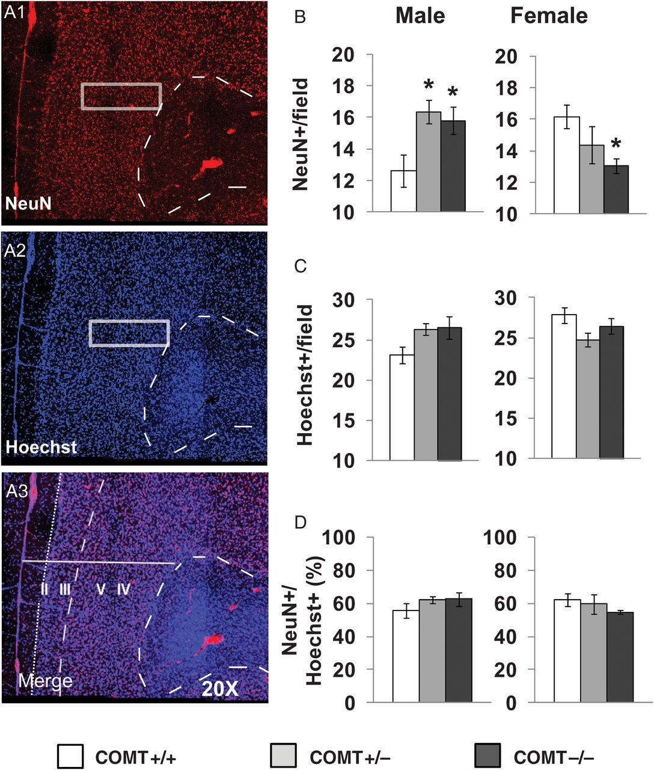
Figure 3. In the medial PFC, COMT genetic reduction increased cortical neuronal density in male mice but reduced ...
Notes:
Figure 3. In the medial PFC, COMT genetic reduction increased cortical neuronal density in male mice but reduced density in female mice. (A) Confocal images of coronal brain slice immunostained for NeuN (A1), Hoechst (A2), and merge (A3). Fields (white rectangles in A1–2) were predefined in deep layers, and positive cells were counted. (B) Number of NeuN positive cells and (C) of Hoechst positive cells per field. (D) Percentage of NeuN/Hoechst positive cells. COMT+/+ males N = 20, females, N = 16; COMT+/− males N = 20, females N = 16; COMT−/− males N = 20, females N = 20. *P < 0.05 versus +/+ mice.
Unless provided in the caption above, the following copyright applies to the content of this slide: © The Author 2014. Published by Oxford University Press. All rights reserved. For Permissions, please e-mail: journals.permissions@oup.com

Slide 4
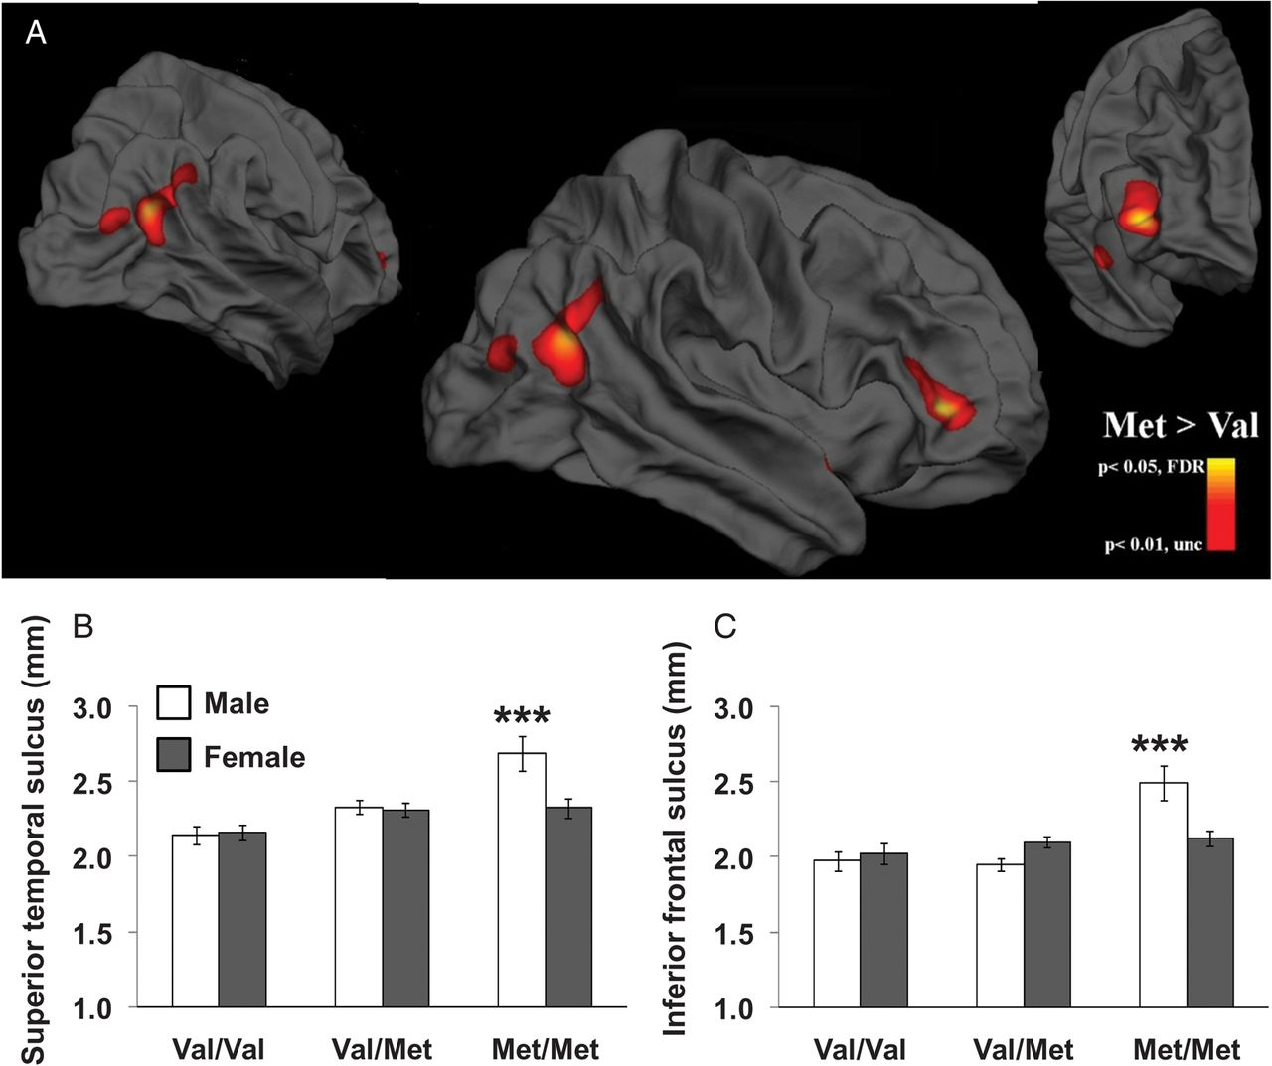
Figure 4. COMT Met/Met male healthy humans, but not female, show increased thickness of the inferior frontal sulcus and ...
Notes:
Figure 4. COMT Met/Met male healthy humans, but not female, show increased thickness of the inferior frontal sulcus and superior temporal sulcus. (A) Whole-brain vertex-wise analysis of cortical thickness for the COMT Val/Met by sex interaction effect. The regions displayed in red (uncorrected level <0.01) and yellow (correction for multiple comparisons, FDR <0.05) represent areas where males homozygous for the Met allele have significantly thicker cortex than other groups. The effect on the posterior cortex is widespread with cortical thickness alterations encompassing both inferior parietal cortex and middle occipital cortex. The pial view has been used to highlight the 3D gyral and sulcal anatomy. (B, C) Bar graphs represent mean cortical thickness within the right superior temporal sulcus and the right inferior frontal sulcus plotted as a function of genotype and sex. COMT Val/Val: males N = 16, females N = 15; COMT Val/Met: males N = 27, females N = 37; COMT Met/Met: males N = 9, females N = 17. ***P < 0.0001 versus all other groups.
Unless provided in the caption above, the following copyright applies to the content of this slide: © The Author 2014. Published by Oxford University Press. All rights reserved. For Permissions, please e-mail: journals.permissions@oup.com

Slide 5
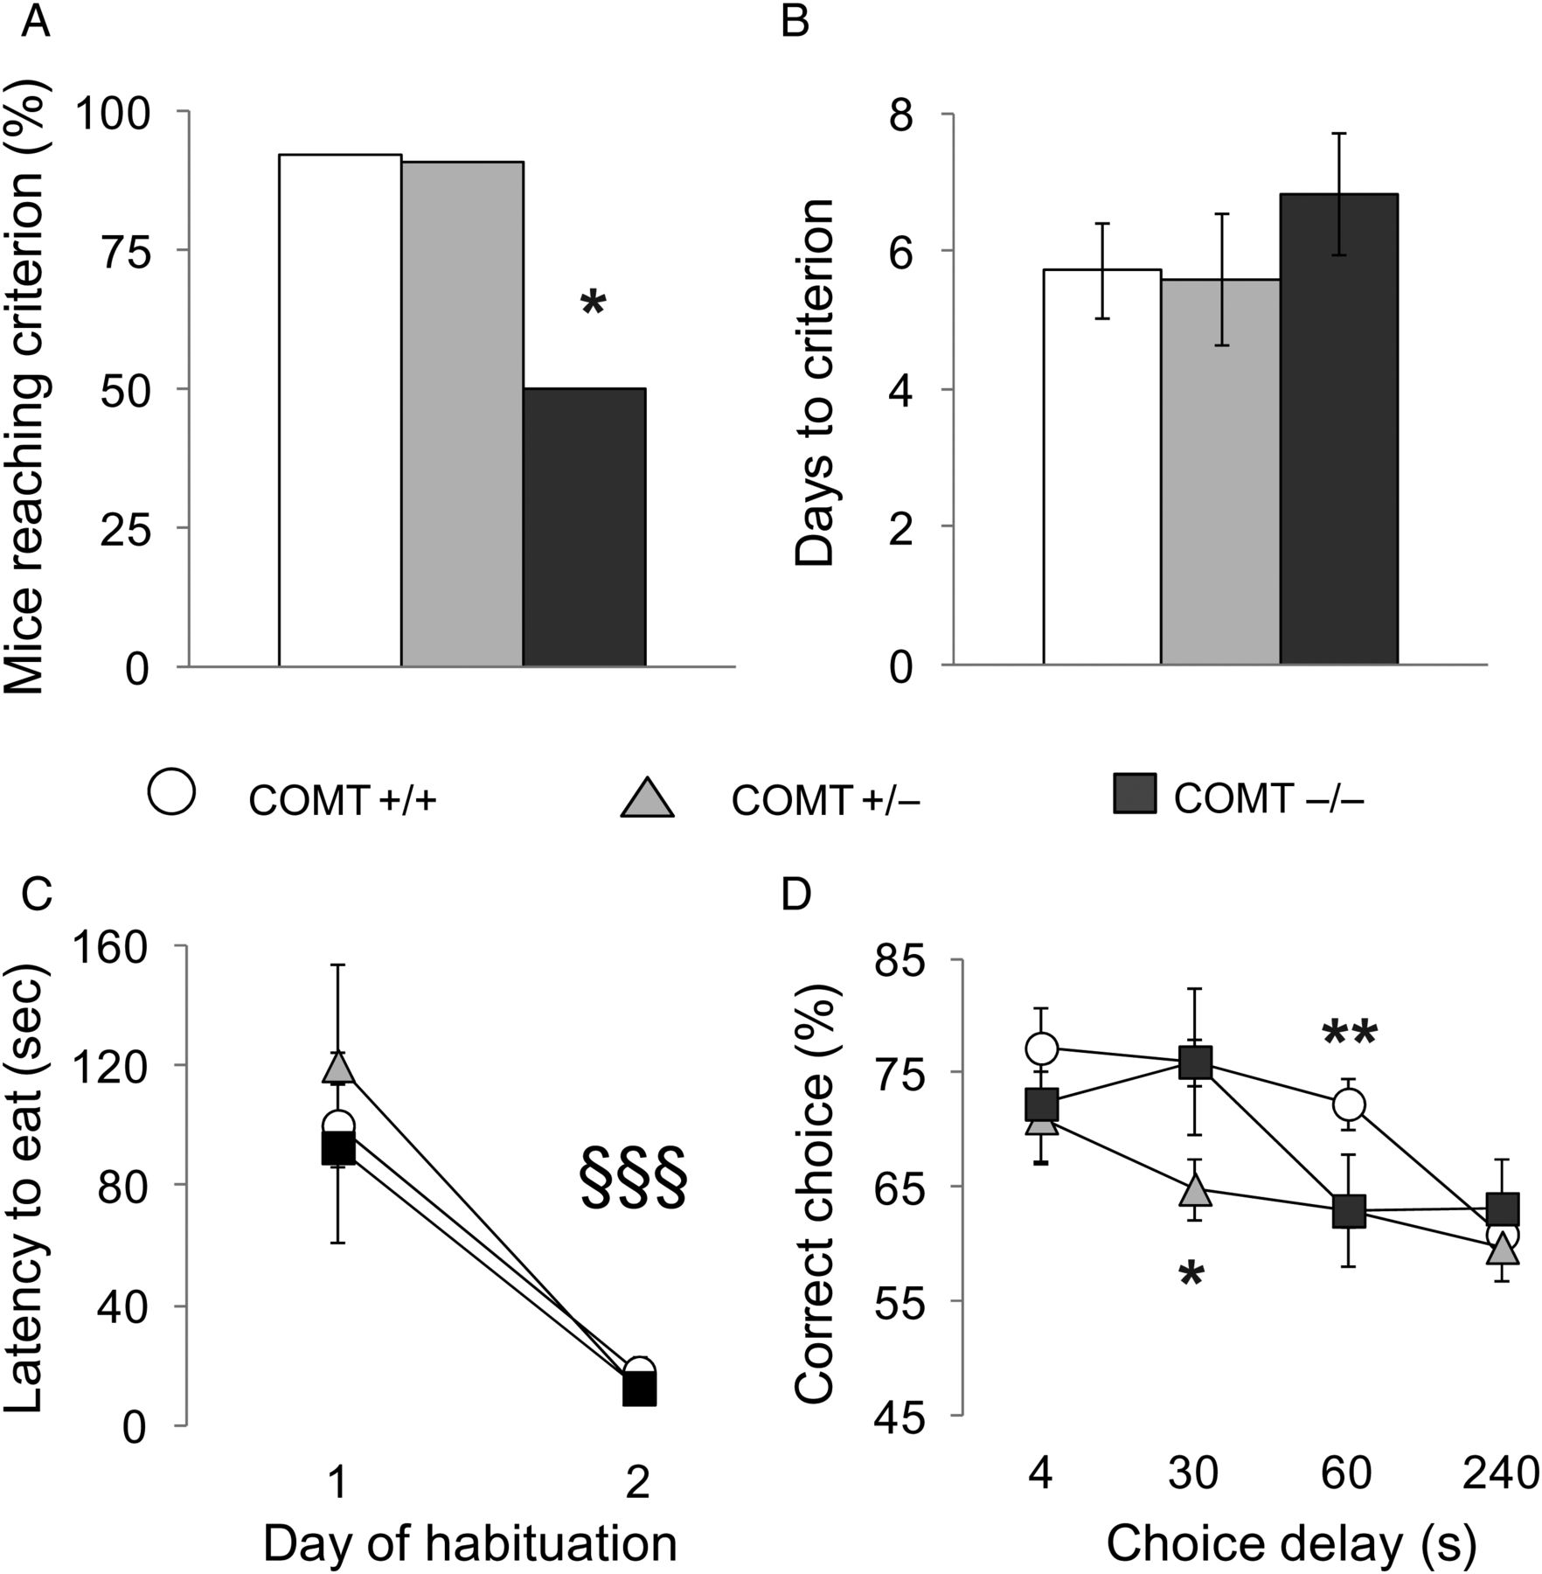
Figure 5. Working memory impairment in COMT knockout female mice. (A) Number of mice reaching criteria after 20 days of ...
Notes:
Figure 5. Working memory impairment in COMT knockout female mice. (A) Number of mice reaching criteria after 20 days of training, (B) days needed to reach the criteria, and (C) latency to retrieve the hidden food pellet displayed by COMT+/+, +/−, and −/− female littermates during the discrete paired-trial T-maze task. COMT+/+ females N = 12; COMT+/− females N = 11; COMT−/− females N = 12. *P < 0.05 versus +/+ and +/− mice; §§§P < 0.0005 versus day 1 of the habituation. (D) Percentage of correct choices displayed by COMT+/+, +/−, and −/− during the discrete paired-trial variable-delay T-maze task with different intratrial delays randomly presented (4, 30, 60, 240 s) and an intertrial delay of 20 s. The dotted line corresponds to chance levels (50%) of correct choices. COMT+/+ females N = 11; COMT+/− females N = 10; COMT−/− females N = 6. *P < 0.05 versus +/+ and −/− mice; **P < 0.05 versus +/− and −/− mice.
Unless provided in the caption above, the following copyright applies to the content of this slide: © The Author 2014. Published by Oxford University Press. All rights reserved. For Permissions, please e-mail: journals.permissions@oup.com

Slide 6
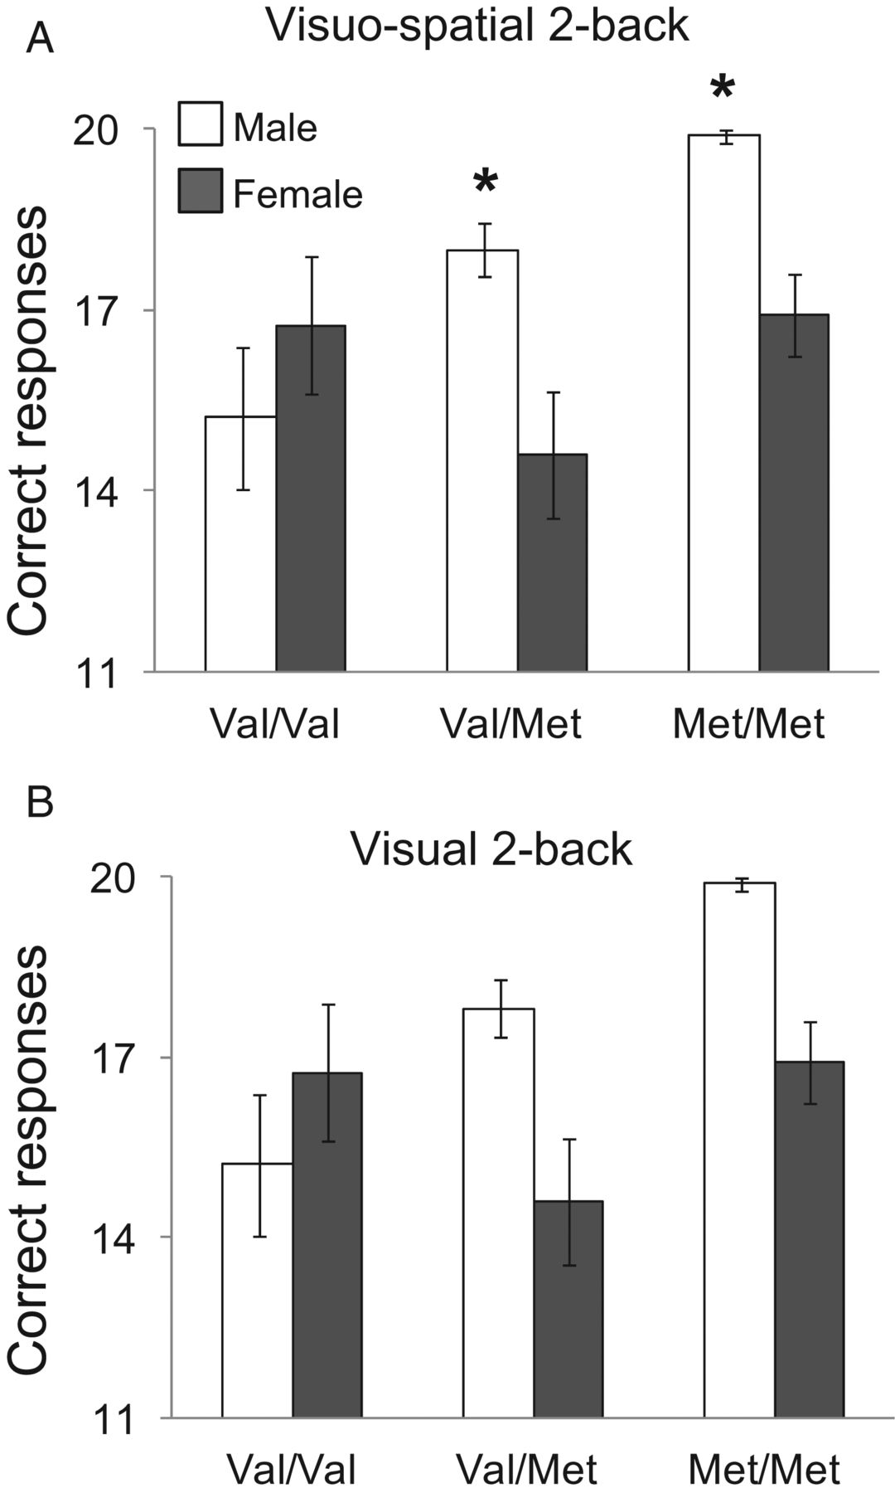
Figure 6. Genetic reduction of COMT leads to improved working memory performance in men but not women. Number of ...
Notes:
Figure 6. Genetic reduction of COMT leads to improved working memory performance in men but not women. Number of correct responses (A) in the visuo-spatial and (B) in the visual 2-Back tests displayed by COMT Val/Val, Val/Met and Met/Met male and female healthy adult human subjects. COMT Val/Val males N = 14, females, N = 12; COMT Val/Met males N = 32, females N = 40; COMT Met/Met males N = 8, females N = 25. *P < 0.02 versus Val/Met women.
Unless provided in the caption above, the following copyright applies to the content of this slide: © The Author 2014. Published by Oxford University Press. All rights reserved. For Permissions, please e-mail: journals.permissions@oup.com

