Slide 1
Figure 1 Study flow chart of patient enrolment and samples used for analysis. The follicular fluids (FFs) (total n = ...
Notes:
Figure 1 Study flow chart of patient enrolment and samples used for analysis. The follicular fluids (FFs) (total n = 105, natural cycle IVF [NC-IVF] n = 36, c-IVF n = 69) were analyzed by flow cytometry and immunohistochemistry. Some samples used for flow cytometry were randomly selected and the blood cell count was determined. Furthermore, a random selection of supernatants was analyzed by multiplexed analysis of cytokines and chemokines. The numbers of analyzed samples for each type of assay and each study group are shown (n). In addition, 12 and 21 serum samples after NC-IVF and c-IVF, respectively, were analyzed by multiplexed analysis. Patients’ demographics, mean age, causes of infertility and cycle characteristics. VariablesGroup A NC-IVFGroup B c-IVFPFF samples Total3669Age (years)35.6 ± 5.135.5 ± 4.5NSRange21–4323–43Aetiology of infertility (n) Tubal factor6/363/69 Male factor12/3637/69 Idiopathic18/3627/69 Pre-chemotherapy0/362/69Total hMG dose (IU)02312 ± 892.4<0.0001***No. of retrieved oocytes18.1 ± 4.0<0.0001***Note: Values are mean ± SD; NS, not significant. The total hMG used and the number of retrieved oocytes were higher in stimulated IVF compared with natural IVF cycle.
Unless provided in the caption above, the following copyright applies to the content of this slide: © The Author 2017. Published by Oxford University Press on behalf of the European Society of Human Reproduction and Embryology. All rights reserved. For permissions, please e-mail: journals.permissions@oup.com

Slide 2
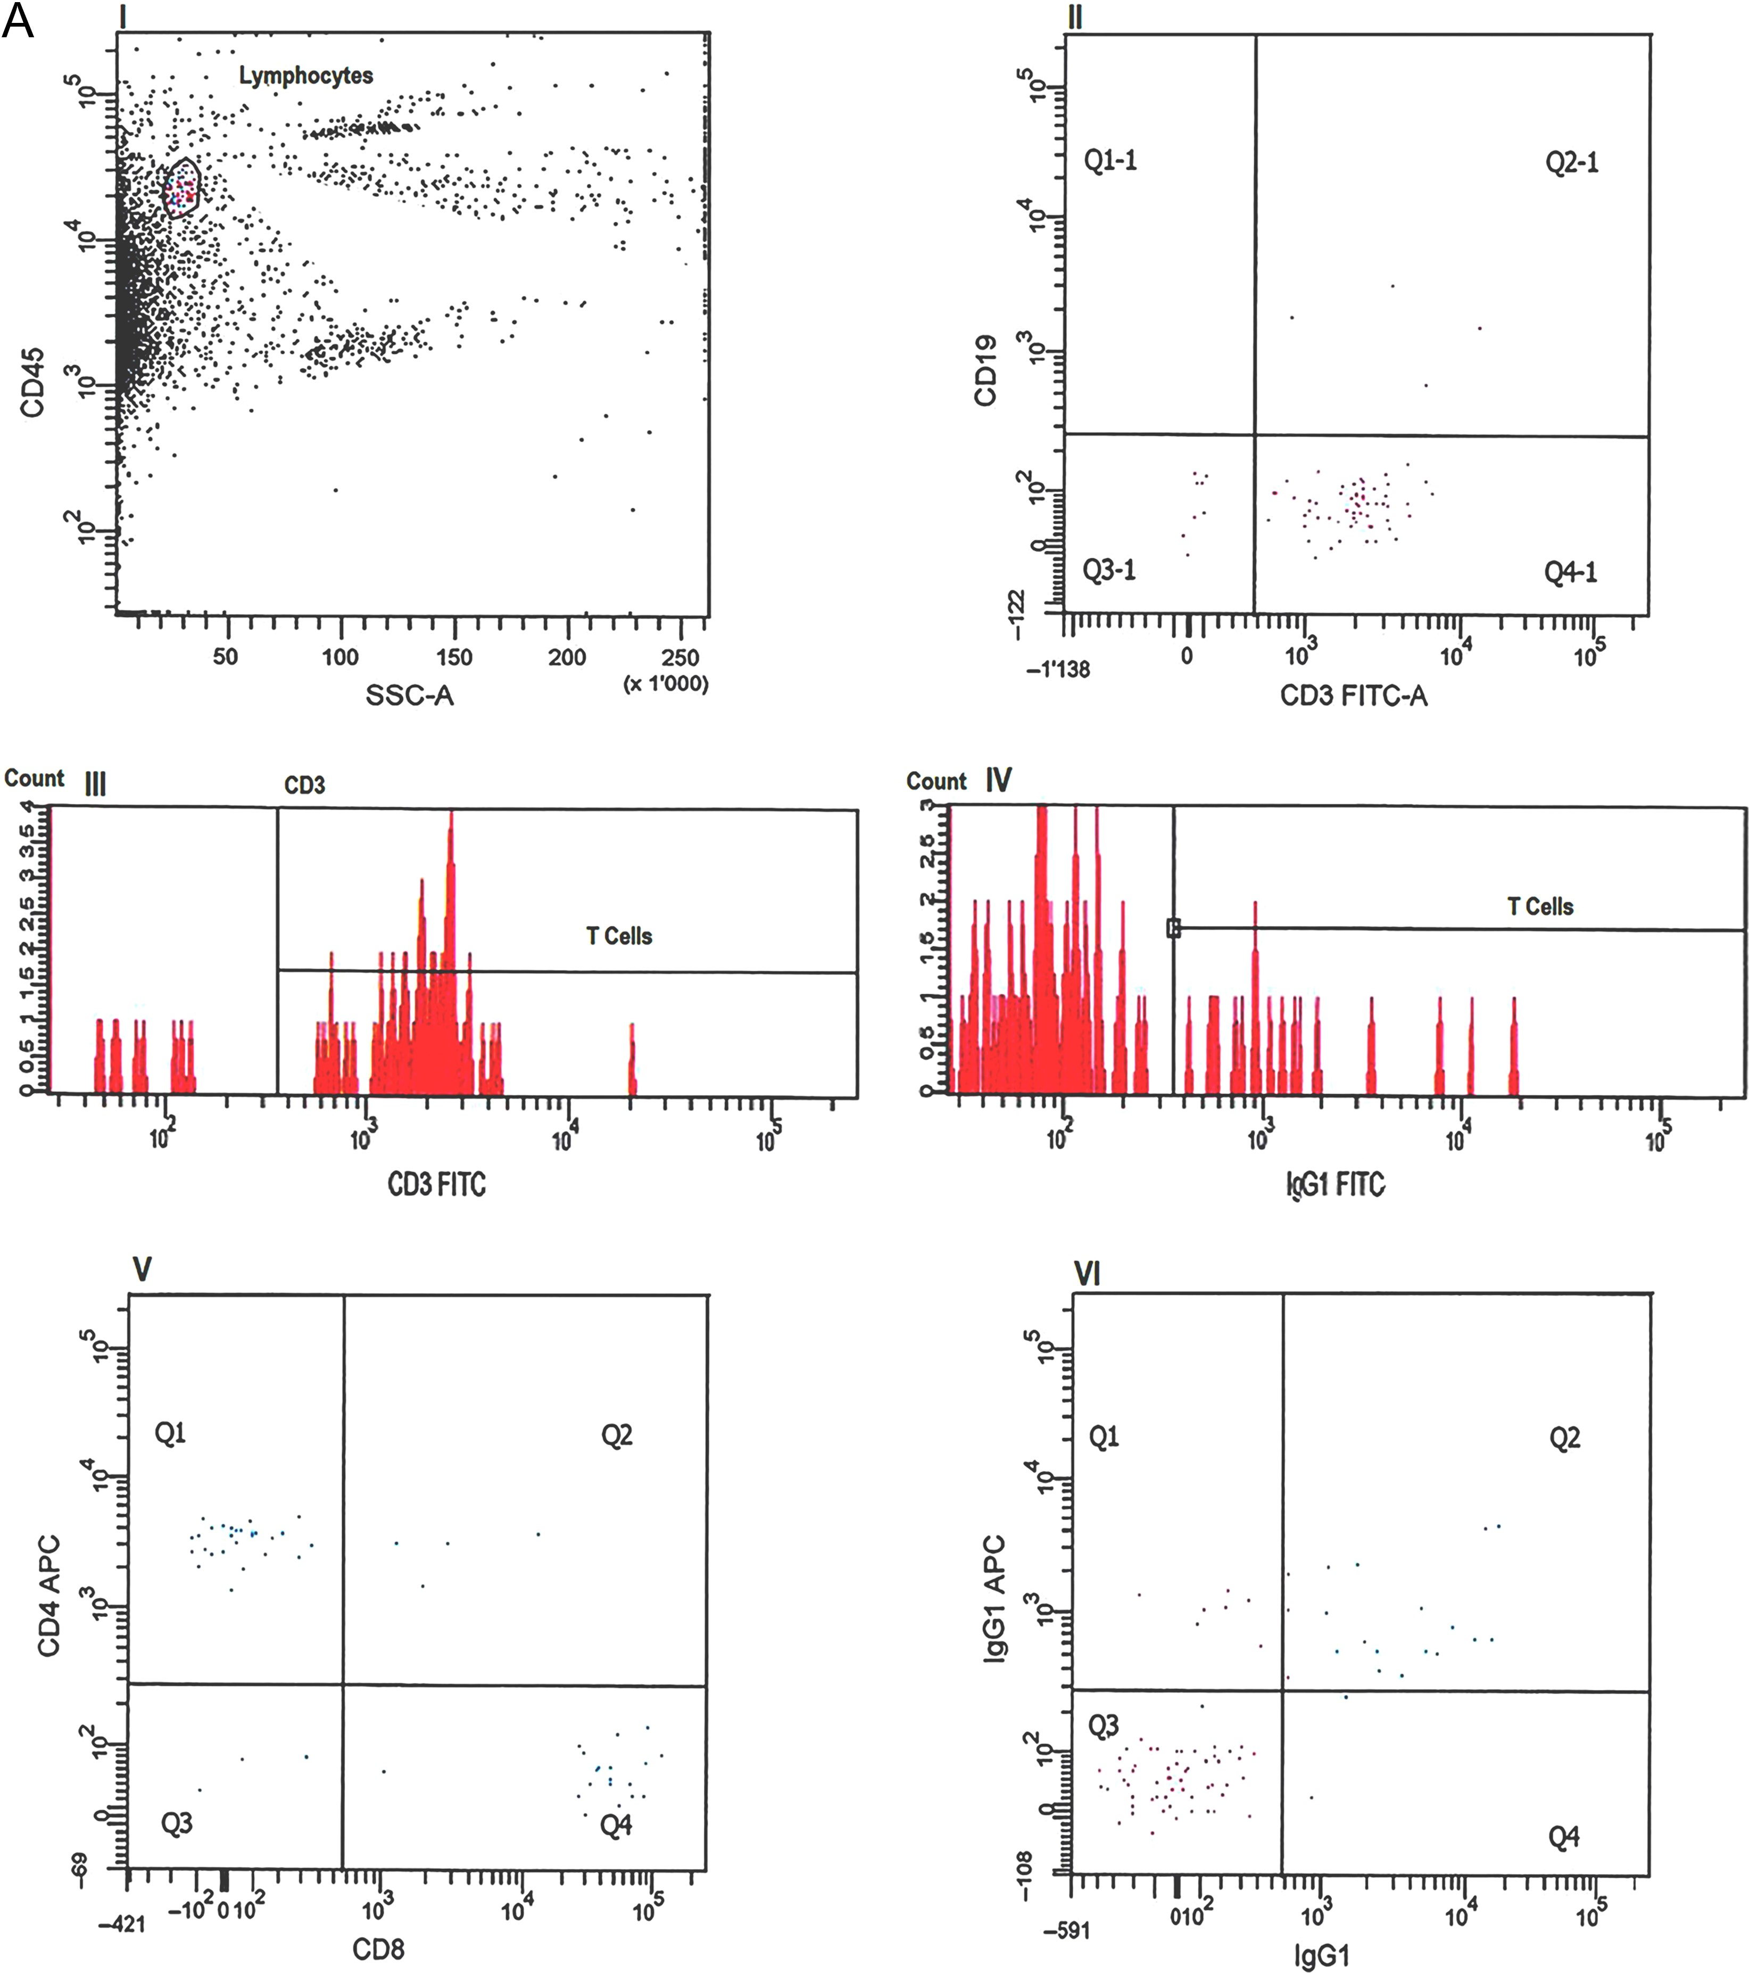
Figure 2 Flow cytometric analysis performed on single FF. Immune cells in the FF collected from patients undergoing ...
Notes:
Figure 2 Flow cytometric analysis performed on single FF. Immune cells in the FF collected from patients undergoing NC-IVF (A) (n = 27) and c-IVF (B) (n = 43) were dispersed, labelled with a series of fluorochrome-conjugated leucocyte markers and analyzed using flow cytometry. (A, B) Gating strategy to determine relative quantity of lymphocytes subpopulations: a primary gate was set around CD45-positive/SSC-low leucocytes (I). Within CD45-positive/SSC-low leucocytes, CD19+ B cells and CD3+ T cells were determined (II). To evaluate percentage of CD4+ and CD8+ cells (V), a gate was set around CD3+ T cells (III). Isotype controls for anti-CD4 APC and anti-CD8 PE and anti-CD3 FITC are shown in IV and VI, respectively. (C) Data show median of percentage of CD3+ T cells within CD45+ cells and of CD4+ and CD8+ cells within CD3+ T lymphocytes of NC-IVF (●) and c-IVF (∆). The percentage of FF- CD8+ in c-IVF was lower compared with NC-IVF. However, the difference was not significant (P = 0.154) as calculated by Holm method for multiple testing.
Unless provided in the caption above, the following copyright applies to the content of this slide: © The Author 2017. Published by Oxford University Press on behalf of the European Society of Human Reproduction and Embryology. All rights reserved. For permissions, please e-mail: journals.permissions@oup.com

Slide 3
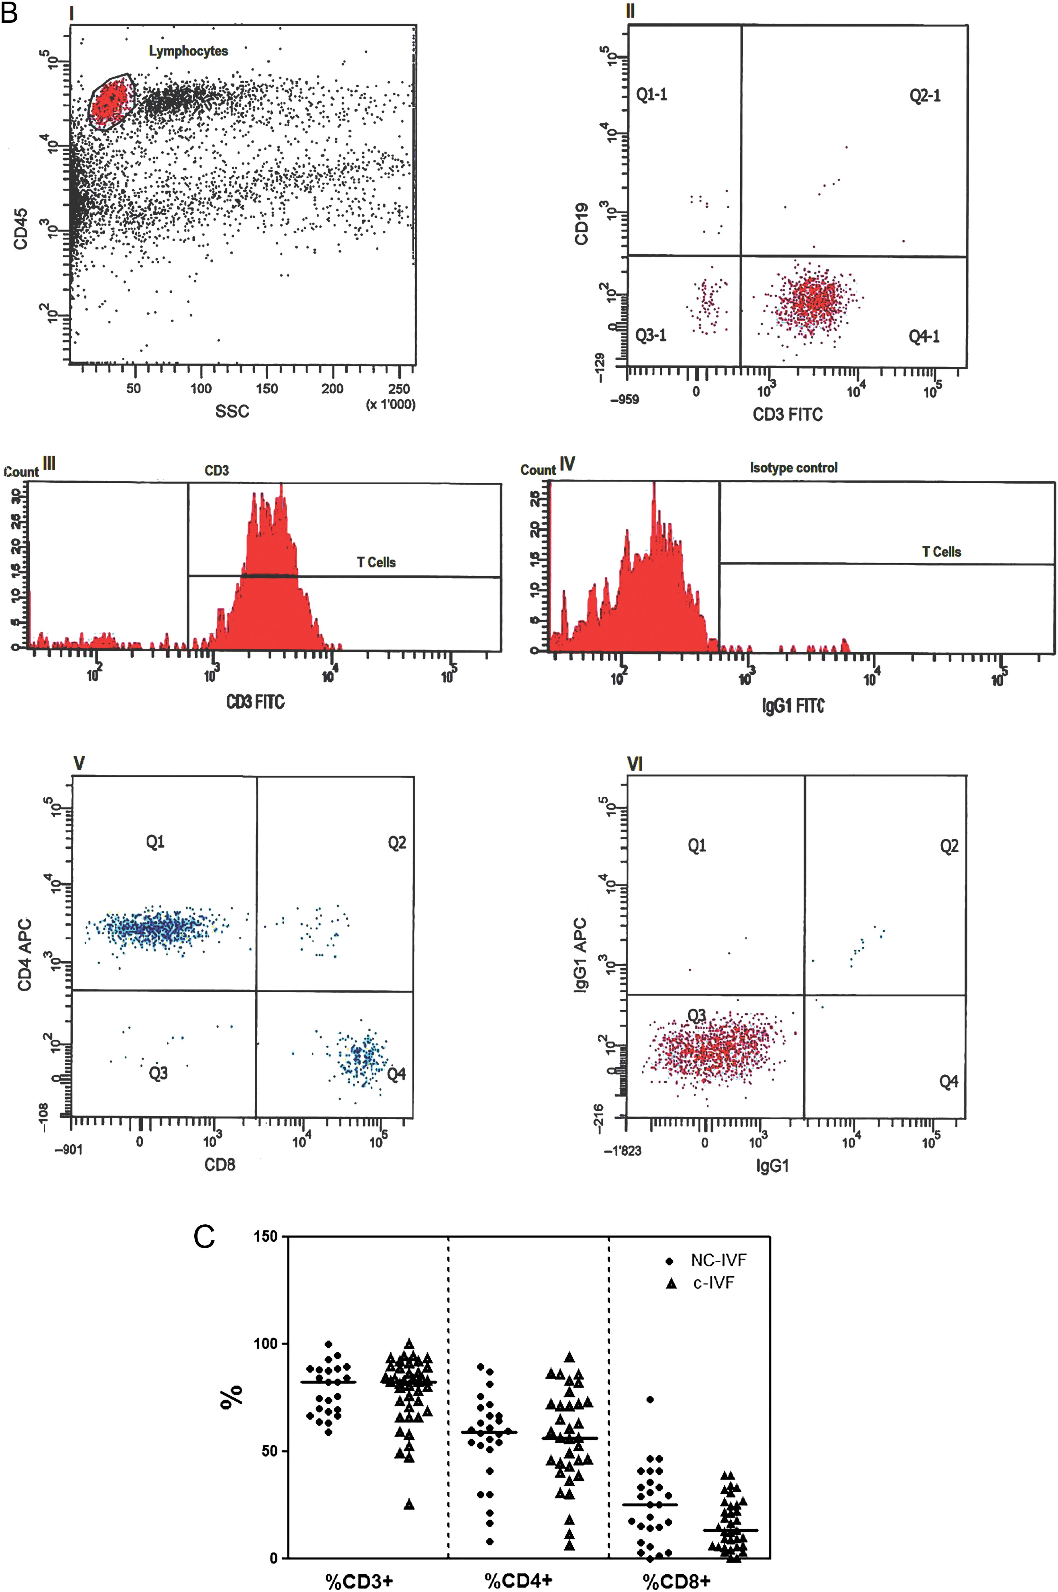
Figure 2 Flow cytometric analysis performed on single FF. Immune cells in the FF collected from patients undergoing ...
Notes:
Figure 2 Flow cytometric analysis performed on single FF. Immune cells in the FF collected from patients undergoing NC-IVF (A) (n = 27) and c-IVF (B) (n = 43) were dispersed, labelled with a series of fluorochrome-conjugated leucocyte markers and analyzed using flow cytometry. (A, B) Gating strategy to determine relative quantity of lymphocytes subpopulations: a primary gate was set around CD45-positive/SSC-low leucocytes (I). Within CD45-positive/SSC-low leucocytes, CD19+ B cells and CD3+ T cells were determined (II). To evaluate percentage of CD4+ and CD8+ cells (V), a gate was set around CD3+ T cells (III). Isotype controls for anti-CD4 APC and anti-CD8 PE and anti-CD3 FITC are shown in IV and VI, respectively. (C) Data show median of percentage of CD3+ T cells within CD45+ cells and of CD4+ and CD8+ cells within CD3+ T lymphocytes of NC-IVF (●) and c-IVF (∆). The percentage of FF- CD8+ in c-IVF was lower compared with NC-IVF. However, the difference was not significant (P = 0.154) as calculated by Holm method for multiple testing.
Unless provided in the caption above, the following copyright applies to the content of this slide: © The Author 2017. Published by Oxford University Press on behalf of the European Society of Human Reproduction and Embryology. All rights reserved. For permissions, please e-mail: journals.permissions@oup.com

Slide 4
Figure 3 Levels of cytokines in sera and FF. Concentrations of IL-6, IL-8, IL-10 and vascular endothelial growth ...
Notes:
Figure 3 Levels of cytokines in sera and FF. Concentrations of IL-6, IL-8, IL-10 and vascular endothelial growth factor (VEGF) in individual sera (A) collected from patients undergoing NC-IVF (n = 12) and c-IVF (n = 21) at the preovulatory stage and in FF (B) from NC-IVF (n = 15) and c-IVF (n = 31) are shown. The levels of the cytokines were measured using the Bio-Plex® platform. The samples were run in duplicates. The medians are shown as solid horizontal lines. The P-values are given in Table III, ***P < 0.001. Cytokine concentrations in sera and FF of the study groups. pg/mlSerumP valueFFP valueNC-IVFc-IVFNC-IVFc-IVFIL-20.5 [0.5–31.6] (2/9)0.5 [0.5–25.1] (4/16)12.9 [0.5–6.1] (11/12)1.9 [0.5–6.9] (17/23)0.597IL-61.0 [0.4–31.5] (4/12)1.5 [1.0–263.3] (13/21)0.2054.8 [1.3–12.8] (15/15)6.9 [1.6–18.0] (31/31)0.700IL-82.6 [1.0–35.2] (6/12)7.7 [1.0–5892] (13/21)1224.6 [35.6–332.1] (14/14)133.3 [34.2–361.0] (31/31)0.077IL-107.5 [1.0–32.1] (10/12)14.3 [2.0–80.8] (21/21)0.2166.7 [35.7–332.1] (14/14)62.0 [14.0–172.4] (31/31)0.793TNF-α1.0 [0.5–39.7] (2/9)1.0 [1.0–45.9] (3/16)12.6 [1.0–6.8] (7/12)1.0 [0.3–6.8] (10/23)0.546IFN-γND (0/9)200 [200.0–817.2] (2/16)327.3 [200.0–387.8] (11/12)284.3 [200.0–363.7] (14 /23)0.605VEGF32.1 [5.0–140.7] (8/12)97.3 [28.1–554.1] (21/21)0.007***1110 [41.0–2687] (15/15)1034 [202.5–4015] (31/31)1Values are given as Median [range]. Numbers of samples with detectable cytokine levels/total number of analyzed samples are shown in parentheses (). Statistically differences of cytokines concentrations in sera as well in the FFs between the two groups were analyzed by non-parametric Mann–Whitney U-test. Adjusted P-value determined by Holm method for multiple testing. IFN-γ was in all serum samples obtained from NC-IVF cycles not detectable (ND). IL, interleukin; TNF-α, tumour necrosis factor; IFN-γ, Interferon gamma.
Unless provided in the caption above, the following copyright applies to the content of this slide: © The Author 2017. Published by Oxford University Press on behalf of the European Society of Human Reproduction and Embryology. All rights reserved. For permissions, please e-mail: journals.permissions@oup.com

Slide 5
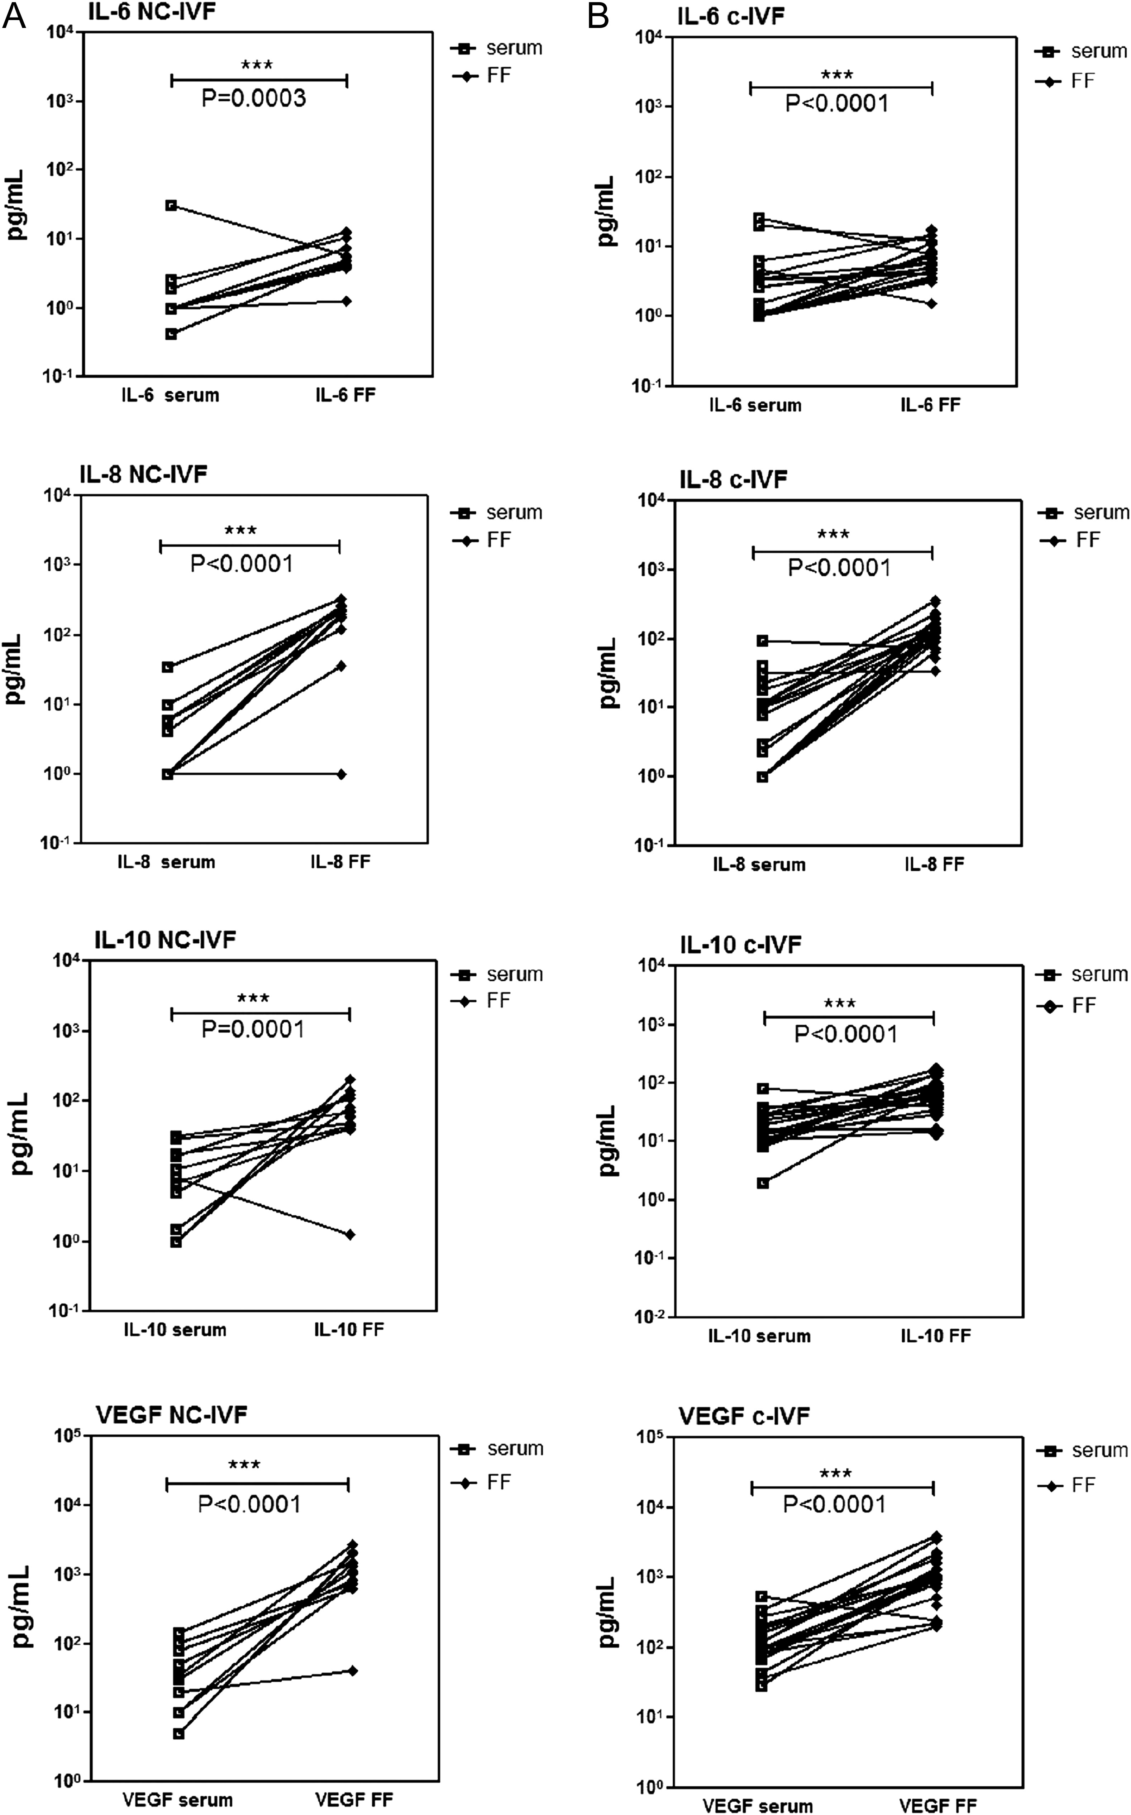
Figure 4 Comparison of concentrations of mediators between FF and sera within the same IVF cycle and individual ...
Notes:
Figure 4 Comparison of concentrations of mediators between FF and sera within the same IVF cycle and individual patients. Data points of IL-6, IL-8, IL-10 and VEGF concentrations in FF (●) and sera (□) obtained from NC-IVF (A) and c-IVF (B) cycles are shown for individual patients. P-values using Mann–Whitney U-tests are noted on the graphs, ***P < 0.001.
Unless provided in the caption above, the following copyright applies to the content of this slide: © The Author 2017. Published by Oxford University Press on behalf of the European Society of Human Reproduction and Embryology. All rights reserved. For permissions, please e-mail: journals.permissions@oup.com

