Slide 1
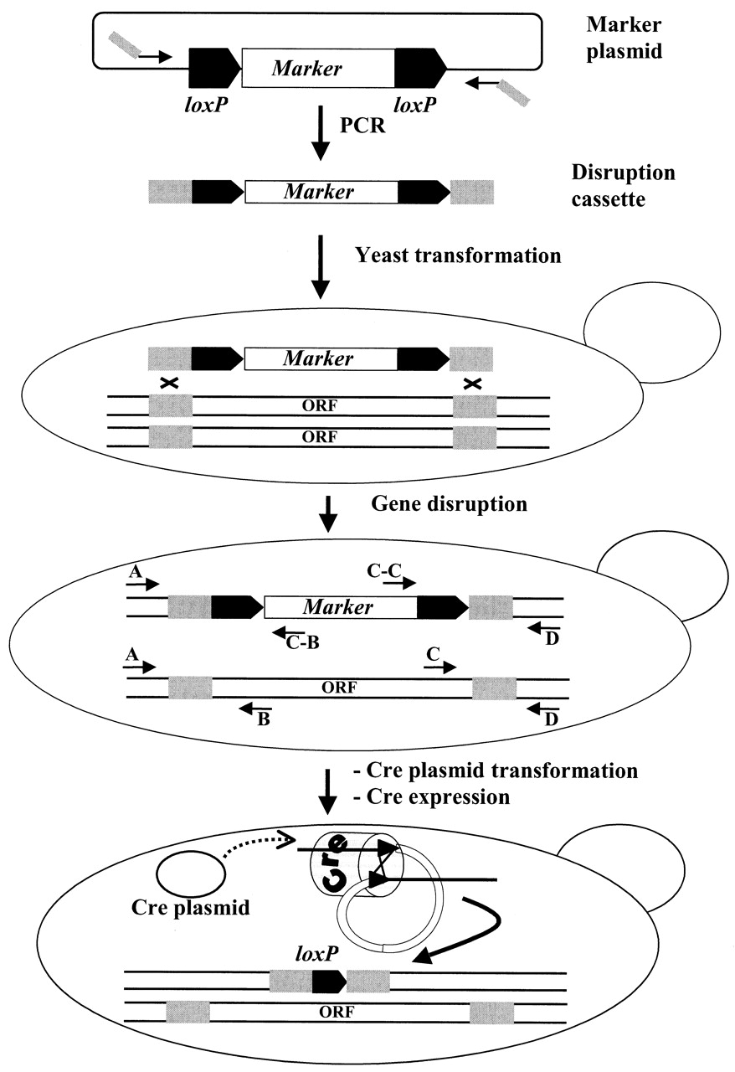
Figure 1. The loxP/Cre gene disruption and marker rescue procedure. The gene disruption cassette consists of ...
Notes:
Figure 1. The loxP/Cre gene disruption and marker rescue procedure. The gene disruption cassette consists of a selection marker gene (marker), usually conferring drug resistance or prototrophy, flanked by two 34 bp loxP sequences as direct repeats located adjacent to 45 bp of sequence flanking the chromosomal target sequence (ORF) to be deleted. The disruption cassette is produced by PCR using oligonucleotides comprising 19 or 22 3′ nucleotides complementary to sequences in the template (marker plasmid) flanking the disruption cassette and 45 5′ nucleotides that anneal to sites upstream or downstream of the genomic target sequence to be deleted. After transformation of the linear disruption cassette into yeast cells, selected transformants are checked by PCR for correct integration of the cassette and concurrent deletion of the chromosomal target sequence. The verification PCRs are done using combinations of primers complementary to sequences within the cassette (C-B, cassette B primer; C-C, cassette C primer) and to sequences within or flanking the target sequence (A, B, C and D). In a diploid yeast cell (shown here) in which one allele of the target sequence has been replaced by a disruption cassette, all PCRs indicated will produce products of the expected size. Finally, expression of the Cre recombinase results in removal of the marker gene, leaving behind a single loxP site at the chromosomal locus.
Unless provided in the caption above, the following copyright applies to the content of this slide:

Slide 2
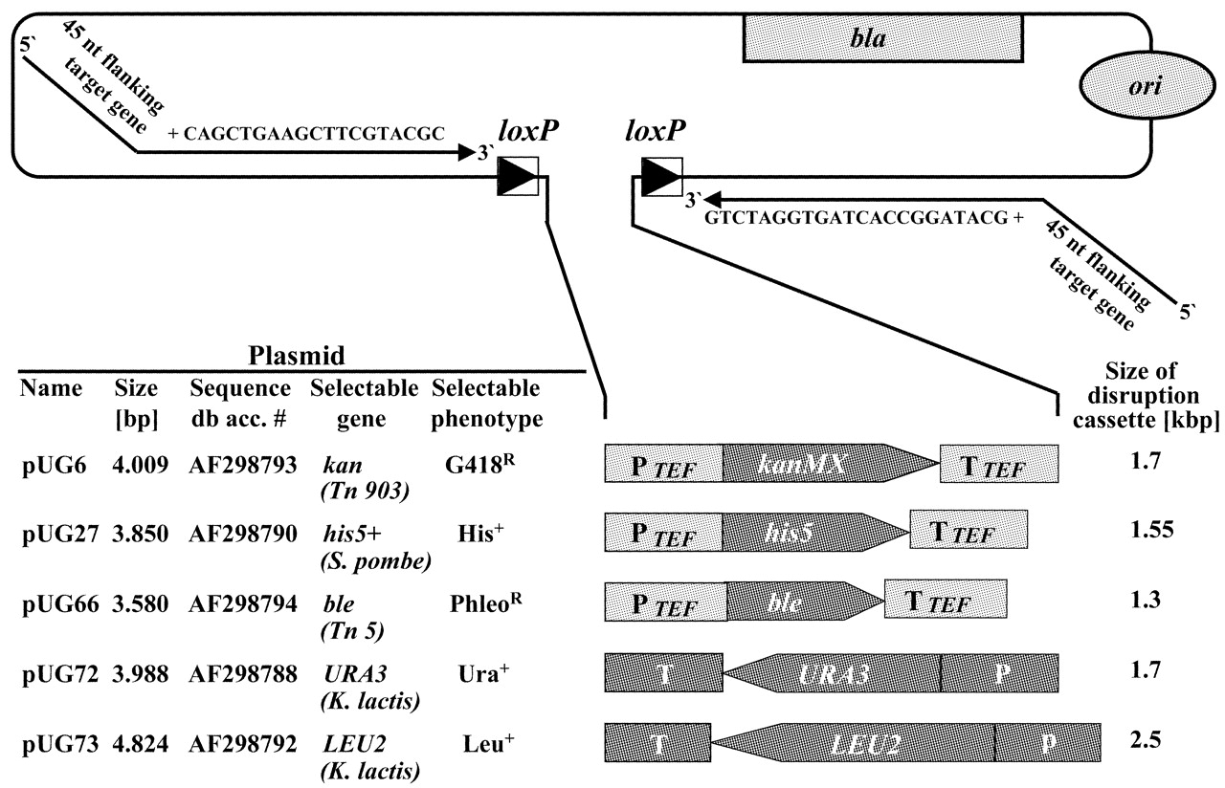
Figure 2. The series of loxP–marker gene–loxP gene disruption cassettes. The marker plasmids pUG6, pUG27, ...
Notes:
Figure 2. The series of loxP–marker gene–loxP gene disruption cassettes. The marker plasmids pUG6, pUG27, pUG66, pUG72 and pUG73 serve as templates for PCR to generate the five different gene disruption cassettes. All marker genes (selectable genes) are derived from organisms other than S.cerevisiae and are expressed from the A.gossypiiTEF2 promoter and terminated by the TEF2 terminator (6), except for the two K.lactis genes, URA3 and LEU2, which retain their own regulatory sequences. kanr and bler are dominant resistance marker genes conferring resistance to G418 and phleomycin (selectable phenotype), respectively. Each marker gene including promoter and terminator is flanked by loxP sites. Since the vector backbone is the same in all cases, each of the five disruption cassettes can be amplified by PCR using the same two primers. The complete vector sequences have been deposited at GenBank under the accession numbers listed in the figure (Sequence db acc. #).
Unless provided in the caption above, the following copyright applies to the content of this slide:

Slide 3
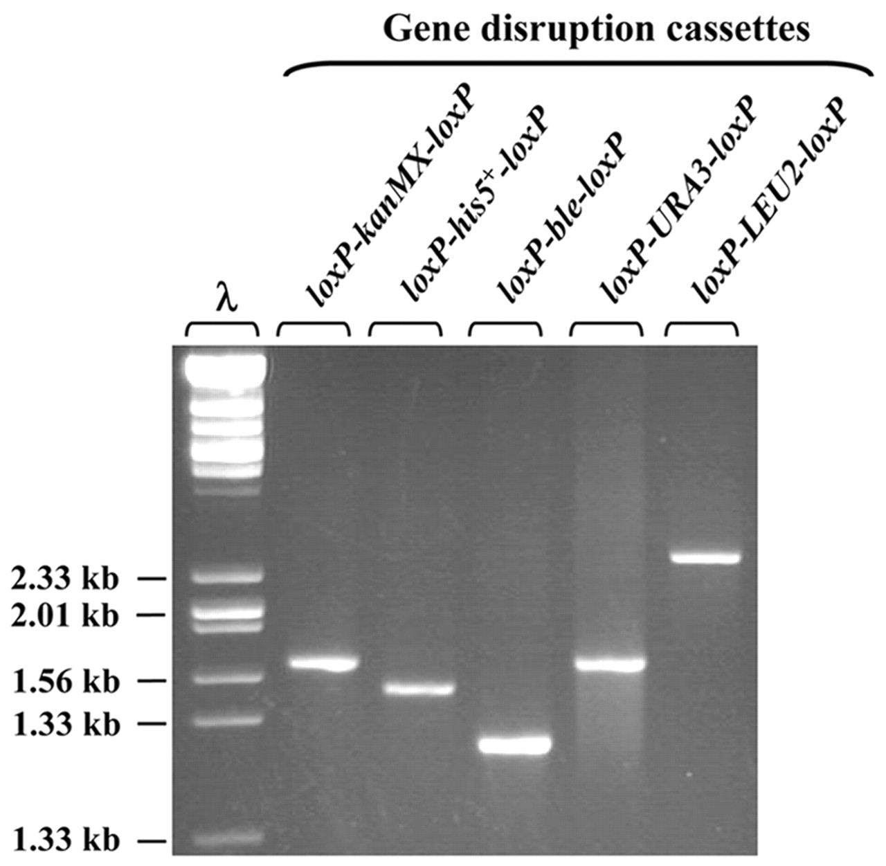
Figure 3. For deletion of the ADE2 gene, five different gene disruption cassettes were produced in parallel ...
Notes:
Figure 3. For deletion of the ADE2 gene, five different gene disruption cassettes were produced in parallel PCRs using the primers 1134 and 1135 (see Table 1). The sizes of the cassettes vary between 1300 and 2500 bp (2% of each PCR product was loaded).
Unless provided in the caption above, the following copyright applies to the content of this slide:

Slide 4
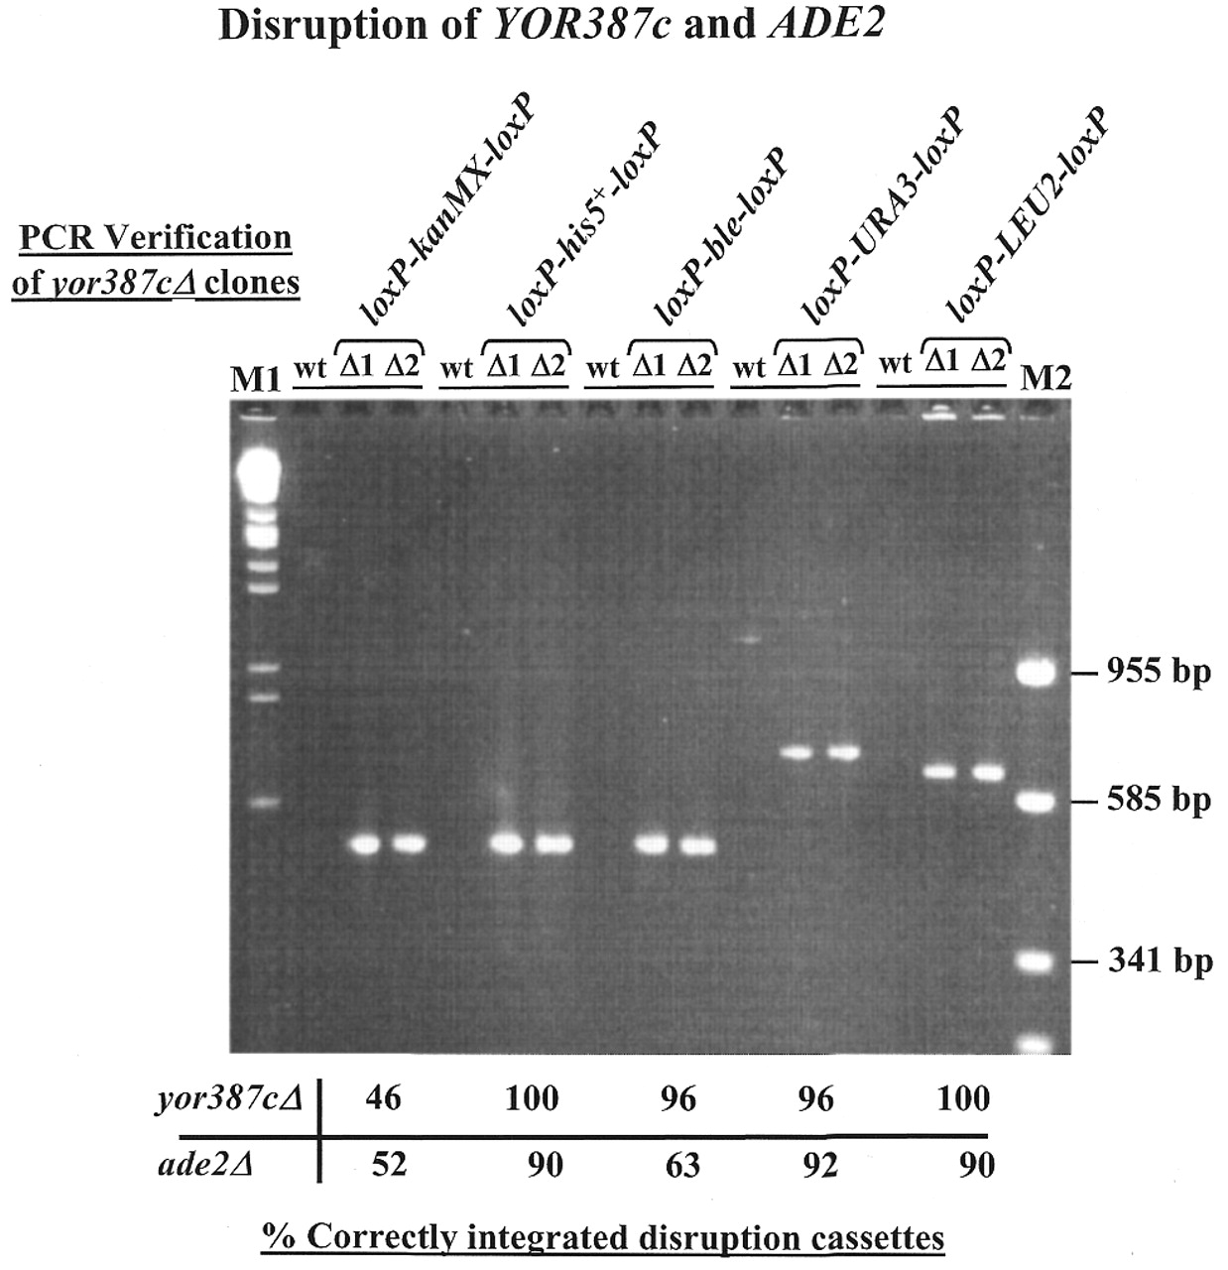
Figure 4. PCR analysis to confirm correct integration of the gene disruption cassettes at the YOR387c and ...
Notes:
Figure 4. PCR analysis to confirm correct integration of the gene disruption cassettes at the YOR387c and ADE2 loci (see Fig. 1). PCR was carried out on transformants obtained in the YOR387c disruption experiment, using target gene-specific primer A (primer 1025) and the disruption cassette-specific primer C-B (for kanr, his5+ and bler the kan-B primer 363; for URA3 the Ura-B primer 1115; for LEU2 the Leu2-B primer 1136). The products obtained from two yor387cΔ mutants (Δ1 and Δ2) disrupted with each of the various disruption cassettes and from wild-type (wt) cells were then subjected to agarose gel electrophoresis. For both genes 24 transformants obtained with each of the gene disruption cassettes were analysed in similar experiments. The percentages of correctly integrated cassettes at YOR387c and ADE2 are indicated below the gel. DNA fragment size markers: M1, EcoRI + HindIII-cleaved λ DNA; M2, Bsp143I-cleaved pUC19 (the sizes of selected marker DNA fragments are shown on the right).
Unless provided in the caption above, the following copyright applies to the content of this slide:

Slide 5
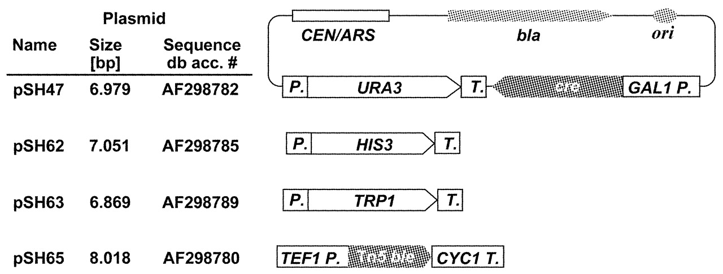
Figure 5. Cre expression plasmids. All plasmids carry the CEN6/ARSH4 module to ensure stability in yeast and ...
Notes:
Figure 5. Cre expression plasmids. All plasmids carry the CEN6/ARSH4 module to ensure stability in yeast and a Cre expression cassette consisting of the cre open reading frame flanked by the galactose-inducible GAL1 promoter and the CYC1 terminator from S.cerevisiae. The vectors differ in the type of selection marker used. The URA3, HIS3 and TRP1 marker genes are from S.cerevisiae and retain their own regulatory sequences, while the bler gene from transposon Tn5 is expressed from the S.cerevisiaeTEF1 promoter.
Unless provided in the caption above, the following copyright applies to the content of this slide:

