Slide 1
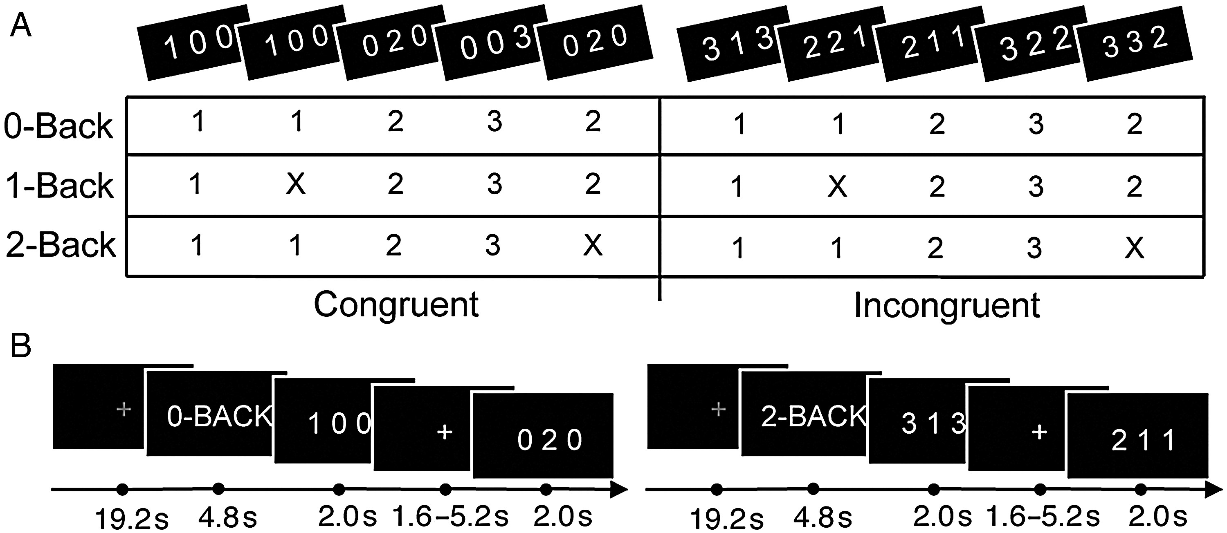
Figure 1. Experimental design. (A) A 2 × 3 factorial structure of the cognitive paradigm with examples of visual ...
Notes:
Figure 1. Experimental design. (A) A 2 × 3 factorial structure of the cognitive paradigm with examples of visual stimuli corresponding to low-demand (congruent) and high-demand (incongruent) CC presented at the top. Given a sequential presentation, the appropriate response option to each stimulus is indicated for the 3 levels of WM demand. (B) Example time course of experimental presentation, including rest periods (grey fixation) followed by an instruction screen and stimulus presentation with jittered interstimulus interval.
Unless provided in the caption above, the following copyright applies to the content of this slide: © The Author 2014. Published by Oxford University Press. All rights reserved. For Permissions, please e-mail: journals.permissions@oup.com

Slide 2
Figure 2. Behavioral results. (A andB) Interaction plots of group reaction times and error rates, respectively, for ...
Notes:
Figure 2. Behavioral results. (A andB) Interaction plots of group reaction times and error rates, respectively, for each of the 6 conditions (error bars = SEM). Point estimate values are included for clarity. (C) Correlation plots depicting the relationship between main CC reaction time and WM reaction times at both levels (engagement: 1-back − 0-back; load: 2-back − 1-back).
Unless provided in the caption above, the following copyright applies to the content of this slide: © The Author 2014. Published by Oxford University Press. All rights reserved. For Permissions, please e-mail: journals.permissions@oup.com

Slide 3
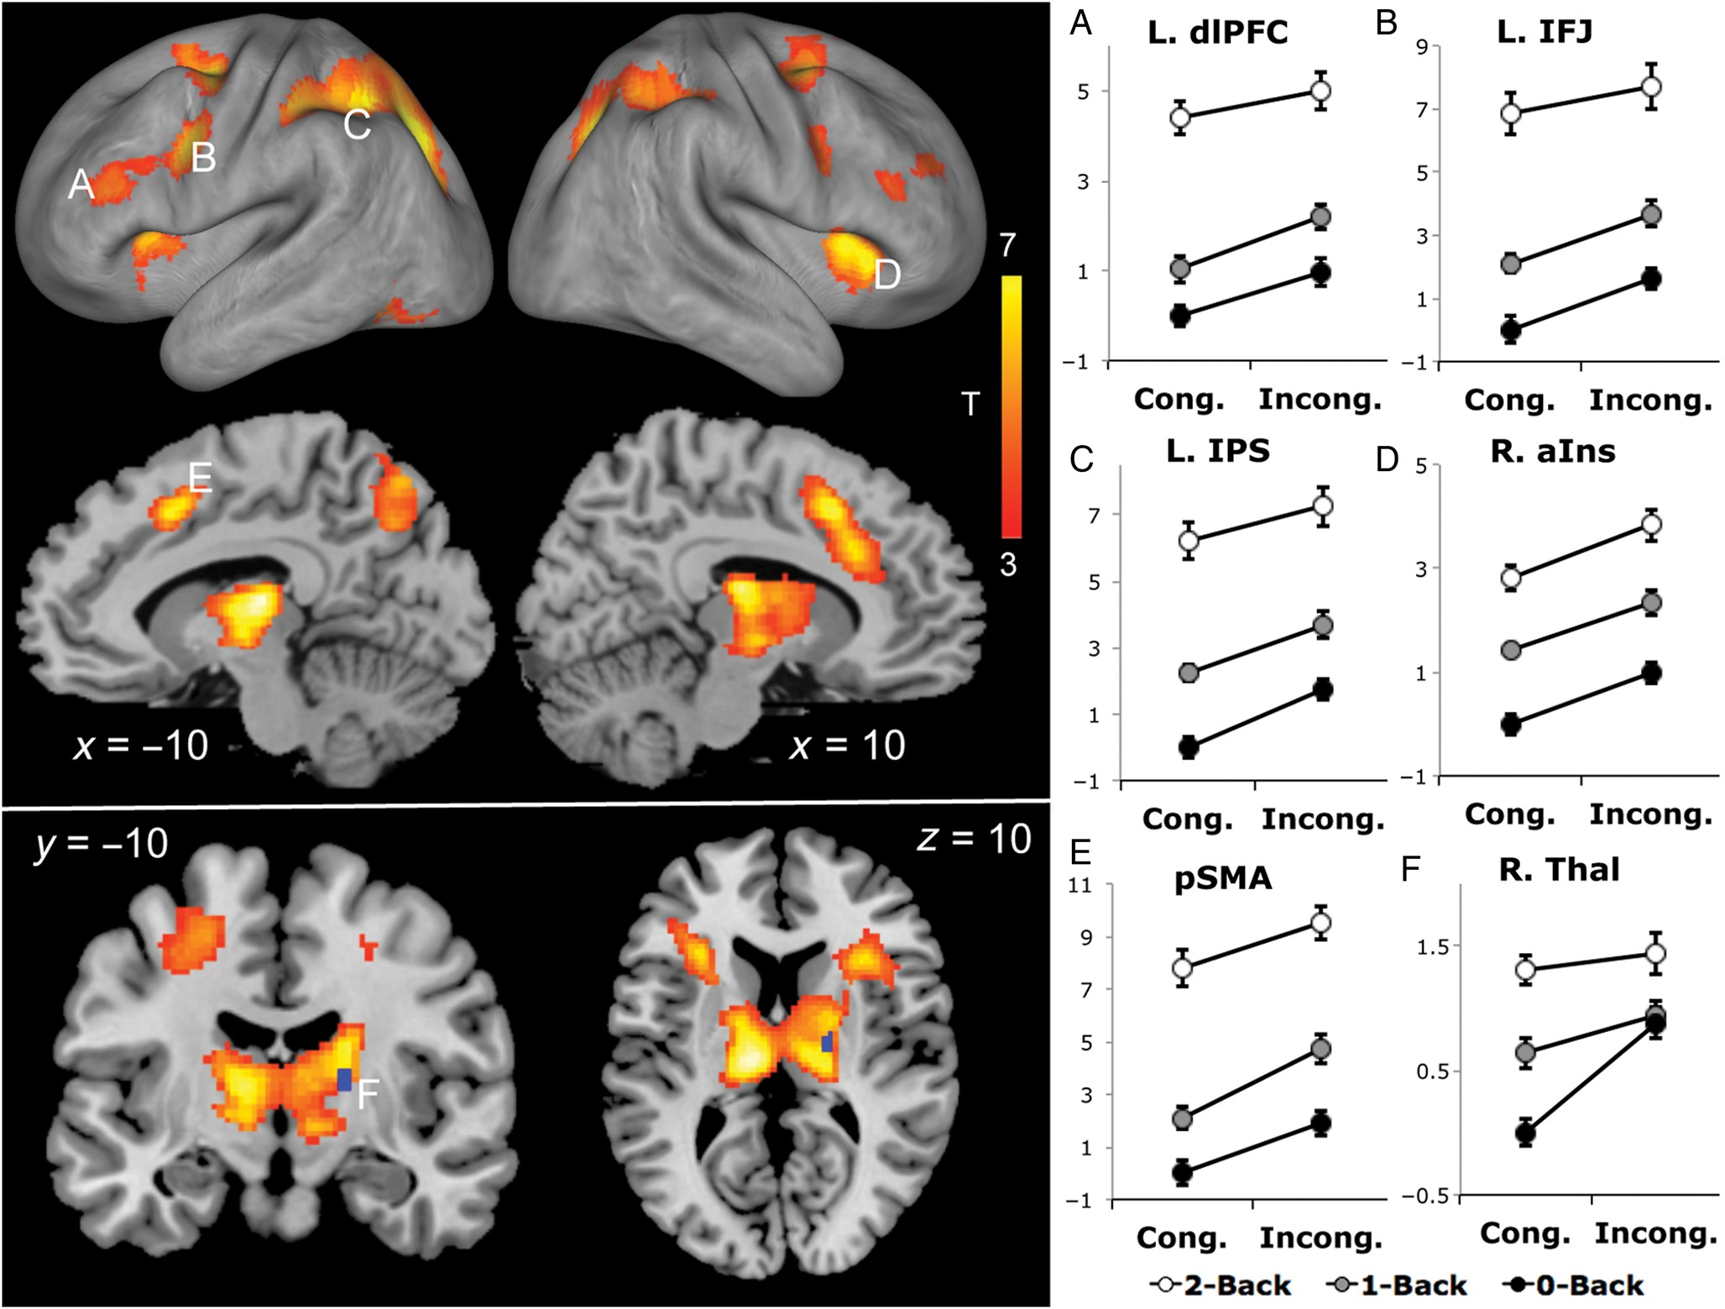
Figure 3. Functional activation results. (Left) Statistical T-map representing the conjunction of the positive main CC ...
Notes:
Figure 3. Functional activation results. (Left) Statistical T-map representing the conjunction of the positive main CC and main WM effects rendered on a brain surface (orange-yellow; PFWE 3.1; extent > 182 voxels). Regions eliciting a significant interaction effect within this mask are illustrated in blue (PFWE 4.8; extent > 12 voxels). (Right) Interaction plots depict fMRI effects averaged across 5-mm spheres centered at the peak activations of 5 main effect clusters (A, left dorsolateral prefrontal cortex; B, left inferior frontal junction; C, left intraparietal sulcus; D, right anterior insula; and E, presupplementary motor area) and the interaction cluster (F, right thalamus); y-axes = beta-regression point estimates normalized to the baseline condition, error bars = SEM.
Unless provided in the caption above, the following copyright applies to the content of this slide: © The Author 2014. Published by Oxford University Press. All rights reserved. For Permissions, please e-mail: journals.permissions@oup.com

Slide 4
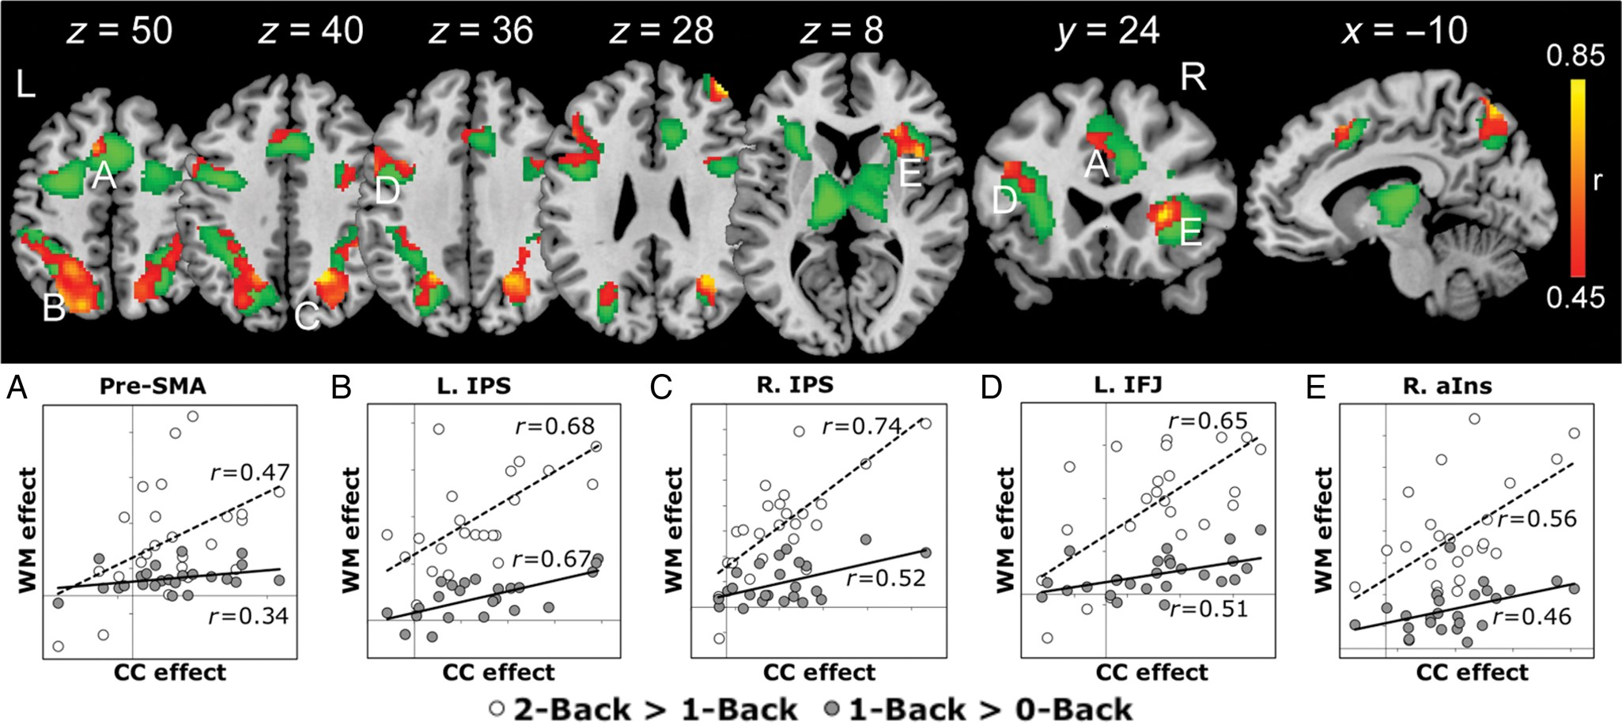
Figure 4. Correlations between CC and WM functional activations. (Top) Significant group-level correlations between the ...
Notes:
Figure 4. Correlations between CC and WM functional activations. (Top) Significant group-level correlations between the 2 main effects (orange-yellow; PFWE 0.46, extent >124 voxels) within the main effect conjunction mask (green) are overlayed on brain slices in neurological space. (Bottom) Correlation plots illustrating the relationship between the cognitive control effect (incongruent > congruent) and the WM effects (load effect: 2-Back > 1-Back; engagement effect: 1-Back > 0-Back) across subjects within a 5-mm sphere surrounding the peak correlation in 5 clusters (A, presupplementary motor area; B, left intraparietal sulcus; C, right intraparietal sulcus; D, left inferior frontal junction; E, right anterior insula).
Unless provided in the caption above, the following copyright applies to the content of this slide: © The Author 2014. Published by Oxford University Press. All rights reserved. For Permissions, please e-mail: journals.permissions@oup.com

