Slide 1
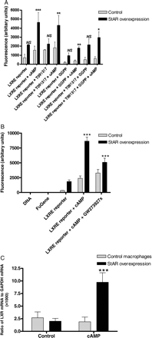
Figure 1 Activation of LXRE reporter plasmid in control and StAR-overexpressing macrophages, treated for 24 h ± cAMP ...
Notes:
Figure 1 Activation of LXRE reporter plasmid in control and StAR-overexpressing macrophages, treated for 24 h ± cAMP (0.3 mM) and (A) ±T0901317 (10 µM), GGPP (10 µM), or combinations thereof (n = 4) and (B) ±GW2739297x (1 µM). Expression of LXRα in control and StAR-overexpressing cells, treated with cAMP (0.3 mM), is shown in Figure 2C. All values are mean ± SEM n = 4–7 experiments; *P < 0.05, **P < 0.01, and ***P < 0.001, compared with control macrophages incubated under the same conditions.
Unless provided in the caption above, the following copyright applies to the content of this slide: Published on behalf of the European Society of Cardiology. All rights reserved. © The Author 2010. For permissions please email: journals.permissions@oxfordjournals.org.

Slide 2
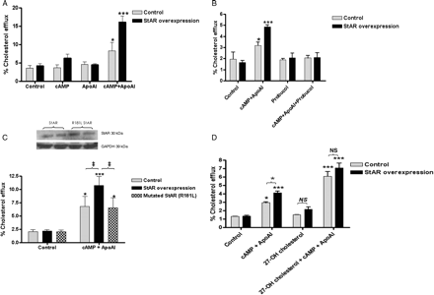
Figure 2 Efflux of [³H]cholesterol (24 h) from control and StAR-overexpressing macrophages, (A) ±cAMP (0.3 ...
Notes:
Figure 2 Efflux of [3H]cholesterol (24 h) from control and StAR-overexpressing macrophages, (A) ±cAMP (0.3 mM), apoAI (20 µg mL−1), or both agents together, (B) ±cAMP (0.3 mM) and apoAI (20 µg mL−1) together, and ±probucol (10 µM). (C) Cholesterol efflux (24 h) from control, StAR-overexpressing and mutated (R181L) StAR cells ± cAMP (0.3 mM), apoAI (20 µg mL−1), and both agents together. (D) Cholesterol efflux (24 h) from control and StAR-overexpressing cells, ±cAMP (0.3 mM) and apoAI (20 µg mL−1) together, and ±27-hydroxycholesterol (5 µM) added during the labelling period (24 h; Methods) and during the efflux period. Values are the mean ± SEM, n = 4 experiments; *P < 0.05, **P < 0.01, and ***P < 0.001 compared with untreated macrophages; ‡P < 0.05 for the comparisons indicated.
Unless provided in the caption above, the following copyright applies to the content of this slide: Published on behalf of the European Society of Cardiology. All rights reserved. © The Author 2010. For permissions please email: journals.permissions@oxfordjournals.org.

Slide 3
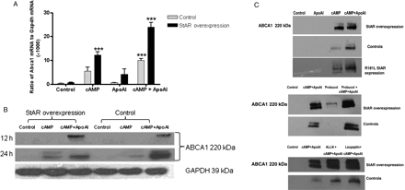
Figure 3 (A) Expression of Abca1 mRNA 12 h after treatment with cAMP (0.3 mM), apoAI (20 µg mL⁻¹), and both ...
Notes:
Figure 3 (A) Expression of Abca1 mRNA 12 h after treatment with cAMP (0.3 mM), apoAI (20 µg mL−1), and both agents together, in control and StAR-overexpressing macrophages. Values are the mean ± SEM of three independent experiments; ***P < 0.001 compared with untreated macrophages. (B) Expression of ABCA1 protein 12 and 24 h after treatment with cAMP (0.3 mM) and cAMP (0.3 mM) and apoAI (20 µg mL−1) together, in control and StAR-overexpressing macrophages, relative to the housekeeping protein GAPDH; the figure shown is representative of three independent experiments. (C) Expression of ABCA1 protein, 12 h after treatment with apoAI (20 µg mL−1), cAMP (0.3 mM), or both together, in control and StAR-overexpressing macrophages, and in macrophages overexpressing mutated R181LStAR (top panel). Levels of ABCA1 protein in control and StAR-overexpressing cells (12 h), following treatment with cAMP (0.3 mM) and apoAI (20 µg mL−1) together, are shown in the middle and bottom panels, and in combination with probucol (10 µM), or protease inhibitors ALLN (50 µM) or leupeptin (100 µM); treatment with thiol protease inhibitors was initiated 4 h after treatment with cAMP and apoAI. In all cases, expression of the housekeeping protein GAPDH remained constant (data not shown for simplicity) and results are representative of three independent experiments.
Unless provided in the caption above, the following copyright applies to the content of this slide: Published on behalf of the European Society of Cardiology. All rights reserved. © The Author 2010. For permissions please email: journals.permissions@oxfordjournals.org.

Slide 4
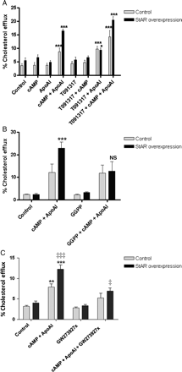
Figure 4 Efflux of [³H]cholesterol (24 h) to apoAI (20 µg mL⁻¹) in the presence of cAMP (0.3 mM) ...
Notes:
Figure 4 Efflux of [3H]cholesterol (24 h) to apoAI (20 µg mL−1) in the presence of cAMP (0.3 mM) and (A) T0901317 (10 µM), (B) GGPP (10 µM), or (C) GW2739297x (1 µM), from control and StAR-overexpressing macrophages (Methods). Values are the mean ± SEM of four independent experiments in each figure: *P < 0.05, **P < 0.01, and ***P < 0.001 for each treatment, relative to control macrophages, and ‡P < 0.05 for the comparisons indicated.
Unless provided in the caption above, the following copyright applies to the content of this slide: Published on behalf of the European Society of Cardiology. All rights reserved. © The Author 2010. For permissions please email: journals.permissions@oxfordjournals.org.

Slide 5
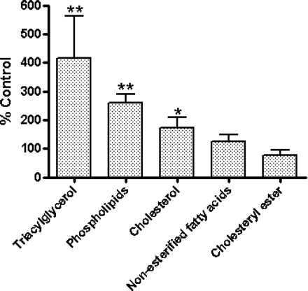
Figure 5 Incorporation of [¹⁴C]acetate into the indicated cellular lipid pools in StAR-overexpressing ...
Notes:
Figure 5 Incorporation of [14C]acetate into the indicated cellular lipid pools in StAR-overexpressing cells, expressed as a percentage of that in control (empty vector) macrophages; values are the mean ± SEM of four independent experiments; **P < 0.01; *P < 0.05 compared with the control incubation.
Unless provided in the caption above, the following copyright applies to the content of this slide: Published on behalf of the European Society of Cardiology. All rights reserved. © The Author 2010. For permissions please email: journals.permissions@oxfordjournals.org.

